Slide 2
AI vs Human:
The Turing Test
Teacher Key

Slide 3
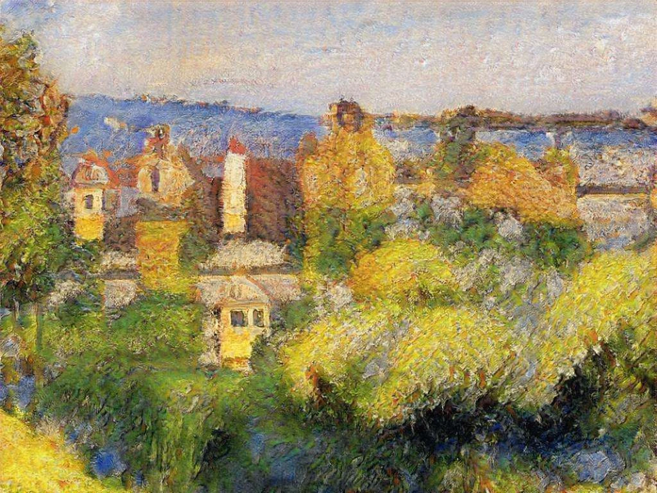
AI
Notes:
Pissaro, C. (1878). Côte des Grouettes, near Pontoise [oil on canvas]. The Met, New York City, New York, USA. https://www.metmuseum.org/art/collection/search/437316

Slide 4
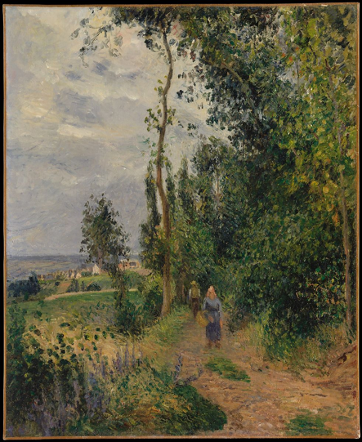
Human
Notes:
Pissaro, C. (1878). Côte des Grouettes, near Pontoise [oil on canvas]. The Met, New York City, New York, USA. https://www.metmuseum.org/art/collection/search/437316

Slide 5
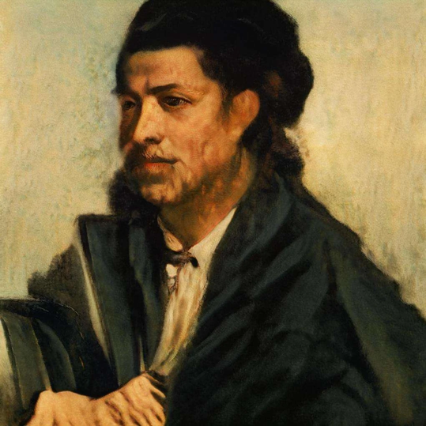
AI
Notes:
AI. Frederick Helman [computer generated]. https://www.artaigallery.com/collections/ai-portraits/products/fredrick-helman

Slide 6
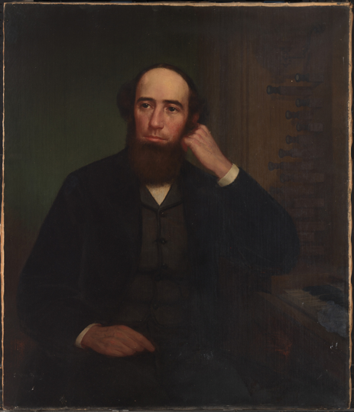
Human
Notes:
Unidentified. (1870). George Frederick Bristow [oil on canvas]. The Smithsonian Institution, Washington, D.C., USA. https://npg.si.edu/object/npg_NPG.87.50?destination=edan-search/default_search%3Fpage%3D1%26return_all%3D1%26edan_local%3D1%26edan_q%3DFrederick

Slide 7
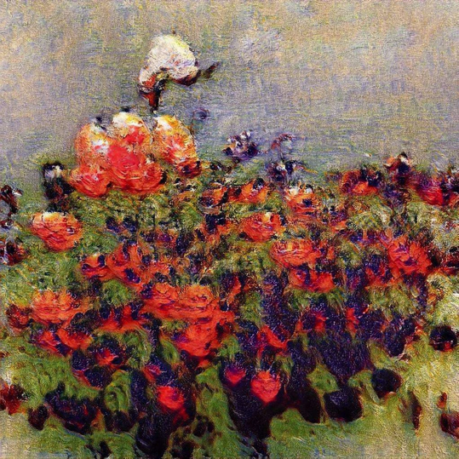
AI
Notes:
AI. Manageable Flowers [computer generated]. https://www.artaigallery.com/collections/flowers/products/manageable-flowers

Slide 8
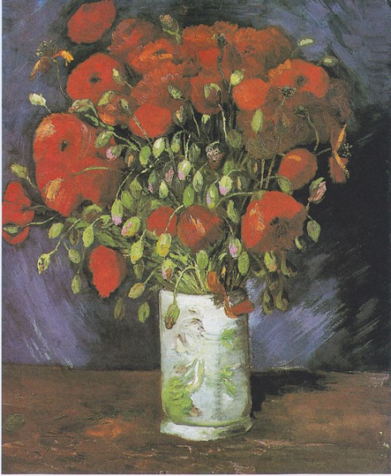
Human
Notes:
Van Gogh, V. (1886). Vase with flowers [oil on canvas]. Van Gogh Museum, Amsterdam, Denmark. https://en.wikipedia.org/wiki/Vase_with_Poppies

Slide 9
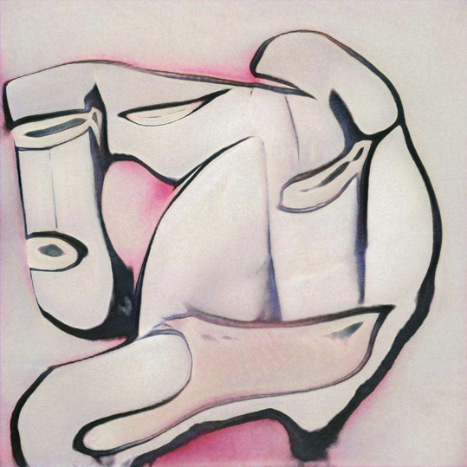
AI
Notes:
AI. Light Perfume [computer generated]. https://www.artaigallery.com/collections/abstract-art/products/light-perfume

Slide 10
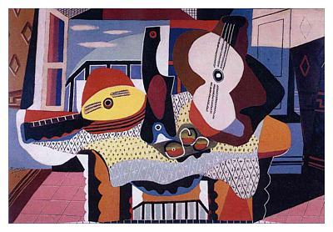
Human
Notes:
Picasso, P. (1886). Still life with mandolin and guitar [oil on canvas]. Solomon R. Guggenheim Museum, Bilbao, Spain. https://focusonpicasso.com/product/mandolin-and-guitar-mandoline-et-guitare/#:~:text=Mandolin%20and%20Guitar%20is%20one,of%20overlapping%20and%20contiguous%20forms.

Slide 11
Happy endings will someday fill your life with brains.
AI
Notes:
TEACHERS: Create a poll using either mentimeter or choose to make a copy of the google form for this station here: https://docs.google.com/forms/d/1Gqd_cTyIMRC3mIabR-8XTcyrSQHcZGiKm0WopY_ZqdI/copy. Then place the link for the poll in the slide above.

Slide 12
Taking joy in living is a woman’s best cosmetic.
Human
Notes:
Rosalind Russel

Slide 13
You can ignite equality by destroying society.
AI
Notes:
Inspirobot

Slide 14
If you don’t risk anything, you risk even more.
Human
Notes:
Erica Jong

Slide 15
Betrayed is as betrayed does
AI
Notes:
Inspirobot

Slide 16
Doubt kills more dreams than failure ever will
Human
Notes:
Karim Seddiki

Slide 17
Let’s make the truth mandatory.
AI
Notes:
Inspirobot

Slide 18
There is no secret to success.
Human
Notes:
Colin Powell

Slide 19

AI
Notes:
Inspirobot

Slide 20
It’s better to be a pirate than to join the navy.
Human
Notes:
Steve Jobs

Slide 21
Cause I Need Your Love
Verse 1
Cause I need your love
Cause I need your love
In this world we all feel alone
And not worth the pain
But you are my friend
You are my friend
Chorus
Just call me
I'm never gonna make it home again
So pretend that you're the only one
Never called out my name
Verse 2
Never thought that it would only get more absurd
The more is more
And the stronger two can say it
There's one thing I can say
And it's this
Never thought that I'd fall in love
Chorus
Just call me
I'm never gonna make it home again
So pretend that you're the only one
Never called out my name
AI
Notes:
AI. Cause I need your love. Song Lyric Generator.

Slide 22
Cause I Need Your Love
Verse 3
So tell me what's the deal. I will risk it all. All for you.
I hope you will believe the things i try to say to you.
All I dream of is you. Why do I love you like i do.
If you leave me now. You always be inside of me.
Chorus
Cause I need your love
Verse 4
You came into my room and saw.
Saw me there standing all alone.
Please forgive me. My love is true.
It's never to late.
Chorus
Cause I need your love .
Verse 1
I want you to hold my hand I want you to understand.
Time and space will never ever be the reason why.
In my mind i believe. Will you forgive the things that you see.
If you leave me now. You always be inside of me.
Chorus
Cause I need your love.
Verse 2
Baby you're the one for me.
Can you see I'm always there.
I wanna hold your hand.
Baby please come back to me.
Human
Notes:
Da Buzz. (2013). Cause I need your love [Song]. On More than alive [Album]. Warner/Chappell Music.

Slide 23
But In Reality
Verse 1
My heart
Is filled with fear
This is my last chance to show my love
I will move on
Some people find it easier than they do
Some people dream
Chorus
Hard to face tomorrow
You finally found the time
And the joy of life
Someday I'm gonna live on
Verse 2
Some people find it easier than others
Some people are calm
But in reality
Some of them can see
That nothing's wrong
Hard to deal with
Chorus
Hard to face tomorrow
You finally found the time
And the joy of life
Someday I'm gonna live on
AI
Notes:
AI. But in reality. Song Lyric Generator.

Slide 24
Edge of Reality
Verse 1
I walk along a thin line darling
Dark shadows follow me
Here's where life's dream lies disillusioned
The edge of reality
Verse 2
Oh I can hear strange voices echo
Laughing with mockery
The border line of doom I'm facing
The edge of reality
Chorus
On the edge of reality she sits there tormenting me
The girl with the nameless face
On the edge of reality where she overpowers me
With fears that I can't explain
She drove me to the point of madness
The brink of misery
If she's not real then I'm condemned to
The edge of reality
Chorus
On the edge of reality she sits there tormenting me
The girl with the nameless face
On the edge of reality where she overpowers me
With fears that I can't explain
She drove me to the point of madness
The brink of misery
If she's not real then I'm condemned to
The edge of reality
Human
Notes:
Elvis Presley. (1968). Edge of Reality [Song]. On Live a little, love a little [Album]. RCA Victor.

Slide 25
Underoos
Children’s most important underwear
AI
Notes:
TEACHERS: Create a poll using either mentimeter or choose to make a copy of the google form for this station here: https://docs.google.com/forms/d/1jnb4nyoWb0_xiaIw5YEnEe_TtAJxJU9ipDVkJiYTJDU/copy. Then place the link for the poll in the slide above.

Slide 26
Underoos
The underwear that’s fun to wear
Human
Notes:
TEACHERS: Create a poll using either mentimeter or choose to make a copy of the google form for this station here: https://docs.google.com/forms/d/1jnb4nyoWb0_xiaIw5YEnEe_TtAJxJU9ipDVkJiYTJDU/copy. Then place the link for the poll in the slide above.

Slide 27
Legos
They’re building stories
AI
Notes:
TEACHERS: Create a poll using either mentimeter or choose to make a copy of the google form for this station here: https://docs.google.com/forms/d/1jnb4nyoWb0_xiaIw5YEnEe_TtAJxJU9ipDVkJiYTJDU/copy. Then place the link for the poll in the slide above.

Slide 28
Legos
Rebuild the world
Human
Notes:
TEACHERS: Create a poll using either mentimeter or choose to make a copy of the google form for this station here: https://docs.google.com/forms/d/1jnb4nyoWb0_xiaIw5YEnEe_TtAJxJU9ipDVkJiYTJDU/copy. Then place the link for the poll in the slide above.

Slide 29
Barbie
For all girls
AI
Notes:
TEACHERS: Create a poll using either mentimeter or choose to make a copy of the google form for this station here: https://docs.google.com/forms/d/1jnb4nyoWb0_xiaIw5YEnEe_TtAJxJU9ipDVkJiYTJDU/copy. Then place the link for the poll in the slide above.

Slide 30
Barbie
We can do anything, right, Barbie?
Human
Notes:
TEACHERS: Create a poll using either mentimeter or choose to make a copy of the google form for this station here: https://docs.google.com/forms/d/1jnb4nyoWb0_xiaIw5YEnEe_TtAJxJU9ipDVkJiYTJDU/copy. Then place the link for the poll in the slide above.

Slide 31
Snuggie
So many others
AI
Notes:
TEACHERS: Create a poll using either mentimeter or choose to make a copy of the google form for this station here: https://docs.google.com/forms/d/1jnb4nyoWb0_xiaIw5YEnEe_TtAJxJU9ipDVkJiYTJDU/copy. Then place the link for the poll in the slide above.

Slide 32
Snuggie
Wrapped in warmth
Human
Notes:
TEACHERS: Create a poll using either mentimeter or choose to make a copy of the google form for this station here: https://docs.google.com/forms/d/1jnb4nyoWb0_xiaIw5YEnEe_TtAJxJU9ipDVkJiYTJDU/copy. Then place the link for the poll in the slide above.

Slide 33
Milk
Milk: Healthier from the inside out
AI
Notes:
TEACHERS: Create a poll using either mentimeter or choose to make a copy of the google form for this station here: https://docs.google.com/forms/d/1jnb4nyoWb0_xiaIw5YEnEe_TtAJxJU9ipDVkJiYTJDU/copy. Then place the link for the poll in the slide above.

Slide 34
Milk
Got milk?
Human
Notes:
TEACHERS: Create a poll using either mentimeter or choose to make a copy of the google form for this station here: https://docs.google.com/forms/d/1jnb4nyoWb0_xiaIw5YEnEe_TtAJxJU9ipDVkJiYTJDU/copy. Then place the link for the poll in the slide above.

Slide 35
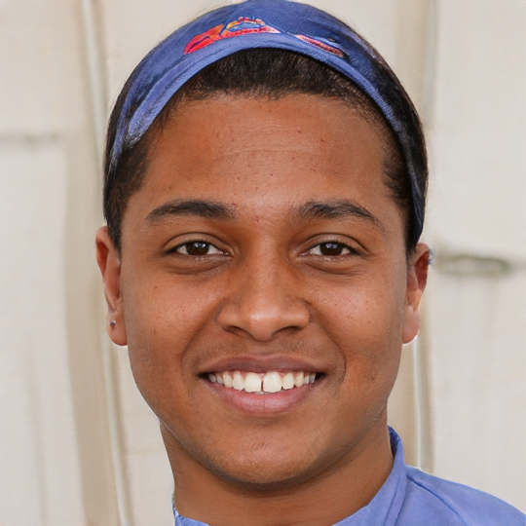
AI
Notes:
AI generated https://thispersondoesnotexist.com/
Imagined by a GAN (generative adversarial network)
StyleGAN2 (Dec 2019) - Karras et al. and Nvidia

Slide 36

Human
Notes:
tommerton2010. (January 25, 2011). Beautiful faces [Photograph]. Flickr. https://www.flickr.com/photos/58842866@N08/5388139473

Slide 37
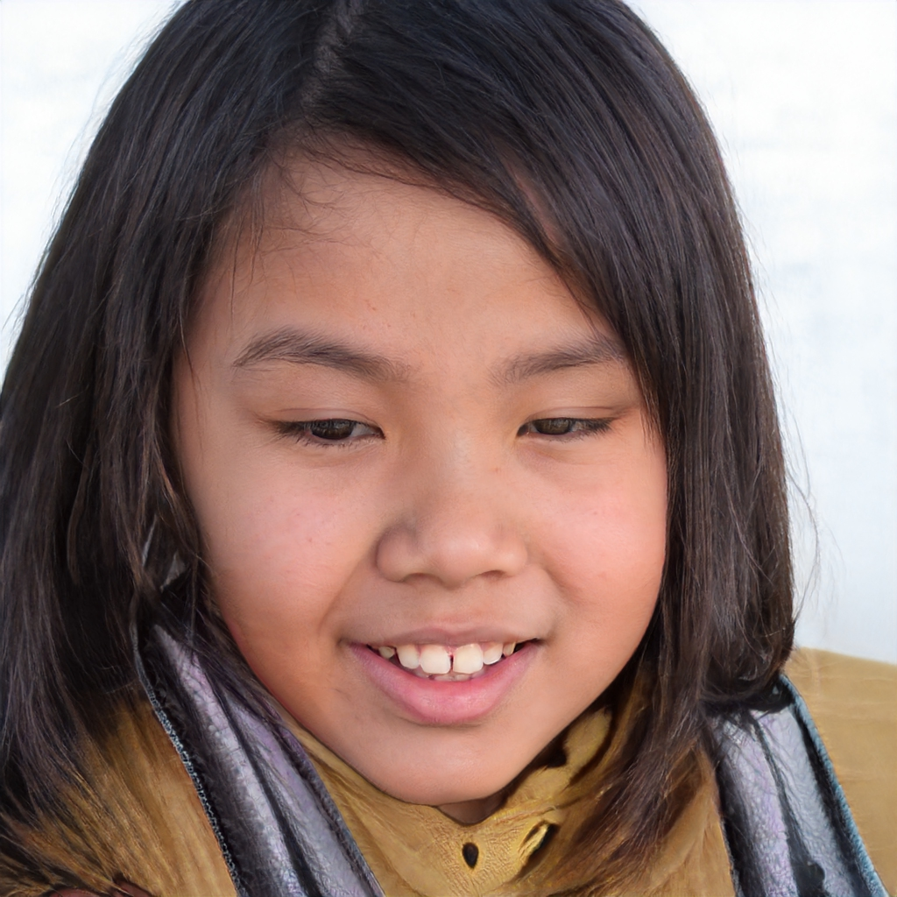
AI
Notes:
AI generated https://thispersondoesnotexist.com/
Imagined by a GAN (generative adversarial network)
StyleGAN2 (Dec 2019) - Karras et al. and Nvidia

Slide 38
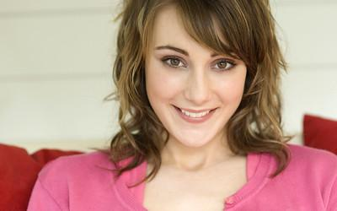
Human
Notes:
tommerton2010. (January 25, 2011). Beautiful faces [Photograph]. Flickr. https://www.flickr.com/photos/58842866@N08/5388139473

Slide 39
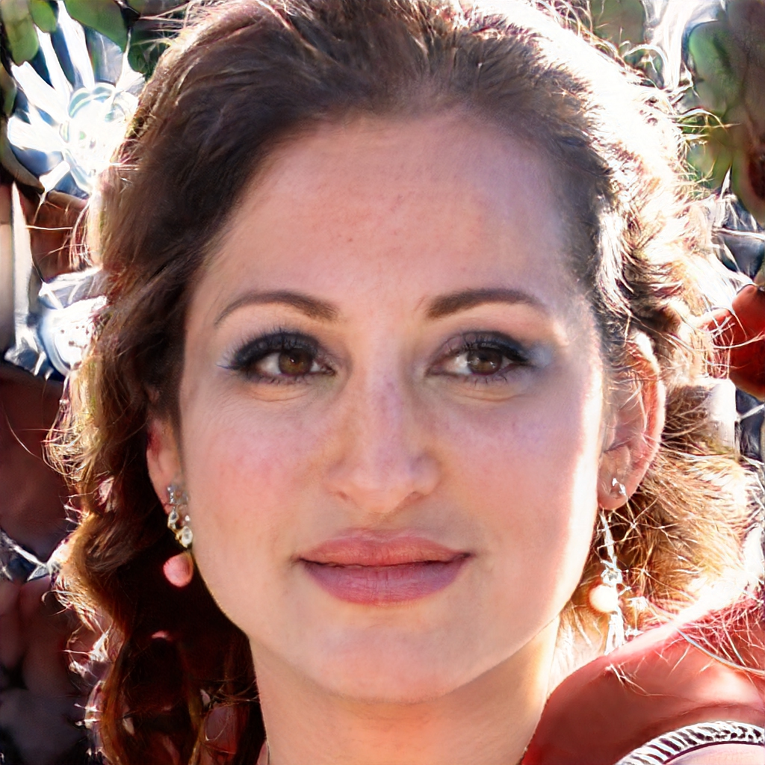
AI
Notes:
AI generated https://thispersondoesnotexist.com/
Imagined by a GAN (generative adversarial network)
StyleGAN2 (Dec 2019) - Karras et al. and Nvidia

Slide 40
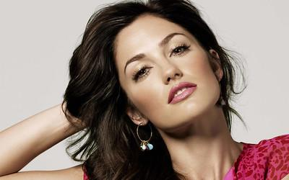
Human

Slide 41
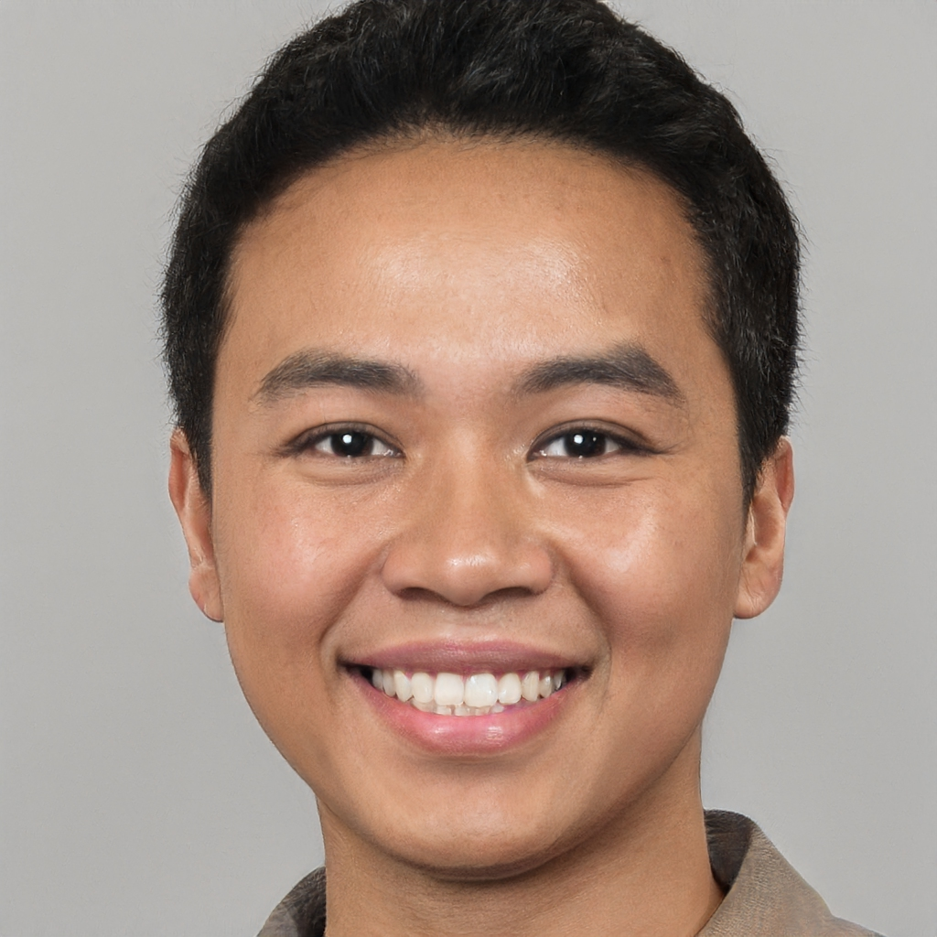
AI
Notes:
AI generated https://thispersondoesnotexist.com/
Imagined by a GAN (generative adversarial network)
StyleGAN2 (Dec 2019) - Karras et al. and Nvidia

Slide 42
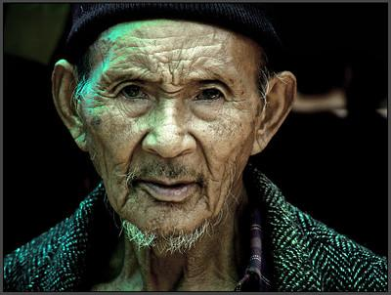
Human
Notes:
AI. Shedding light [computer generated]. https://www.artaigallery.com/collections/sparking-interest/products/shedding-light

