Slide 2
Center of Attention
Writing the Equation of a Circle

Slide 3
Essential Question
How are triangles and circles related?

Slide 4
Lesson Objectives
Identify the radius and center of a circle from an equation or graph.
Write the equation of a circle given the radius and center, given the center and a point on the circle, given a graph, or given the endpoints of a diameter.

Slide 5
Circle Characteristics: Engage
Look at the Engage portion of your handout.
Based on what you already know, use numbers and academic vocabulary to label as many things as you can about the circle.
Next to the picture, write anything else you know about circles that you did not label.
When you are finished, find a partner and compare what you wrote.

Slide 6
Circle Characteristics: Explore
Work with your partner to complete the Explore portion of the handout.
Remember to show your thinking!
Be sure to use mathematical terms and reasoning.

Slide 7
Discussion
Share how you and your partner found the center, radius, and diameter of the circle.

Slide 8
Guided Notes
Let’s complete the Guided Notes together.

Slide 9
Writing Equations: It’s Your Turn
Apply what you have learned to complete the handout.
Using the formula below, write the equation of a circle in standard form for each graph:

Slide 10
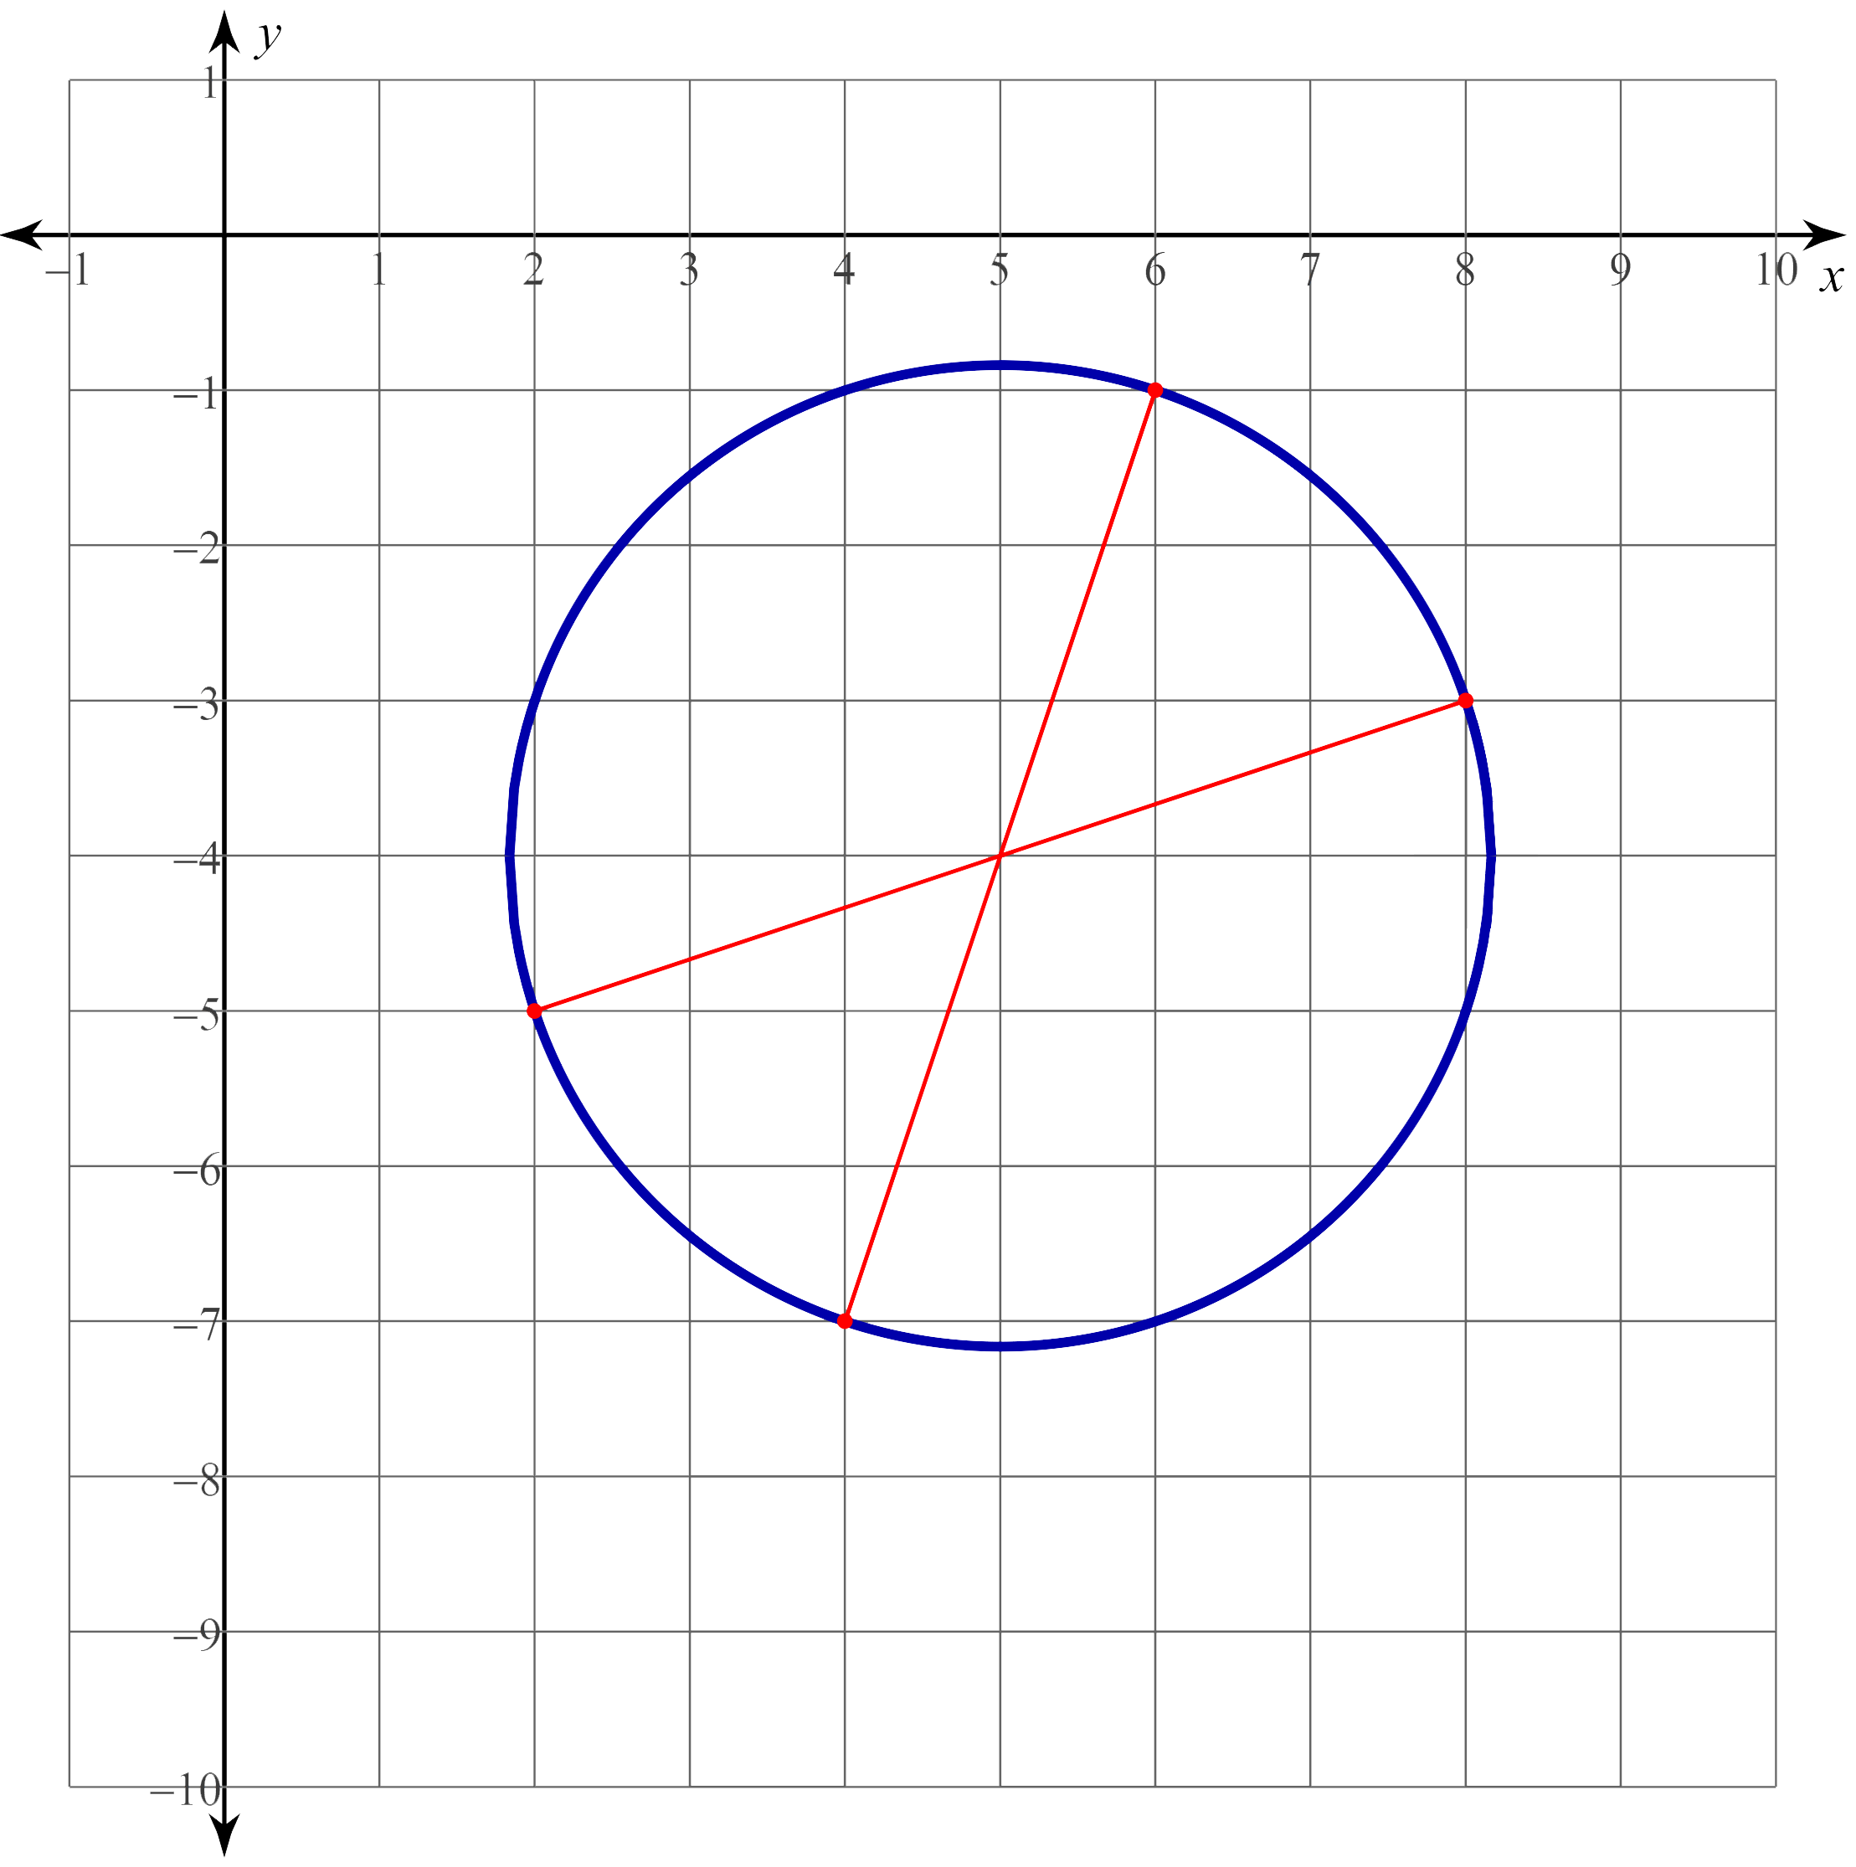
Writing Equations: It’s Your Turn (Key)
First graph: First equation:

Slide 11
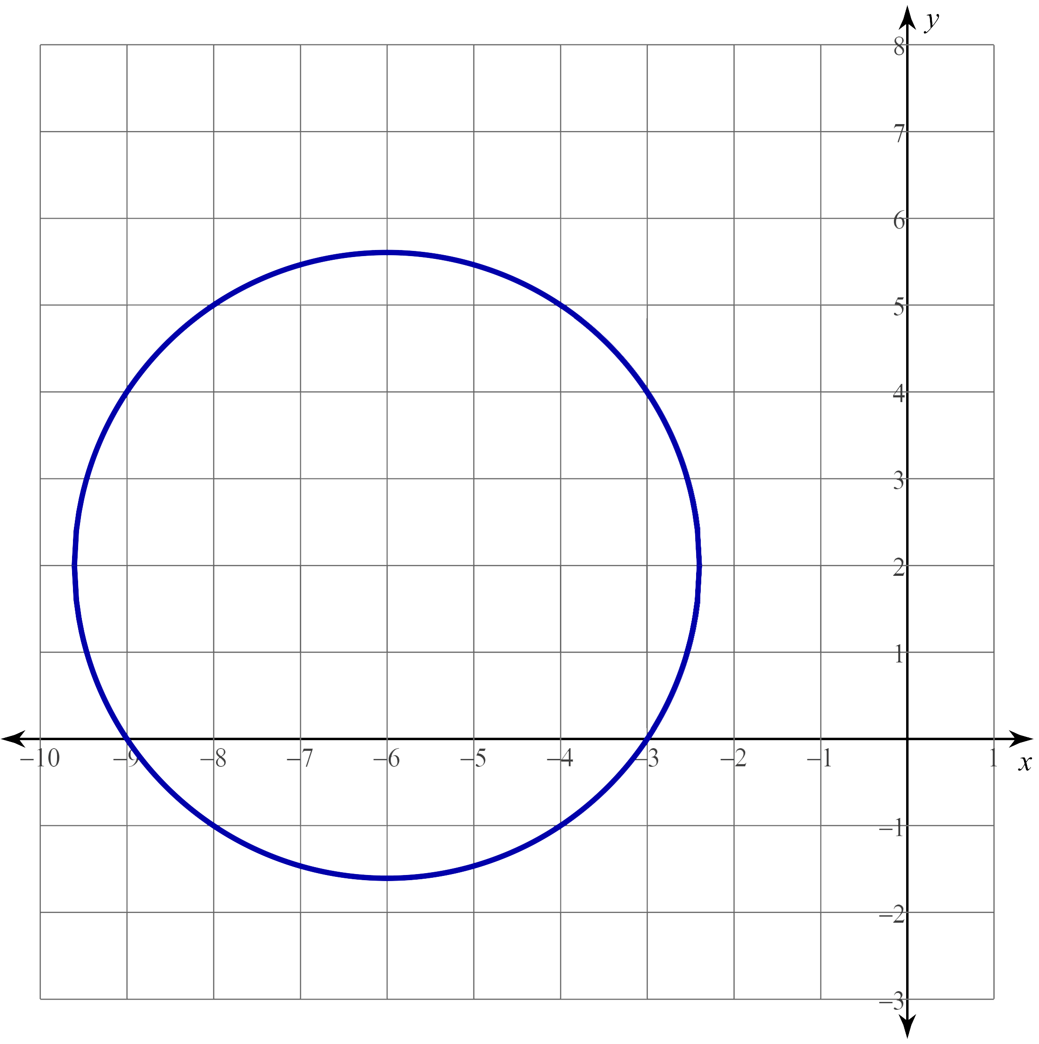
Writing Equations: It’s Your Turn (Key)
Second graph: Second equation:

Slide 12
GeoGebra Activity
Hopefully, the equation of a circle feels familiar to you. But do you know why it looks so familiar?
Let’s find out! Go to https://www.geogebra.org/m/a4sm8fc6.
Read through and follow the directions in the activity.
Notes:
Share this GeoGebra link with students: https://www.geogebra.org/m/a4sm8fc6

Slide 13
Matching
On your Exit Ticket, match an equation with each of the four circles with the following characteristics:
A circle with a radius of 2 and a center at (−2, 3).
A circle with a center at (2, −3) and passes through (2, −1).
A circle with a given graph.
A circle with endpoints of a diameter at (2, 7) and (2, −1).
You will have two equations that are not used.

