Slide 2
Environmental Racism in America
Connecting Social Issues and Health Inequities

Slide 3
Essential Question
How do inequitable environmental factors affect human health?

Slide 4
Lesson Objectives
Analyze Marvin Gaye’s song Mercy, Mercy Me.
Discuss the history of environmental racism in America.
Present a proposal that will improve air quality and raise awareness of environmental racism.

Slide 5

Notes:
https://www.youtube.com/watch?v=efiDnHS3fzk

Slide 6
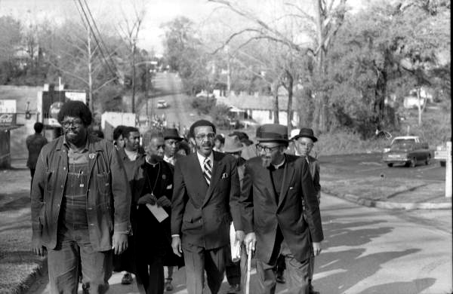
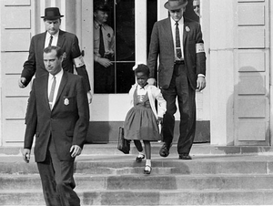
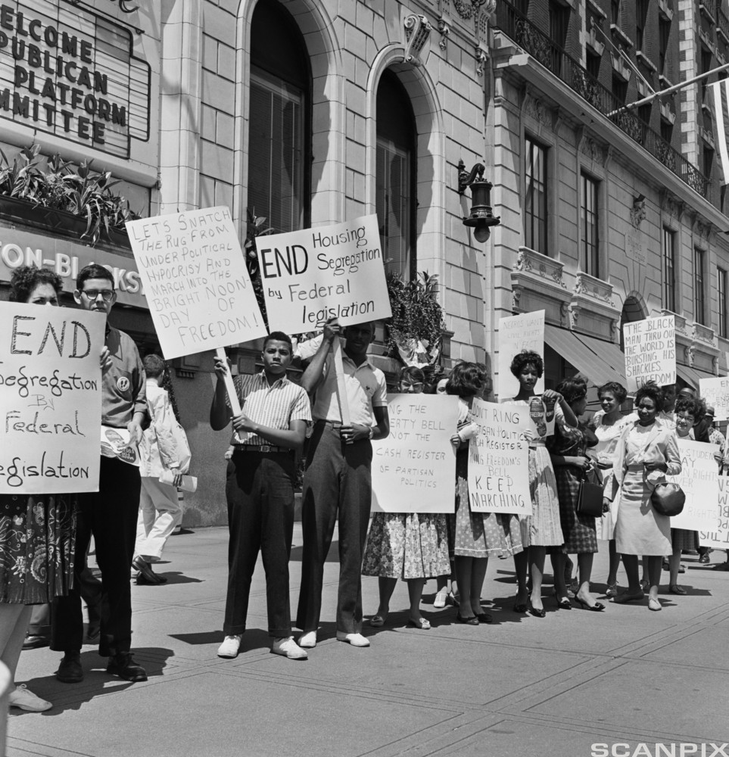

Notes:
Florida Memory. (2013, January 13). Tallahassee Civil Rights March. [Digital image]. https://commons.wikimedia.org/wiki/File:Tallahassee_Civil_Rights_March_(6795031142).jpg
U.S. Embassy. The Hague. (2013, February 4). The U.S. Civil Rights Movement. Ruby Bridges. [Digital image]. https://www.flickr.com/photos/usembassythehague/8443765417
Bettmann, NTB scanpix, & Corbis. (n.d.). African-Americans rallying for civil rights in 1960. [Digital image]. https://ndla.no/subject:a1af12e8-0911-4c9c-ad29-dc1a42065c45/topic:b957369b-955d-4ee7-a2f2-7fb7ac70c6ac/topic:e4acb153-ba2b-4e8e-8b41-209d6823fdf8/resource:bebf68da-942f-4b48-8dde-4b9abef0d18b?filters=urn:filter:a81148de-fb95-4e41-b000-57b268337e2d
Scherman, R. (1963). Young woman holds a banner at the civil rights march. [Digital image]. Wikimedia Commons. https://commons.wikimedia.org/wiki/File:A_Young_Woman_Holds_a_Banner_at_the_Civil_Rights_March_on_Washington,_D.C.,_on_August_28,_1963.jpg

Slide 7
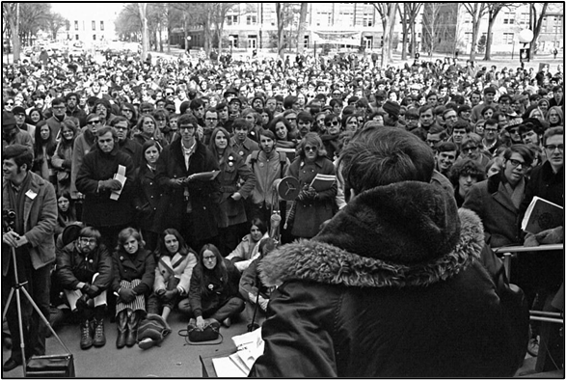
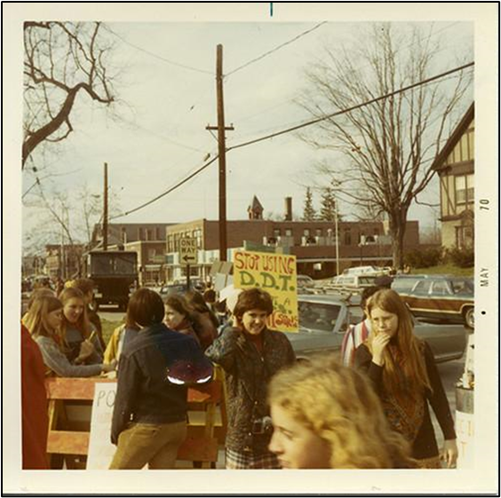
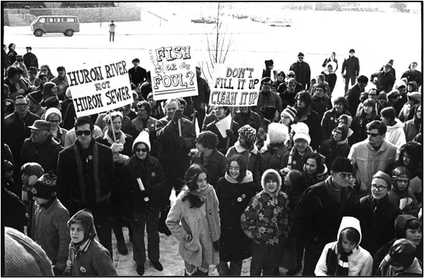
Notes:
University of Michigan School for Environment and Sustainability. (1970). Earth day. [Digital image]. https://www.flickr.com/photos/snre/34605145761
Phillips Academy Archives. (1970). Earth day. [Digital image]. https://www.flickr.com/photos/paarchives/33731084274/in/photostream/
University of Michigan History Department. (1970). Give earth a chance: Environmental activism in Michigan. [Digital image]. http://michiganintheworld.history.lsa.ummich.edu/environmentalism/exhibits/show/main exhibit/pollution politics/Michigan-water-and-rivers

Slide 8

CUS and Discuss
C - Circle any words that you don’t know.
U - Underline any information that helps you understand environmental racism.
S - Star any information that is significant to you.
Notes:
K20 Center. (n.d.). CUS and Discuss. Strategy. https://learn.k20center.ou.edu/strategy/162

Slide 9

Metal Shredding Company Move Sparks Protest

Slide 10
Metal Shredding Company Move Sparks Protest
How is this story similar or different to the stories that we have been reading?
What information is provided in this story that would support the overall message in our proposals?

Slide 11

Driving Question Board
Are there any questions on the Driving Question Board that we can answer right now?
Notes:
K20 Center. (2021). Driving Question Board. Strategies. https://learn.k20center.ou.edu/strategy/1511?rev=8567

Slide 12
Project Proposal
Complete your proposal, adding more information and expanding your initial responses.
Be prepared to present to your classmates when you are done.
What is the problem?
What do you know about the problem that other people should know?
What evidence can you provide to support your claim?
What are some possible solutions to this problem?

Slide 13

Two Stars and a Wish
Each group will present proposals to the class.
While groups are presenting, provide feedback in the form of two stars and one wish:
  Two things that the group did well
  One thing that the group could do to improve
Notes:
K20 Center. (2020). Two Stars and A Wish. Strategies. https://learn.k20center.ou.edu/strategy/83

