Slide 2
Let It Sink In!
Earth’s Systems

Slide 3
Essential Question
How do Earth’s materials cycle through living and nonliving components?

Slide 4
Lesson Objectives
Explore the different stressors that affect rock formation.
Construct models that illustrate the cycling of materials in Earth’s system.

Slide 5
Always, Sometimes, or Never True?
Read each statement carefully and decide whether it is:
Always True
Sometimes True
Never True
Be prepared to discuss the reasons for your response.

Slide 6
Always, Sometimes, or Never True?
All rocks are hard.

Slide 7
Always, Sometimes, or Never True?
Rocks can change form.

Slide 8
Always, Sometimes, or Never True?
Rocks make up the entire earth.

Slide 9
Always, Sometimes, or Never True?
All rocks are the same.

Slide 10
Always, Sometimes, or Never True?
It’s hard to tell how rocks originated.

Slide 11
Always, Sometimes, or Never True?
Rocks and minerals are the same thing.

Slide 12
Always, Sometimes, or Never True?
Humans are the cause of rock formations.

Slide 13
Always, Sometimes, or Never True?
Minerals are not important to my life.

Slide 14
Notes:
Video Source: Sister Christian. (2011, November 30). Massive Oklahoma Sinkhole Appears overnight [Video]. YouTube. https://www.youtube.com/watch?v=Pz6EFS1fu1A

Slide 15
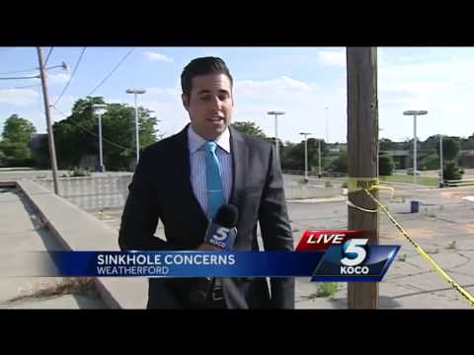
Notes:
Video Source: KOCO TV. (2015, June 05). Weatherford building about to be swallowed by sinkhole [Video]. YouTube. https://www.youtube.com/watch?v=HCUthn8Z_KY&ab_channel=KOCO5News

Slide 16
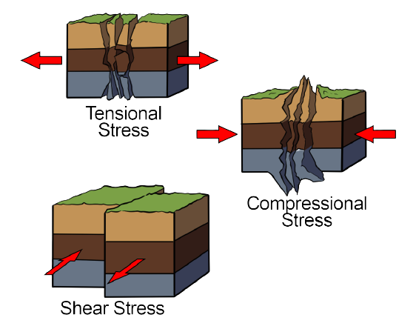
You’re Stressing Me Out Lab
Let’s explore what happens to rocks under different types of stressors.
Each group member will demonstrate one of the following:
Tensional stress
Compressional stress
Shear stress
Notes:
Image Source:

Slide 17
The Rock Cycle
Read your rock cycle article, and then connect with your group to complete the following:
Each group member chooses a different phase of the rock cycle.
Igneous
Sedimentary
Metamorphic
Write a short description of a rock in that stage.
Illustrate that rock going through the rock cycle.

Slide 18
Notes:
Video Source: ParrMr. (2011, April 03). Rock cycle song [Video]. YouTube. https://www.youtube.com/watch?v=53lMdHzvGCQ

Slide 19
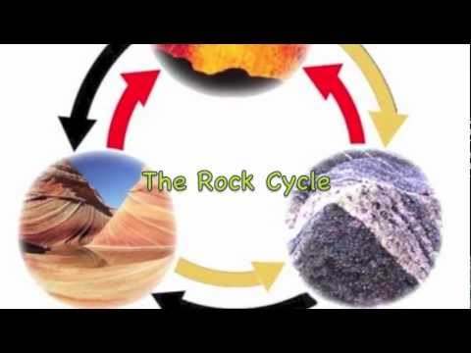
Notes:
Video Source: Emily B. (2012, October 29). We will rock you! (The rock cycle) [Video]. YouTube. https://www.youtube.com/watch?v=r68iEwYdbh4

Slide 20
Biochemical Cycles
With your group:
Research facts about at least three different stages of a given cycle (water, carbon, or nitrogen) and what drives the movement of the material (element or compound) to each part of the cycle.
Be prepared to draw your cycle.

Slide 21
Gallery Walk
Visit the cycles that your classmates researched and drew.
Collect data while keeping the essential question in mind.
Draft a response to the essential question.
How do Earth’s materials cycle through living and nonliving components?

