Slide 2
The Gift of Life
Biology

Slide 3
Essential Question
What are the benefits and risks of organ donation?
How does one determine if two people are a match?

Slide 4
Lesson Objectives
We will identify some contributing factors and solutions for organ donations.
We will determine that parents contribute to their offspring’s makeup by predicting the probability of inherited traits using simple Punnett squares.
We will build knowledge by actively exploring real-world issues and problems, developing ideas and theories and pursuing answers and solutions (ISTE, 2016).
Notes:
ISTE Standards for Educators. (2017). International Society for Technology in Education. Retrieved from https://www.iste.org/standards/for-educators.

Slide 5

Preflection
On a sheet of paper, write for 2 minutes what you know about organ donations.

Slide 6
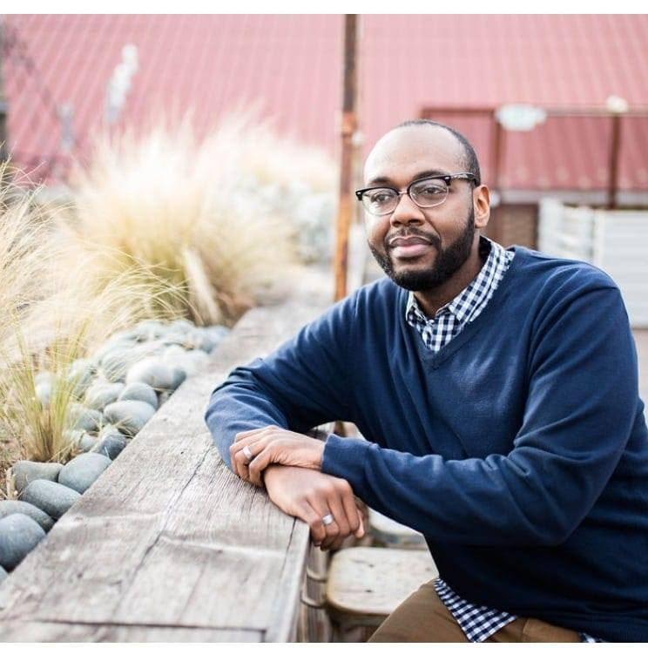
My Little Kidney
While watching this video answer the questions on your handout.
Notes:
K20 Center. (2021, November). My Little Kidney [video]. YouTube. https://youtu.be/I--dFKKI9Y0

Slide 7

True or False Statement
Indicate whether the following statements are true or false and explain your reasoning.

Slide 8
True or False Statement
Organs, eyes, and tissues cannot be given to different ethnic groups or the opposite sex.
Notes:
Adapted from: LifeShare. (n.d.). Student Quiz. LifeShare Transplant Donor Services of Oklahoma. https://www.lifeshareoklahoma.org/educator-resources-lesson-plan-1.html.

Slide 9
True or False Statement
When I get my Oklahoma driver’s license, I am automatically registered as an organ, eye, and tissue donor.
Notes:
Adapted from: LifeShare. (n.d.). Student Quiz. LifeShare Transplant Donor Services of Oklahoma. https://www.lifeshareoklahoma.org/educator-resources-lesson-plan-1.html.

Slide 10
True or False Statement
Anyone can sign up as an organ, eye, and tissue donor, regardless of medical history or age.
Notes:
Adapted from: LifeShare. (n.d.). Student Quiz. LifeShare Transplant Donor Services of Oklahoma. https://www.lifeshareoklahoma.org/educator-resources-lesson-plan-1.html.

Slide 11
True or False Statement
One organ donor can save up to eight lives, and one tissue donor can enhance the lives of up to 75 people.
Notes:
Adapted from: LifeShare. (n.d.). Student Quiz. LifeShare Transplant Donor Services of Oklahoma. https://www.lifeshareoklahoma.org/educator-resources-lesson-plan-1.html.

Slide 12
True or False Statement
Most major religions do not permit organ, eye, and tissue donation.
Notes:
Adapted from: LifeShare. (n.d.). Student Quiz. LifeShare Transplant Donor Services of Oklahoma. https://www.lifeshareoklahoma.org/educator-resources-lesson-plan-1.html.

Slide 13
True or False Statement
When you are admitted to the hospital, the number one priority is to save your life.
Notes:
Adapted from: LifeShare. (n.d.). Student Quiz. LifeShare Transplant Donor Services of Oklahoma. https://www.lifeshareoklahoma.org/educator-resources-lesson-plan-1.html.

Slide 14
True or False Statement
Celebrities and wealthy people on the waiting list receive priority for receiving an organ.
Notes:
Adapted from: LifeShare. (n.d.). Student Quiz. LifeShare Transplant Donor Services of Oklahoma. https://www.lifeshareoklahoma.org/educator-resources-lesson-plan-1.html.

Slide 15
True or False Statement
It is against federal law to sell organs, eyes, and tissues.
Notes:
Adapted from: LifeShare. (n.d.). Student Quiz. LifeShare Transplant Donor Services of Oklahoma. https://www.lifeshareoklahoma.org/educator-resources-lesson-plan-1.html.

Slide 16
True or False Statement
The donor family must pay for organ, eye, and tissue donation.
Notes:
Adapted from: LifeShare. (n.d.). Student Quiz. LifeShare Transplant Donor Services of Oklahoma. https://www.lifeshareoklahoma.org/educator-resources-lesson-plan-1.html.

Slide 17
True or False Statement
An open casket funeral is possible for organ, eye, and tissue donors.
Notes:
Adapted from: LifeShare. (n.d.). Student Quiz. LifeShare Transplant Donor Services of Oklahoma. https://www.lifeshareoklahoma.org/educator-resources-lesson-plan-1.html.

Slide 18
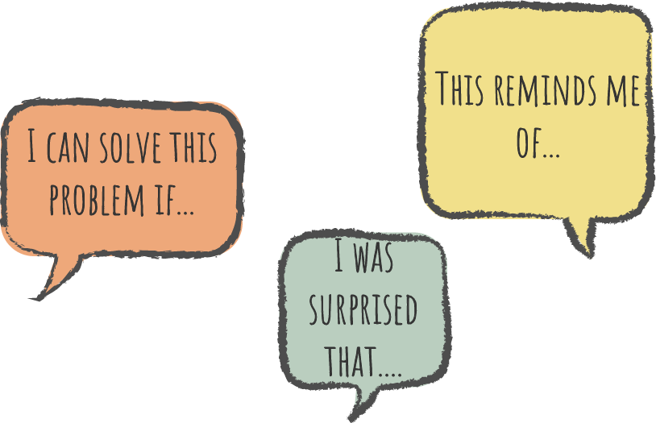
Say Something
Today we are going to watch a video on blood typing.
As you watch, we will pause at certain segments of the video to share something about what we learned.

Slide 19
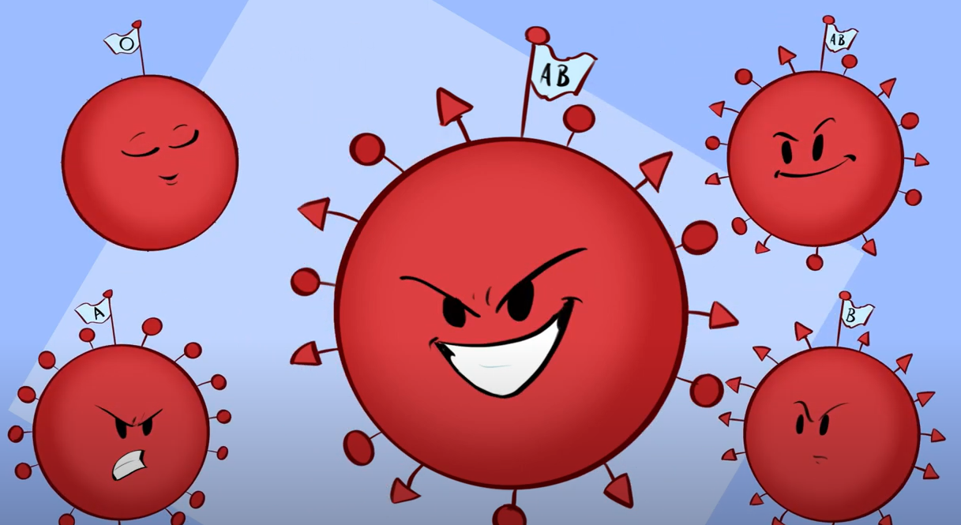
Blood Typing Video
While watching this video, answer the questions.
Notes:
K20 Center. (2021, June). A Match Made in DNA [video]. YouTube. https://youtu.be/vuUsowsM188

Slide 20
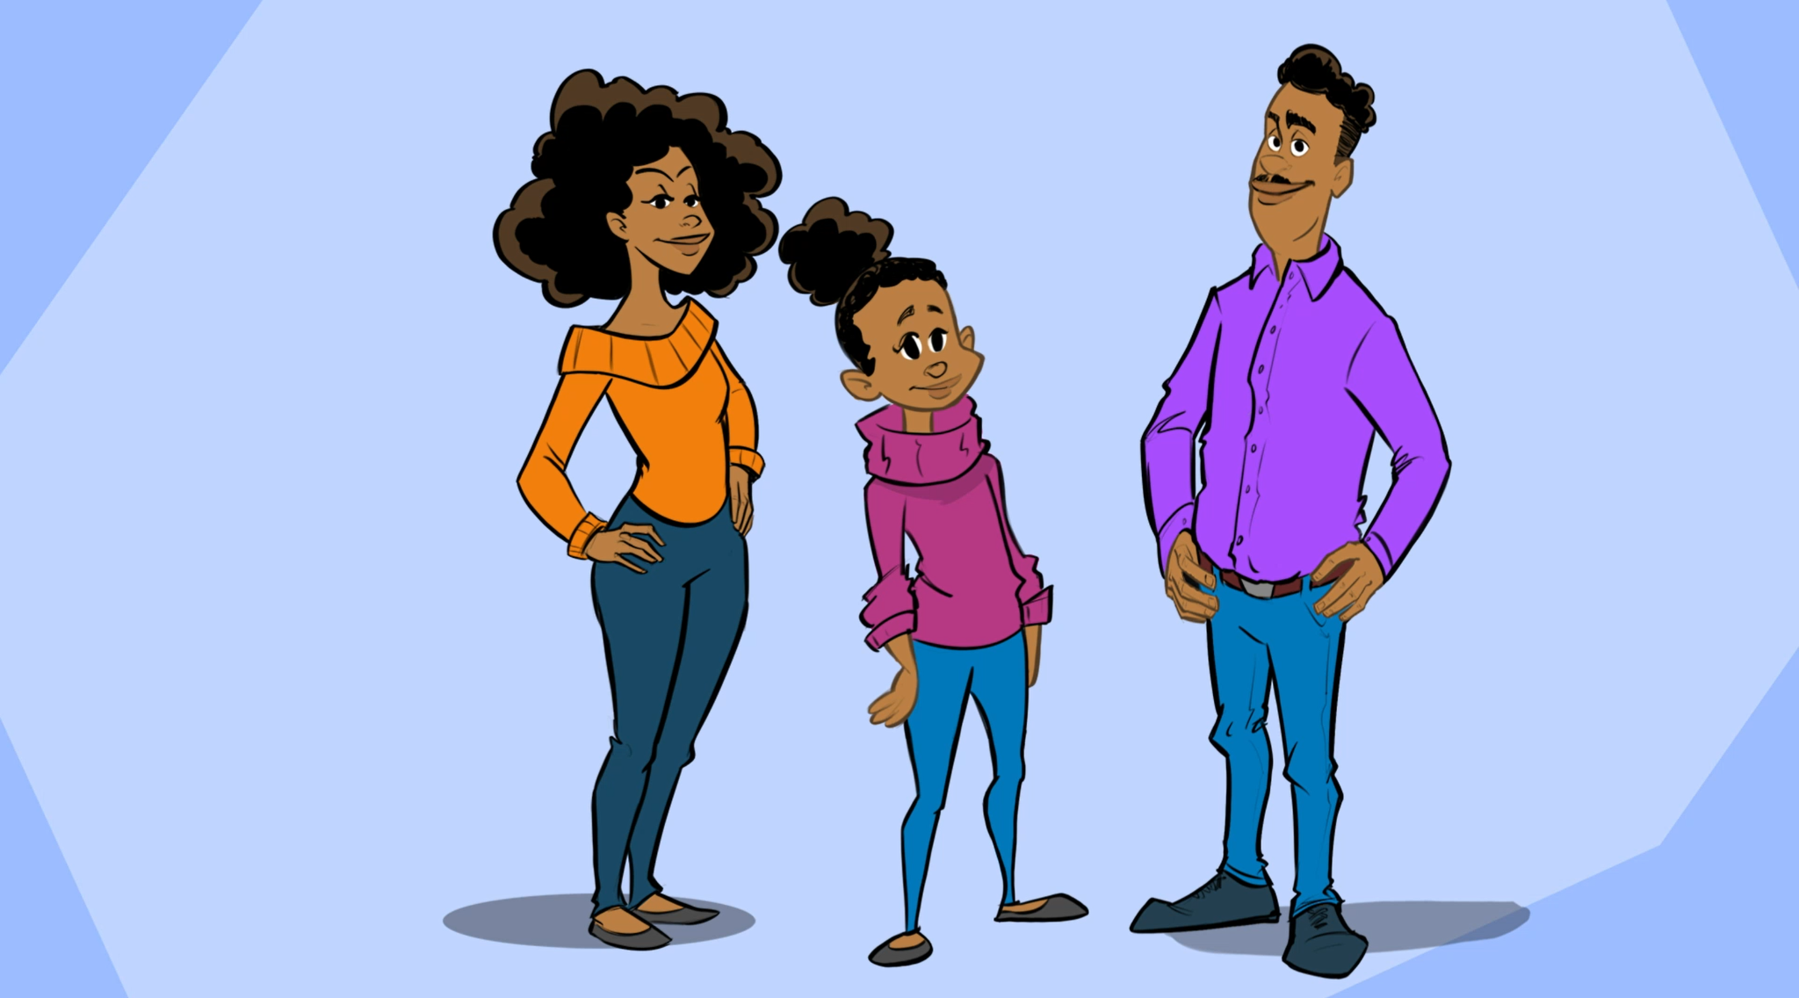
The Blood Connection
Answer the questions as you complete the interactive.
Notes:
K20 Center. (n.d.). The Gift of Life - The Blood Connection. The K20 Center. https://k20center.ou.edu/h5p/the-gift-of-life/

Slide 21

LifeShare of Oklahoma
While watching this video, complete your LifeShare S-I-T handout:
One surprising fact or idea
One interesting fact or idea
One troubling fact or idea
After the video, pass your paper clockwise. Add to your peer’s response. Repeat until you’ve added to each of your group member’s papers.
Notes:
K20 Center. (2021, November). K20 ICAP - LifeShare of Oklahoma [video]. YouTube. https://youtu.be/MGHcyBdDJTk

Slide 22

PSA Poster
Create a social media flyer to help others learn more organ donation and how to be an organ donor.
Research information about organ donations.
Include your knowledge of how organ donor matches are determined.
Notes:
PosterMyWall. (n.d.). PosterMYWall graphic. [Image]. 250 Mills LLC. https://www.postermywall.com/assets/images/open-graph-default.jpg.

