Slide 2
The History of Spoken Word Poetry
Historical and Cultural Perspectives in Literature

Slide 3
Essential Questions
What impact does history have on literature?
How does literature shape or reflect culture?

Slide 4
Lesson Objective
Evaluate how spoken word poetry is affected by historical and cultural perspectives

Slide 5
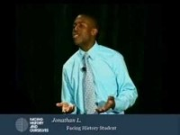
Perception
Notes:
Lykesd, J. (n.d.). Perception. Facing History and Ourselves. [Video].YouTube. https://www.youtube.com/watch?v=7yyrSq7OcOA

Slide 6
Discuss
Why do you think Mr. Lykesd wrote and performed this poem as spoken word?
What in his life might have motivated him to write it?

Slide 7
Spoken Word Poetry
Keep these questions in mind as you watch the next few videos. Take notes on your Note Catcher handout as you watch each video.
Whom is the poet speaking to (their audience)?
From whose perspective is the poet speaking?
What is the subject/topic?
Is the topic culturally relevant? Historically relevant? Socially relevant?
How so?

Slide 8
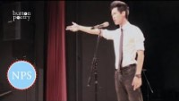
What Kind of Asian Are You?
Notes:
Dang, A. (2014, January 29). What kind of Asian are you? Button Poetry. [Video]. YouTube. https://www.youtube.com/watch?v=VoP0ox_Jw_w

Slide 9
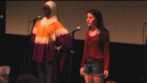
A Muslim Girl and A Jewish Girl
Notes:
Washington D.C. Team. (2013, August 9). 2013 Brave New Voices - A Muslim girl and a Jewish girl .Youth Speaks. [Video]. YouTube. https://www.youtube.com/watch?v=tv00xjClbx0

Slide 10

Spoken Word to His Mother
Notes:
Leake, B. (2020, September 1). Spoken Word to His Mother. America’s Got Talent. [Video]. YouTube. https://www.youtube.com/watch?v=vaM-OrZi6IA

Slide 11

Love You Some Indians
Notes:
Shebala, R. (2014, October 27). Love you some Indians. All Def Poetry. [Video]. YouTube. https://www.youtube.com/watch?v=iJQmGBOP6mc

Slide 12
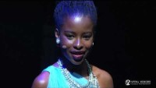
Rise
Notes:
Gorman, A. (2020, March 4). Rise. Vital Voices Global Partnership. [Video]. YouTube. https://www.youtube.com/watch?v=gdBT9JBV09k

Slide 13
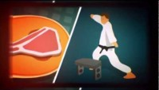
To This Day
Notes:
Koyczan, S. (2013, February 19). To This Day. [Video]. YouTube. https://www.youtube.com/watch?v=ltun92DfnPY

Slide 14

POMS: Point of Most Significance
Read “The History of Spoken Word Poetry” handout.
When you finish reading, decide what is the most significant or most important point in the text.
Write that down.
Share it with your small group and discuss.
Share out with the whole class.
Notes:
https://learn.k20center.ou.edu/strategy/101

Slide 15
What do you think?
Choose a spoken word poetry video from earlier in the lesson or, if you have a favorite of your own, you may choose that one.
Answer these questions about the poet:
What clues to the poet’s culture can you identify?
What historical references does the poet use?
What social issue is the poet addressing?
What does the poet think society expects from them?
Why did the poet chose spoken word poetry over other mediums of expression?

Slide 16

CSI: Color, Symbol, Image
Consider this question:
How is spoken word poetry influenced by historical, social, and/or cultural perspectives?
On your handout, choose a color, a symbol, and an image that represents your understanding of that question.
Explain the reasoning for your choices.
Notes:
https://learn.k20center.ou.edu/strategy/161

