Slide 2
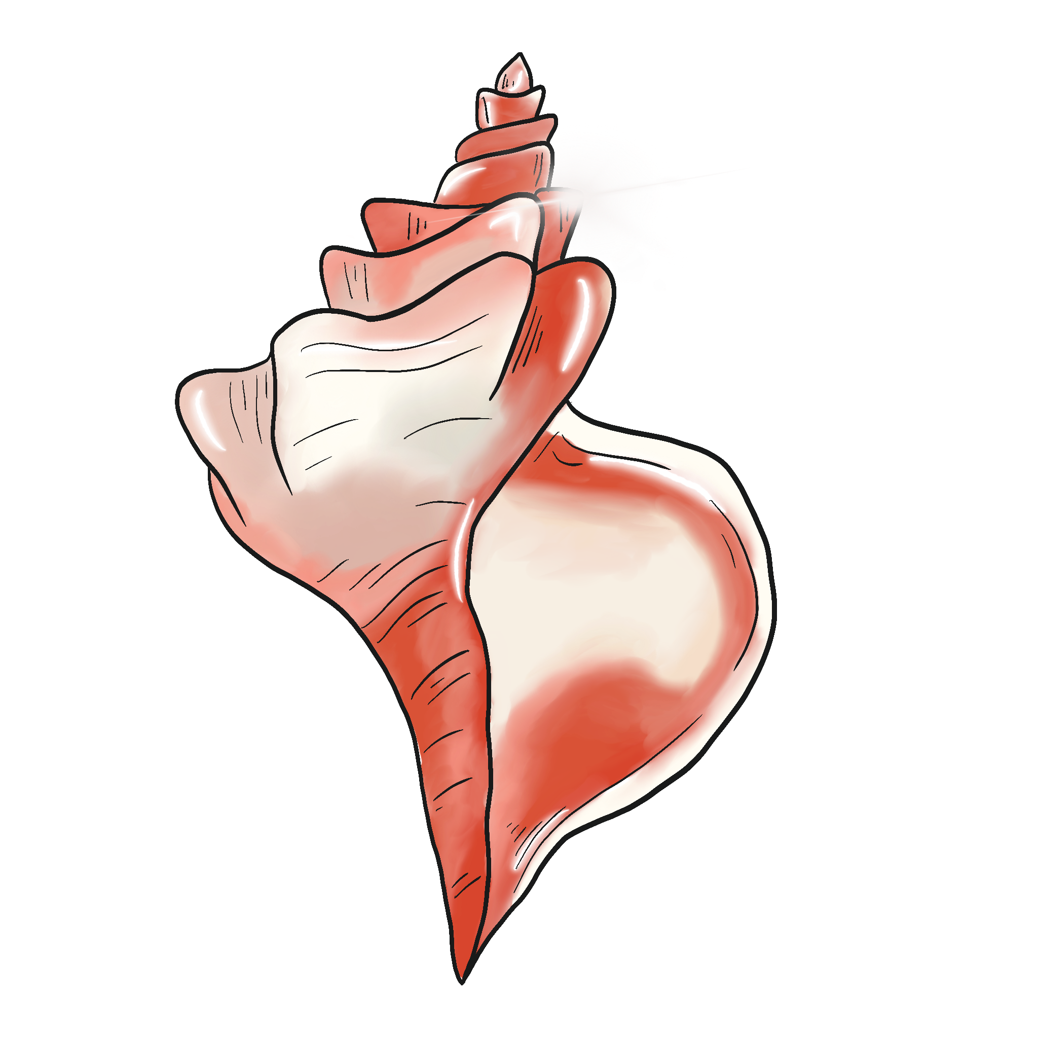
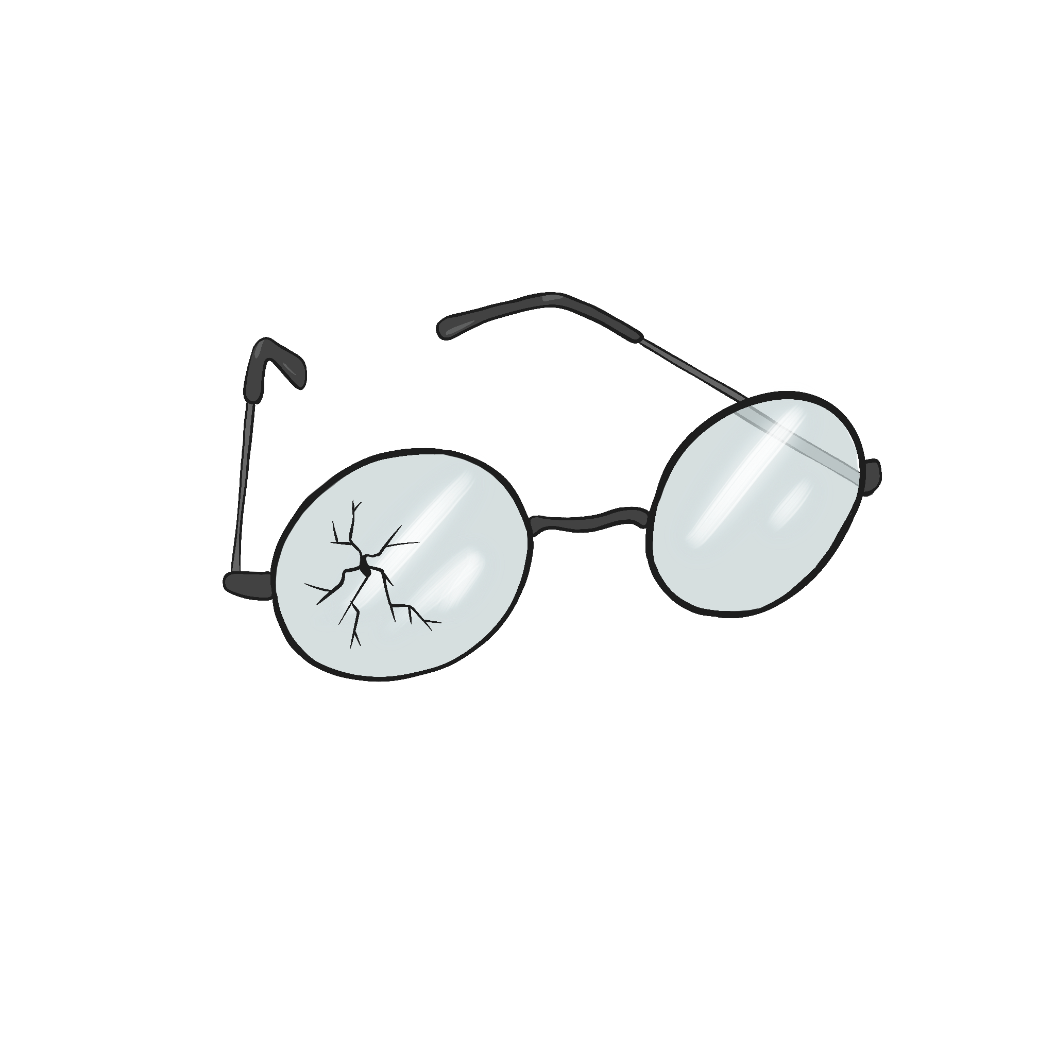
Leader of the Pack
Lord of the Flies Unit Lesson 2

Slide 3
Essential Question:
How does the author use symbolism to develop characterization and theme?

Slide 4
Lesson Objectives
Understand the main characters, Jack and Ralph.
Examine the text based on multiple character viewpoints.

Slide 5


Chain Notes
Review the handout with the question at the top: What makes a good leader?
When the timer sounds, write as many qualities on the page as you can in 90-seconds in the first line.
When the timer goes off a second time, pass the handout to a different person.
Read what has been written on the page you’ve been given and write a different response until the timer goes off.
Build on, extend, or disagree with the last note written in response.
Continue to pass the page around until everyone has made a contribution.
Share out and discuss responses.
Notes:
https://learn.k20center.ou.edu/strategy/52

Slide 6

Categorical Highlighting
Read the handout of excerpts from the novel looking for answers to the following questions.
Focus on Jack and Ralph.
  What are the specific leadership characteristics of each chacter?
  What are the individual qualities of each character?
  What makes each character unique?
  What makes each a good leader?
  What qualities would not make them good leaders?
Use different color highlighters to identify each character: One color for Jack and a different color for Ralph.
Notes:
https://learn.k20center.ou.edu/strategy/192

Slide 7

Jack v. Ralph
What leadership qualities do Jack and Ralph have?
Notes:
https://learn.k20center.ou.edu/strategy/86

Slide 8
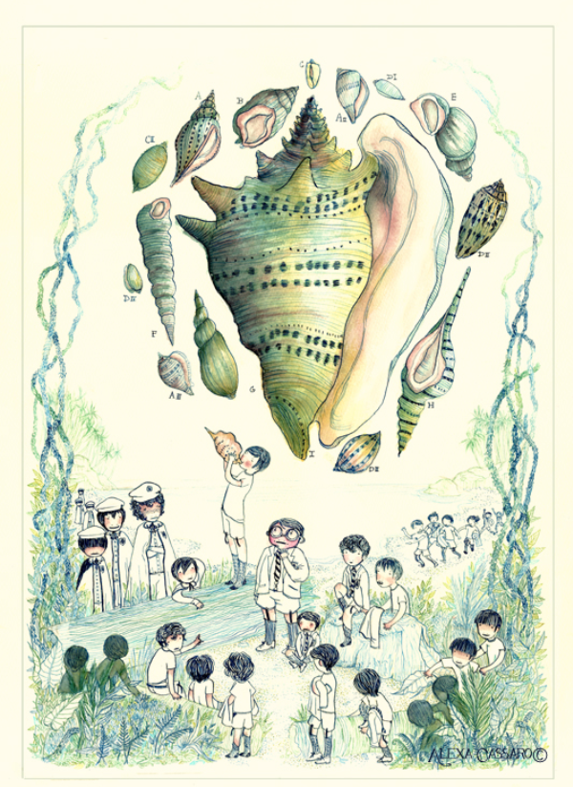
Step In, Step Out, Step Back
Choose one of the following characters:
Jack
Ralph
Piggy
Littluns
Simon
Samneric
Notes:
Cassaro, A. (2012). Man-made monsters. [Digital image]. Behance. https://www.behance.net/gallery/13858009/Lord-of-The-Fliesce
https://learn.k20center.ou.edu/strategy/1585

Slide 9
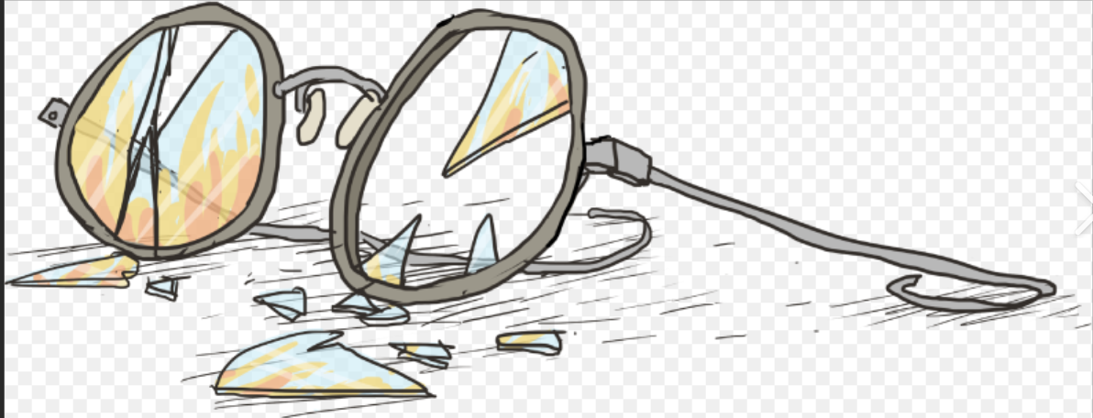
Step In
Given what you see and know at this time, what do you think this person might feel, believe, know, or experience?
Notes:
Shmoop. Piggy’s glasses. [Digital image]. https://www.shmoop.com/study-guides/literature/lord-of-the-flies/analysisoop

Slide 10
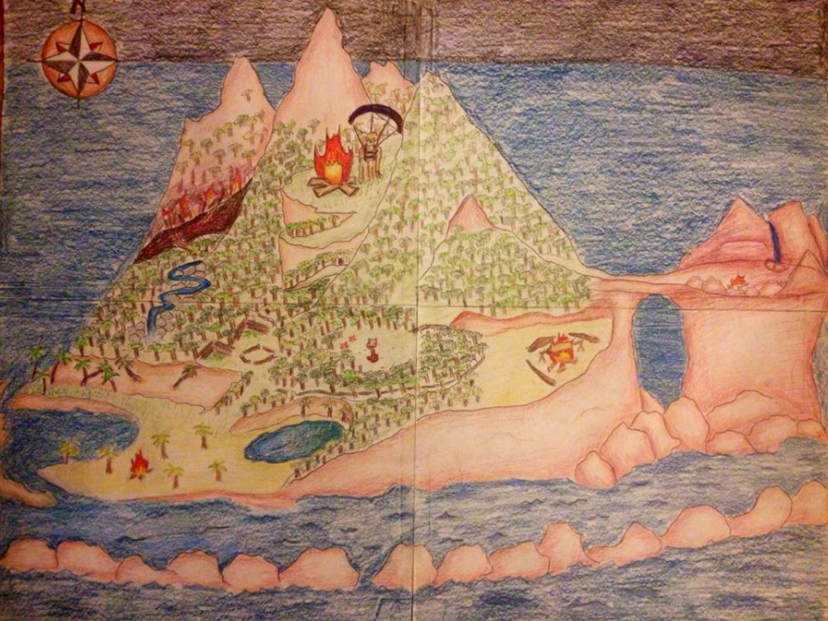
Step Out
What else would you like or need to learn to understand this person’s perspective better?
Notes:
Emperor Deathsaur. (2014) Lord of the Flies island. [Digital image] Wikimedia. . https://commons.wikimedia.org/wiki/File:Lord_of_the_Flies_Island_that_is_Featured_in_the_Story_%22Lord_of_the_Flies%22.jpgons

Slide 11
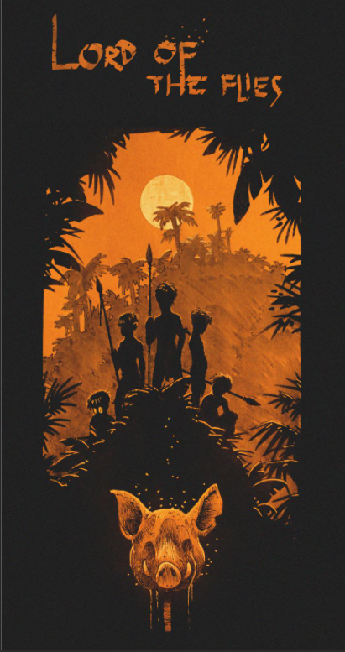
Step Back
Given your exploration of this perspective so far, what do you notice about your own perspective and what it takes to take somebody else’s?
Notes:
Gabriel, S. (n.d.) Lord of the flies. [Digital Image]. ArtStation. https://www.pinterest.com.mx/pin/299278337739256207/

Slide 12

True for Who?
Discuss the statement.
  What kind of situation was it made in?
  Who made it or would make it?
  What were people’s intentions and goals?
  What was at stake?
Brainstorm a list of all the possible points of view for the claim.
Reflect on the statement and decide for each viewpoint:
  Would this person think this statement is true?
  False?
  Uncertain?
  Why?
As a group, determine where each character would fall for the statement.
Notes:
Library as Incubator Project. (2015). Banned books trading cards. [Digital image]. Chapel Hill Public Library. http://www.libraryasincubatorproject.org/?p=17307
https://learn.k20center.ou.edu/strategy/1586

Slide 13
True for Who?
The littluns need a babysitter.

Slide 14
True for Who?
Jack is the best leader.

Slide 15
True for Who?
Piggy is the smartest boy on the island.

Slide 16
True for Who?
Ralph is the most rational boy on the island.

Slide 17
True for Who?
The boys should first concern themselves with building shelter.

Slide 18
True for Who?
The boys should first concern themselves with finding food sources.

Slide 19
True for Who?
The boys should first concern themselves with exploring the island.

Slide 20
True for Who?
Piggy does not really know what he is talking about; no one should listen to him.

Slide 21
True for Who?
Jack is a bully.

