Slide 2
It’s All About Balance!
Parallel Structure

Slide 3
Essential Question
What is the purpose of parallel structure and why do authors use it?

Slide 4
Lesson Objectives
Understand the purpose of parallel structure in writing.
Create sentences that use parallel structure.

Slide 5
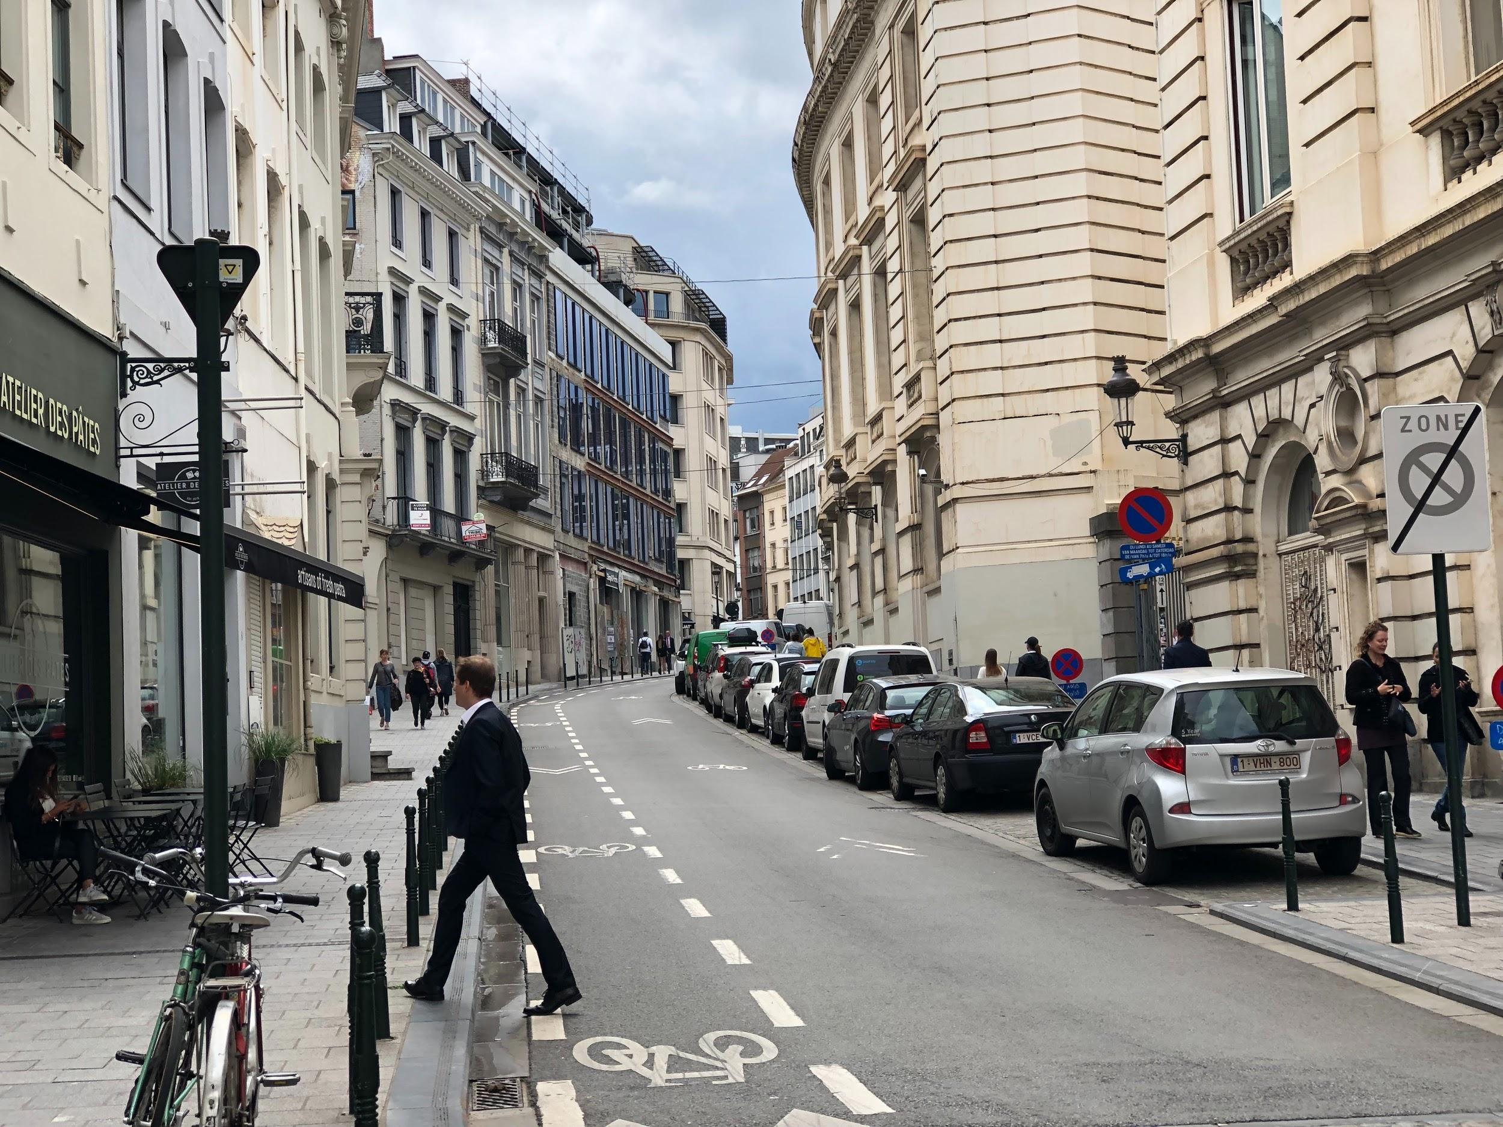
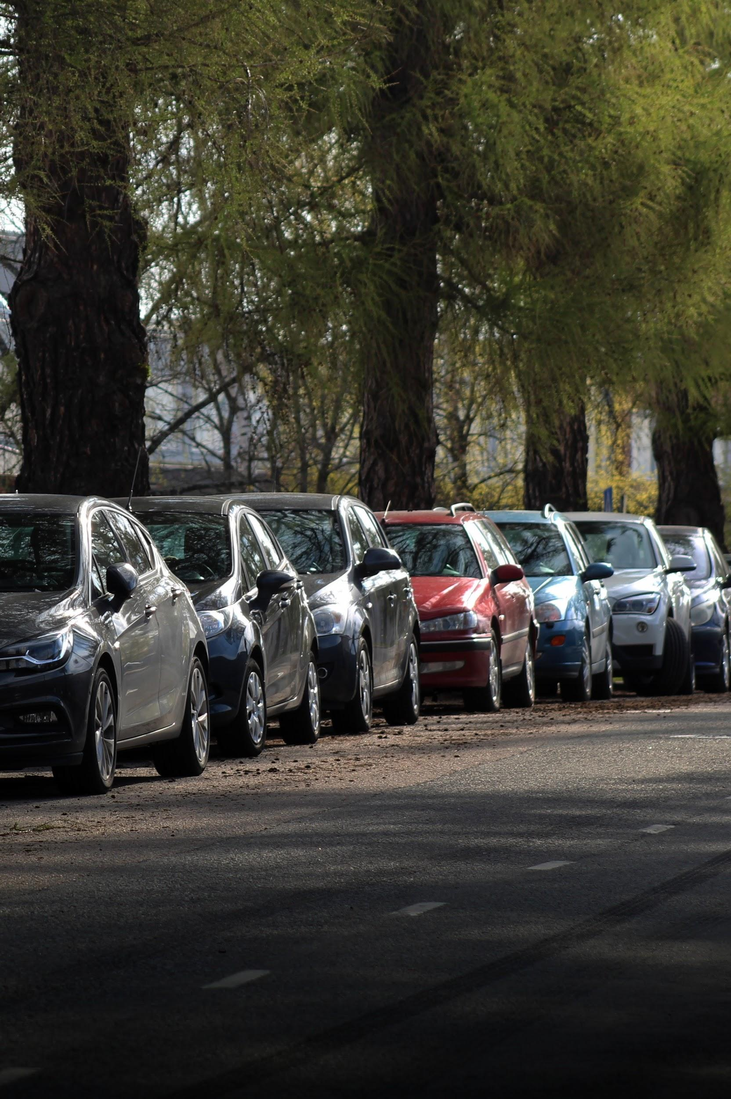
Parallel Parking
Why is it called PARALLEL parking?
What does that mean?
Notes:
Image Sources:
Nygard, A. (2020, May 22). Parked cars [Image]. Retrieved August 18, 2020, from https://unsplash.com/photos/FwRTLAjTeE0
Paquette, A. (2019, August 13). Walking business man in Belgium [Image]. Retrieved August 18, 2020, from https://unsplash.com/photos/p0oC-D6rbWs

Slide 6
Brainstorm
What other words can you think of that are similar to PARALLEL?
In what disciplines do you see these words used? Where have you seen these words applied?

Slide 7
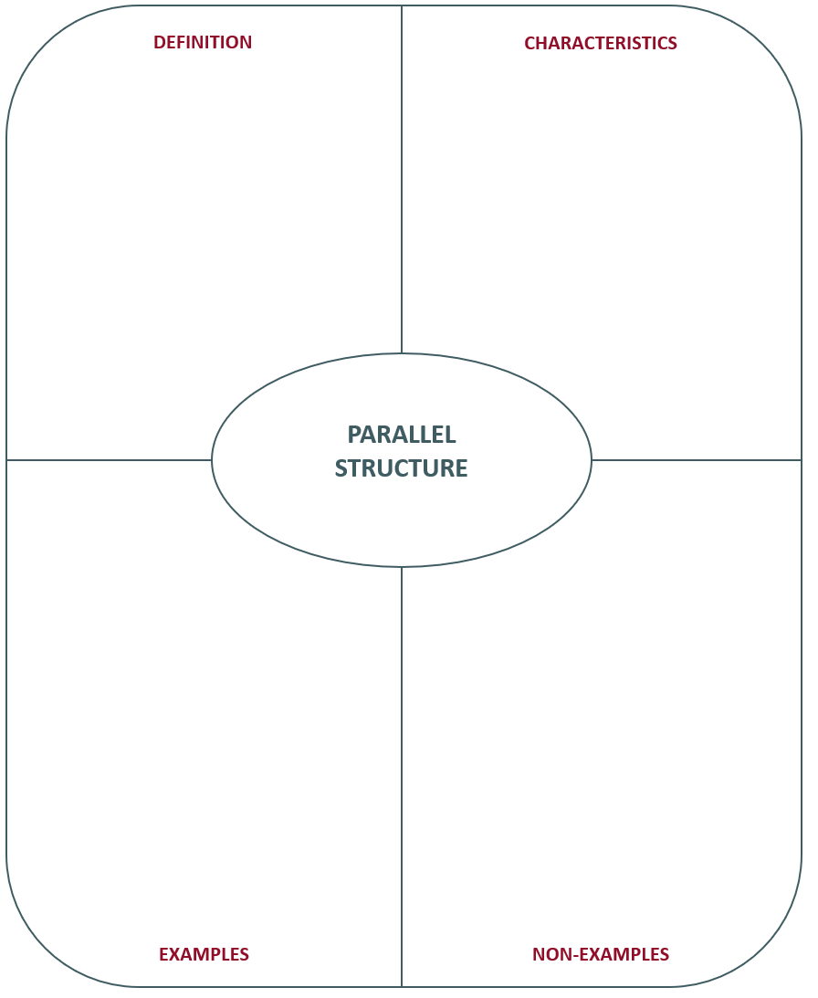
Frayer Model
When writers use the same pattern of words to show that two or more ideas have the same level of importance. For example, Mary likes hiking, swimming, and bicycling.
Parallel Structure

Slide 8
Three Speeches
As you read:
Why-Light your speech.
Highlight places in the text where you see parallel structure.
Note in the margins why you think the author used parallel structure in these places.
After you read:
Discuss the questions below with your group.
What did you notice about the ideas that were used in parallel?
Why did the authors choose to use parallel structure for these ideas?

Slide 9

Claim, Evidence, Reasoning
Prompt:
How did the author use parallel structures in the speech? What was the author’s purpose and intent in using parallel structure with these ideas?

Slide 10
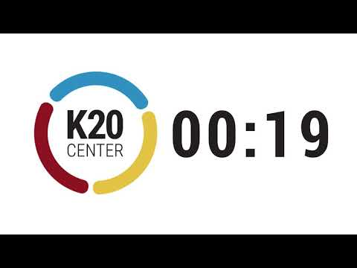
One-Minute Writing
What is the purpose of parallel structure in writing? Explain what you have learned.
Write for one minute without stopping.

Slide 11

Tweet Up!
Summarize the purpose of parallel structure in writing using 140 characters or less.
Try to use parallel structure in your response!

