Slide 2
SHIPping Words
Analogy RelationSHIP

Slide 3
Essential Questions
What is an analogy?
How do words and ideas go together?
What is an example of an analogy?

Slide 4
Lesson Objectives
Define the term analogy.
Write your own analogies.
Describe the relationship of your analogies.

Slide 5
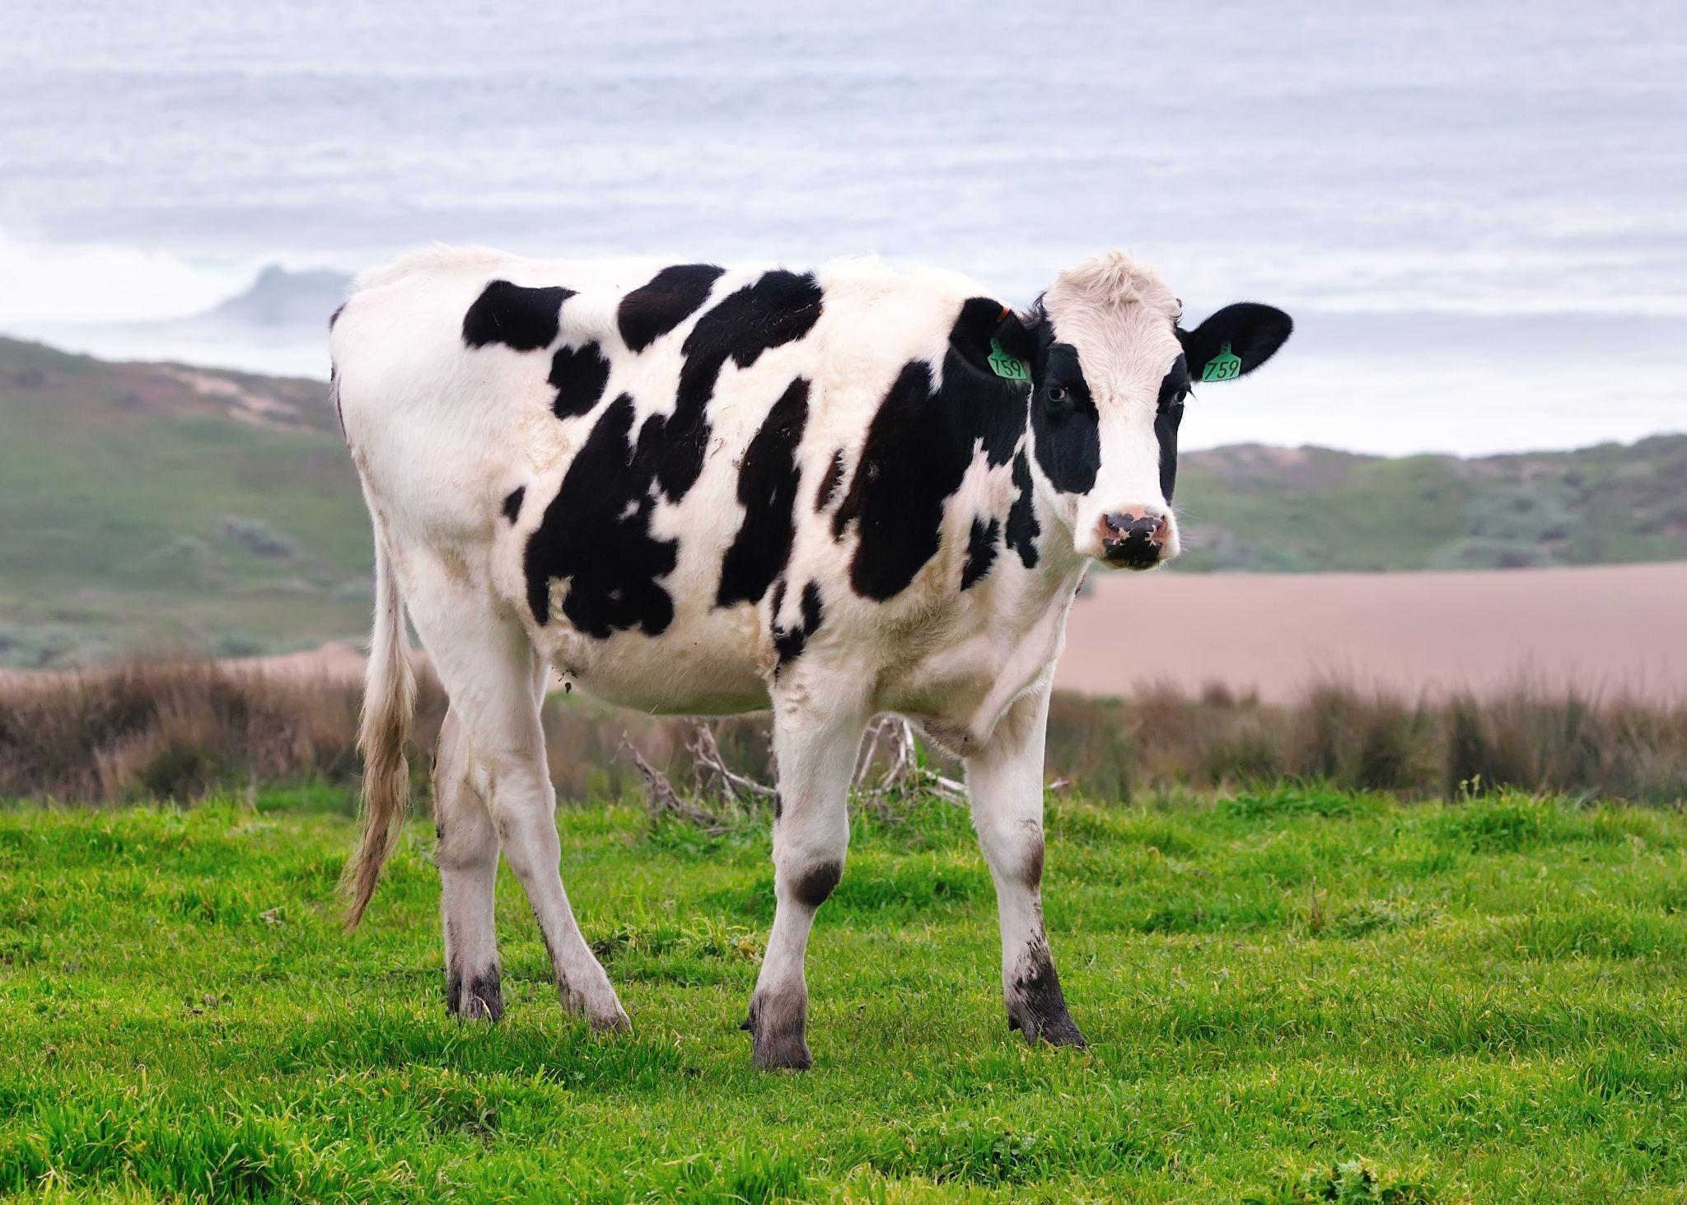
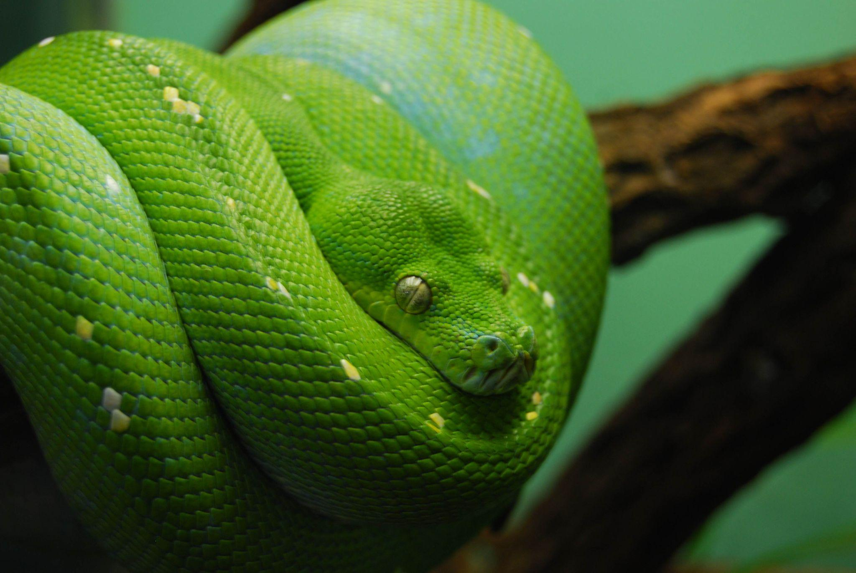
Cow is to mammal as snake is to reptile
Cow:Mammal
Snake:Reptile
Notes:
Cathy. (2008). Happy california cow [Clip art]. flickr. https://www.flickr.com/photos/haglundc/3438077857.
LongitudeLatitude. (2009). Snake [Clip art]. flickr. https://www.flickr.com/photos/longitudelatitude/3819075931.

Slide 6
Gallery Walk
Take some time to review the analogies around the room.
Notes:
K20 Center. (2021, September 21). K20 Center 10 minute timer [Video]. YouTube. https://youtu.be/9gy-1Z2Sa-c

Slide 7
Elbow Partner
With your partner, talk about the following questions:
Which analogy was your favorite?
Why did you like that analogy?
What kind of image did this analogy bring to your mind?

Slide 8
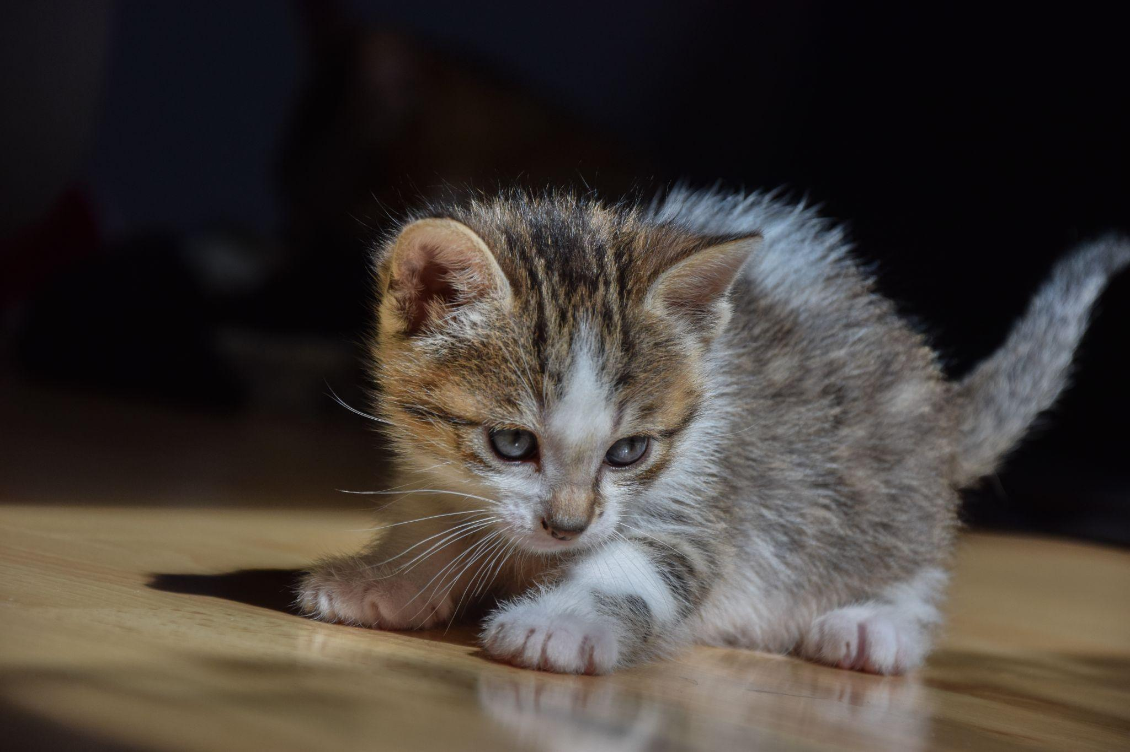
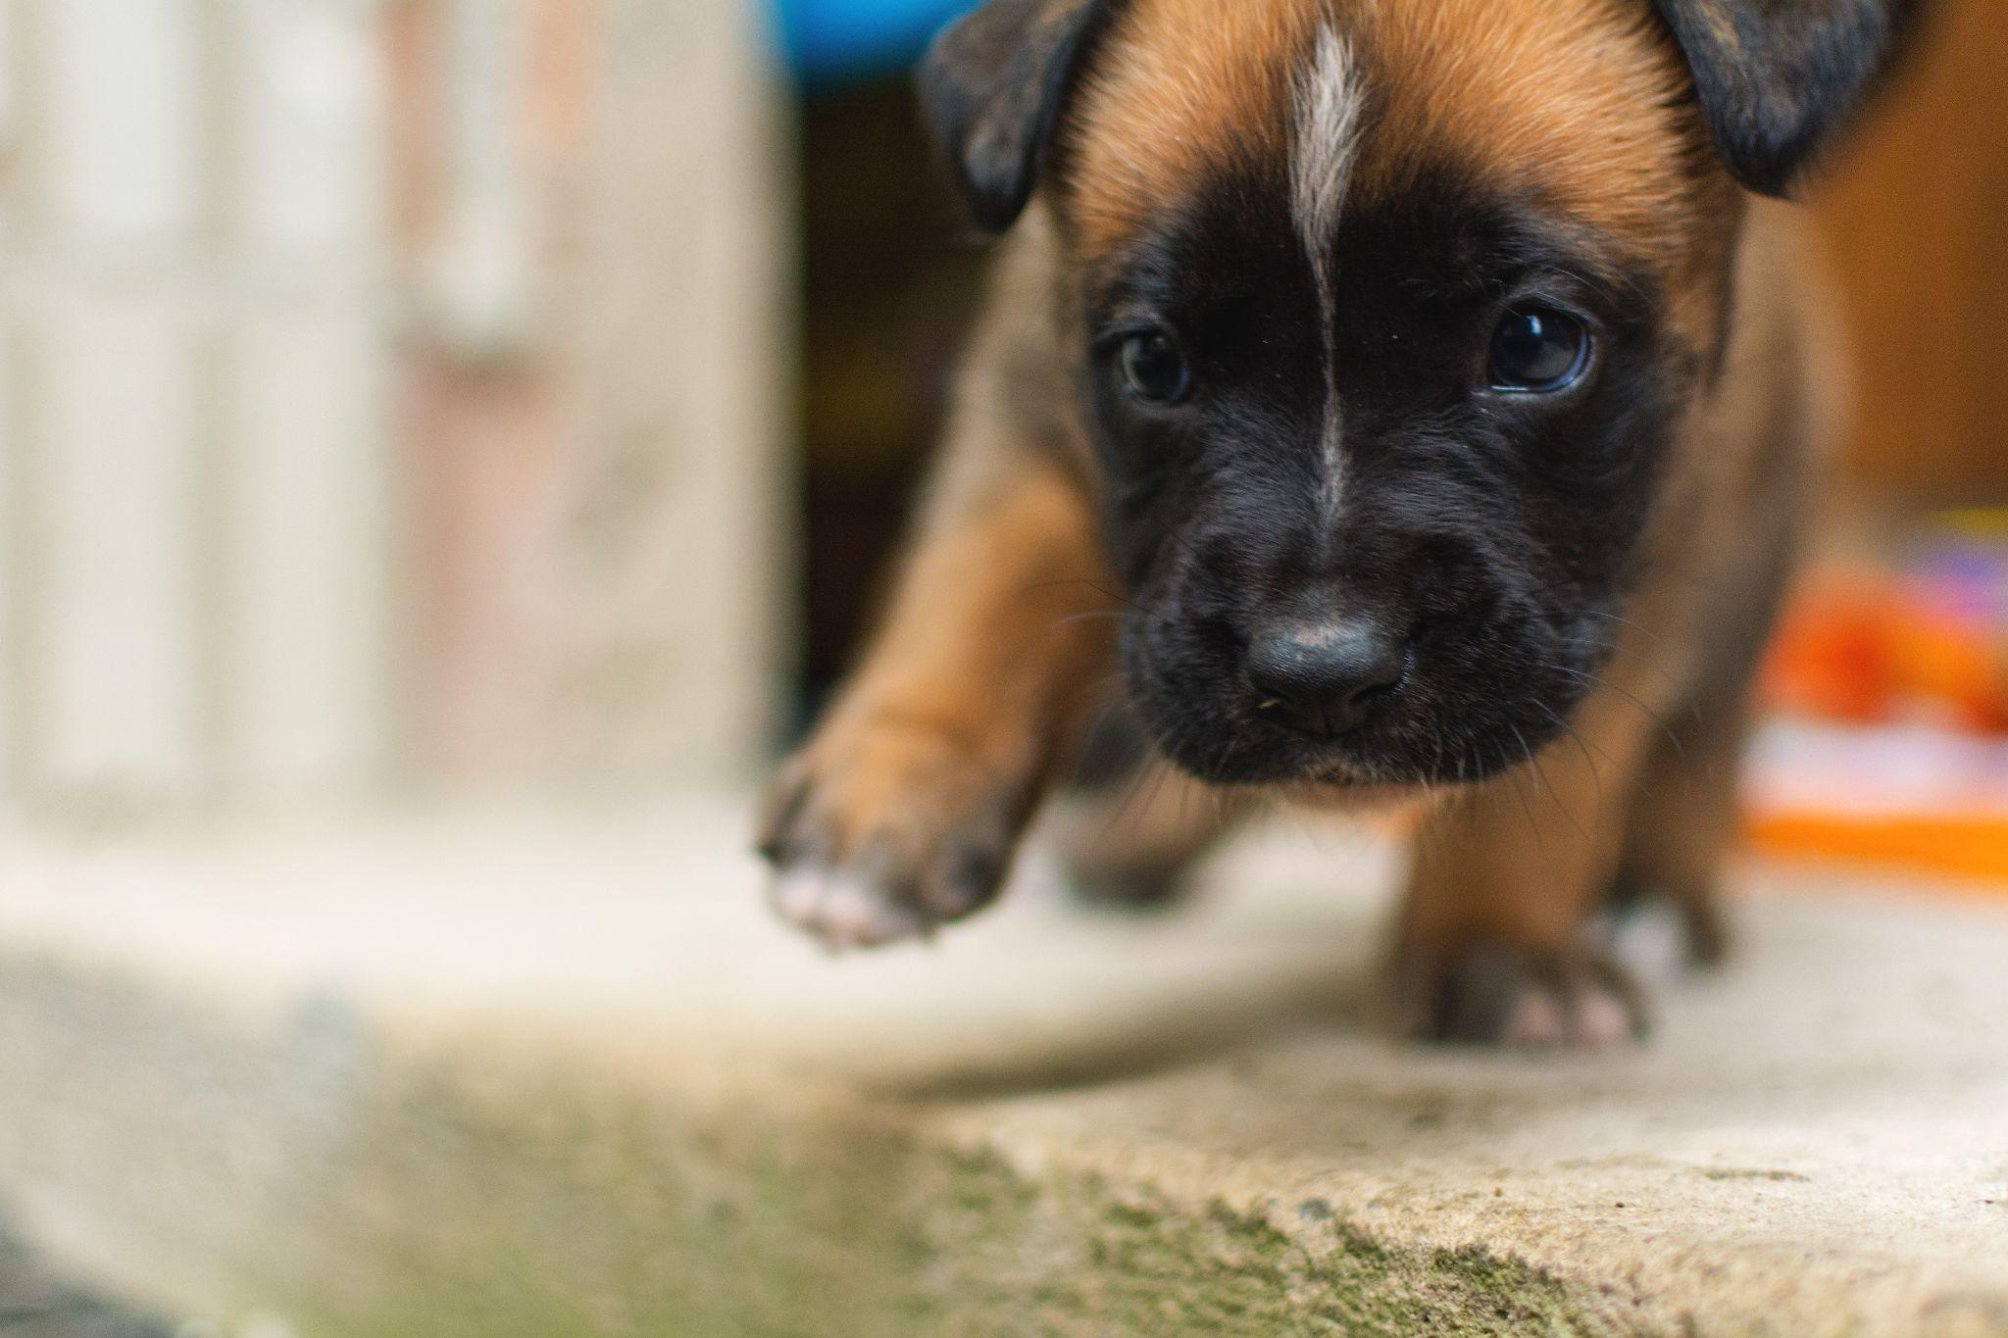
Kitten is to cat as puppy is to dog
Kitten:Cat
Puppy:Dog
Notes:
0x010C. (2015). 1 Month old kitten 45 [Clip art]. Wikimedia Commons. https://commons.wikimedia.org/wiki/File:1-month-old_kitten_45.jpg.
Vorel, M. (2018). Small crossbreed puppy [Clip art]. Wikimedia Commons. https://commons.wikimedia.org/wiki/File:Small_crossbreed_puppy.jpg.

Slide 9
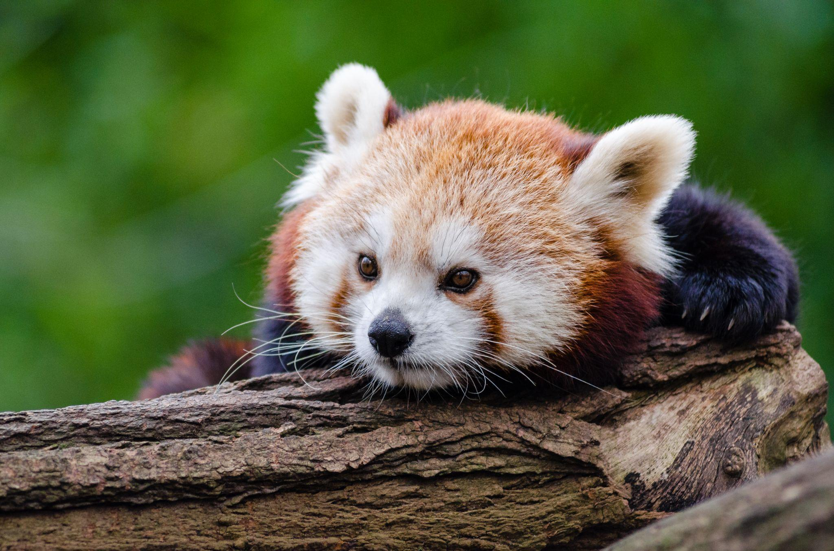
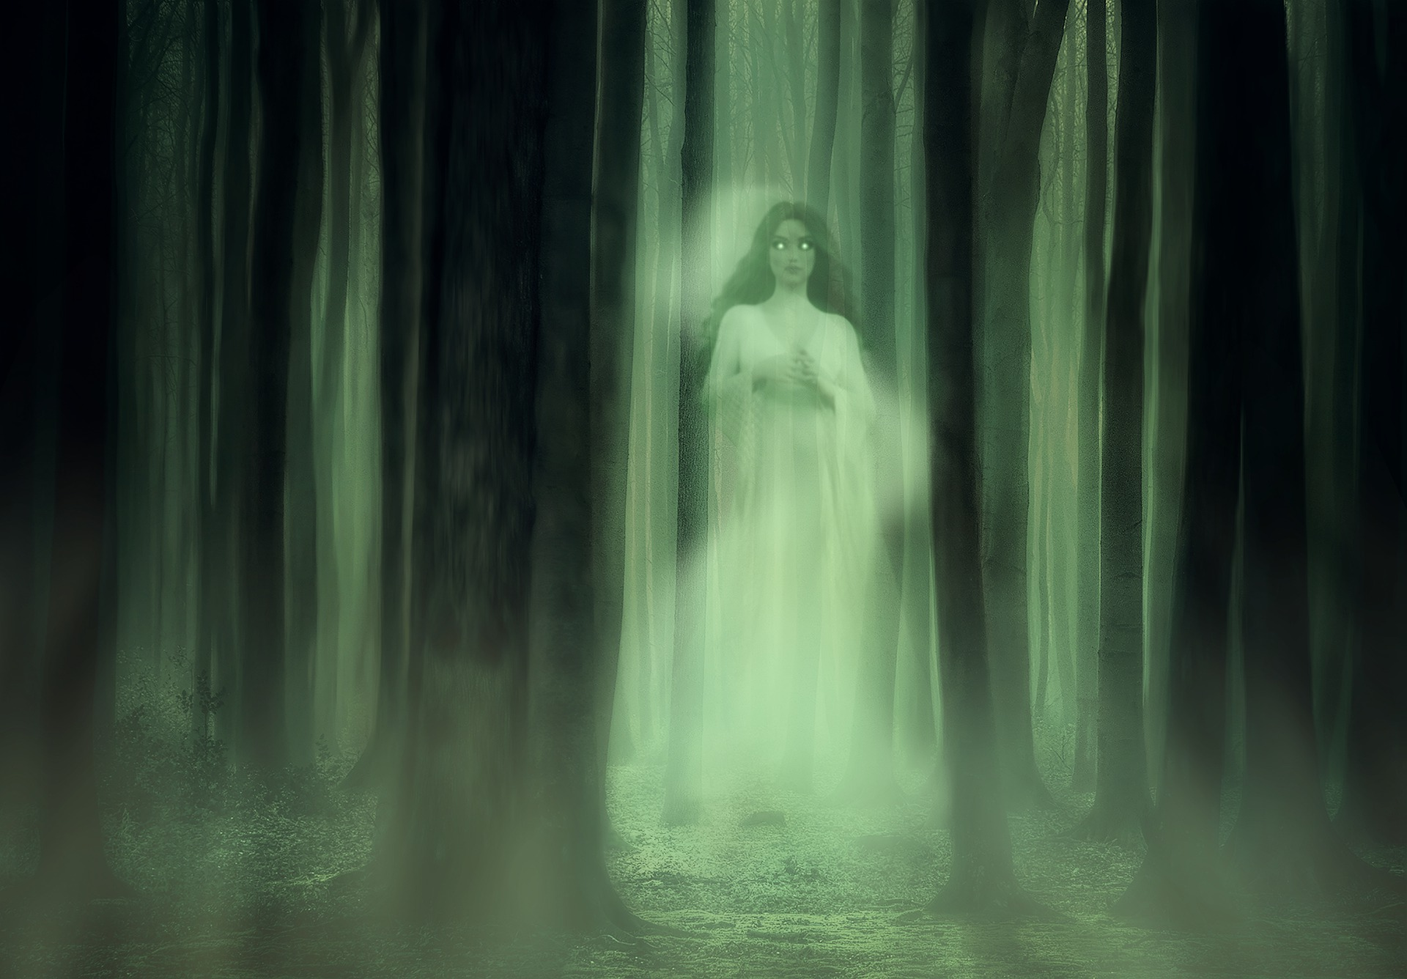
Adorable is to cute as creepy is to scary
Adorable:Cute
Creepy:Scary
Notes:
Darkmoon_Art . (2020). pixabay. https://pixabay.com/illustrations/spirit-ghost-trees-forest-horror-5668490/.
Appel, M. (2015). Taking a break [Clip art]. flickr. https://www.flickr.com/photos/mathiasappel/23325745169.

Slide 10
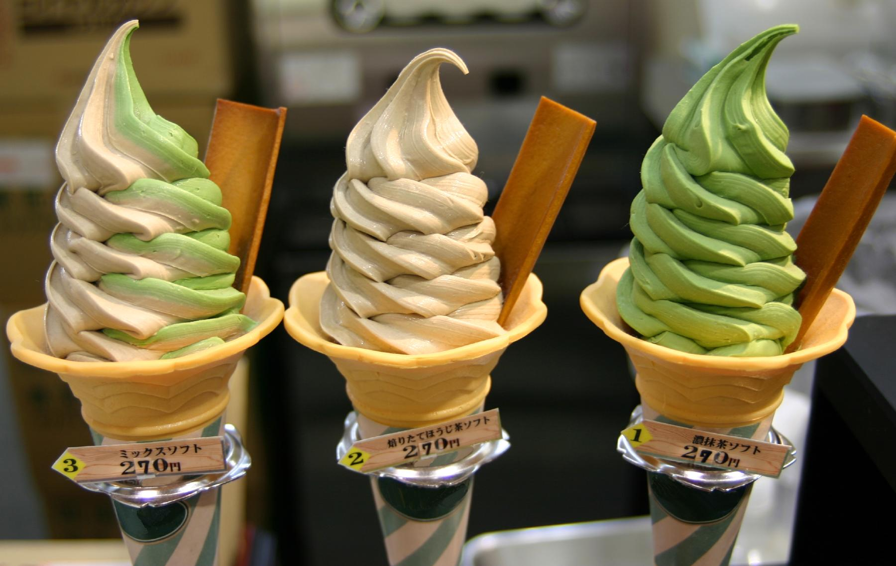
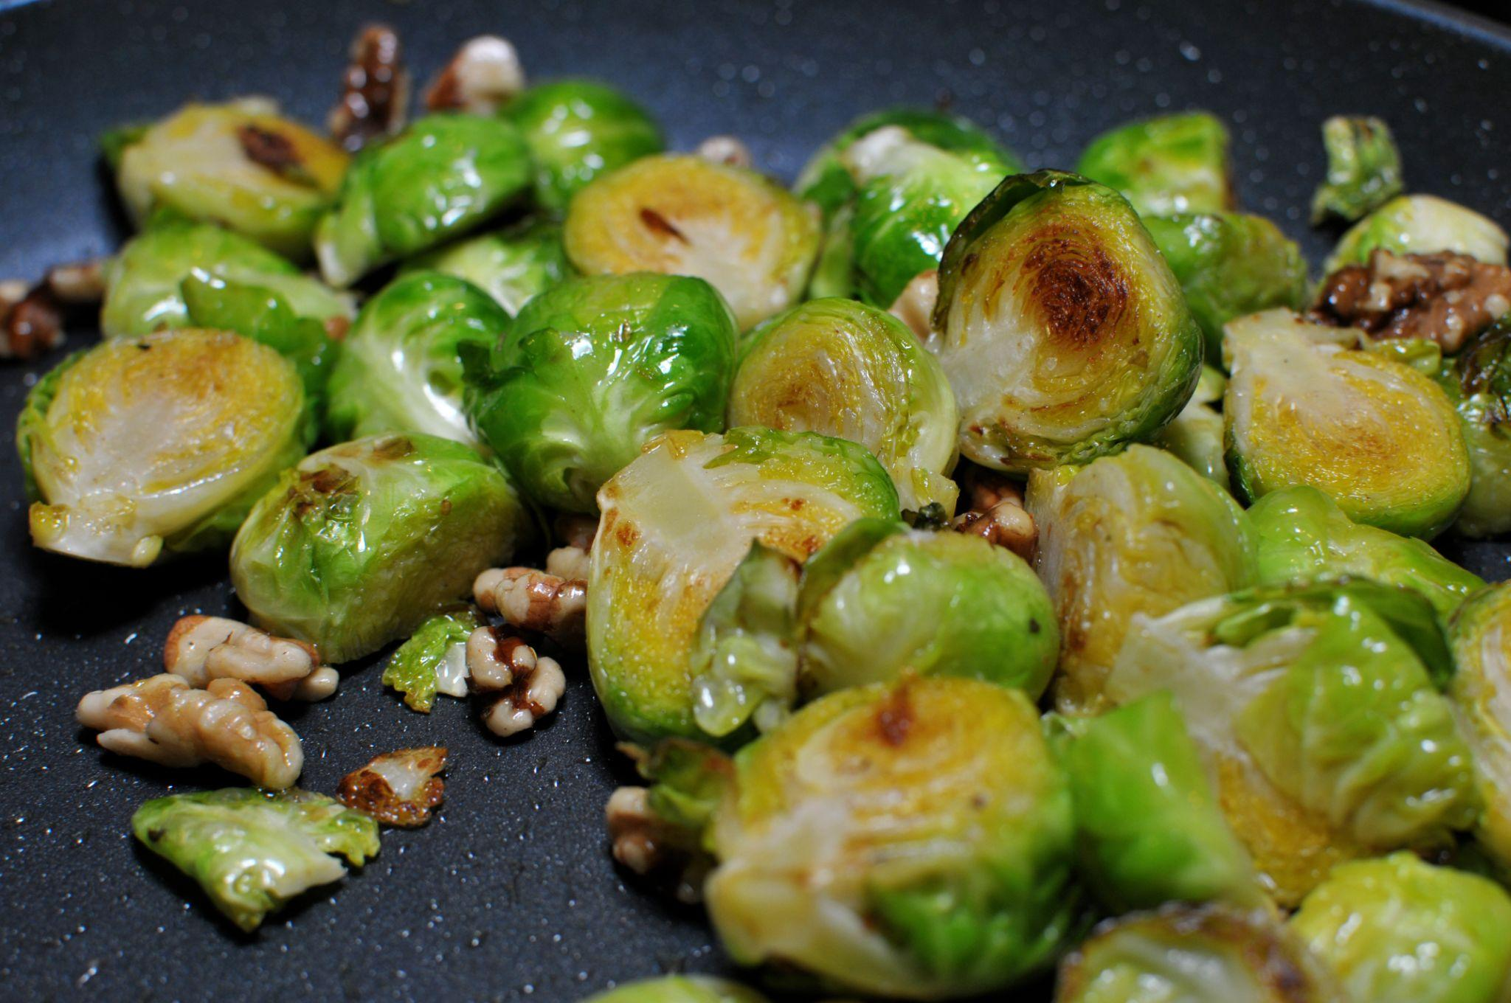
Delicious is to yummy as gross is to yucky
Delicious:Yummy
Gross:Yucky
Notes:
theilr. (2011). You might be surprised [Clip art]. flickr. https://www.flickr.com/photos/theilr/5417612750.
Takemoto, T. (2005). Japanese Tea Flavoured Ice Cream [Clip art]. flickr. https://www.flickr.com/photos/nihonbunka/12849922.

Slide 11
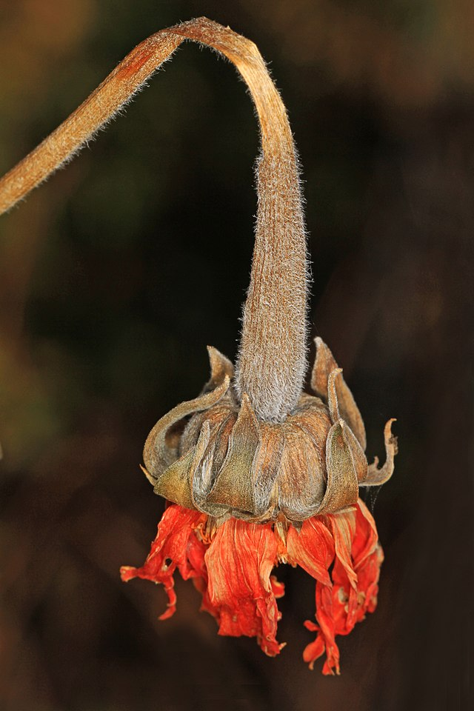
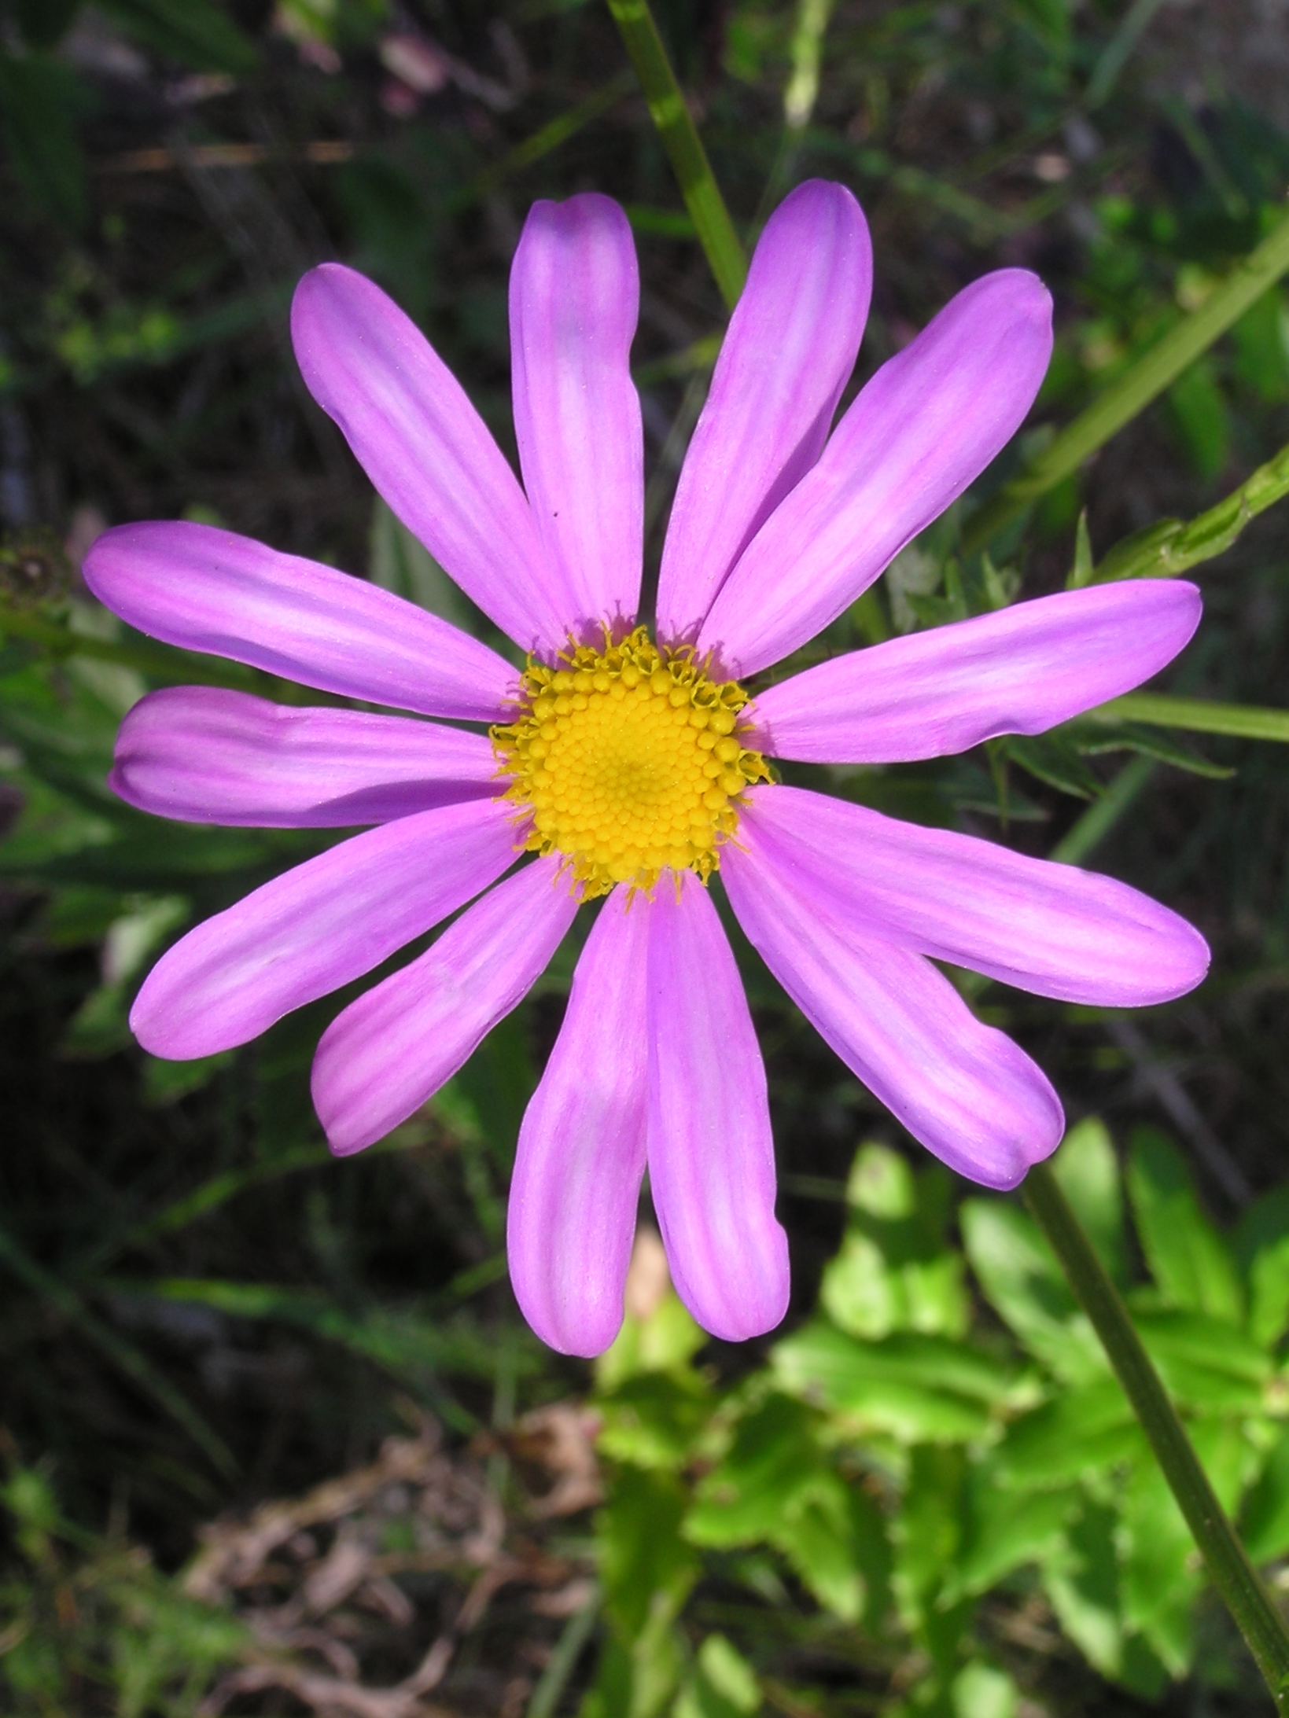
Smile is to frown as pretty is to ugly
Smile:Frown
Pretty:Ugly
Notes:
Orikrin 1998. (2013). Smiles for Article Feed Back [Clip art]. Wikimedia Commons. https://commons.wikimedia.org/wiki/File:Smilies_for_Article_Feed_Back.png
Wills, T. (2007). Mauve and yellow flower [Clip art]. Wikimedia Commons. https://commons.wikimedia.org/wiki/File:Mauve_and_yellow_flower.jpg
Gallagher, J. (2017). Dead flowers [Clip art]. Wikimedia Commons. https://commons.wikimedia.org/wiki/File:Dead_flowers_(38609229501).jpg

Slide 12
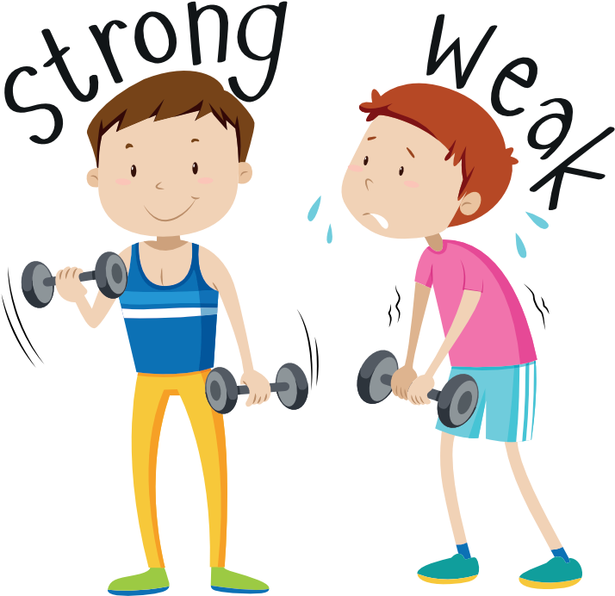
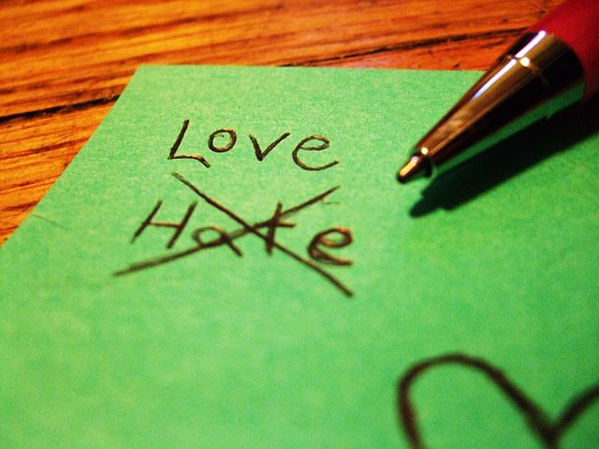
Strong is to weak as love is to hate
Strong:Weak
Love:Hate
Notes:
Strong Vs Weak, Life Vs Live - Strong Weak Clipart [Clip art]. Pinclipart. https://www.pinclipart.com/pindetail/hhJowo_strong-vs-weak-life-vs-live-strong-weak/
RecycledStardust. (2001). Love vs. hate [Clip art]. Wikimedia Commons. https://commons.wikimedia.org/wiki/File:Love_vs._Hate.jpg

Slide 13
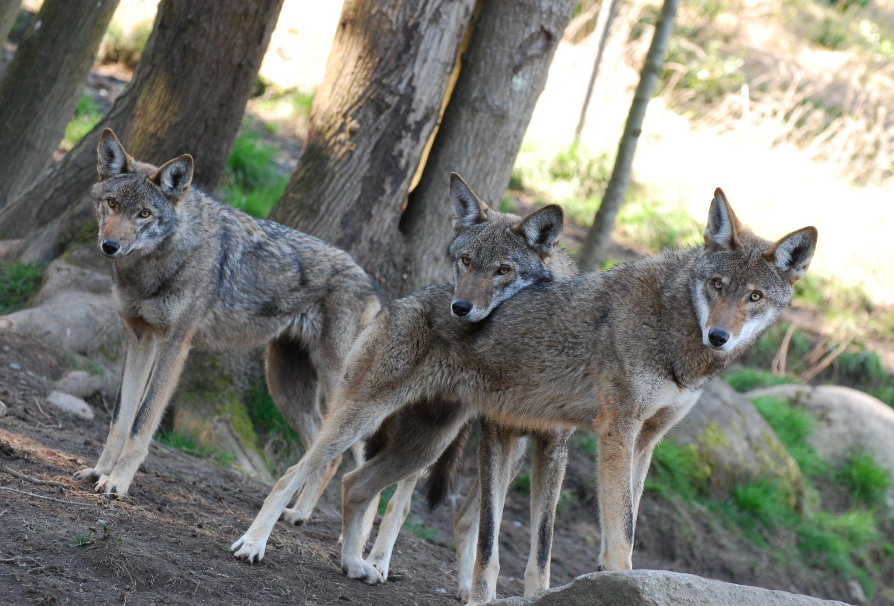
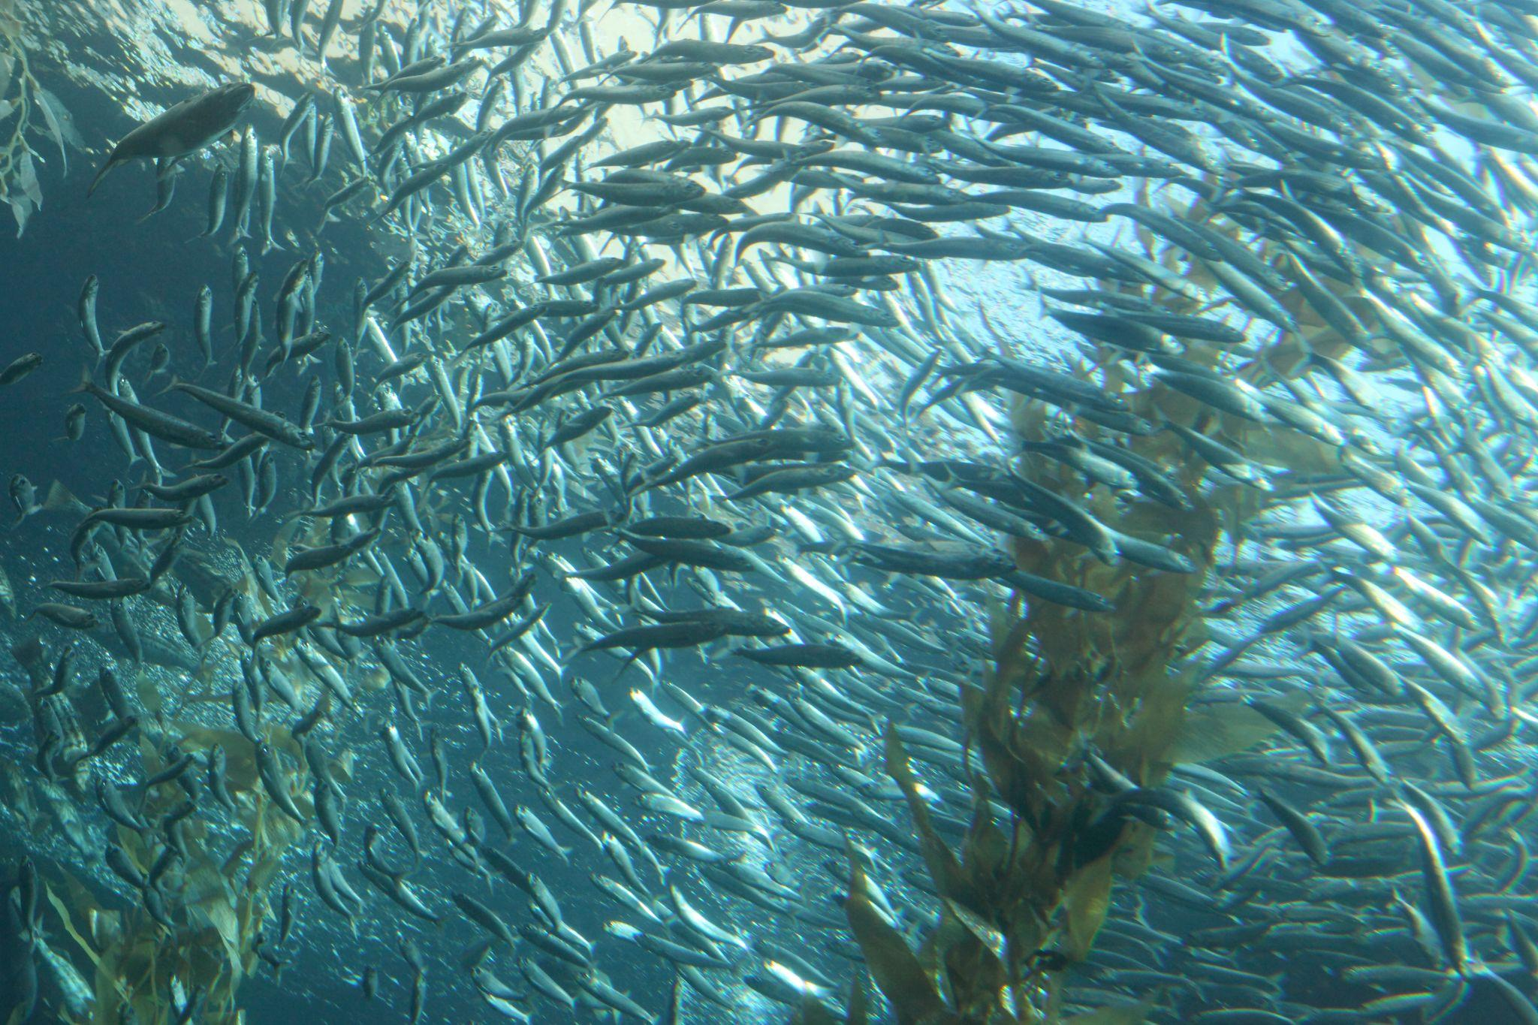
Wolf is to pack as fish is to school
Wolf:Pack
Fish:School
Notes:
OnceAndFutureLaura. (2013). Scary Wolf Pack [Clip art]. flickr. https://www.flickr.com/photos/laura-kali/8646790741.
Miller, S. (2013). School of Fish [Clip art]. flickr. https://www.flickr.com/photos/aloha75/10118765555.

Slide 14
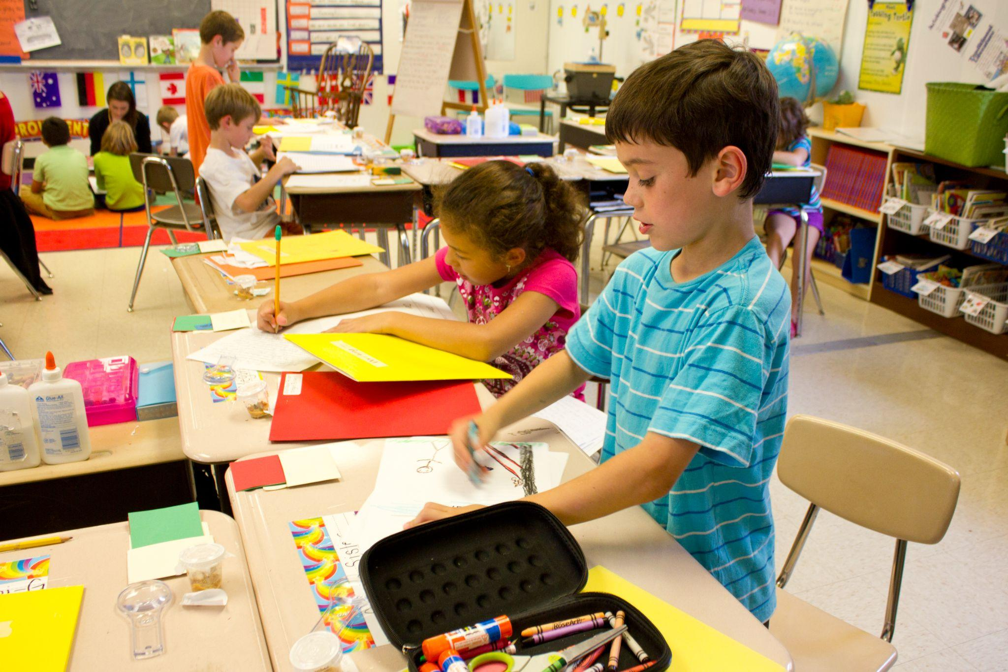
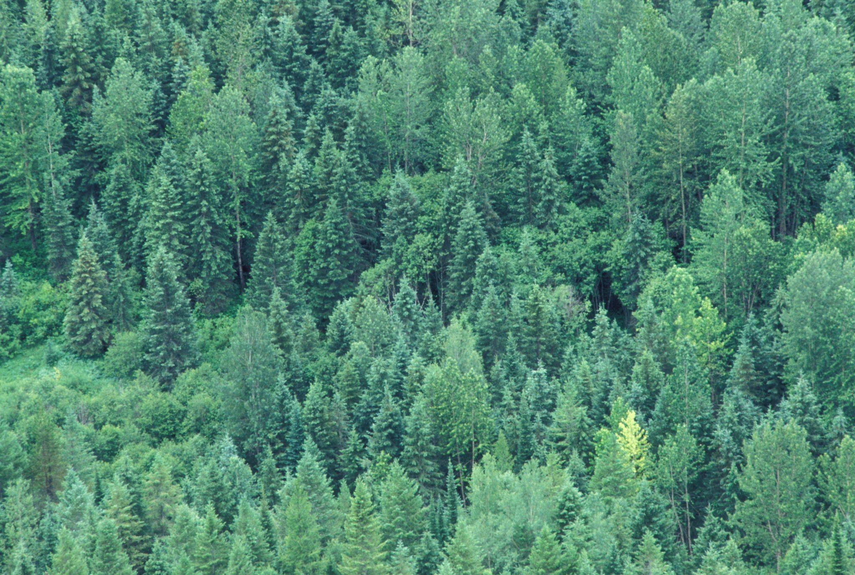
Class is to student as forest is to tree
Class:Student
Forest:Tree
Notes:
woodleywonderworks. (2010). Second grade writing class [Clip art]. flickr. https://www.flickr.com/photos/wwworks/5073552229.
World Bank Photo Collection. (2007). Aerial view of forest [Clip art]. flickr. https://www.flickr.com/photos/worldbank/1443164109.

Slide 15
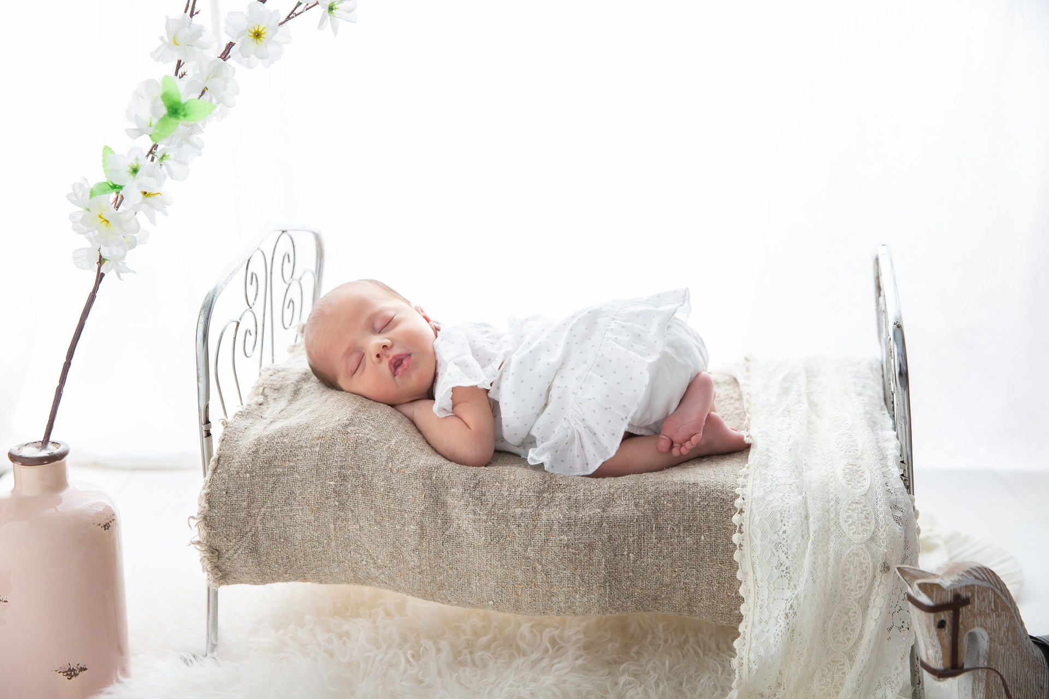
Kitchen is to cook as bedroom is to sleep
Kitchen:Cook
Bedroom:Sleep
Notes:
Nestlé. (2018). Prepared dishes and Cooking aids [Clip art]. flickr. https://www.flickr.com/photos/nestle/40769257910.
timkraaijvanger. (2019). https://pixabay.com/photos/baby-bed-child-cradle-sleep-small-4142216/.

Slide 16
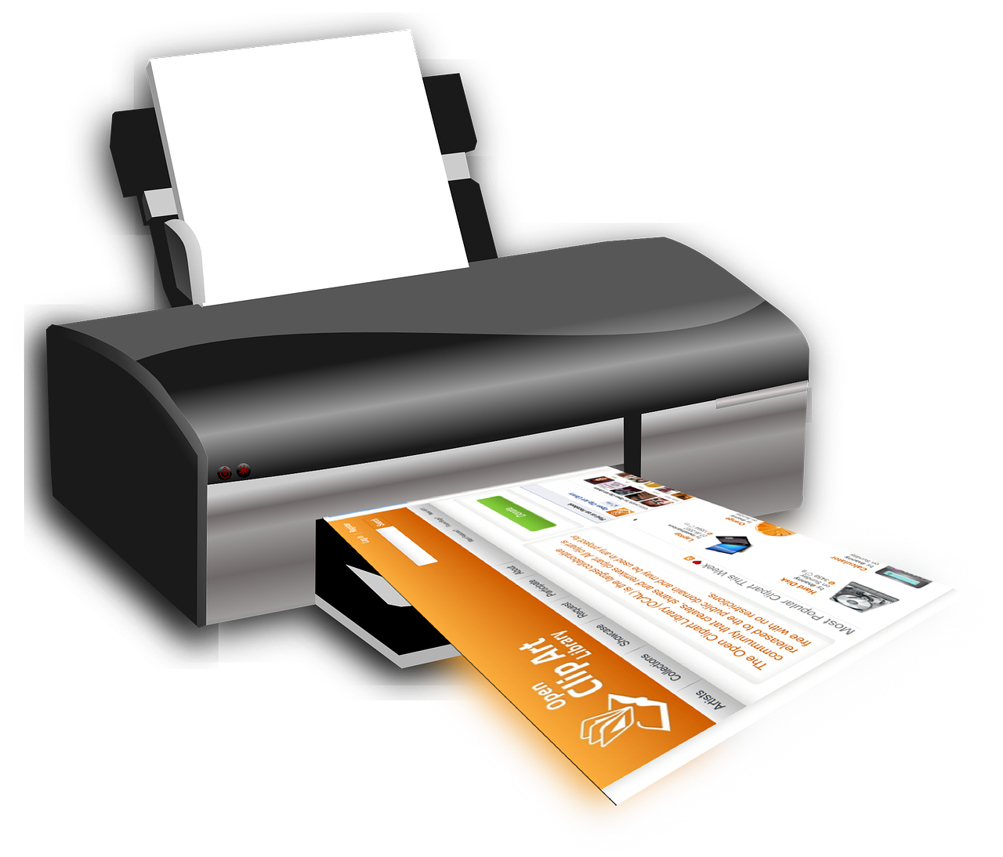
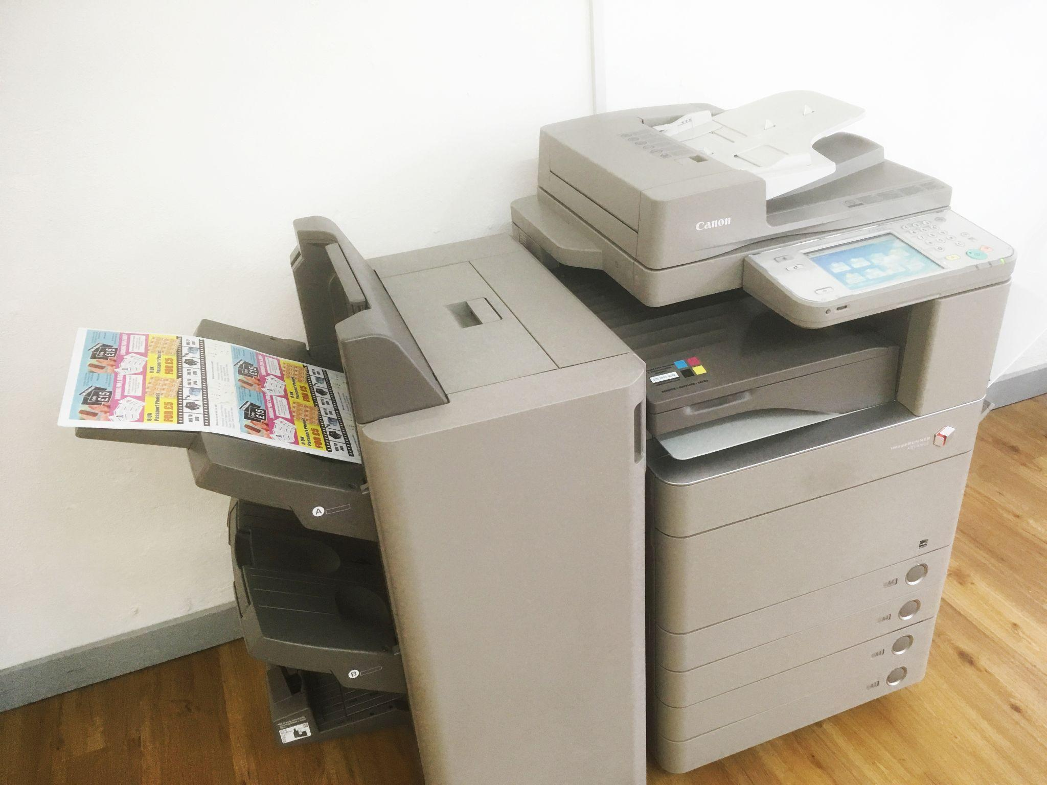
Print is to printer as copy is to copier
Print:Printer
Copy:Copier
Notes:
SimonSpeaker. (2019). Digital Printer [Clip art]. Wikimedia Commons. https://commons.wikimedia.org/wiki/File:Digital_Printer.jpg.
OpenClipart-Vectors. (2013). Print, printer, printing, device, output, paper, computer, hardware, peripheral, office, deskjet [Clip art]. pixabay. https://pixabay.com/vectors/print-printer-printing-device-159336/.

Slide 17
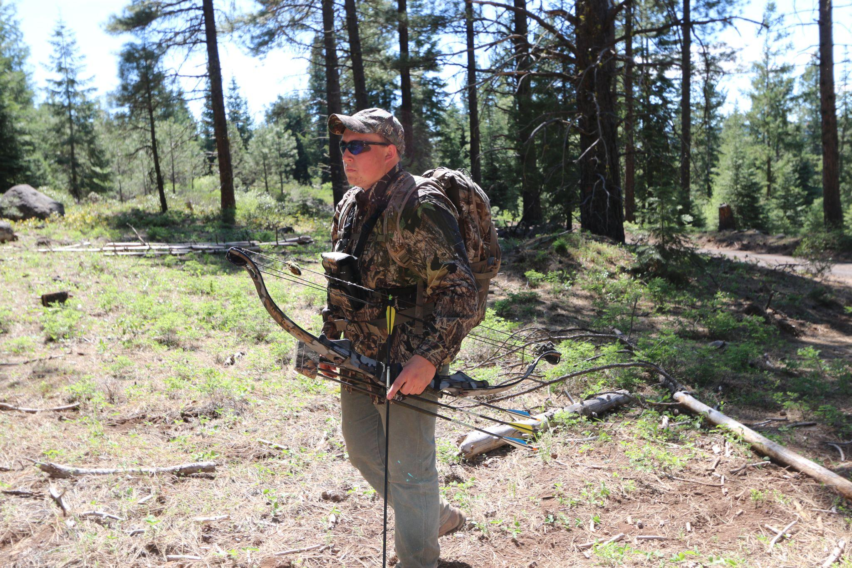
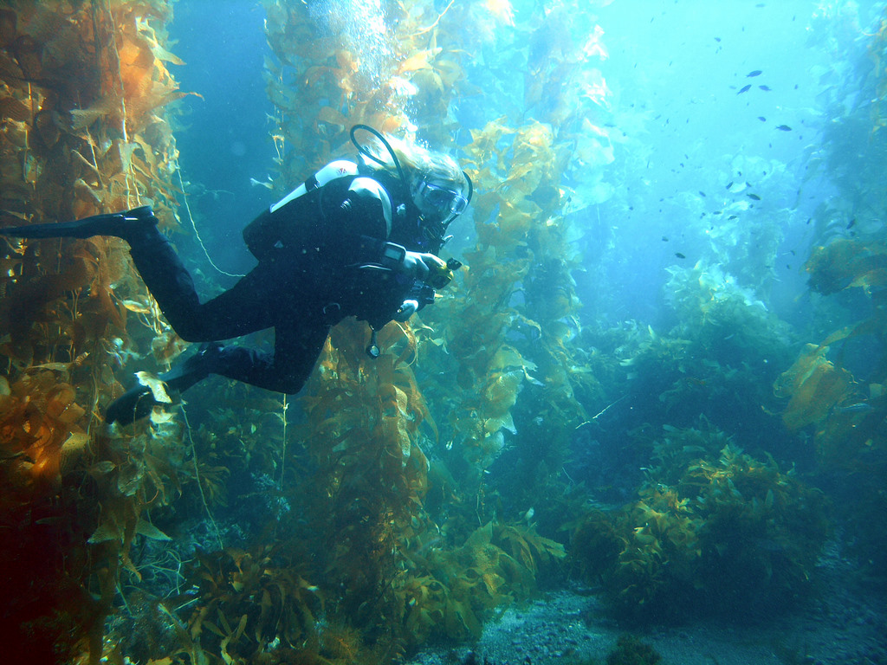
Hunt is to hunter as dive is to scuba diver
Hunt:Hunter
Dive:Scuba Diver
Notes:
Bierman, E. (2004). Diving buddy [Clip art]. flickr. https://www.flickr.com/photos/edbierman/3200958408.
Bureau of Land Management Oregon and Washington. (2017). Hunting [Clip art]. flickr. https://www.flickr.com/photos/blmoregon/34151493324.

Slide 18
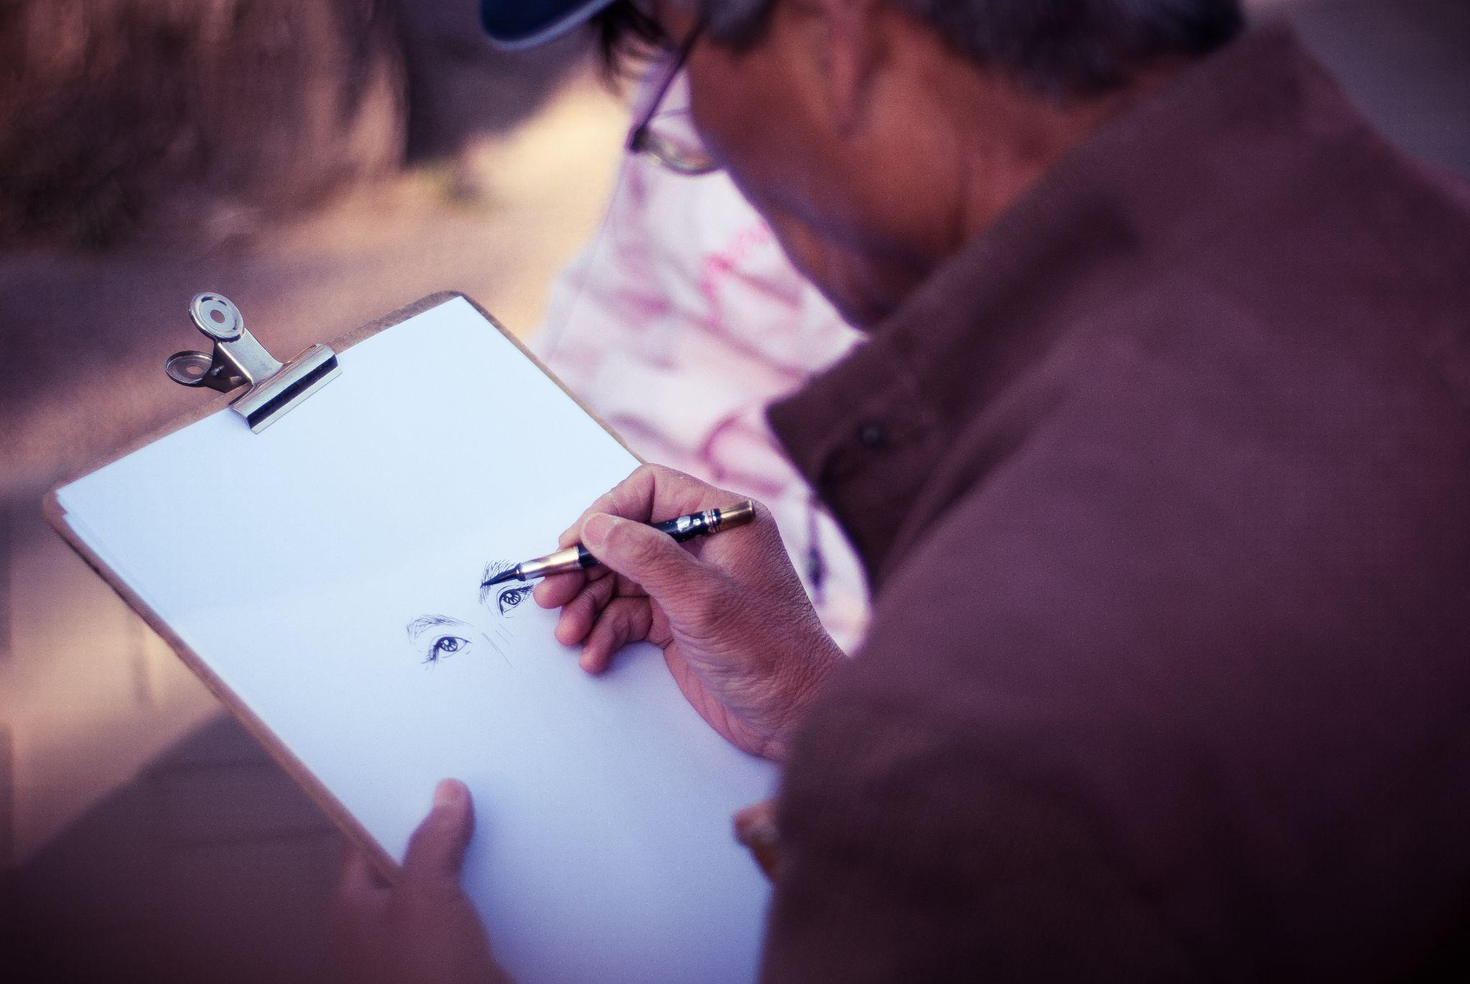
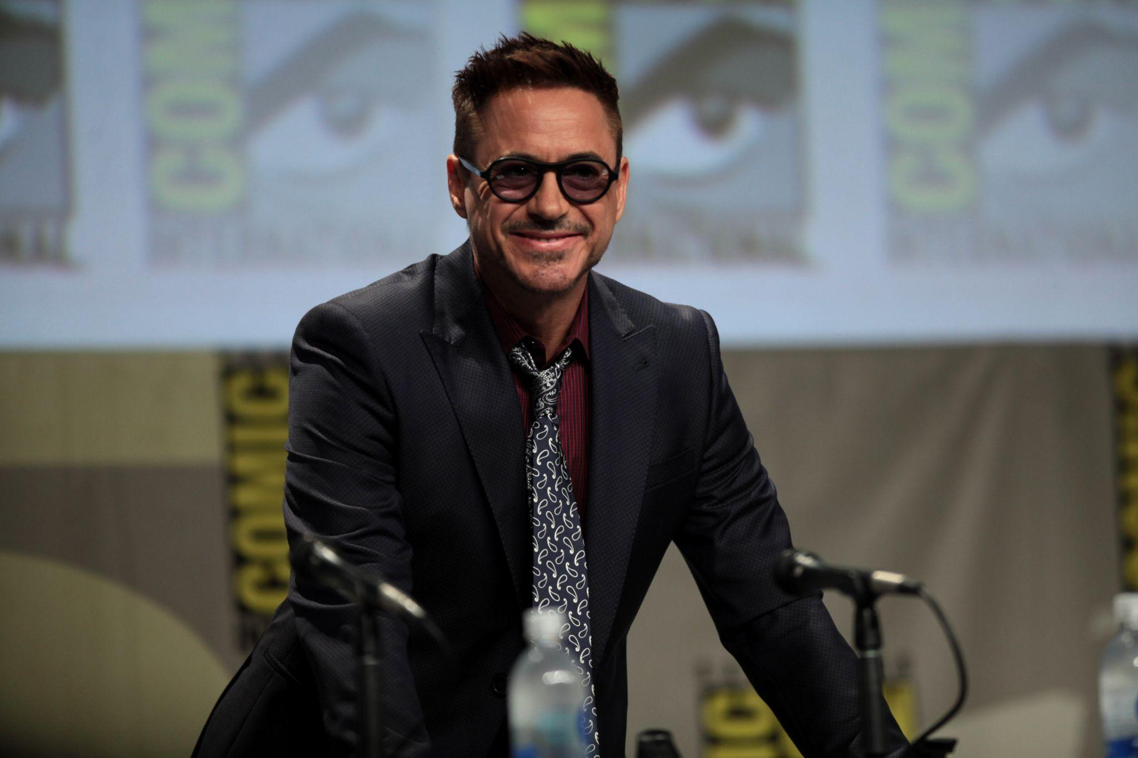
Artist is to draw as movie star is to act
Artist:Draw
Movie Star:Act
Notes:
Ying, J. J. (2017). Male artist drawing [Clip art]. Wikimedia Commons. https://commons.wikimedia.org/wiki/File:Male_artist_drawing_(Unsplash).jpg.
Skidmore, G. (2014). Robert Downey Jr [Clip art]. flickr. https://www.flickr.com/photos/gageskidmore/14800476884.

Slide 19
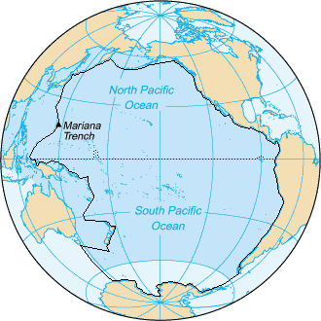
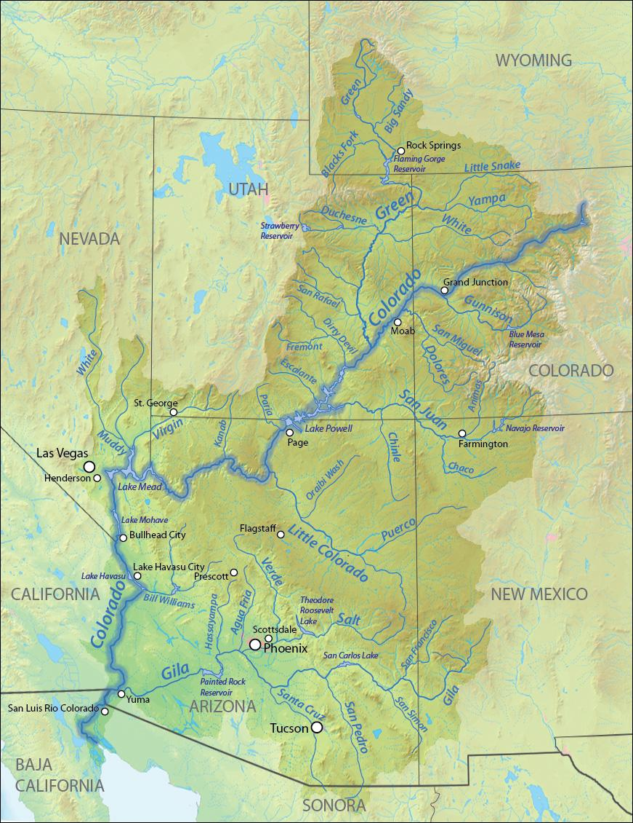
Pacific is to ocean as Colorado is to river
Pacific:Ocean
Colorado:River
Notes:
Lasunncty. (2011). Pacific Ocean - en Iho [Clip art]. Wikimedia Commons. https://commons.wikimedia.org/wiki/File:Pacific_Ocean_-_en_IHO.png.
Shannon. (2012). Coloradorivermapnew1 [Clip art]. Wikimedia Commons. https://commons.wikimedia.org/wiki/File:Coloradorivermapnew1.jpg.

Slide 20
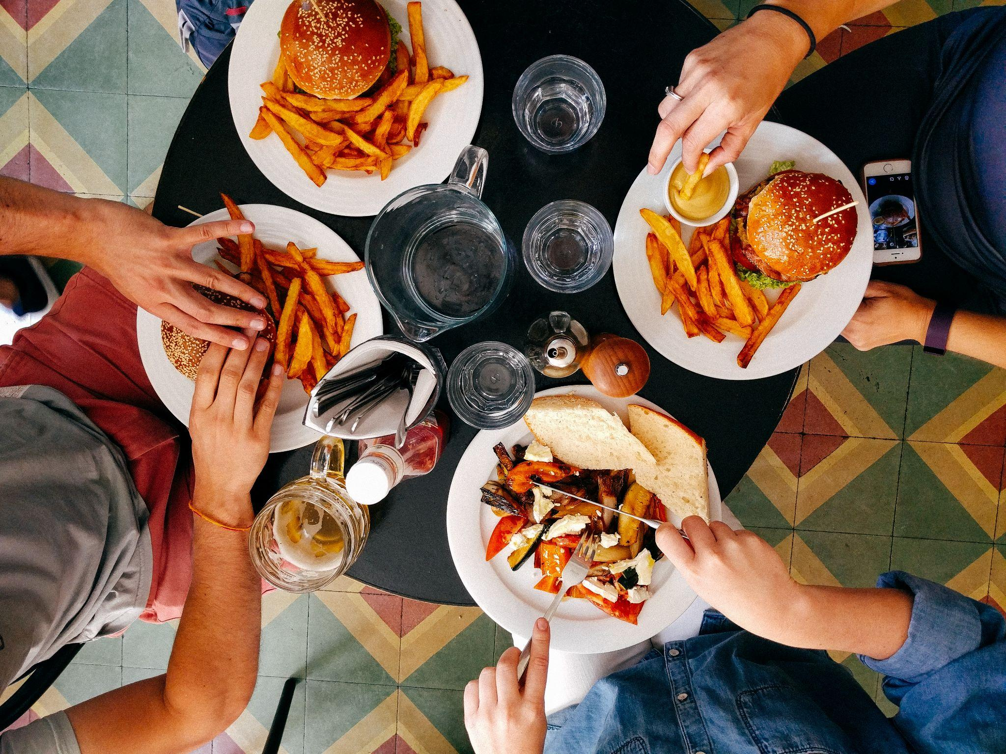
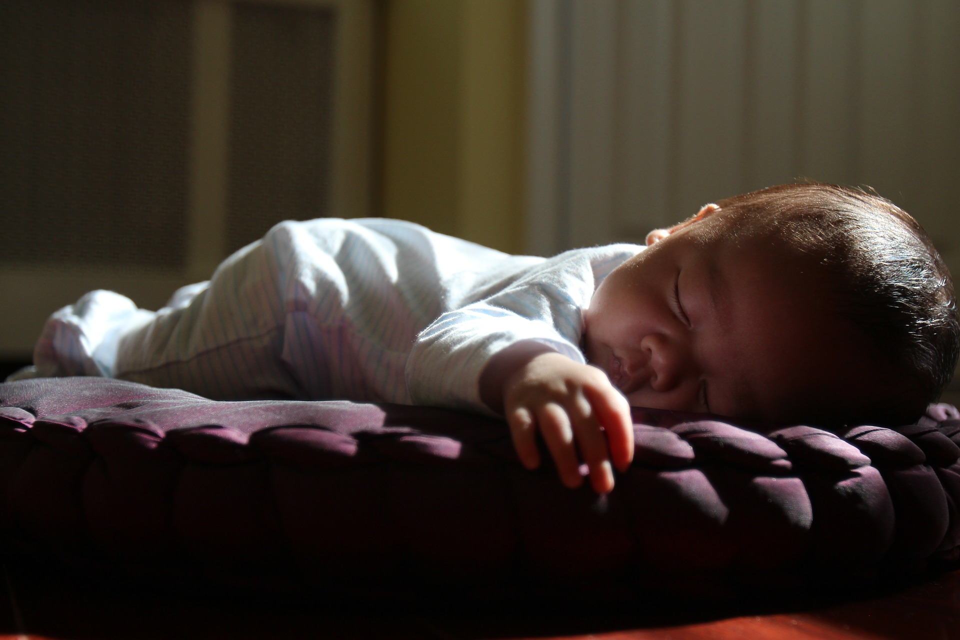
Eat is to fed as sleep is to rested
Eat:Fed
Sleep:Rested
Notes:
Gold, D. (2016). Friends eating lunch in diner [Clip art]. Wikimedia Commons. https://commons.wikimedia.org/wiki/File:Friends_eating_lunch_in_diner_(Unsplash).jpg.
tung256. (2017). pixabay. https://pixabay.com/photos/sleeping-sunset-nap-tummy-time-2545758/.

Slide 21
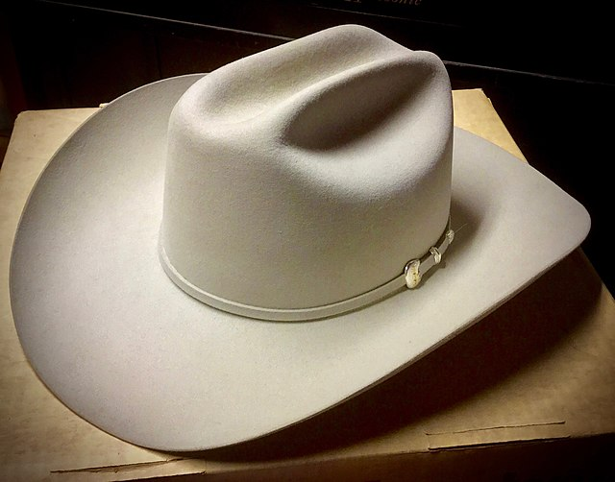
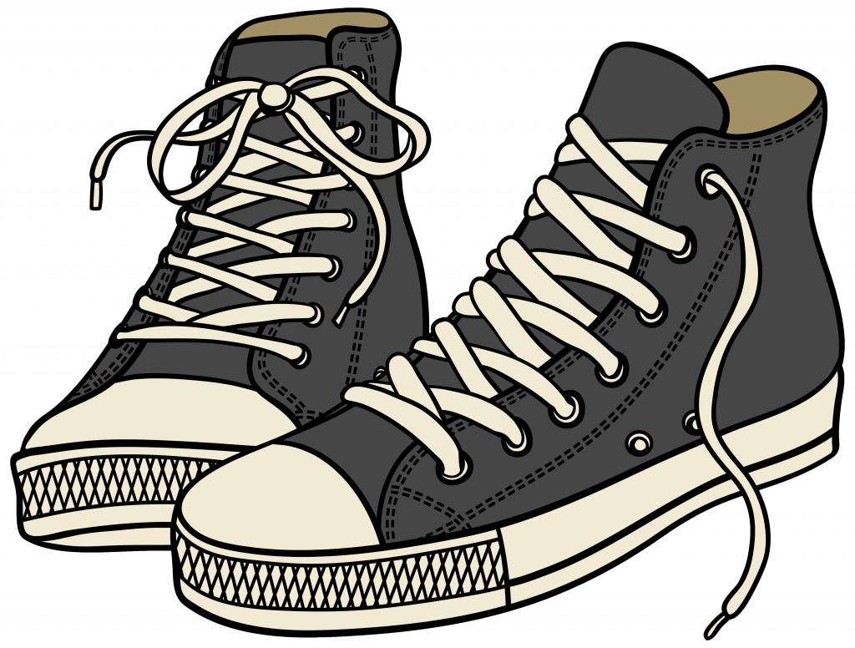
Hat is to head as shoes are to feet
Hat:Head
Shoes:Feet
Notes:
davidd. (2016). Stetson Sutter hat, early 21st century [Clip art]. Wikimedia Commons. https://commons.wikimedia.org/wiki/File:Stetson_Sutter_hat,_early_21st_century.jpg
Tennis Shoe Clipart [Clip art]. Pinclipart. https://www.pinclipart.com/pindetail/iTxhmwJ_tennis-shoe-clipart-shoes-clipart-transparent-background-png/

Slide 22
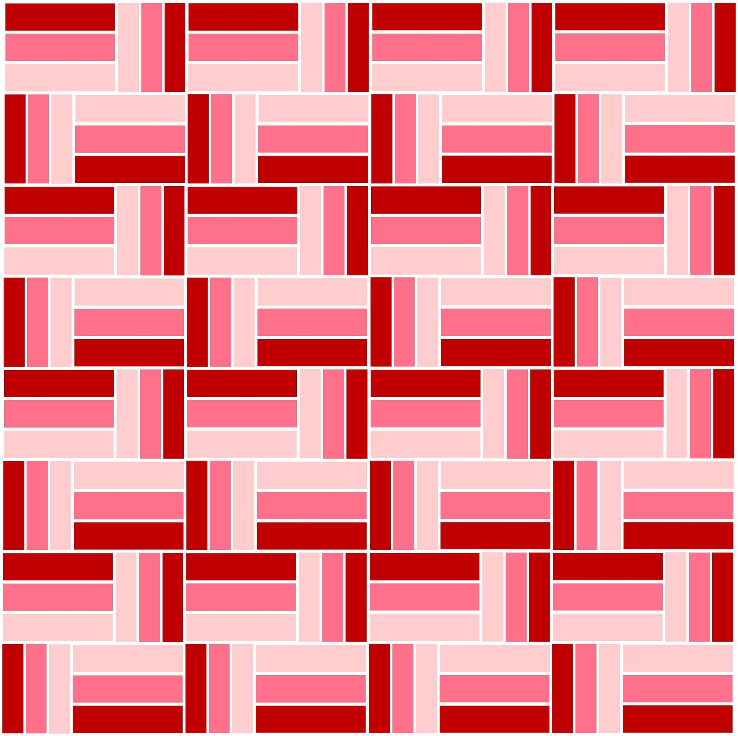
Gray is to black as pink is to red
Gray:Black
Pink:Red
Notes:
ageusantosdsg. (2017). pixabay. https://pixabay.com/photos/grey-black-the-backdrop-2377731/.
ZIPNON. (2016). pixabay. https://pixabay.com/illustrations/pink-red-burgundy-pattern-stripes-1317469/.

Slide 23
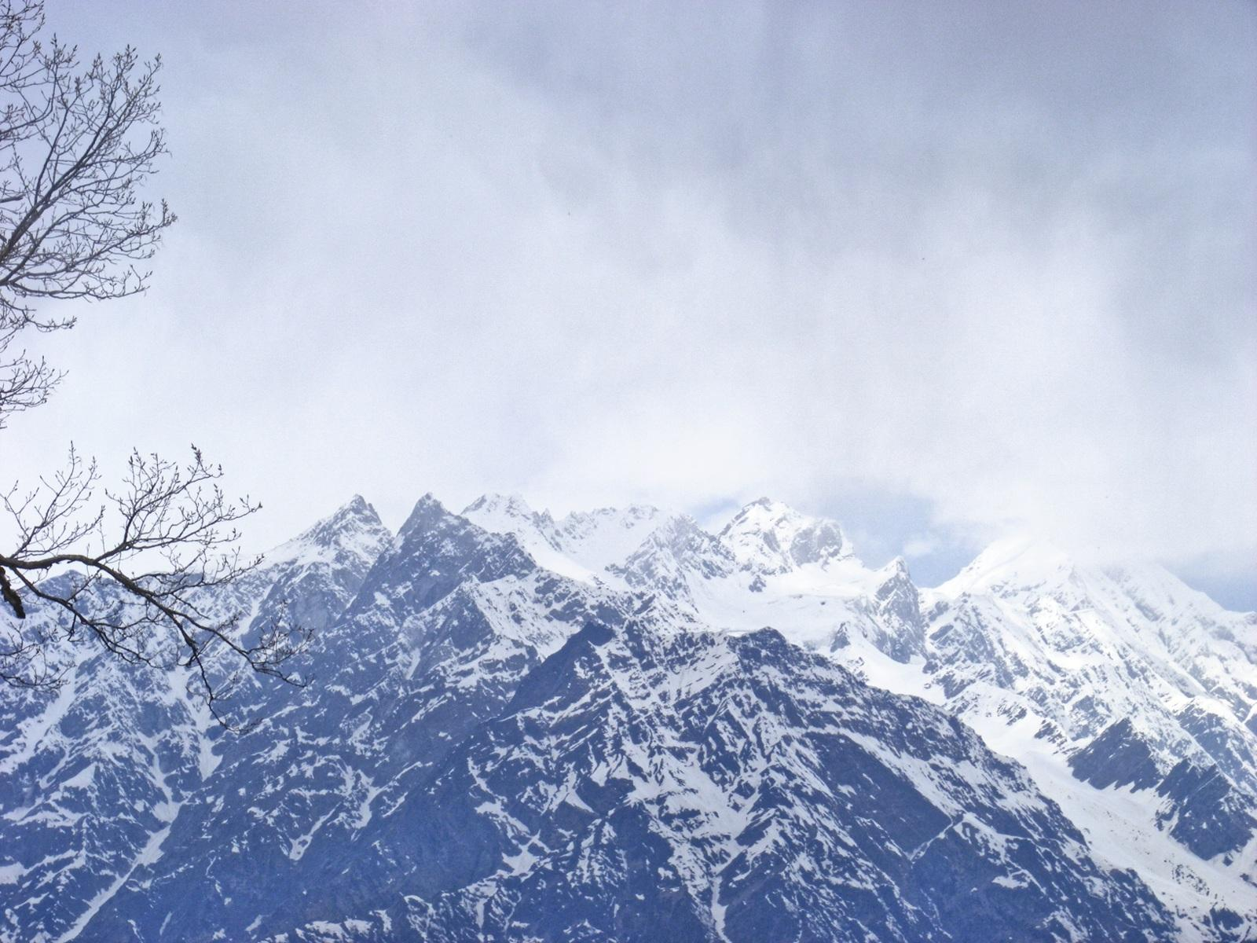
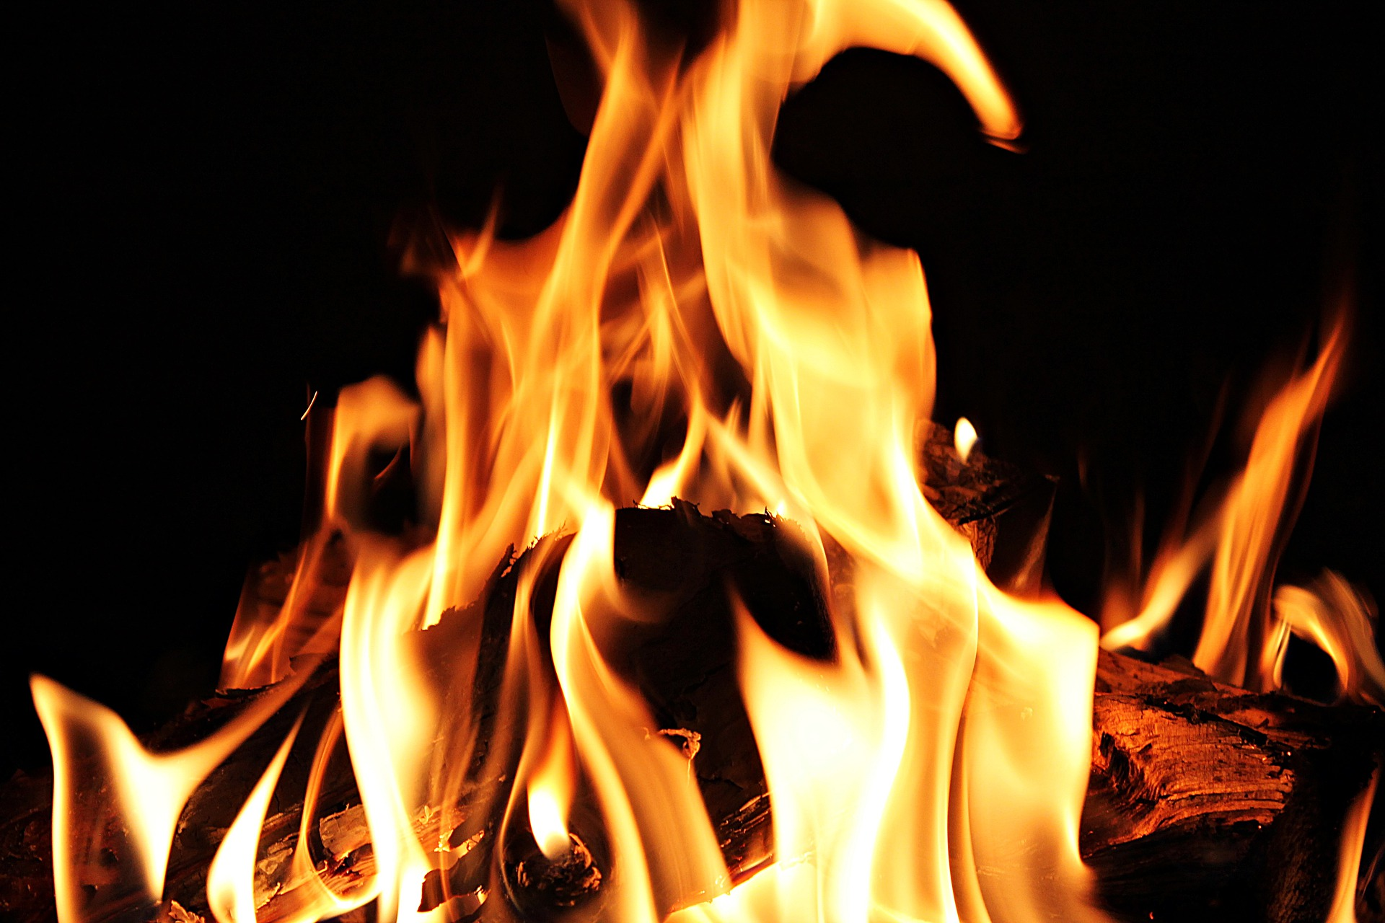
Cold is to cool as hot is to warm
Cold:Cool
Hot:Warm
Notes:
Singh, P. (2007). pixabay. https://pixabay.com/photos/fireplace-fire-open-fireplace-5865005/.

Slide 24
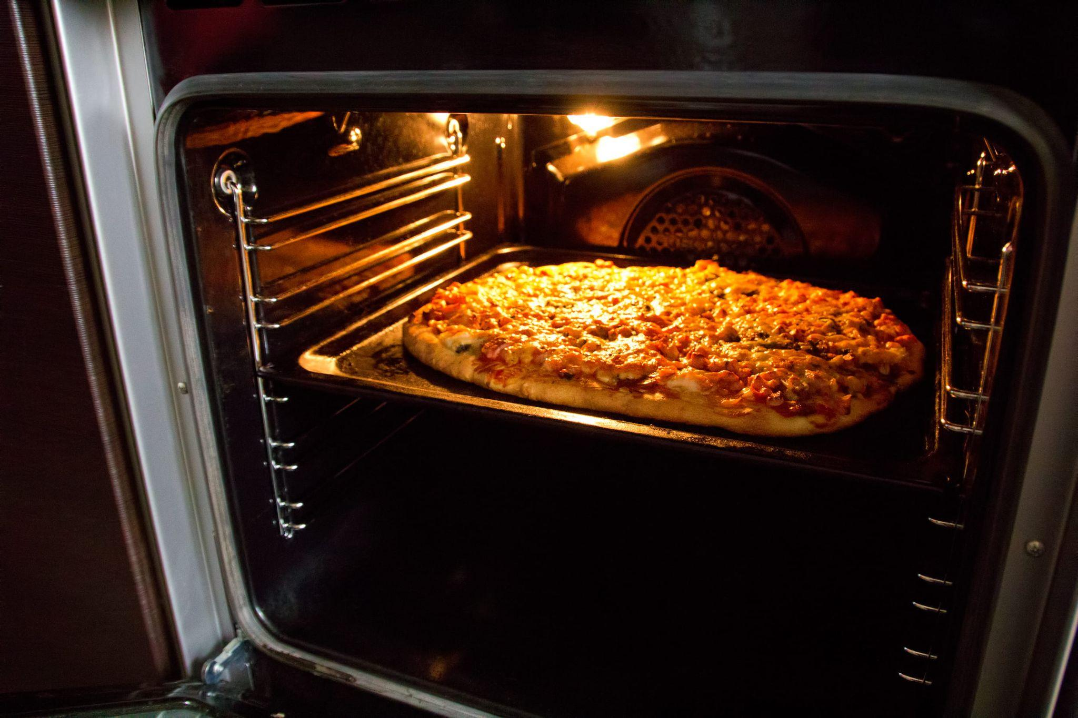
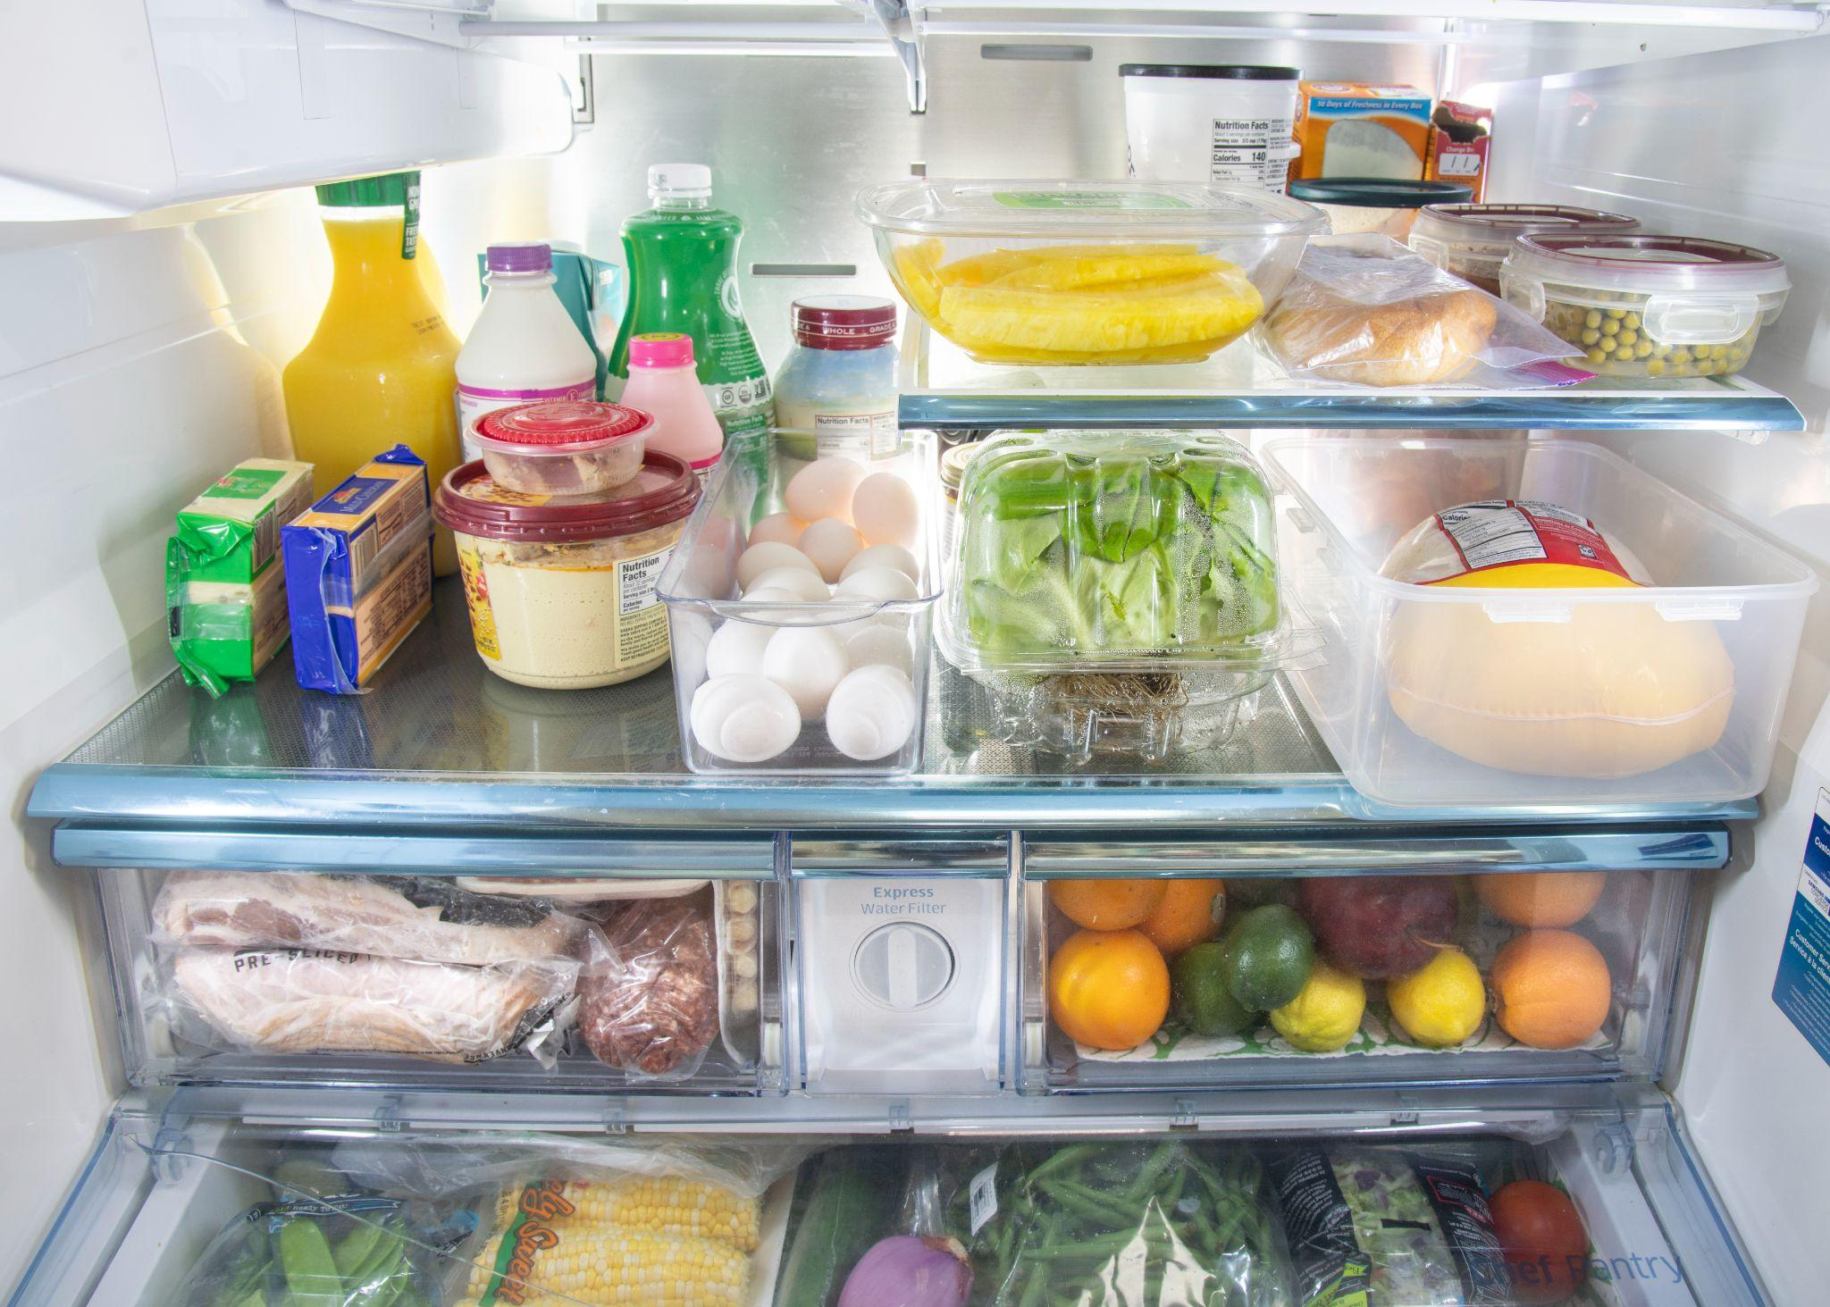
Oven is to hot as refrigerator is to cold
Oven:Hot
Refrigerator:Cold
Notes:
Modern-oven [Clip art]. (2020). Wikimedia Commons. https://commons.wikimedia.org/wiki/File:Modern-oven.jpg.
U.S. Department of Agriculture. (2020). 20200605-Fsis-Lsc-0059 [Clip art]. flickr. https://www.flickr.com/photos/usdagov/49975546052.

Slide 25
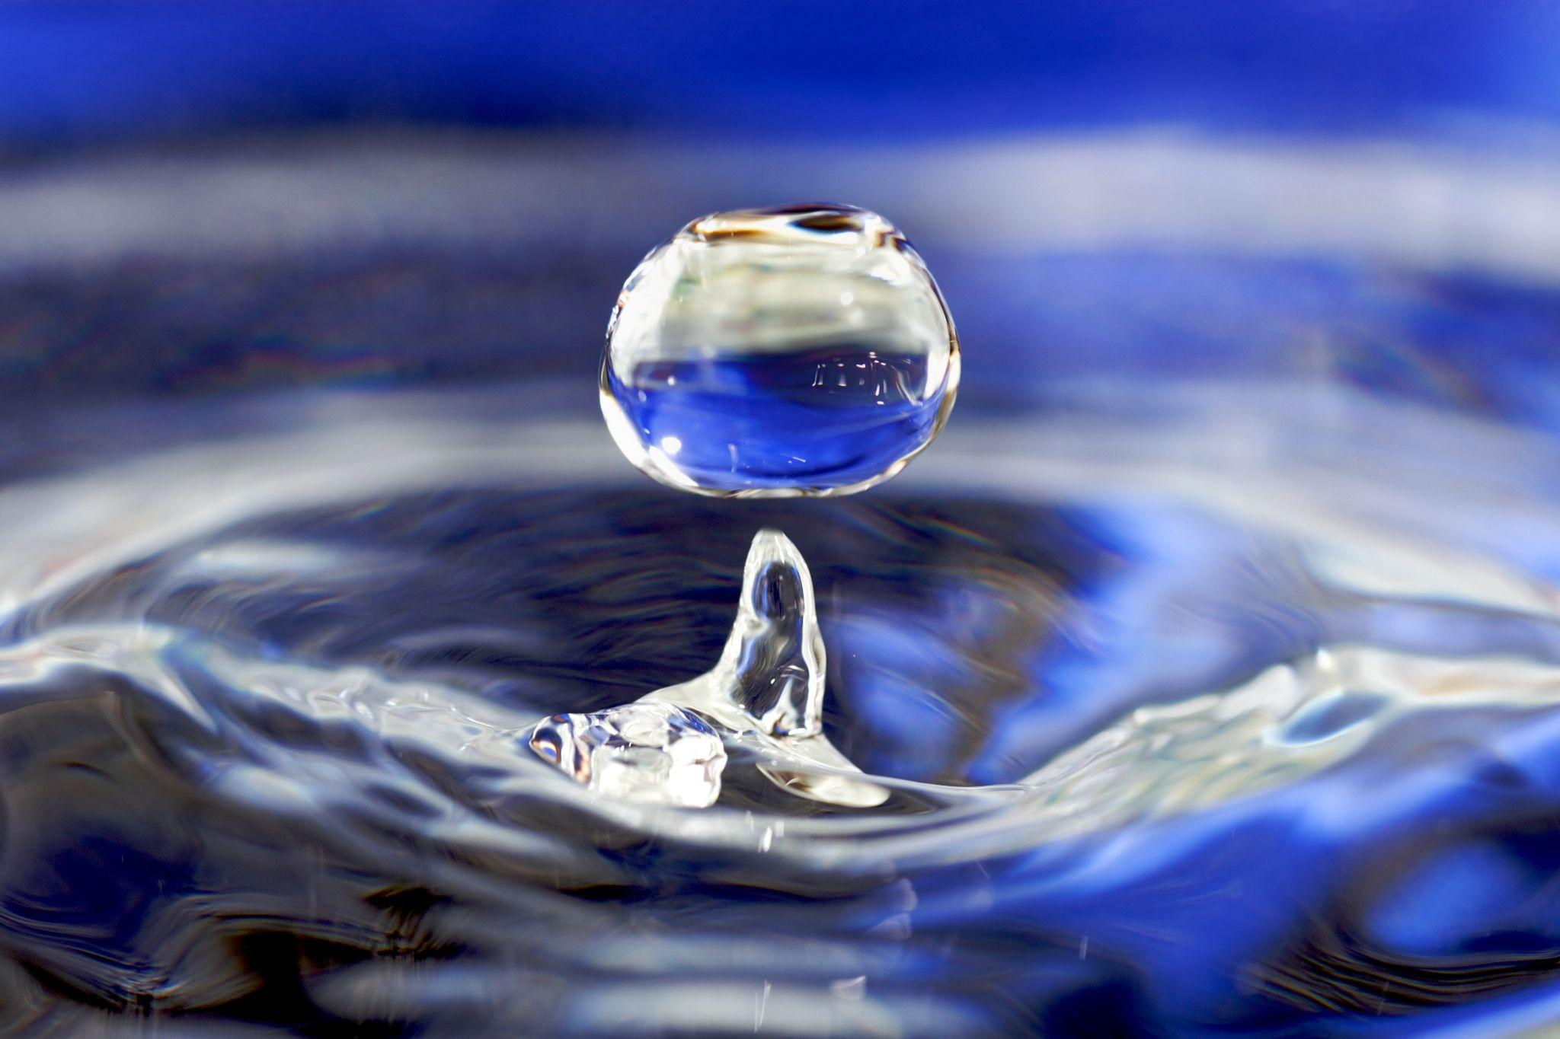
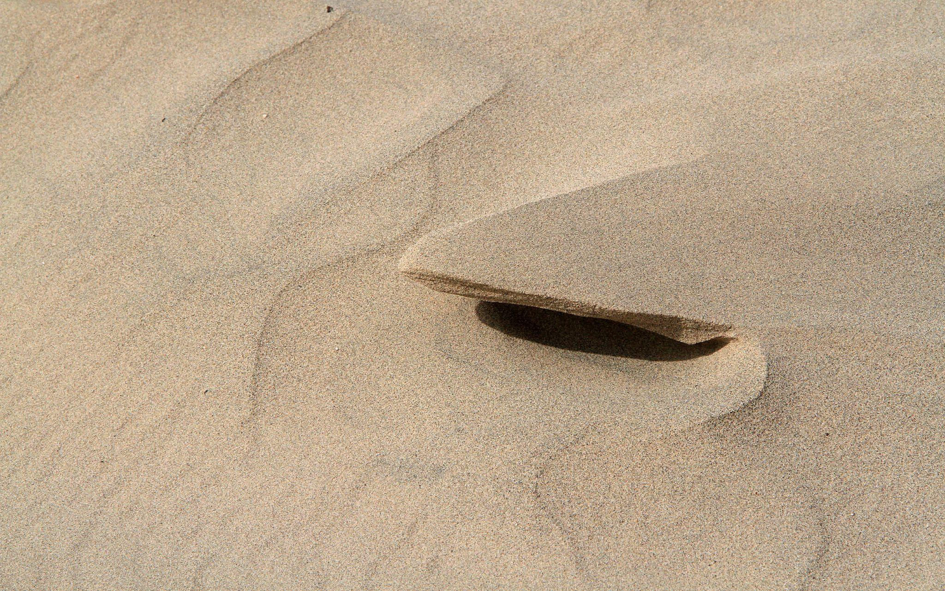
Wet is to water as dry is to sand
Wet:Water
Dry:Sand
Notes:
Suárez, J. M. (2008). Water drop 001 [Clip art]. Wikimedia Commons. https://commons.wikimedia.org/wiki/File:Water_drop_001.jpg.
arbyreed. (2020). Sand Shelf [Clip art]. flickr. https://www.flickr.com/photos/19779889@N00/50185911481.

Slide 26
Analogies
What did you notice about what the analogies had in common?

Slide 27
Anchor Chart
While we are making an anchor chart and discussing analogies, make sure you are taking notes.

Slide 28
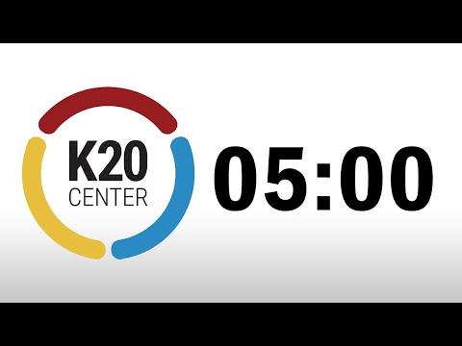
Your Turn!
Working in your small group, create as many analogies as you can come up with.
Notes:
K20 Center. (2021, September 21). K20 Center 5 minute timer [Video]. YouTube. https://youtu.be/EVS_yYQoLJg

Slide 29
Frayer Model
What do analogies do? | Example of an analogy
How might analogies be used outside of school? | What does the analogy mean?
Analogies

