Slide 2
Inflation Investigation
Inflation and Cost of Living

Slide 3
Essential Questions:
What is inflation? What impact has it had on the American economy over the past century?

Slide 4
Learning Objective:
Students will research and analyze the impact of inflation on the U.S. economy from 1920 until today.

Slide 5
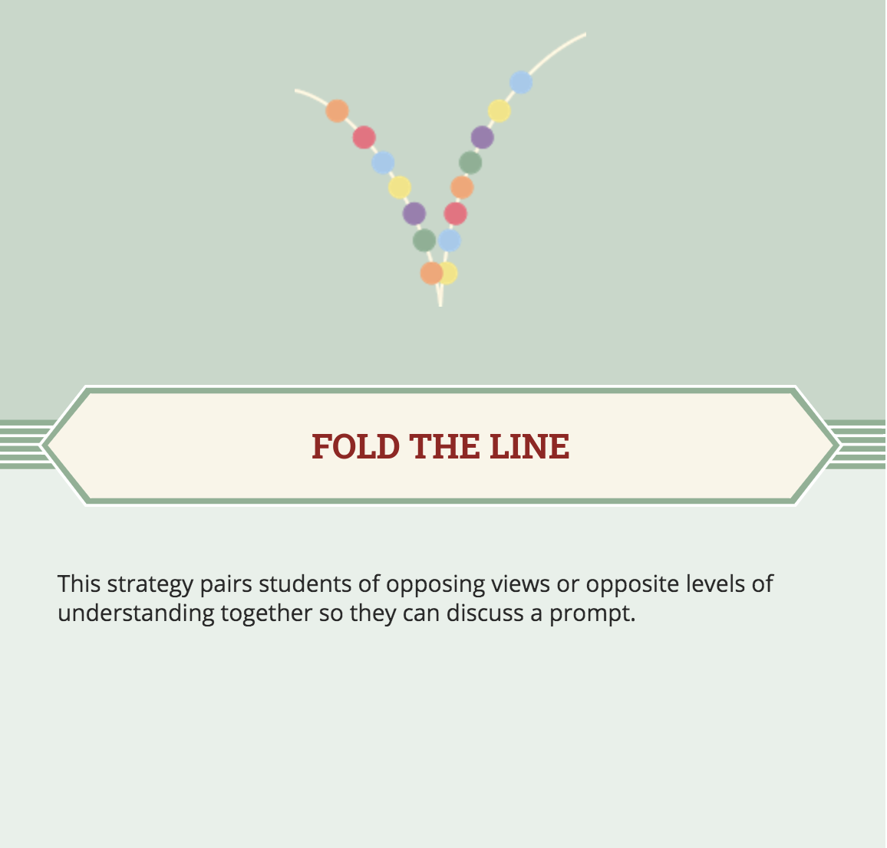
Fold the Line
How much do you think it would have cost to buy a car in 1940?
After you give your answers, you will line up in the order of value.

Slide 6
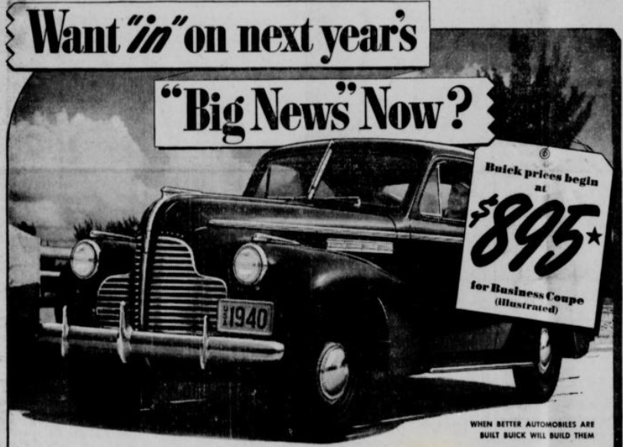
Notes:
Oklahoma Historical Society. (n.d.). The gateway to Oklahoma history. Sapulpa Herald, (1940, April 12), 8.

Slide 7
Value of the American Dollar
Research the purchasing power and value of the American dollar from 1920 until today.
Compare the costs of various goods.
Go through the vintage ad packets with your group.
Follow the directions below each ad, making sure to enter the correct value into the Cost of Goods chart.
Use your calculators if necessary.

Slide 8
COST OF GOODS: 1920 TO 2010
 | Cost of a New Home | Cost of a New Car | Cost of Milk | Cost of Pound of Coffee | Cost of 5-lb. Sack of Flour | Cost of Pound of Bacon
1920
1930
1940
1950
1960
1970
1980
1990
2000
2010

Slide 9
What Is Inflation?
As you view the video, write your responses in the handout provided.
https://oeta.pbslearningmedia.org/resource/mkqed-math-rp-inflation/understanding-inflation-stop-motion-explainer/

Slide 10
Why Is There Inflation? (And Is It Bad?)
As you view the video, write your responses in the handout provided.
https://oeta.pbslearningmedia.org/resource/mkqed-math-rp-inflation/understanding-inflation-stop-motion-explainer/

Slide 11

Anchor Charts
Create an anchor chart with your group. The following elements are required:
1. A definition of inflation that is easy for students to understand.
2. An explanation of the impact of inflation on consumers.
3. An explanation of the impact of inflation on the US economy.
4. 3 pictures or diagrams that support your information.
Choose one of the optional elements to include:
1. Causes of inflation.
2. The effects of inflation on prices over time.
3. Definitions of credit and interest rate.
Your anchor chart should be neatly organized with all words spelled correctly.

Slide 12
Gallery Walk
Next you will view and provide feedback on the created anchor charts.
Choose one group member to stay by your group’s anchor chart. That person will present the information to the other students.
All other students will rotate to each anchor chart and listen to each presentation.
After hearing the presentation, write one question or comment on a sticky note about the anchor chart and attach it to the chart.
Continue this process until you have viewed all anchor charts.

