Slide 2
Femme Fatales:
The Landlady and Mrs. Maloney
Character Analysis Across Multiple Texts

Slide 3
Essential Question
What is gained and missed by making assumptions?
How do assumptions influence our perceptions of individuals?

Slide 4
Learning Objectives
Draw inferences about characters and character development by evaluating multiple texts by same author.
Determine how authors effectively use literary devices such as irony to create meaning across texts.

Slide 5
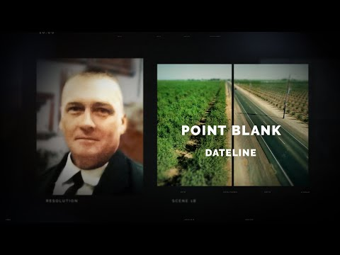
Point Blank
Notes:
(2020). YouTube. https://youtu.be/VioMHyk9fts.

Slide 6

Honeycomb Harvest
Each hexagon has one of the following on it:
  Character name
  Characteristics
With your group, organize the hexagons into groups to determine their relationships and how they all connect with each other.
Notes:
https://learn.k20center.ou.edu/strategy/61

Slide 7






Example Honeycomb Harvest
e
food
d
B
a
b
D
c
apple
f
F
C
Egg-
plant
banana
E
cookie
donut
A
Notes:
https://pixabay.com/illustrations/teacher-apple-school-elementary-1202735/
https://pixabay.com/vectors/banana-bunch-fruit-food-bananas-25339/
https://pixabay.com/vectors/cookie-dessert-snack-biscuits-6035822/
https://pixabay.com/vectors/donut-snack-dessert-sweet-sugary-5985274/
https://pixabay.com/vectors/aubergine-egg-plant-food-greens-1298730/
https://pixabay.com/vectors/vegetables-fruits-food-artichoke-155616/

Slide 8
Egg-
plant
cookie
A
E
c
apple
e
C
a
donut
D
d
banana
f
B
F
b
food

Slide 9
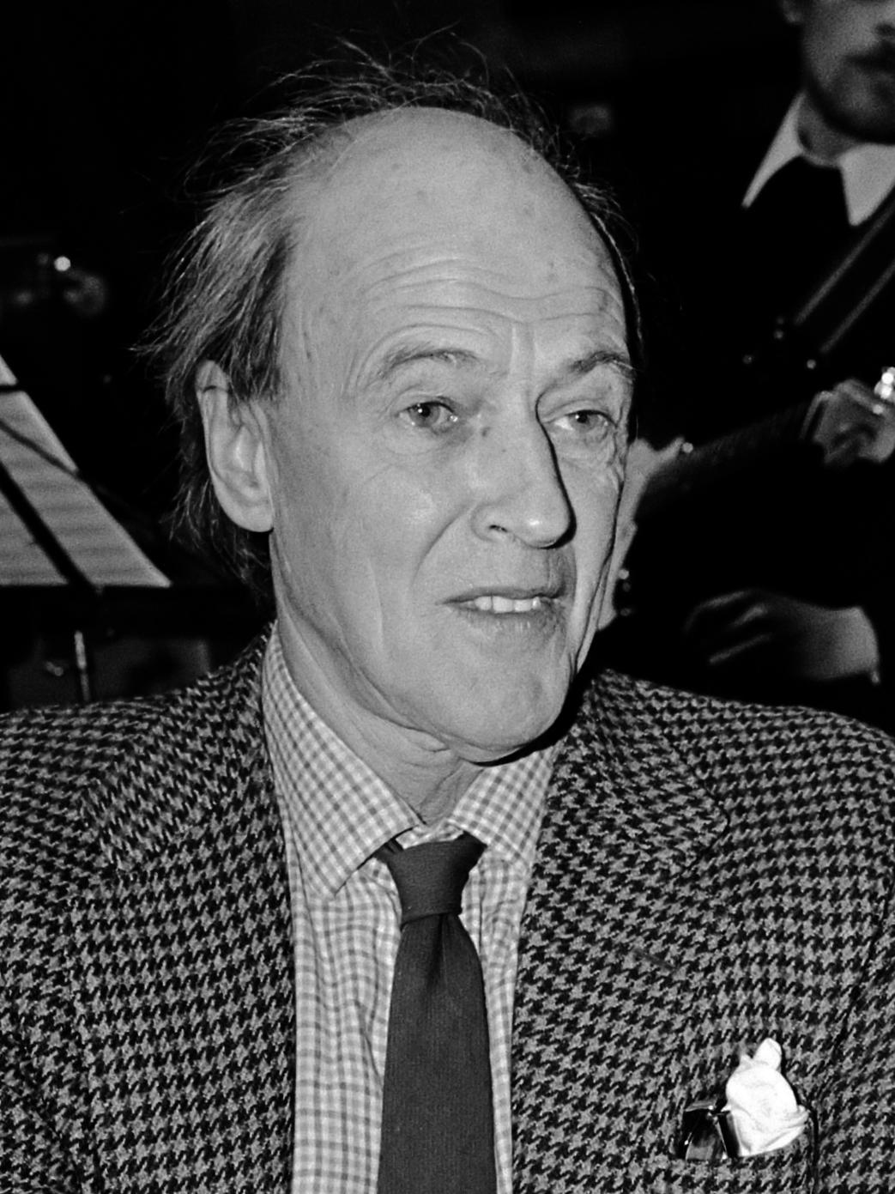
Roald Dahl
Born in Wales;
Fought in WWII as a fighter pilot in the Royal Air Force;
When his 4-month old son suffered from hydrocephalus after being hit by a taxi, Dahl became involved in developing the WDT valve which helps alleviate the condition;
Wrote Charlie and the Chocolate Factory, James and the Giant Peach, The BFG, and Matilda.
Notes:
Hans van Dijk. (2014). Roald Dahl (1982). https://commons.wikimedia.org/wiki/File:Roald_Dahl_(1982).jpg.

Slide 10

The Landlady
Published on November 28, 1959;
As you are reading, find at least five quotations you want to analyze.
Consider the following:
  What does the text actually say?
  What does the text mean?
  What does the text reveal about the characters?
  Example:
    Says: “He had never been to Bath before. He didn’t know anyone who lived there.”
    Means?
    Reveals?
Notes:
The Linville River Farm Bed and Breakfast, No Longer in Operation. (n.d.). https://www.commonlit.org/en/texts/the-landlady.

Slide 11
Honeycomb Harvest - Revisit
Revisit your Honeycomb Harvest.
Explain your reasons for the way you arranged your honeycomb on sticky notes.
Add your own characteristics or evidence to the Harvest.
Notes:
https://learn.k20center.ou.edu/strategy/61

Slide 12
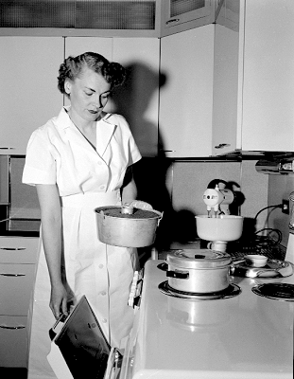
Lamb to the Slaughter
Published September 1953;
As you are reading, find at least 5 quotations you want to analyze.
Consider the following:
  What does the text actually say?
  What does the text mean?
  What does the text reveal about the characters?
  Example:
    Says: “He now became absolutely motionless, and he kept his head down so that the light from the lamp beside him fell across the upper part of his face, leaving the chin and mouth in shadow.”
    Means?
    Reveals?
Notes:
Seattle Municipal Archives. (2013). Home Economics Instructor. https://en.wikipedia.org/wiki/Home_economics#/media/File:Home_ec_mary_norris_seattle.gif.

Slide 13
Dateline Interview
Find a partner.
Based on information from the two short stories, complete the following:
  Write interview questions that an interviewer might ask an imaginary neighbor, a close friend of the Landlady or Mary Maloney, or even one of the other characters from the story if they were writing a news story about the experience.
  Write the answers the interviewee might provide.
    What are some characteristics of the Landlady or Mary Maloney?
    How would the Landlady or Mary Maloney be described?
Decide who will play the roles of the interviewer and the interviewee.

Slide 14
Dateline Interview
Using the questions and answers you have brainstormed:
  Create a video with your partner in front of your green screen;
  Take a few pictures that will help you tell your story;
    Take some pictures in front of the green screen;
    Take some without the green screen;
    Use the internet to find some additional ones if you need them.
Be creative and have fun!

Slide 15

Getting to Know Green Screen by Do Ink
How well do you know the Do Ink app?
With your partner, use the provided Scavenger Hunt to identify and explore key features of the application.
As you work through the list, upload the videos and pictures you took into Do Ink.
Notes:
Do Ink. http://www.doink.com/

Slide 16
Step into the Production Room
Using your digital storytelling experience from Do Ink:
Open iMovie.
Choose “New Project.”
Import your media from Do Ink into iMovie.
Record a script. Use your storyboard template as an outline and guide.
Add effects and background sound.
Export to your camera roll to share it with an audience.
Ask questions as needed!

Slide 17
Audience, take your seats!
Show and explain your collaboration and production.

Slide 18
Venn Diagram
Similar characteristics of the Landlady and Mary Maloney
LANDLADY
MARY MALONEY
Unique characteristics of the Landlady
Unique characteristics of Mary Maloney

Slide 19

Quick Write
How does the author use multiple texts to convey the same message?
What characteristics from the Honeycomb Harvest do you see in these characters?
  Provide evidence from the text to support your answer.
  Use your Says/Means/Reveals chart to support your answer.
Notes:
https://learn.k20center.ou.edu/strategy/1127

