Slide 2
Electric Avenue
What Is a Wave? Lesson 4

Slide 3
Essential Questions
What are waves?
How do waves behave differently from particles?

Slide 4
Lesson Objectives
Explain that light has wave properties and is part of a bigger phenomenon called electromagnetic radiation.
Explain the main features of the EM spectrum.

Slide 5

Puzzled
With your group:
Assemble the pictures.
Summarize what each picture represents.

Slide 6

Puzzled

Slide 7

Puzzled

Slide 8

Puzzled

Slide 9
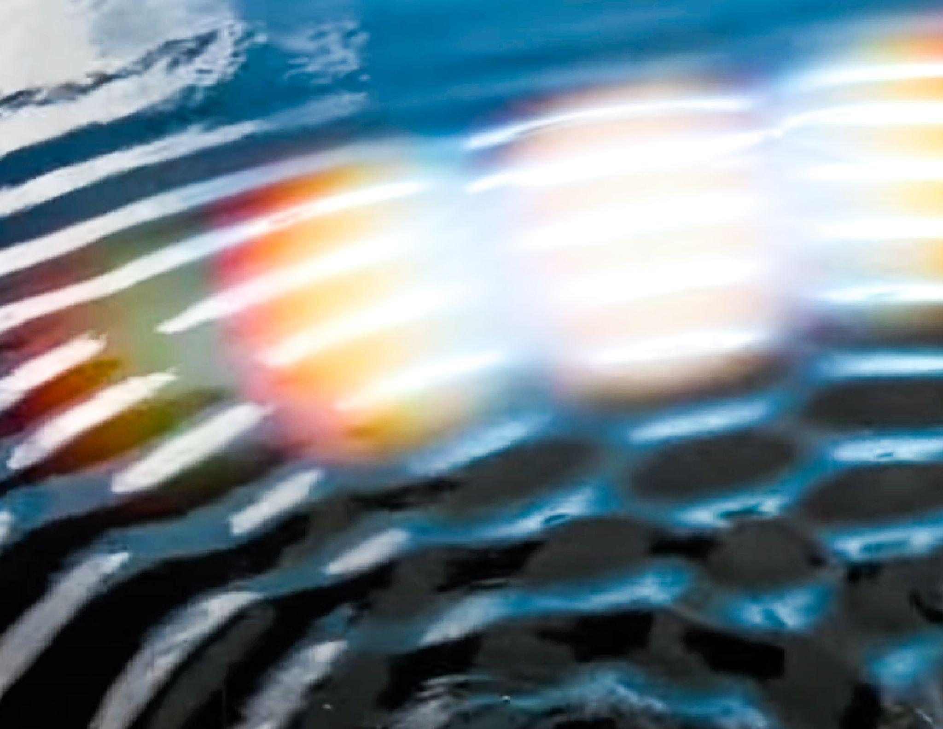
Puzzled

Slide 10
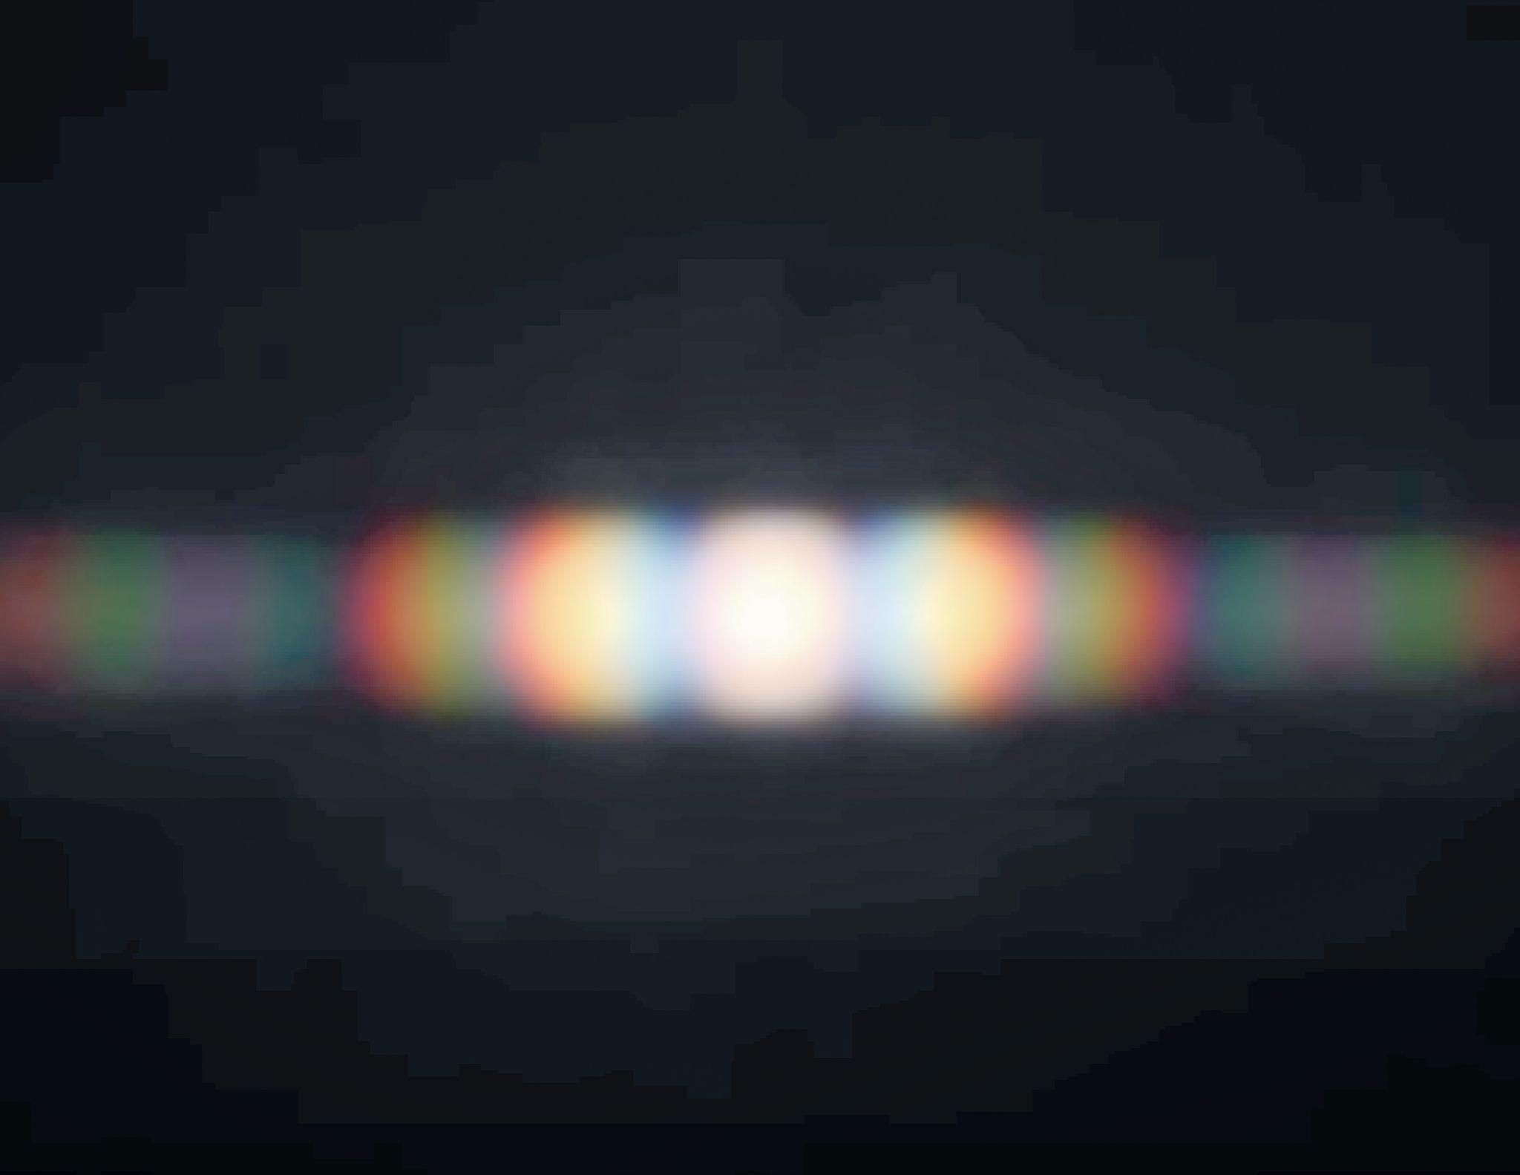
Puzzled

Slide 11

Painting a Picture
View the images that are related to electromagnetic (EM) waves.
In the chart provided, include the following:
  Observations
  Inferences
  Explanation

Slide 12
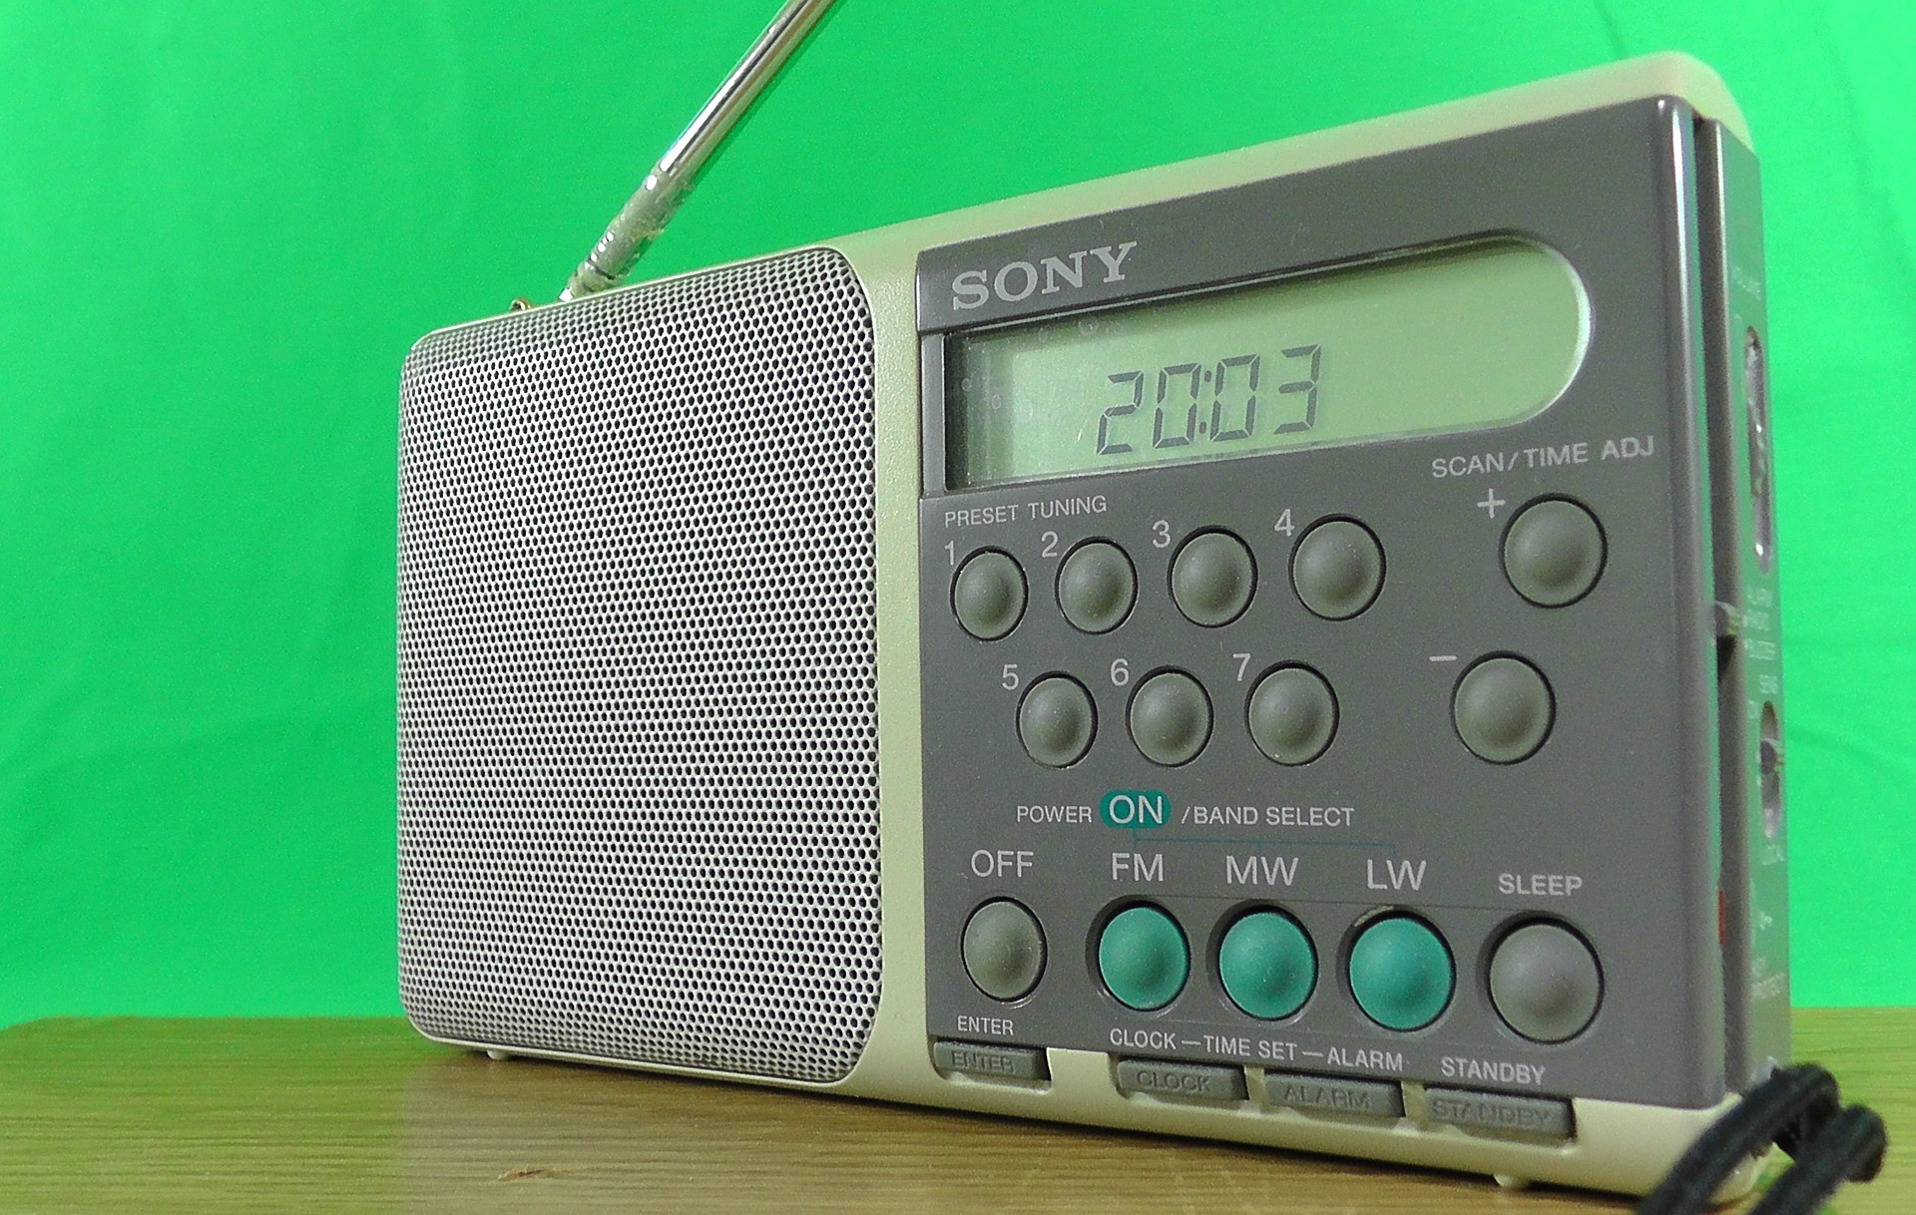
Radio Waves
Frequency Range (Hz)
< 3*10¹¹
Wavelength Range
> 1 mm
Notes:
dansamu. (2016). Radio small green background [Image]. Pixabay. https://pixabay.com/photos/radio-small-green-background-1339186/

Slide 13
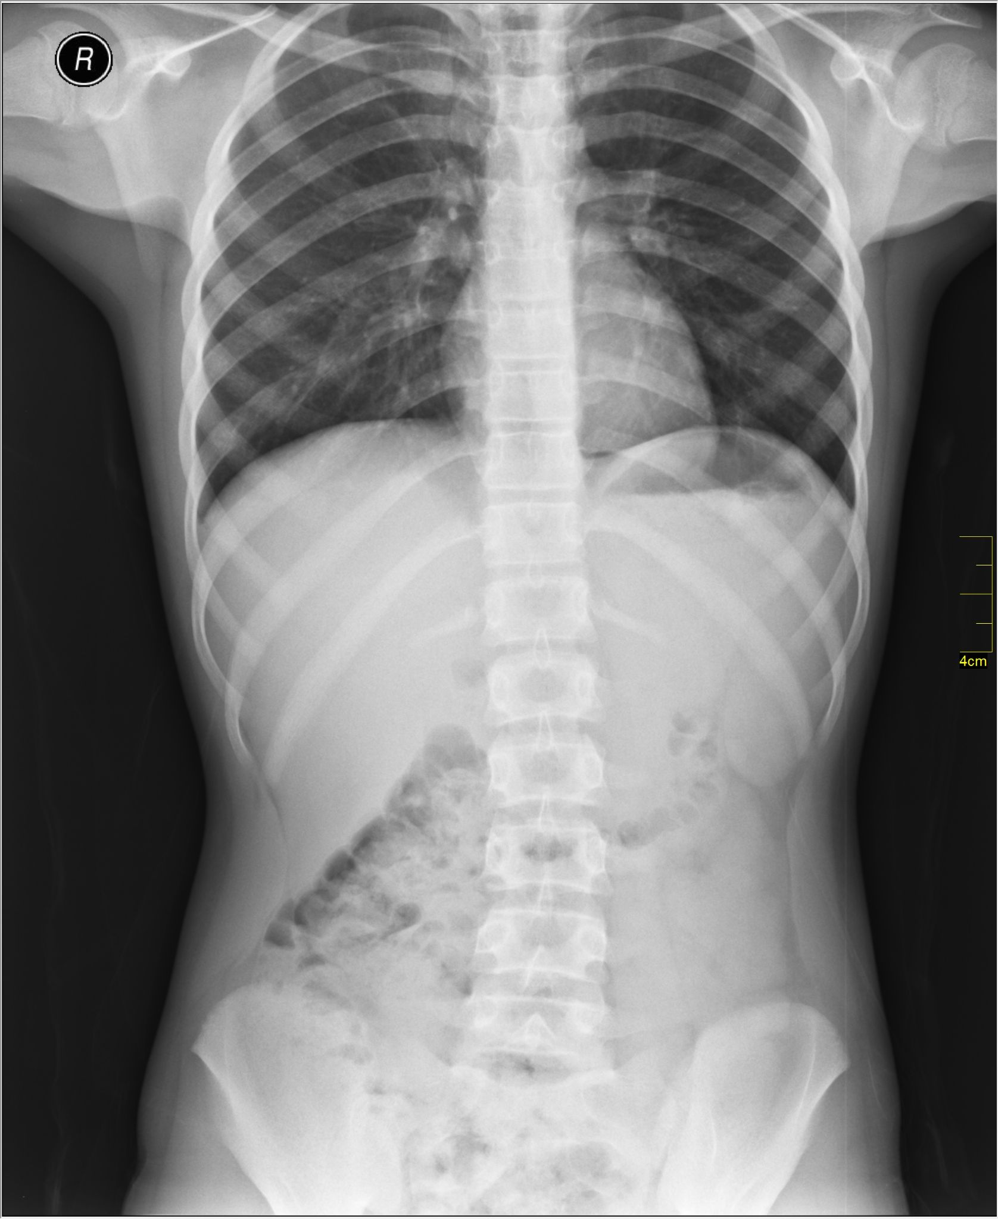
X-Rays
Frequency Range (Hz)
10¹⁷ - 10²⁰
Wavelength Range
1 nm - 1 pm
Notes:
Dilmen, N. (2011). Medical X-ray [Image]. Wikimedia Commons. https://commons.wikimedia.org/wiki/File:Medical_X-Ray_imaging_TOW07_nevit.jpg

Slide 14
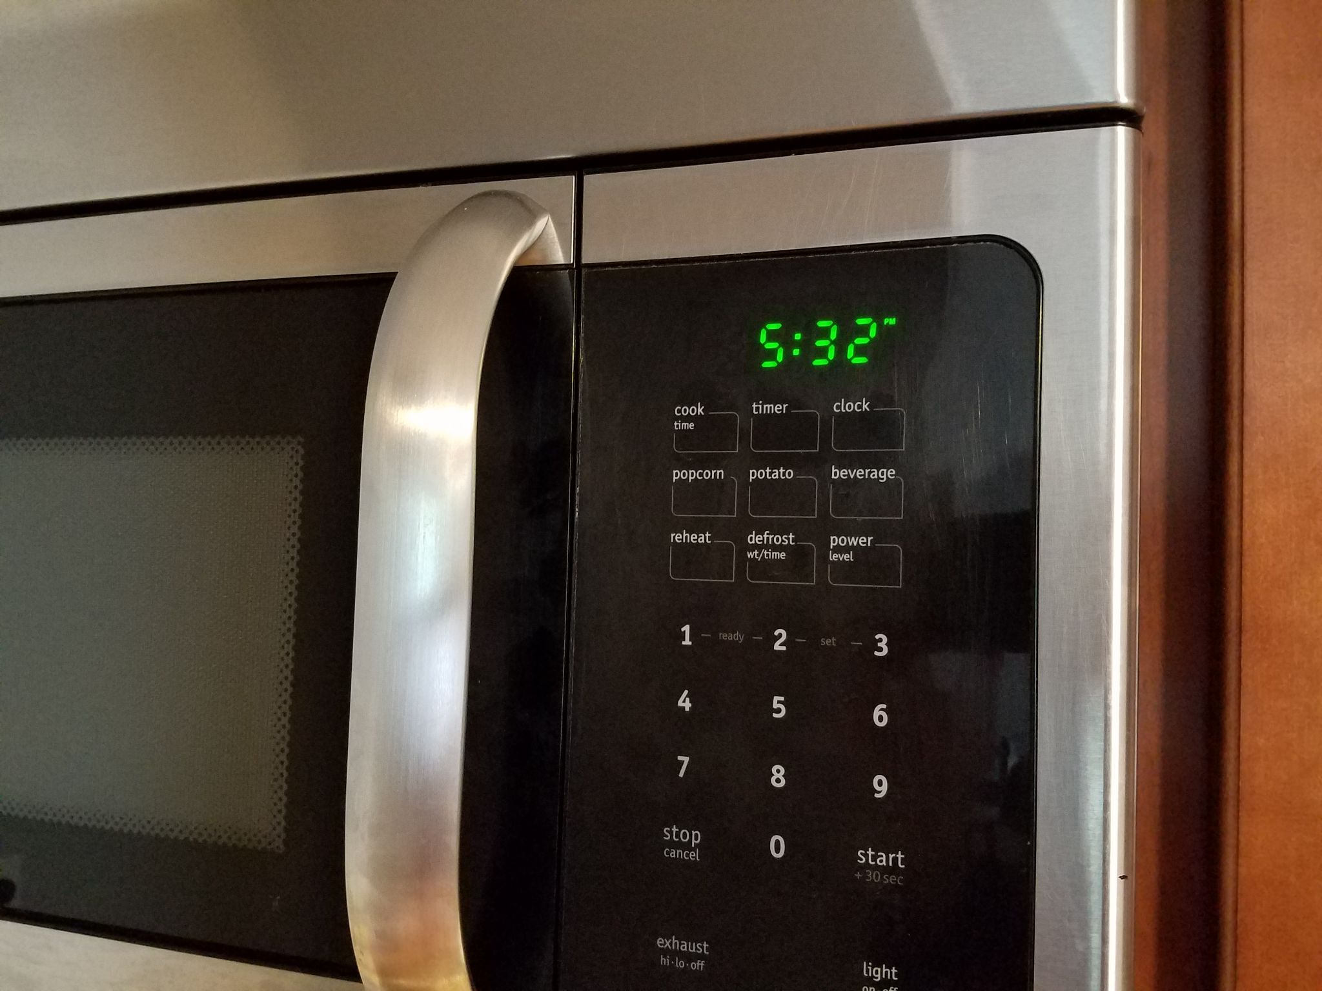
Microwaves
Frequency Range (Hz)
3*10¹¹ - 10¹³
Wavelength Range
1 mm - 25 μm
Notes:
ECTran71. (2020). Frigidaire microwave clock [Image]. Wikimedia Commons. https://commons.wikimedia.org/wiki/File:Frigidaire_microwave_clock_20200418.jpg

Slide 15
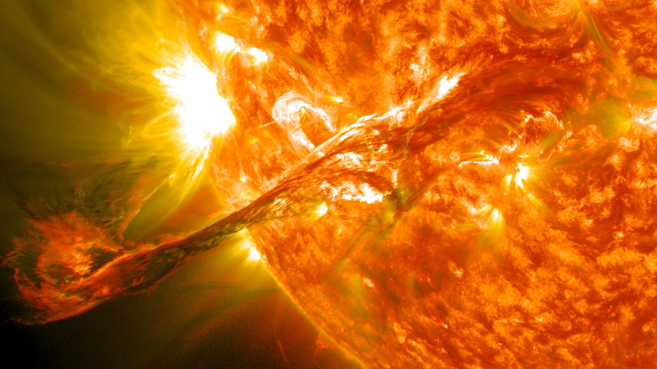
Solar Rays
Frequency Range (Hz)
10¹³ - 10¹⁴
Wavelength Range
25 μm - 2.5 μm
Notes:
NASA Goddard Space Flight Center. (2012). Magnificent cme erupts on the Sun [Image]. Wikimedia Commons. https://commons.wikimedia.org/wiki/File:Magnificent_CME_Erupts_on_the_Sun_-_August_31.jpg

Slide 16
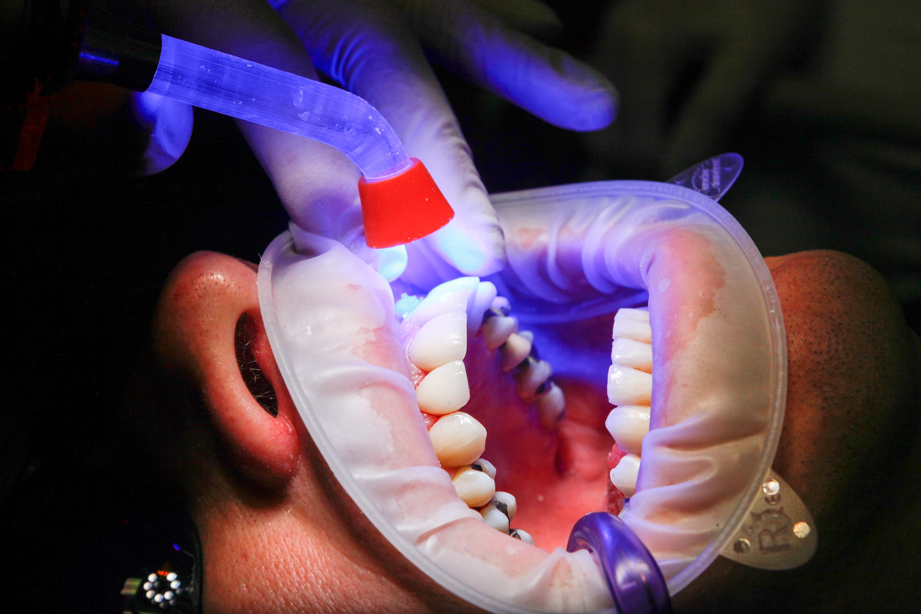
UV Light
Frequency Range (Hz)
10¹⁵ - 10¹⁷
Wavelength Range
400 nm - 1 nm
Notes:
ales_kartal. (2016). UV light curing [Image]. Pixabay. https://pixabay.com/photos/dentist-facet-uv-light-curing-1864921/

Slide 17

Notes:
Best0fScience. (2010, August 1). The electromagnetic spectrum [Video]. YouTube. https://www.youtube.com/watch?v=cfXzwh3KadE

Slide 18
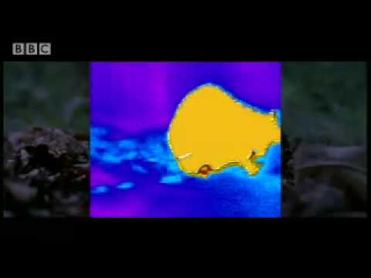
Notes:
BBC Studios. (2008, November 24). Heat sensing pit vipers - deadly vipers - BBC animals [Video]. YouTube. https://www.youtube.com/watch?v=lySW2-eYilg

Slide 19

Cornell Notes
Source of electromagnetic waves is emission by energized electrons in atoms that make up ALL matter. This is how atoms discard excess energy. Different electron energies produce electromagnetic (EM) waves with different frequencies.

Slide 20
Cornell Notes
Electromagnetic (EM) waves are a vibration that travels through electric and magnetic energy fields, which are present everywhere in the universe. These energy fields are the medium for EM waves.

Slide 21
Cornell Notes
EM waves travel at c through the vacuum of space or close to c through matter.
c = speed of light = 3 x 10⁸ m/s

Slide 22
Cornell Notes
EM waves with the lowest energy have the longest wavelength and smallest frequency. As the energy of EM waves increases, their wavelength gets shorter and their frequency increases.

Slide 23
Cornell Notes
Radio waves, microwaves, infrared radiation, visible light, ultraviolet light, x-rays, and gamma rays are all part of the electromagnetic spectrum. We detect heat through our skin and visible light through our eyes.

Slide 24
Cornell Notes
The color of visible light is directly related to its frequency, which is directly related to its energy. Red light has the lowest energy (even though we feel infrared as “heat”), and violet light has the highest energy.

Slide 25
Cornell Notes
At the bottom of your notes page, summarize the ideas into one or two sentences.

Slide 26
Cornell Notes
Review your notes and summaries with a partner.
What are the key concepts?
Update your summary based on the discussion.

Slide 27
Electromagnetic Spectrum Charts
In your charts include each of the following:
Definition of electromagnetic waves
Number line with wavelengths and frequencies included
Illustrations of the different uses for electromagnetic waves
The names of the electromagnetic bands
A light spectrum

