Slide 2
New Direction
What Is a Wave? Lesson 5

Slide 3
Essential Questions
What are waves?
How do waves behave differently from particles?

Slide 4
Lesson Objectives
Explain how different types of matter interact with electromagnetic waves.

Slide 5

Strike Out!
In your small group, generate a list of key ideas or themes from the last two lessons on waves.
Pass your list to another group.
Strike the least important idea from the list you are reviewing.
Return lists to original groups.
Reclaim one concept that was stricken from your list.
Notes:
https://learn.k20center.ou.edu/strategy/136

Slide 6
Strike Out!
Combine your lists of important ideas and themes;
Add these to the Strike Out! Board created in Lesson 2.
Notes:
https://learn.k20center.ou.edu/strategy/136

Slide 7

Driving Question Board
Are there any questions on the Driving Question Board that we can answer right now?
Are there any questions we can add to the Driving Question Board at this point?
Notes:
https://learn.k20center.ou.edu/strategy/1511

Slide 8

C.E.R.T.I.fy Your Thinking
On your handout, write your claim for the following question:
  How does adding water to the glass affect the way you see the pencil?
Consider all that you have learned about waves so far, what evidence do you have to support your claim?
Provide a reasoning for your claim and evidence.
Notes:
https://learn.k20center.ou.edu/strategy/827

Slide 9
Water/Pencil Demonstration

Slide 10
C.E.R.T.I.fy Your Thinking
Watch the water/pencil demonstration.
Do you still agree with your original claim?
Explain why or why not, using evidence from the demonstration.
Notes:
https://learn.k20center.ou.edu/strategy/827

Slide 11
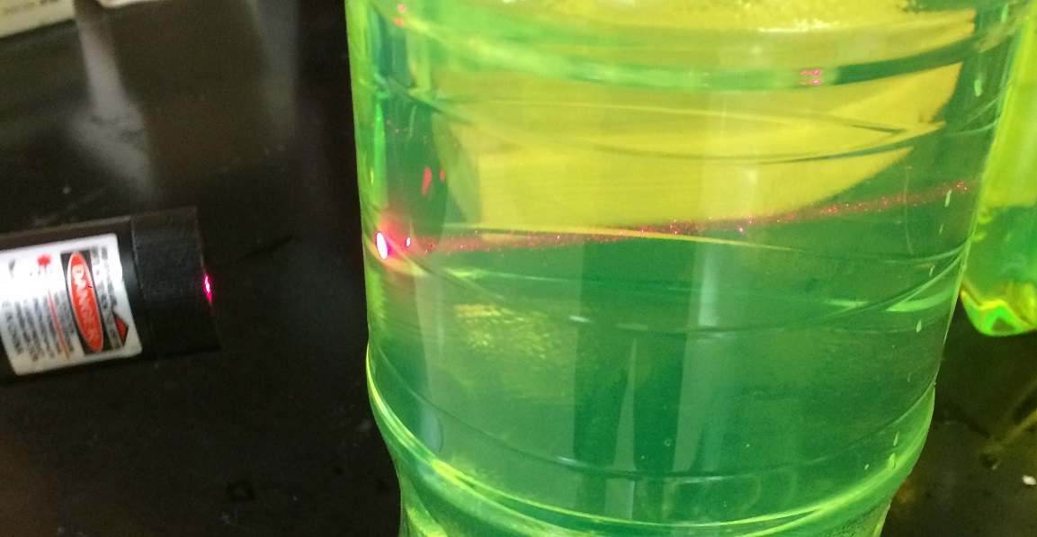
What happens when the laser beam enters the water?

Slide 12
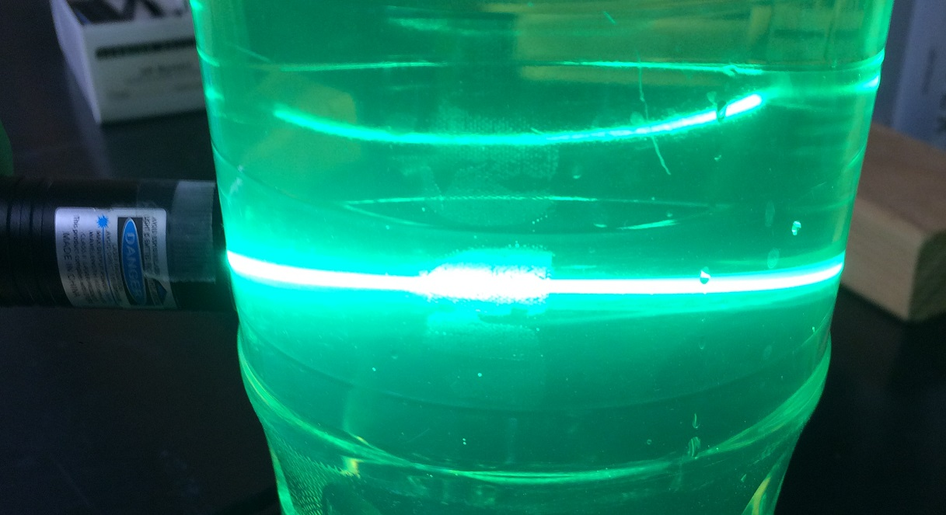
What happens when the laser beam enters the water?

Slide 13
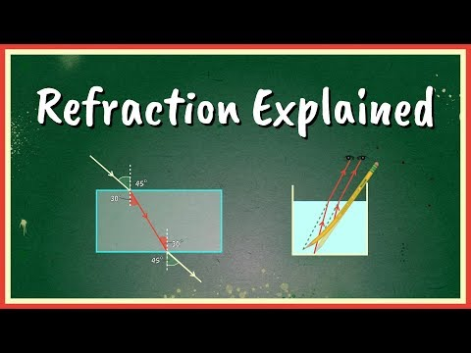
Notes:
Science Sauce. (2019, Oct 29). Refraction explained. [Video]. YouTube. https://youtu.be/zarxpu43-ls.

Slide 14
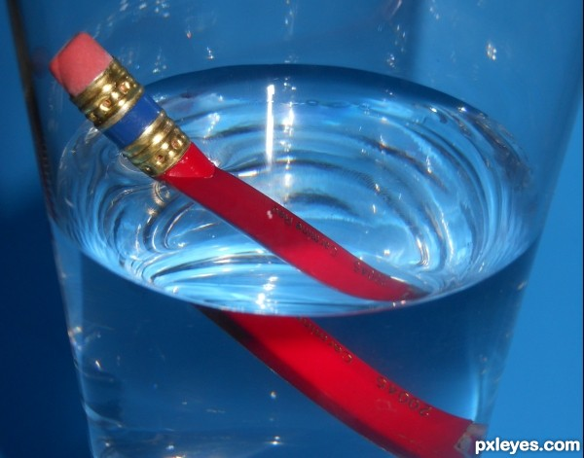
Refraction
The fact or phenomenon of light, radio waves, etc. being deflected when they pass obliquely through the interface between one medium and another through a medium of varying density.
Notes:
Pxleyes.com (n.d.). Light refraction. [Digital Image]. http://www.pxleyes.com/photography-picture/500ab33be9af2/Light-refraction.html

Slide 15
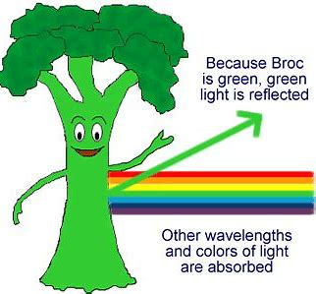
Absorption
The process or action by which one thing soaks up or blots out another.
Notes:
North Carolina State University. (n.d.). Adventures of the agronauts. [Digital Image]. https://projects.ncsu.edu/project/agronauts/mission4_6.htm

Slide 16
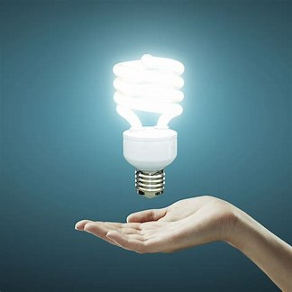
Emission
Something that has been emitted, released, or discharged.
Notes:
Fehrmann. (n.d.) The fluorescent lamp.. [Digital Image]. https://fehrmann.com.br/site/noticias/detalhes/a-lampada-fluorescente

Slide 17
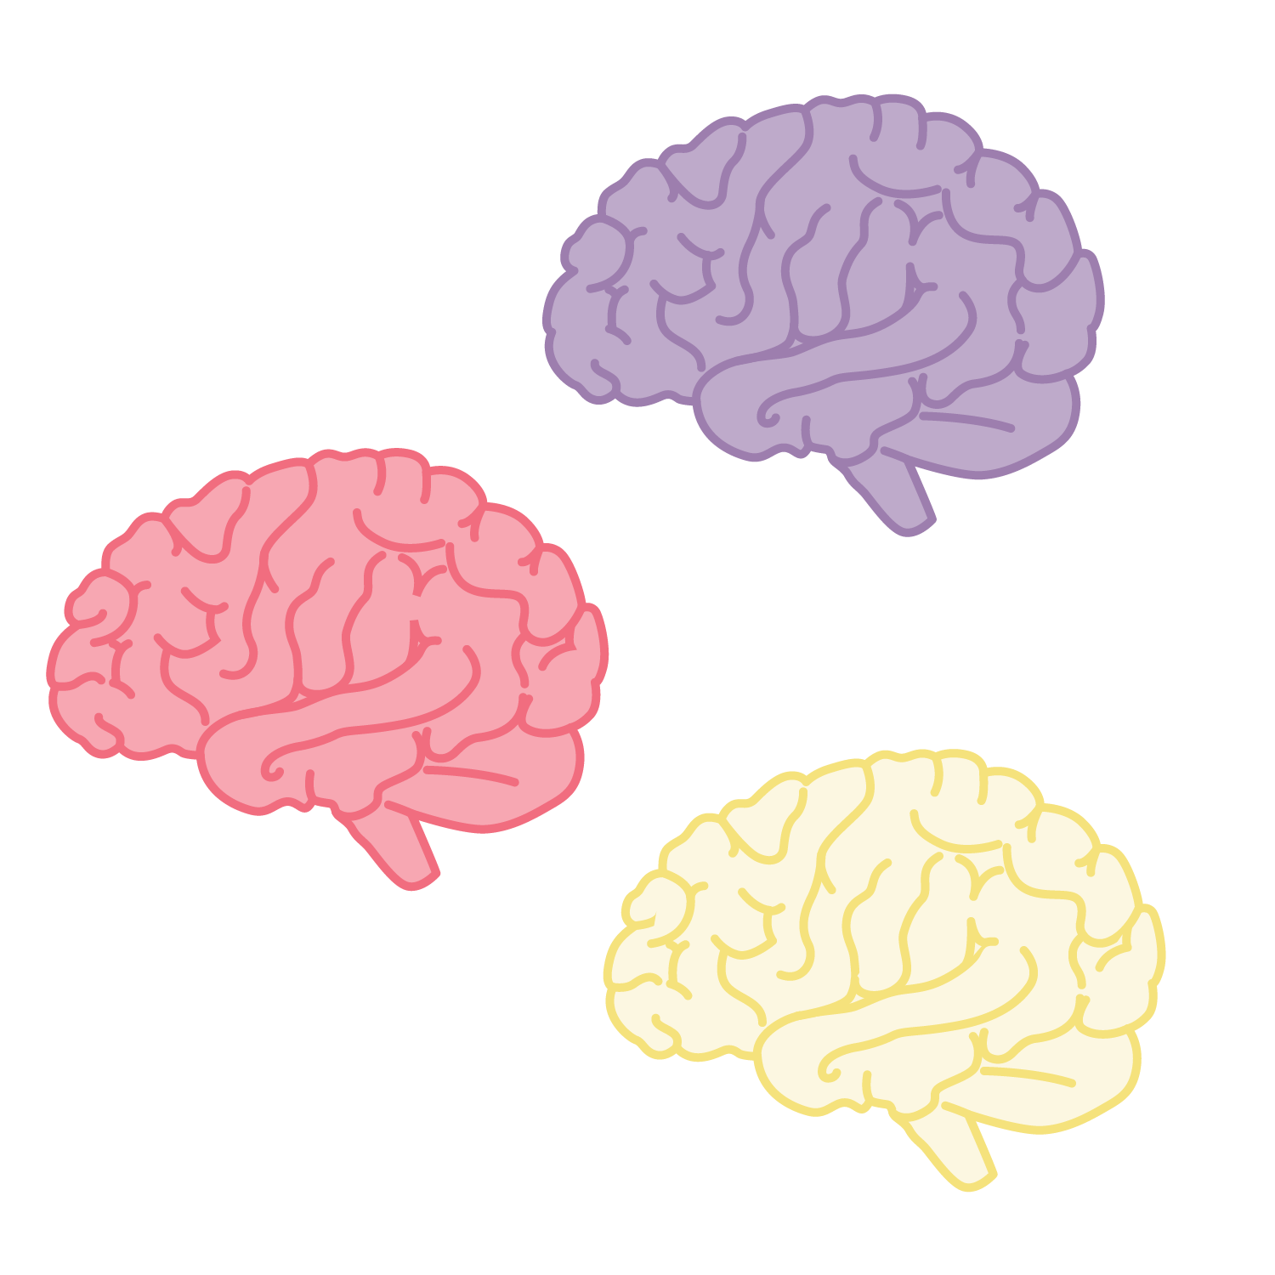
Other types of EM radiation
With your group, create a list of other types of EM radiation.

Slide 18

Concept Card Mapping
With your partners:
Review the concept cards.
Determine how they connect.
Sort them into appropriate groups.
Determine how the groups connect.
Label the connections.
Provide a summary phrase that describes how all of the cards come together.
Notes:
https://learn.k20center.ou.edu/strategy/123

