Slide 2
Let Us Start the Lettuce Club (Or Not)
Writing a Thesis Statement

Slide 3
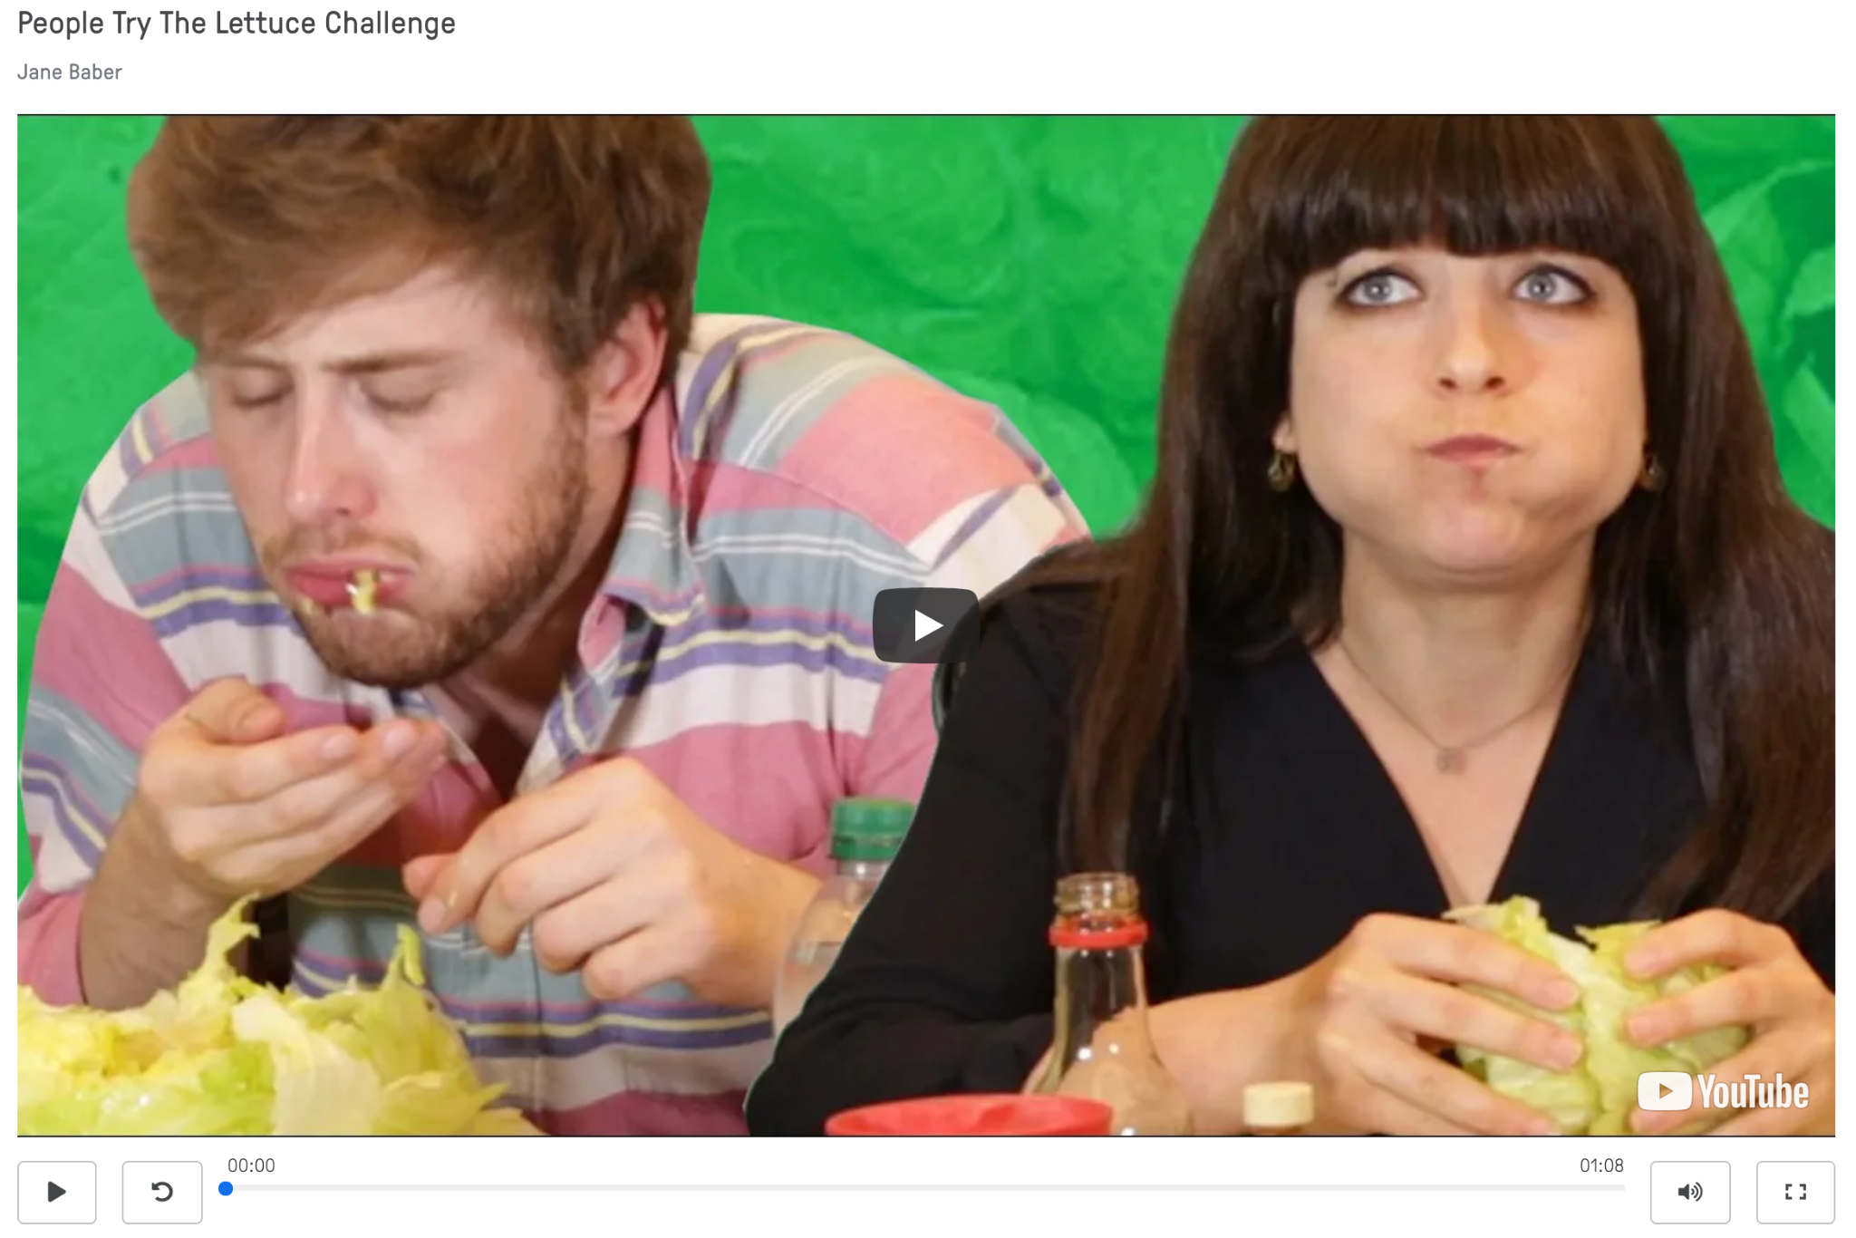
People Try the Lettuce Challenge
Click the link to view: https://edpuzzle.com/media/6054f4853ef1a642d1e73e35
Notes:
BuzzFeedVideo. (2016, July 6). People try the lettuce challenge. [Video]. Youtube. https://www.youtube.com/watch?v=za-WknY7lMQ

Slide 4
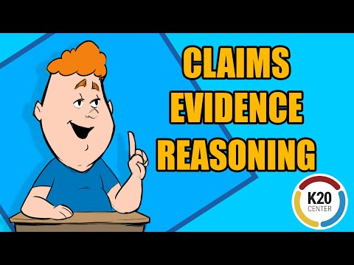
Claims, Evidence, and Reasoning
Notes:
K20 Center. (2021, Aug. 19). Claims, Evidence, and Reasoning. [Video]. YouTube. https://www.youtube.com/watch?v=JGOxVIgmGWE
Click the link to view: https://www.youtube.com/watch?v=JGOxVIgmGWE

Slide 5
Stating a Claim
What is your position?
Make sure you can back up your claim with evidence.
Do not use “I think” or “I believe.”

Slide 6
Essential Question
In what ways can a piece of writing be clear and purposeful for the reader?

Slide 7
Lesson Objectives
Analyze a topic or question to formulate a stance that informs a clear claim;
Synthesize relevant subtopics to support a claim;
Write a thesis statement that could be used in a research paper or expository essay.

Slide 8

Surprising-Interesting-Troubling
What is surprising?
What is interesting?
What is troubling?
Notes:
K20 Center. (n.d.). S-I-T (Surprising-Interesting-Troubling). Strategies. https://learn.k20center.ou.edu/strategy/926

Slide 9
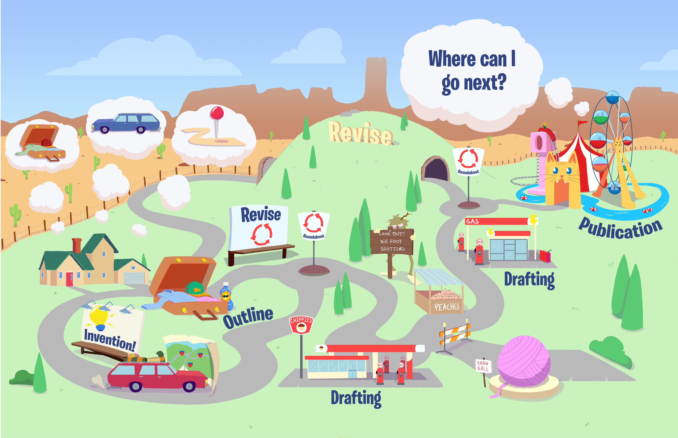
Writing Road Map
Notes:
K20 Center. (2022), Writing Road Map Infographic. https://learn.k20center.ou.edu/lesson/1737/LettuceClub-RoadMap-1-1.pdf?rev=13483

Slide 10
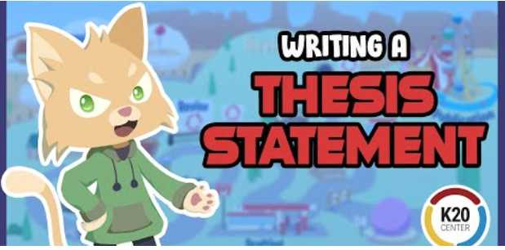
Writing a Thesis Statement
Click the link to view video: Writing a Thesis Statement - YouTube
Notes:
K2O Center. 2021. Writing a Thesis Statement. Video. YouTube. https://www.youtube.com/watch?v=qWb2zbVl-rot - YouTube

Slide 11
Consider the Following:
How can having one sentence like a thesis statement accomplish the following:
Efficiency
Clarity
Structure

Slide 12
Thesis Statement: People Try the Lettuce Challenge
Click the link to view: https://edpuzzle.com/media/6054f4853ef1a642d1e73e35

Slide 13
Thesis Elements | Example
Claim | Eating iceberg lettuce is a good group activity because
Subtopic 1 | it can bring together a diverse mix of friends,
Subtopic 2 | it invites healthy competition,
Subtopic 3 | and it requires a sense of humor.
Thesis Statement | Eating iceberg lettuce is a good group activity because it can bring together a diverse mix of friends, it invites healthy competition, and it requires a sense of humor.

Slide 14
Outline
Introduction
Thesis statement with claim and 1, 2, 3 subtopics.
Subtopic 1
Transition
Subtopic 2
Transition
Subtopic 3
Transition
Conclusion
Restate claim and summarize 1, 2, 3 subtopics

Slide 15
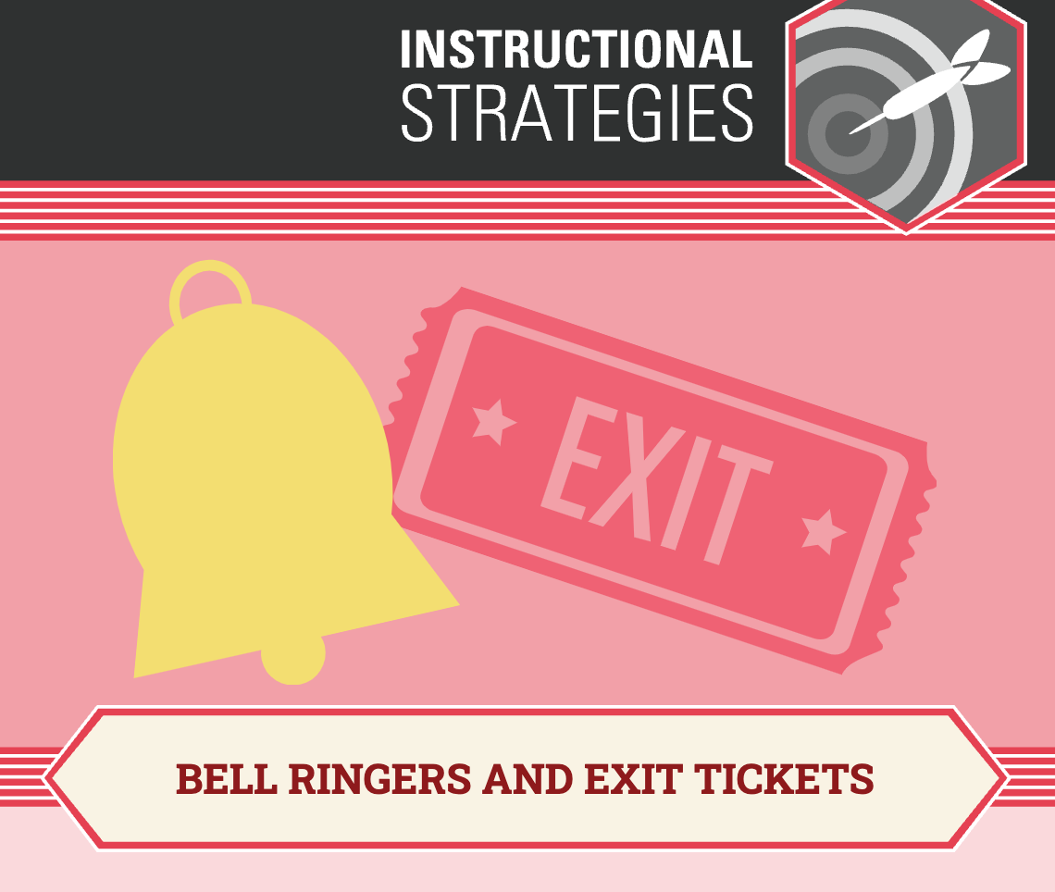
Exit Ticket
[insert prompt here]
Notes:
K20 Center. (n.d.). Bell Ringers and Exit Tickets. Strategies. https://learn.k20center.ou.edu/strategy/125

