Slide 2
Food Fight
Difficult Conversations in the Classroom

Slide 3
Essential Question
What do productive discussions about difficult topics look like, sound like, and feel like?

Slide 4
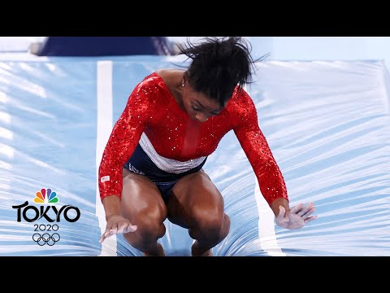
Notes:
NBC Sports. (2021, July 27). Simone Biles stumbles on vault before pulling out of team final | Tokyo Live | NBC Sports. YouTube. https://youtu.be/nO-vMUApyJQ

Slide 5
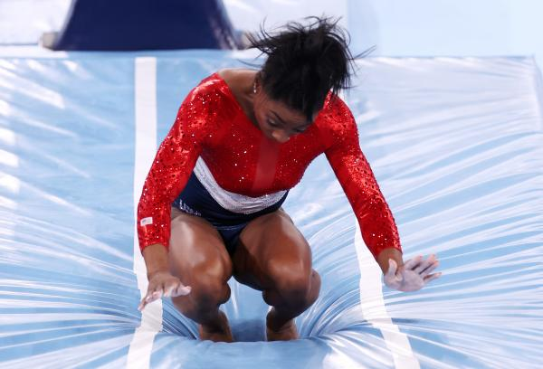
I Think/We Think
What is happening in this photo?
What happened just before this photo was taken?
What happened immediately after this photo was taken?
What theme or main idea can you take from this?
Notes:
Getty Images. (2021, July 27). Simone Biles makes bad landing in gymnastics. Newsweek. https://www.newsweek.com/simone-biles-walks-out-olympics-arena-bad-landing-gymnastics-1613438

Slide 6
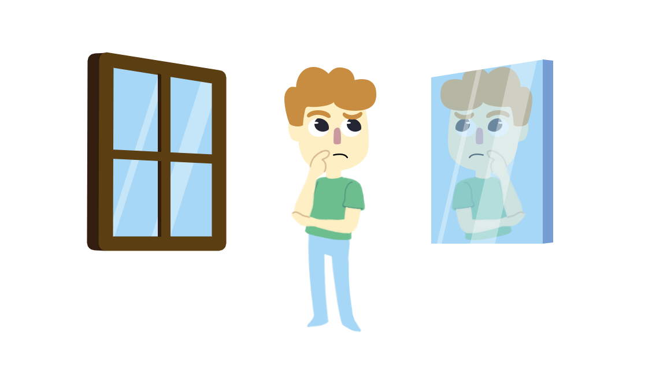
Window and Mirrors
Window: What you observe in the image does not reflect your experiences or identities. It is a “window” into the experiences and identities that are different from your own.
Mirror: What you observe reflects some of your experiences and identities. It is a “mirror” of some aspects of your own life.

Slide 8
Windows and Mirrors
Simone Biles aka The GOAT
Four-time Olympic gold winner.
On July 28, 2021, as the most successful U.S. gymnast ever, Biles was going for her first of a possible six gold medals in the 2020 Tokyo Olympics.
She suffered what is known as “twisties” on the vault.
She later withdrew from the competition.
Notes:
Getty Images. (2021, July 27). Simone Biles makes bad landing in gymnastics. Newsweek. https://www.newsweek.com/simone-biles-walks-out-olympics-arena-bad-landing-gymnastics-1613438

Slide 9
Lesson Objectives
We will be able to identify what type of communicator they are speaking with and how to appropriately communicate with them.
We will be able to debate difficult topics in a respectful manner.

Slide 10
Is a hot dog a sandwich?
On a sticky note:
Answer the question, “Is a hot dog a sandwich?” with your reasoning.
Each separate answer or reason should have its own sticky note.
Notes:
Instruct your students to write their rationale for the answer on a small sticky note, using a new one for each new reason. Students should write as many reasons/rationales as they have for the question.
Sample Student Response A HOT DOG IS NOT A SANDWICH because sandwiches have two pieces of bread, and buns are just one piece of bread.

Slide 11
Affinity Process
With your partner:
Read through your sticky notes.
Group similar sticky notes into categories. Label each category.

Slide 12
Gallery Walk
Take your sticky note pad and look at your peers’ categories.
Leave written comments or questions beside the categories on your peers’ desks.
Notes:
Instruct your students to walk around the room with sticky notes in their hands looking at how other pairs categorized their notes. If they have a question or comment, they can leave one on a sticky note.
When students return to their seats, ask each pair to share a question or comment they received. Did anyone disagree with your decision? Did anyone agree with you?

Slide 13
How Am I Feeling? What Am I Thinking?
Sticky Note 1:
If someone offered you a hot dog and gave you a sandwich, how would you feel? What would you think?
Sticky Note 2:
If someone offered you a sandwich and gave you a hot dog, how would you feel? What would you think?

Slide 14
Is a hot dog a sandwich?
Play the Twine:
https://k20center.ou.edu/e-learning/food-fight/
Notes:
https://drive.google.com/file/d/1211UBDRGH93yPYtp9nrqr90IEFXYbi5G/view?usp=sharing
(download and open in browser)

Slide 15
Is a hot dog a sandwich?
What did you notice about the choices you made?
What promoted positive conversation?
What did you notice that was negative?
How could you take what was negative and approach it differently?

Slide 16
Which type of communicator are you?
Why do you think you communicate in this way?
Which way do you normally approach other people in a conversation?
Do our classroom norms accommodate for all of these styles?

Slide 17
Ask-Oriented vs. Tell-Oriented
Ask-Oriented
Tell-Oriented
Indirect and discussion-oriented in their approach
Asks many questions
Might speak more quietly
Takes more time to communicate and listen
Direct in their approach
Asks fewer questions
Might speak loudly
Responds more quickly

Slide 18
Task-Directed vs. People-Directed
Task-Directed
People-Directed
Talks about tasks first, then considers relationships later
Shares few feelings
Tries to be more objective in decision-making
Tries to rely on logic
Considers relationships first, then moves to tasks
Shares feelings to support the discussion
Subjective approach to decision-making
Relies on intuition

Slide 19
Amiable
People-Directed & Ask-Oriented
How to Approach This Person:
Indirect and discussion-oriented in their approach
Asks many questions
Might speak more quietly
Takes more time to communicate and listen
Shares feelings to support the discussion
More subjective and intuitive when making decisions
Appreciate their efforts to be coooperative
Make an effort to cooperate in kind
Give them time to think before expecting an answer
Support the relationship between you and consider their feelings
Give reassurance
Remember: they are concerned about the “why”

Slide 20
Expressive
People-Directed & Tell-Oriented
How to Approach This Person:
Shares feelings to support the discussion
More subjective and intuitive when making decisions
Direct in their approach
Asks fewer questions
Responds more quickly
Be collaborative to make it easier for both of you to find a solution
Share thoughts of interest
Support their vision and intuition
Remember: they are most interested in the “who”—who is involved in the solution

Slide 21
Driver
Task-Directed & Tell-Oriented
How to Approach This Person:
Talks about tasks first, then considers relationships later
Shares few feelings
Tries to be more logical and objective in decision-making
Direct in their approach, and may speak loudly and quickly
Asks fewer questions
Cares most about results
Listen carefully and thoroughly before responding
Keep your communication concise and on-topic
Support their conclusions and actions
Remember: they are interested in your ideas, and they are and concerned about the “what”—what the solution will accomplish

Slide 22
Establishing Norms
Think back to the question, “Is a hot dog a sandwich?”
Discuss how the conversation with your partner went compared to the Twine.
Take out a sheet of paper and list the ways we should speak to one another during a difficult conversation. You may use sentence stems, nonverbal cues, positive conversation cues, or any other ideas that come to mind.

Slide 23
Conversation Elements
Find an idea from your brainstorming list that would make a good classroom norm for each category:
Sentence Stems
Nonverbal Cues
Positive Conversation Cues
Other Ideas
Write one idea down for each category, one idea per sticky note. Place your sticky notes on the correct conversation element posters.

Slide 24
Classroom Norms for Difficult Conversations
Notes:
Ask your students to choose the top three ideas from each poster to create classroom discussion norms. You can write these answers on a poster entitled Difficult Conversations Classroom Norms and/or add these norms to this slide.

Slide 25
Should governments limit the number of children families are allowed to have?

Slide 26
Why-Lighting
While reading the article:
Highlight information in the passage that you believe to be important.
Annotate in the margins why you highlighted the information.

Slide 27
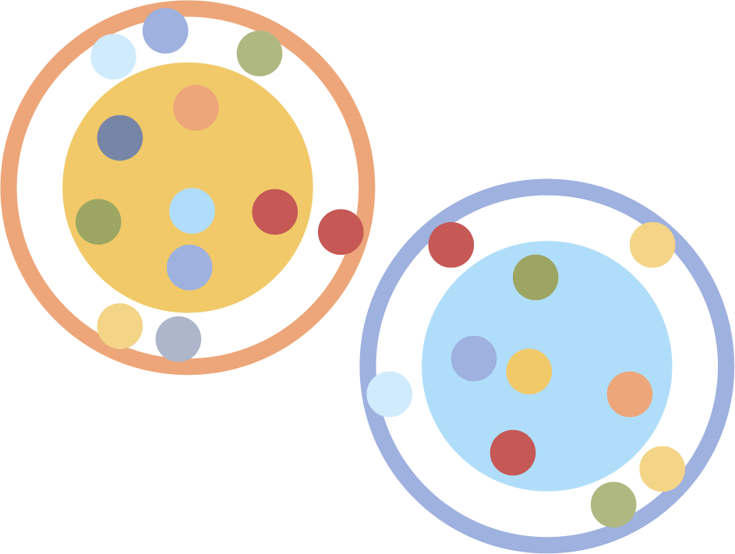
Socratic Seminar
What are some lingering questions you have about the topic of government involvement in family planning?
Come to class with three to five questions you have about government involvement in family planning.

Slide 28
Socratic Seminar
Form two groups.
Inner circle: Discuss the question and your thoughts.
Outer circle: Quietly observe and record what you notice about the inner circle. Are they following class norms?

Slide 29
Classroom Norms
How well were the classroom norms followed during the Socratic Seminar?

Slide 30
Create Your Own Twine: Choose a Topic
Start with a difficult topic from one of your classes or suggest one of your own.
ELA | Science | History | Math
Should the US reduce restrictions on legal immigration? | Should it be legal to clone human beings? | Should COVID-19 vaccines be required by the government? | Should the electoral college be abolished?
Should bullying be censored on social media? | Should people be required to wear masks? Alternatively, should people be prohibited from wearing masks? | Should marijuana be legalized? | Should minimum wage be raised to $15 an hour?
Should traditional justice be replaced by restorative justice? | Should fracking be illegal? | Should the government authorize reparations for the Tulsa Race Massacre? | Should public college be tuition-free?
Should people be legally required to get vaccines? | Does reforestation solve the issue of deforestation? | Should nuclear weapons be banned? | Should wealthy people pay higher taxes than the poor?

Slide 31
Create Your Own Twine: Tutorial
Navigate to twinery.org.
Follow along with this tutorial:
https://ior.ad/7RX6
Notes:
Play the tutorial for the class

