Slide 2
A Peace Built on Quicksand
Economic, social, and political conditions that caused WWII.

Slide 3
Essential Question
Did economic challenges following WWI lead the world into a second war?
How did leaders and political blunders pave the road to WWII?

Slide 4
Lesson Objectives
Students will evaluate various economic and political causes that led to the outbreak of WWII.

Slide 5

T-Chart
Create a T-chart on you paper.
Label the left side with “What do I know about the causes of WWII?” and fill it in.
Label the right side with “What I learned from my partner.”

Slide 6


30-Second Expert
Share everything you know about the causes of WWII with your partner.
When your partner shares what they know, write down anything you learned from them in the right column of your T-chart

Slide 7

K.I.M.S.
Fill-out the following information for your vocabulary:
K - key word
I - important information
M - memory clue
S - use the word in a sentence

Slide 8
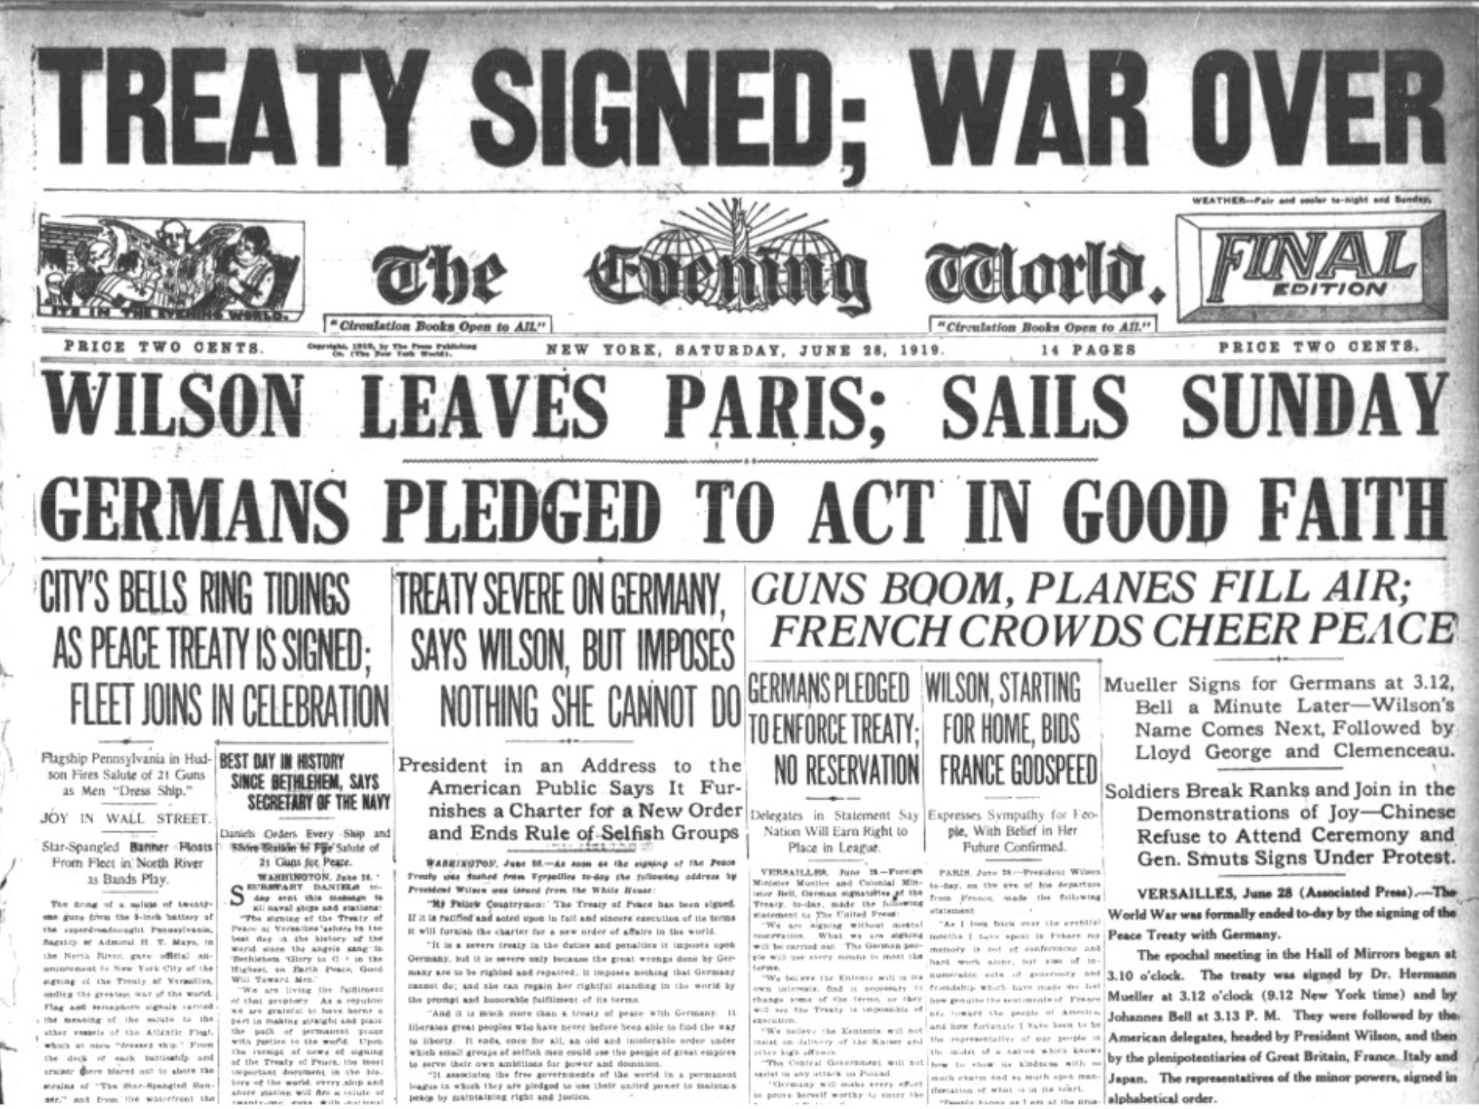
Treaty of Versailles
Key Points:
Ended WWI
Harsh against Germany and wanted them to pay an unrealistic amount in reparations
Created a lot of resentment in places like Germany, Italy, and Japan
League of Nations were very limited in stopping aggression after WWI
Notes:
Kallen2021. (2016). Treaty of Versailles Newspaper Article. Retrieved September 10, 2021, from https://commons.wikimedia.org/wiki/File:Treaty_of_Versailles_Newspaper_Article_.png.
Lumen Learning. (n.d.). Causes of WWII. https://courses.lumenlearning.com/atd-tcc-worldciv2/chapter/causes-of-world-war-ii/

Slide 9
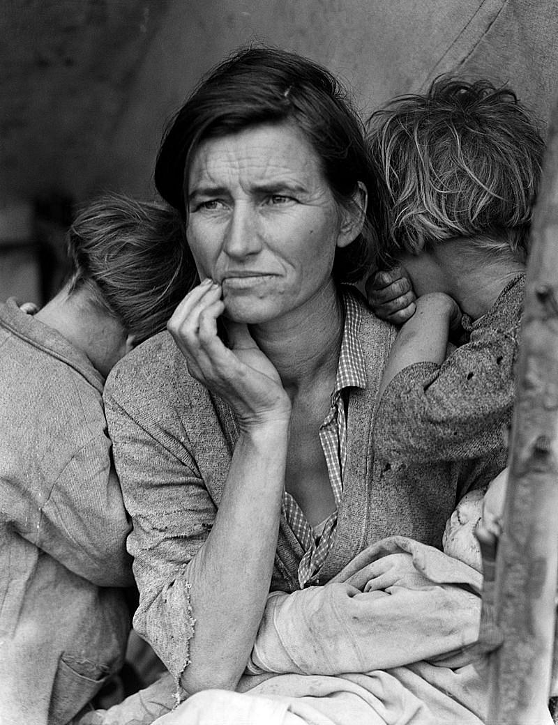
Great Depression
Key Points:
There was massive debt from WWI and the Treaty of Versailles
Countries like the Weimar Republic of Germany led to ineffective economies
Crash of the New York Stock Market (Oct. 29th, 1929)
Countries were unable to pay loans and the Western economies began to fail
Notes:
Dillon, L. (2016). Migrant Mother. Retrieved September 10, 2021, from https://www.flickr.com/photos/reddirtpics/28713771664.
Lumen Learning. (n.d.). Causes of WWII. https://courses.lumenlearning.com/atd-tcc-worldciv2/chapter/causes-of-world-war-ii/

Slide 10
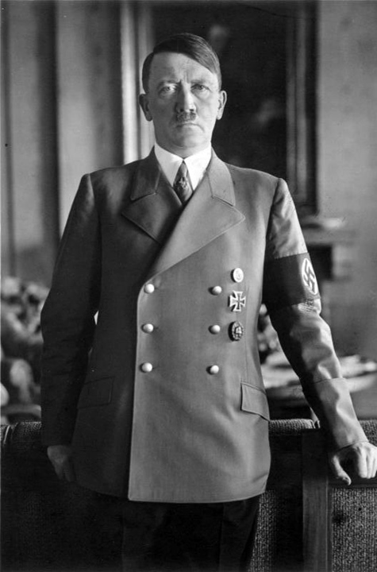
Adolf Hitler
Key Points:
Dictator of Germany
Fulfilled promises to overturn the Treaty of Versailles by having a large military
Promised more “Lebensraum” or living space and began seizing land during the 1930s including Poland
Gained credibility in Germany by combating the Great Depression
Had an alliance with Italy and Japan and a pact of neutrality with the Soviet Union
Notes:
Lumen Learning. (n.d.). Causes of WWII. https://courses.lumenlearning.com/atd-tcc-worldciv2/chapter/causes-of-world-war-ii/
Mundial, S. G. (2016). Gustav Adolf Hitler. Retrieved September 10, 2021, from https://www.flickr.com/photos/144890920@N02/29881010594.

Slide 11

Fascism
Key Points:
Began to rise in the 1920s
Nationalistic
Militaristic
Claimed it would be a counter to Communism
Included the dictators Mussolini of Italy and Hitler of Germany
Notes:
Lumen Learning. (n.d.). Causes of WWII. https://courses.lumenlearning.com/atd-tcc-worldciv2/chapter/causes-of-world-war-ii/
OpenClipart-Vectors. (2013). Symbol of Fascism. Retrieved September 10, 2021, from https://pixabay.com/vectors/fascism-nazi-swastika-symbol-147370/.

Slide 12



Axis Powers
Key Points:
Brought together Germany, Japan, and Italy
They were against the Treaty of Versailles
Created strong militaries
Desired more land
Against Communism
Notes:
Lumen Learning. (n.d.). Causes of WWII. https://courses.lumenlearning.com/atd-tcc-worldciv2/chapter/causes-of-world-war-ii/
Thommy. (2008). War Flag of the Imperial Japanese Army. Retrieved September 10, 2021, from https://commons.wikimedia.org/wiki/File:War_flag_of_the_Imperial_Japanese_Army.svg.
R-41. (2012). Flag Variant of Nazi Party (1923). Retrieved September 10, 2021, from https://commons.wikimedia.org/wiki/File:Flag_variant_of_Nazi_Party_(1923).svg.
Flanker. (2008). Flag of Italy (1861-1946) Crowned Alternate. Retrieved September 10, 2021, from https://commons.wikimedia.org/wiki/File:Flag_of_Italy_(1861-1946)_crowned_alternate.svg.

Slide 13

Jigsaw
In your group of three (3) you will split up the articles.
There are three (3) articles to choose from:
  Treaty of Versailles
  The Great Depression
  Rise of Dictators
As you read, write a summary of the cause of WWII on your handout.

Slide 14
Jigsaw
Connect with those who read the same article as you and discuss the following:
Takeaways from the article
Questions you still have
Things you wondered about

Slide 15
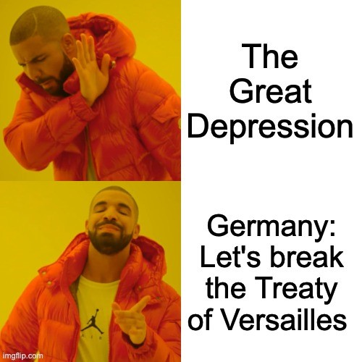
Example

Slide 16

What do you meme?
Create a meme of your own that helps to summarize an economic or political cause that led to WWII.
Be prepared to share it with the class.

Slide 17
Jigsaw
In your original group of three (3) each person should share the following:
What you learned from your reading
Causes of WWII
Summary of the causes

Slide 18

Gallery Walk
As you walk around looking at other groups’ memes, leave behind two (2) questions of comments about their cause of WWII that will help clarify your understanding on a sticky note.

Slide 19


Two-Minute Paper
What conditions led to the breakout of WWII?

