Slide 2
London Bridge Is Falling Down
What Is a Wave? Lesson 1

Slide 3

I Notice, I Wonder
As you watch the video, write the following on your handout:
Any observations you make
(What do you notice?)
Any questions you still have
(What do you wonder?)
Notes:
Strategy: K20 Center. (n.d.). I Notice, I Wonder. Strategies. https://learn.k20center.ou.edu/strategy/180

Slide 4

Notes:
To play the video, click the image on the slide or copy and paste the following link into your web browser: https://www.youtube.com/watch?v=Q3oItpVa9fs
Video source:
Stanford, N. J. (2014, November 12). CYMATICS: Science Vs. Music - Nigel Stanford [Video]. YouTube. https://www.youtube.com/watch?v=Q3oItpVa9fs

Slide 5

Elbow Partners
With your partner, discuss what is similar and what is different about what you recorded on your handout.
Add any new questions or observations to your handout.
Notes:
Strategy: K20 Center. (n.d.). Elbow Partners. Strategies. https://learn.k20center.ou.edu/strategy/116

Slide 6

Driving Question Board
Based on what you discussed with your partner, what are some questions we can add to our Driving Question Board?
Notes:
Strategy: K20 Center. (n.d.). Driving Question Board. Strategies. https://learn.k20center.ou.edu/strategy/1511

Slide 7

Always, Sometimes, or Never True
Read each statement on the following slides and decide whether it is always true, sometimes true, or never true.
On your handout, include rationale that supports your selection.
Notes:
Strategy: K20 Center. (n.d.). Always, Sometimes, or Never True. Strategies. https://learn.k20center.ou.edu/strategy/145

Slide 8
Always, Sometimes, or Never True
Waves are visible.
On your handout, include rationale that supports your selection.

Slide 9
Always, Sometimes, or Never True
Waves can be used to describe the behavior of less obvious things like light, TV and radio signals, and cell phone data signals as they travel from one location to another.
On your handout, include rationale that supports your selection.

Slide 10
Always, Sometimes, or Never True
There are patterns in waves.
On your handout, include rationale that supports your selection.

Slide 11
Always, Sometimes, or Never True
Waves are not affected by
their environment.
On your handout, include rationale that supports your selection.

Slide 12
Always, Sometimes, or Never True
A wave can be thought of as a disturbance that travels through something, accompanied by a transfer of energy.
On your handout, include rationale that supports your selection.

Slide 13
Always, Sometimes, or Never True
Waves travel through solids.
On your handout, include rationale that supports your selection.

Slide 14
Always, Sometimes, or Never True
Radio waves can travel through the vacuum of space.
On your handout, include rationale that supports your selection.

Slide 15
Always, Sometimes, or Never True
Sound waves need to travel through a medium.
On your handout, include rationale that supports your selection.

Slide 16
Always, Sometimes, or Never True
Amplitude and frequency affect the energy of a wave.
On your handout, include rationale that supports your selection.

Slide 17
Essential Questions
What are waves?
How do waves behave differently from particles?

Slide 18
Lesson Objectives
Analyze anchoring phenomena to determine your current level of knowledge on a topic.
Use springs to experiment with making waves.
Describe the basic characteristics of the waves you made with the springs.

Slide 19
Exploring Mechanical Waves
What are mechanical waves?
How are they made?

Slide 20
Exploring Mechanical Waves
We use the term “wave” to describe many things we recognize in the world around us.
“Wave” also describes the behavior of less obvious things like electrons, light, TV and radio signals, and cell phone data signals as they travel from one location to another.
Let’s learn about waves by making some waves with a spring and observing their characteristics.

Slide 21
Exploring Mechanical Waves
With a partner:
Find a place where you can stretch out the spring on a tabletop or on a tile floor.
  The spring must be on a surface, not dangling in the air!
Hold one end of the spring and have your partner hold the other end. Together, stretch the spring 3–4 meters.
Write down your observations as you work
through the questions on the handout.

Slide 22

Anchor Charts
With a partner, create an anchor chart. Be sure to include:
An example of each exercise you did with the spring.
A description of what you observed the spring doing in each exercise.
Notes:
Strategy: K20 Center. (n.d.). Anchor Charts. Strategies. https://learn.k20center.ou.edu/strategy/58

Slide 23
Anchor Charts
As the following definitions are shared, look at your anchor chart and label where/when each one occurred during the Exploring Waves activity.
For each definition, you’ll need to add an example from the Exploring Waves activity if you don’t already have one.

Slide 24


Oscillation
Definition:
Consistently repeating vibration or motion.
Notes:
Image sources:
Geralt. (2019). Pendulum hypnosis, clock, pocket watch [Image]. Pixabay. https://pixabay.com/photos/hypnosis-clock-pocket-watch-4041583/
Summa. (2017). Playground swing, child [Image]. Pixabay. https://pixabay.com/photos/playground-swing-child-2543210/

Slide 25

Millennium Bridge in London
Notes:
To play the video, click the image on the slide or copy and paste the following link into your web browser: https://www.youtube.com/watch?v=eAXVa__XWZ8
Video source:
Mdepablo. (2007, February 14). Millennium Bridge [Video]. YouTube. https://www.youtube.com/watch?v=eAXVa__XWZ8

Slide 26
Medium
Definition:
A physical substance that carries the wave.
Examples:
Almost any kind of matter, including the following:
  Air
  Water or other liquids
  Solids, such as steel or rock

Slide 27
Medium
Important fact to know:
The wave medium always returns to its original position after a wave passes through it.
Notes:
https://www.flickr.com/photos/102642344@N02/15278413843/in/photostream/

Slide 28
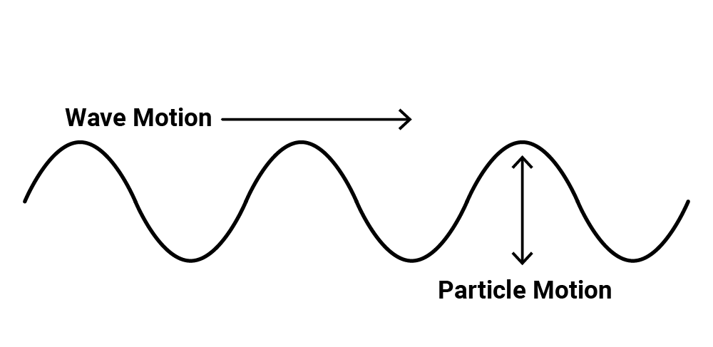
Transverse Waves
Definition:
“Bouncy” waves.
The medium vibrates up and down.
Note: This is how waves are usually represented in pictures.

Slide 29
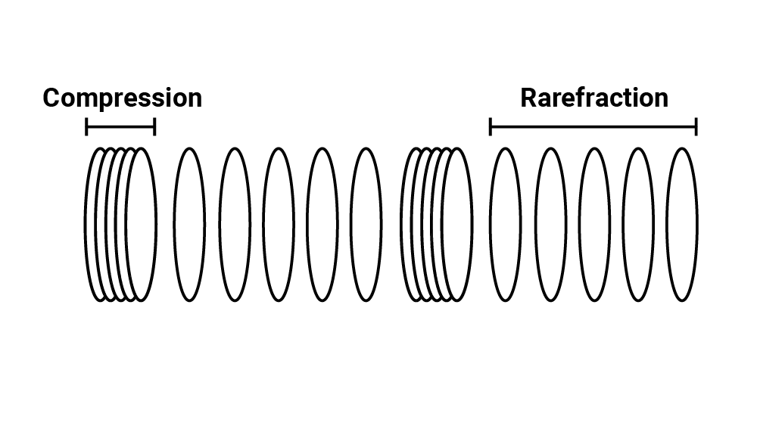
Longitudinal Waves
Definition:
“Stretchy” waves.
The medium compresses (squeezes) and expands (stretches).

Slide 30
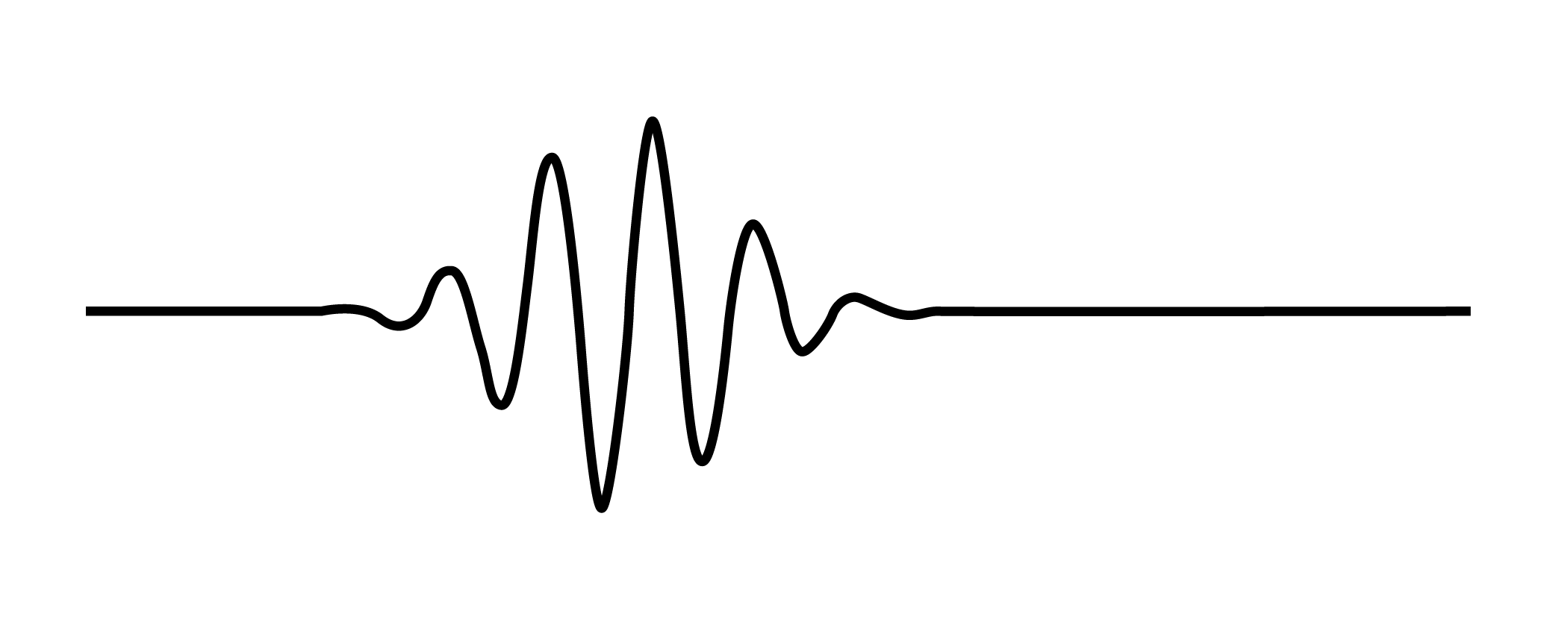
Wave Pulse
Definition:
A short-duration vibration creates a single displacement, which then travels through the medium as a wave.
Notes:
Image source:
Schrope B.A., Goel N. (2014) Physical Principles of Ultrasound [Image]. In: Hagopian E., Machi J. (eds) Abdominal Ultrasound for Surgeons. Springer: New York, NY. https://doi.org/10.1007/978-1-4614-9599-4_2

Slide 31

Driven Wave
Definition:
A constant oscillation that creates a continuous displacement or vibration of the medium.
Notes:
Image source:
Schrope B.A., Goel N. (2014) Physical Principles of Ultrasound [Image]. In: Hagopian E., Machi J. (eds) Abdominal Ultrasound for Surgeons. Springer: New York, NY. https://doi.org/10.1007/978-1-4614-9599-4_2

Slide 32
Driving Question Board
Are there any questions on our Driving Question Board that we can answer right now?

Slide 33

POMS: Point of Most Significance
Imagine if your best friend in the class had been absent for this lesson.
What is the most important thing you learned during this lesson that you would want to share with your friend when they return?
Notes:
Strategy: K20 Center. (n.d.). POMS: Point of Most Significance. Strategies. https://learn.k20center.ou.edu/strategy/101

Slide 34

What Do You Meme We Have Homework?
Create a meme of your own that helps to summarize the content you learned in this lesson.
Be prepared to share it at the start of the next class period.
Notes:
Strategy: K20 Center. (n.d.). What do you meme? Strategies. https://learn.k20center.ou.edu/strategy/984

