Slide 2
Classifying Stars with Spectra
Light, Stars, and Blackbody Radiation

Slide 3
Essential Question
How are star spectra used to help us find stars that are more likely to harbor planets with life?

Slide 4
Lesson Objectives
We will:
Develop a classification system for 14 real star spectra.
Understand links between the temperature of a star and light emission and absorption events in that star.
Learn about the OBAFGKM classification system and its use in the search for stars that are more likely to support planets with life.

Slide 5

Are There Other Planets With Life?
What physical characteristics make stars more likely to harbor an orbiting planet with complex life on it?
How do we look for these stars?
Distant Star
Planet With Life
Notes:
Image source: [Jupiter95]. (December 2011). File: Logo telescope green. Wikimedia Commons. https://commons.wikimedia.org/wiki/File:Logo_telescope_green).png

Slide 6
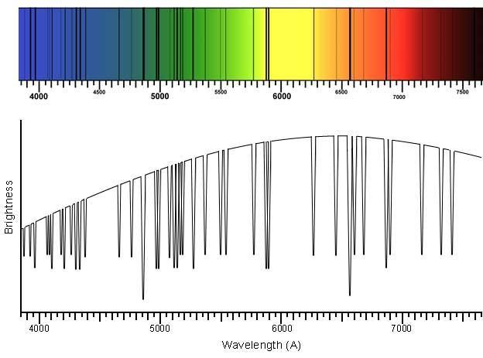
Star Spectra Teach Us About Stars
The rainbow spectrum is missing colors (represented by black lines)—these are spectral absorption lines
Absorption
by Elements at Surface
Emission in the Center
Notes:
Image source: Investigating Astronomy. (n.a.). Solar spectrum. TERC. https://ia.terc.edu/spectral_solar_spectrum.html

Slide 7
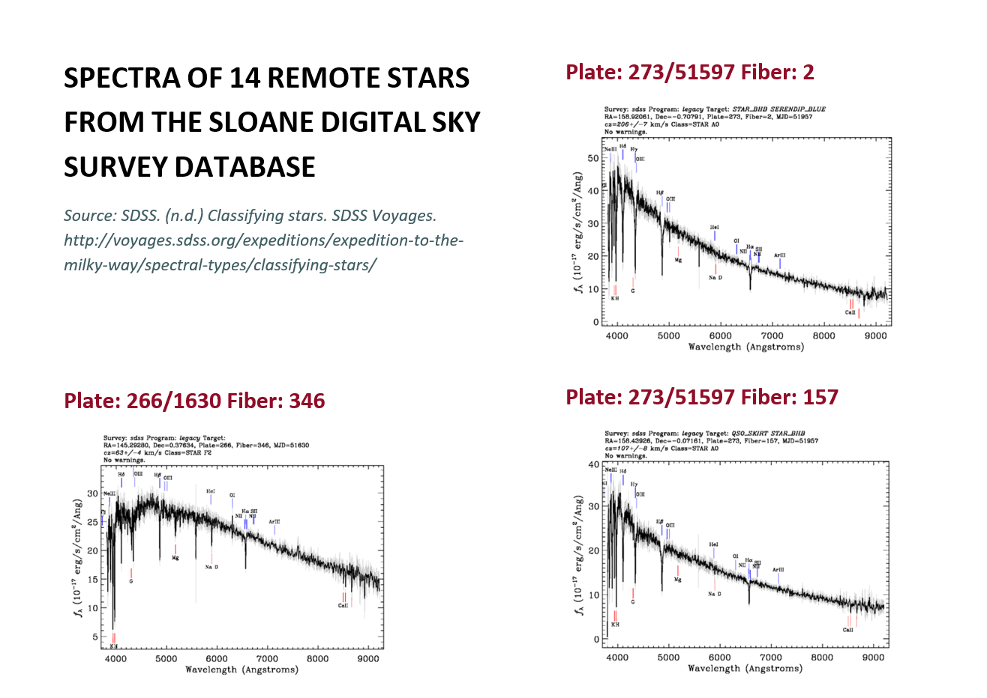
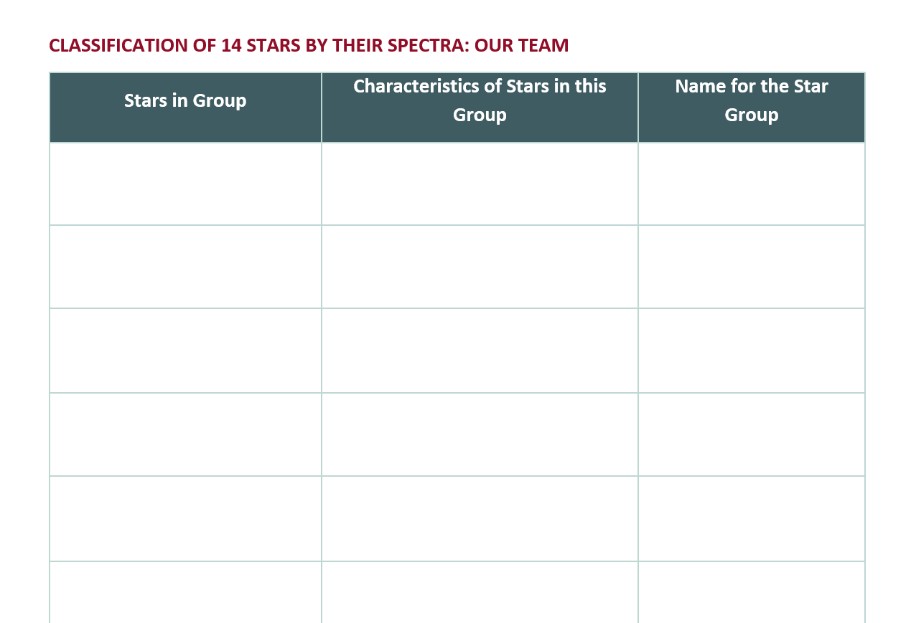
Goal: Classify Star Spectra Into Groups
Find similar spectra:
Report groups in this table:

Slide 8
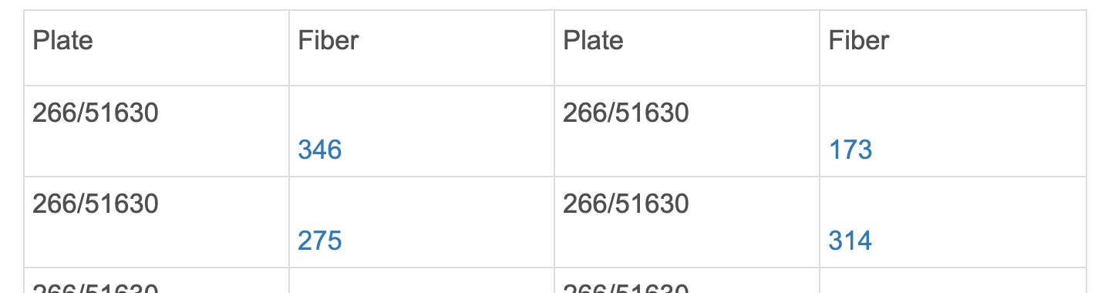
Accessing the SDSS Database
The database: http://voyages.sdss.org/expeditions/expedition-to-the-milky-way/spectral-types/classifying-stars/
Open the SDSS page and scroll down to find this table.
Click on a blue “fiber” number (circled) to select a star.

Slide 9
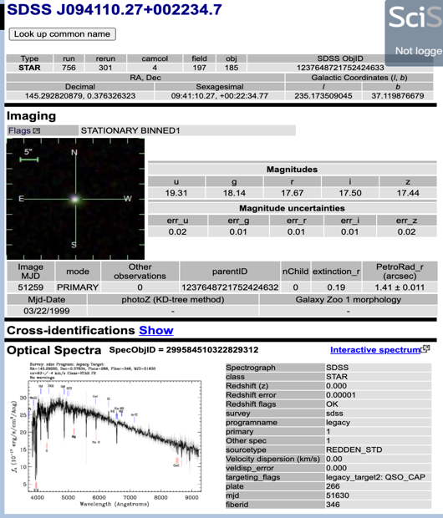
SDSS Star Page
Notice the star spectrum (circled) on each “fiber” page.
Click on the spectrum to see a larger image.
Notes:
Source: SRSS. (n.d.). SDSS J094110.27+002234.7. SDSS Voyages. http://skyserver.sdss.org/dr16/en/tools/explore/Summary.aspx?plate=266&mjd=51630&fiber=346

Slide 10

Goal of Part B
Your team will now work with another team
  Compare classification schemes.
  Create a “consensus” classification that works for both groups.
  Create a diagram to summarize the consensus classification.
  Work through discussion questions. Take notes.

Slide 11
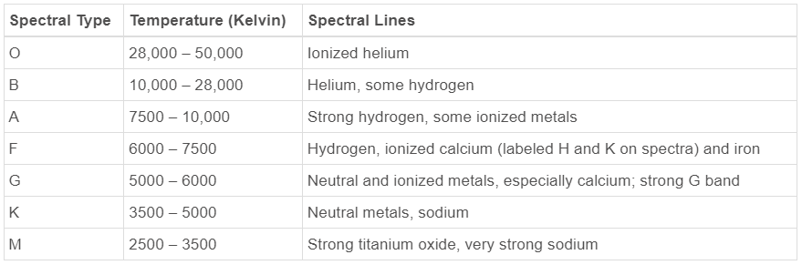
Use the Harvard-Based OBAFGKM System
Table A1: Elements create key absorption spectral lines.
Element Creating Spectral Line | Wavelength of Spectral Line (Angstroms)
Helium, Ionized | 4400
Helium, neutral | 4200
Hydrogen atom (H_{α}, H_{β}, H_{γ}) | 6600, 4800, 4350
Ionized Calcium (Ca) | 3800-4000
Sodium (Na) | 5800
Titanium Oxide (O) | Lots of lines 4900 - 5200, 5400 - 5700, 6200 - 6300, 6700 - 6900
Table A2: Absorption lines dictate star type.
Notes:
Source: SDSS. (n.d.) Absorption and emission lines. SDSS Voyages. http://voyages.sdss.org/expeditions/expedition-to-the-milky-way/spectral-types/absorption-and-emission-lines/

Slide 12
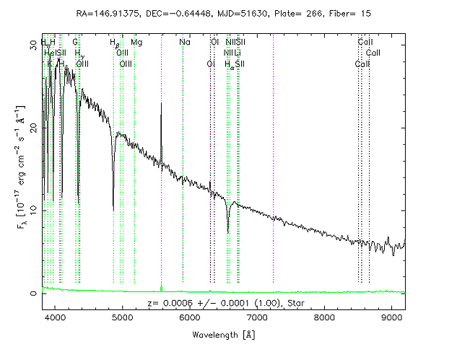
Goals for Explain Questions
Learn the classification system by studying the Earth’s Sun.
Use the system to classify the star spectrum in Figure A3.
Study Figures B1–B4 to see how star spectra predict star temperature.
Figure A3. Spectrum of a star (not the Sun)
Notes:
Source: SDSS. (n.d.) Absorption and emission lines. SDSS Voyages. http://voyages.sdss.org/expeditions/expedition-to-the-milky-way/spectral-types/absorption-and-emission-lines/

Slide 13

Muddiest Point
What was the most confusing thing you want to be explained and discussed with the class?
Describe the Muddiest Point of your learning. Include your name.
Your name will not be used even if your point is shared with the class.

Slide 14
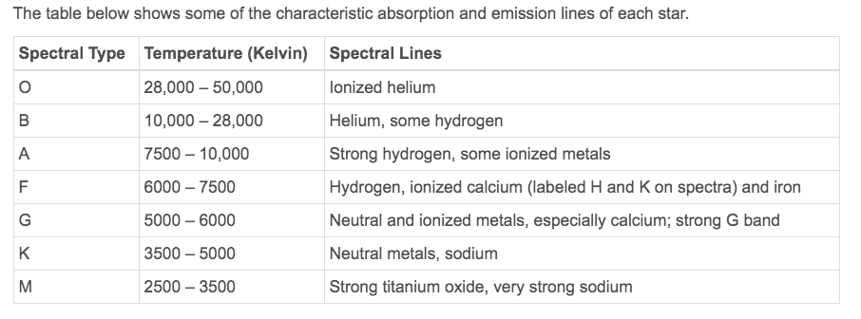
Properties of Our G-type Sun (Qs A1–A5)
Which elements absorb light in our G-type Sun?
  Calcium?
  Helium?
Notes:
Source: SDSS. (n.d.) Absorption and emission lines. SDSS Voyages. http://voyages.sdss.org/expeditions/expedition-to-the-milky-way/spectral-types/absorption-and-emission-lines/

Slide 15
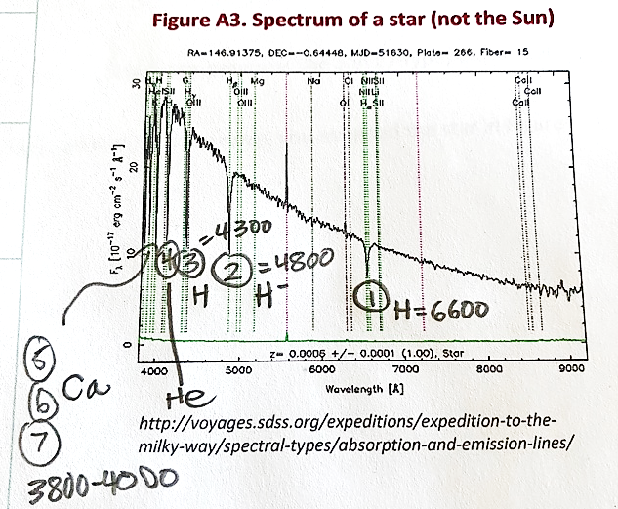
What Type of Star Is This? (Qs A6–A11)
What elements make these absorption lines? (Use Table A1.)
  6600, 4800, 4300
  3800-4100
Based on the elements found, what type of star is it? (Use table A2.)
How sure are you?

Slide 16
Use the Harvard-Based OBAFGKM System
Table A1: Elements create key absorption spectral lines.
Element Creating Spectral Line | Wavelength of Spectral Line (Angstroms)
Helium, Ionized | 4400
Helium, neutral | 4200
Hydrogen atom (H_{α}, H_{β}, H_{γ}) | 6600, 4800, 4350
Ionized Calcium (Ca) | 3800-4000
Sodium (Na) | 5800
Titanium Oxide (O) | Lots of lines 4900 - 5200, 5400 - 5700, 6200 - 6300, 6700 - 6900
Table A2: Absorption lines dictate star type.
Notes:
Source: SDSS. (n.d.) Absorption and emission lines. SDSS Voyages. http://voyages.sdss.org/expeditions/expedition-to-the-milky-way/spectral-types/absorption-and-emission-lines/

Slide 17
How Confident Is Our Star Type Assignment?
Class vote
Type | Votes
O
B
A
F
G
K
M

Slide 18
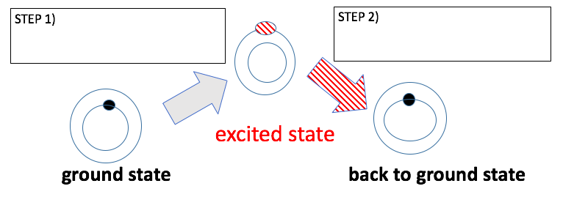
How Do Atoms Absorb Light?
Rings = Energy Levels; Dots = Electrons
Step 1 = Light Absorbed
Step 2 = Energy Released = Heat or Emitted Light
Overall energy is conserved.

Slide 19
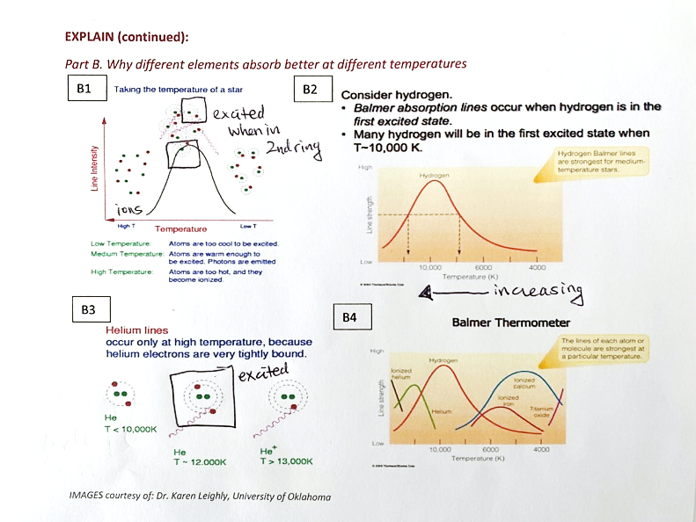
Temperature Effects on Excitation
Squares are drawn around excited electrons.
In Figures B2 and B4, temperatures decrease left to right.
Helium ≠ hydrogen

Slide 20
How Different Colors Are Absorbed
Bohr Model
Different color = different energy
  Red = less energy = level 2 to 3
  Green = more energy = level 2 to 4
Electrons must be excited to level 2 before absorbing “visible light” wavelengths.
Only specific jumps exist.
So specific colors excite the electron to higher levels.
2
2

Slide 21
Helium vs. Hydrogen
Hydrogen: larger atom= easier to excite electron
Helium: smaller atom = harder to excite electron
Lower temp
Higher temp
+1
+2

Slide 22
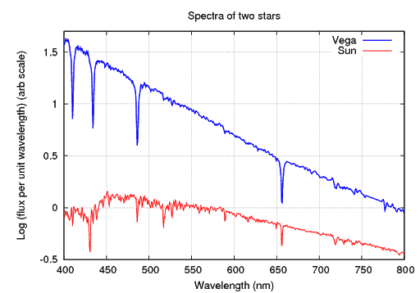
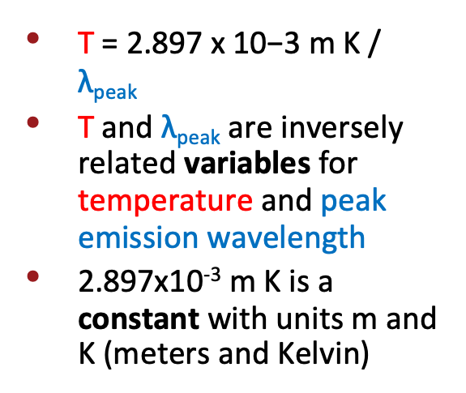

Blackbody Equation for Star Temperatures
SUN
Notes:
Source: Richmond, M. (n.d.). Emission and Absorption Lines. Rochester Institute of Technology. http://spiff.rit.edu/classes/phys301/lectures/spec_lines/spec_lines.html

Slide 23
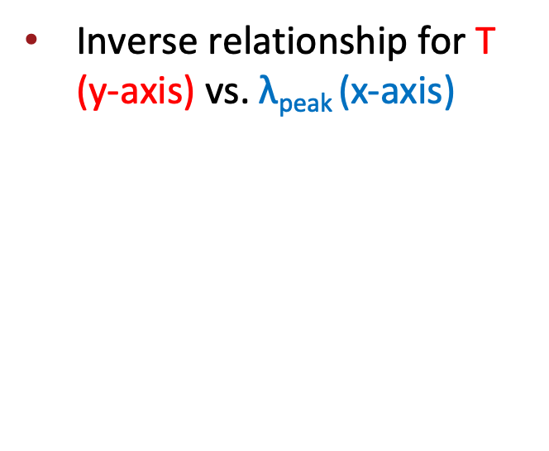
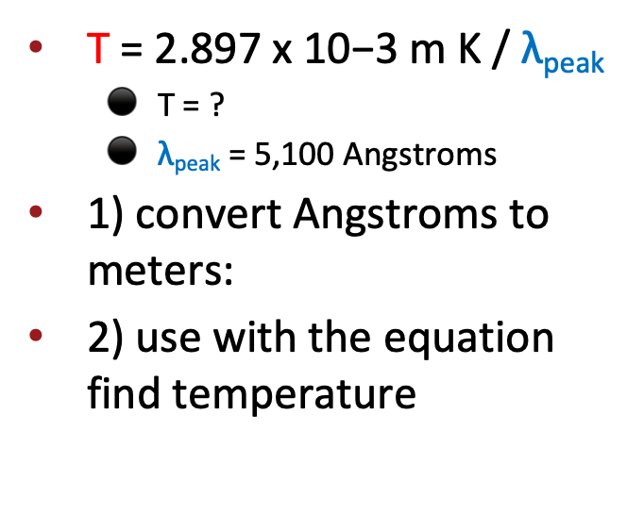

Example of Blackbody Equation with the Sun
              T = ?
      = 5,100 Angstroms
1) Convert Angstroms to meters.
2) Use with the equation to find the temperature.

Slide 24
So, What Kind of OBAFGKM Stars Support Life?
4-2-1 Strategy to Find the Main Points
Read the article.
On your own, identify and write down the four most important ideas from the reading.
In pairs, share your ideas, and decide on the two most important ideas from the reading.
In groups of four, share your ideas. Decide on the most important idea from the reading.
On your own, write for 3–5 minutes about what you learned in this activity and from this article.

Slide 25
Cognitive Comics
Draw and write captions for a Cognitive Comic that expresses your understanding of the main point of this reading. Your comic should attempt to explain the reading to someone who isn’t familiar with classifying stars.
Think about the content. Use as much art as you want to help you convey that content.

