Slide 2
Environmental Factors
Connecting Social Issues and Health Inequities

Slide 3
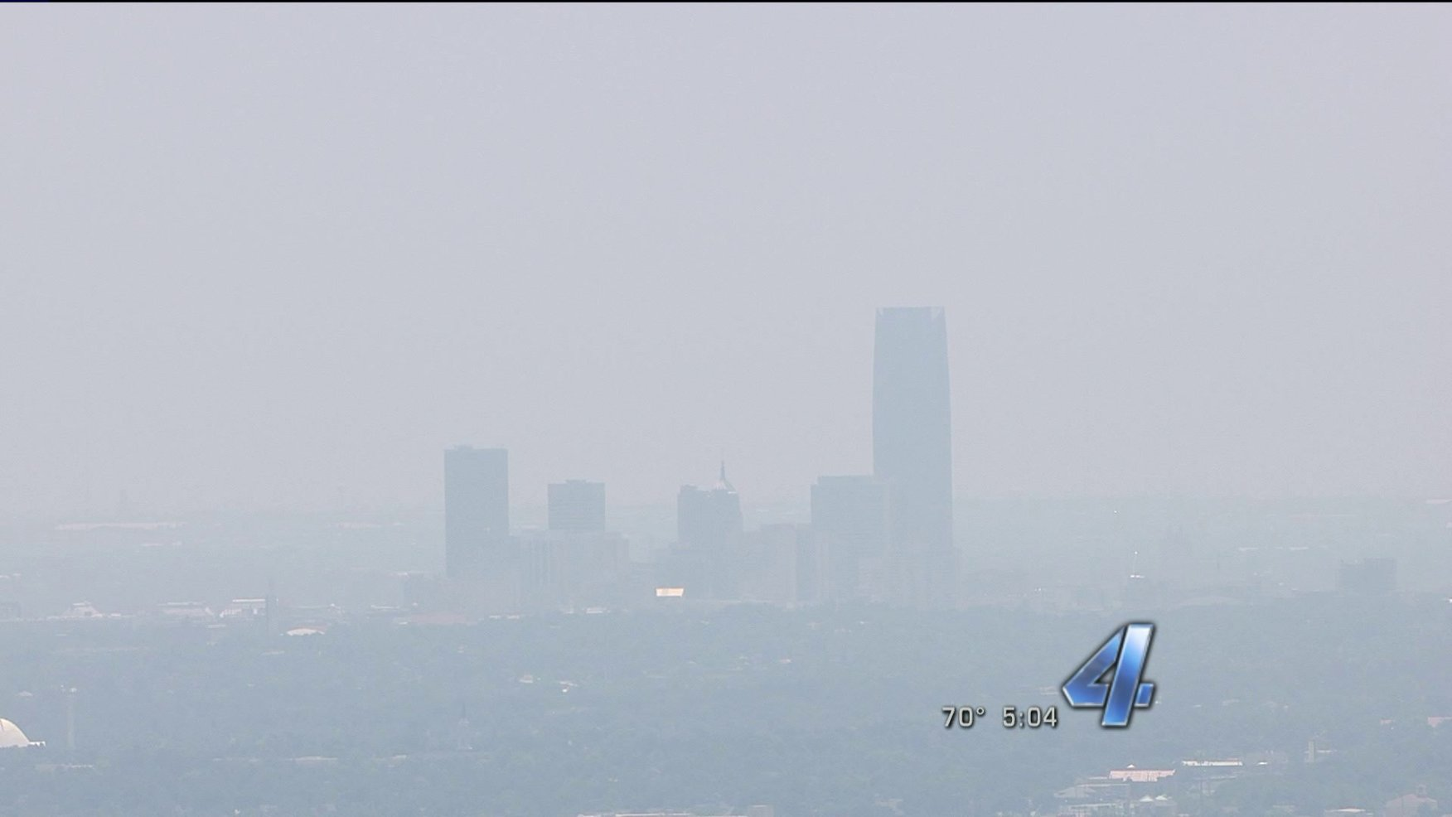
Ozone Alert Day
Notes:
Source:
Butcher, K. (2018, May 17). Ozone Alert Day issued for Oklahoma City, Tulsa metro areas for Thursday. KFOR.com Oklahoma City. https://kfor.com/news/ozone-alert-day-issued-for-oklahoma-city-tulsa-metro-areas-for-thursday/.
This ozone alert was issued on July 11, 2013, at 4:04 p.m. (CDT).
ALERT:
OKLAHOMA CITY– While temperatures continue to climb, officials are predicting that conditions are right for an ozone alert day.
The Oklahoma Department of Environmental Quality projects that Friday will have atmospheric conditions favorable for air pollution that could cause health issues for some residents.
Officials say ozone particles may form near the ground, which can be especially dangerous to children, the elderly and anyone with respiratory illnesses.

Slide 4
Essential Question
How do inequitable environmental factors affect human health?

Slide 5
Lesson Objectives
Students analyze Oklahoma City’s Air Quality data to determine patterns.
Students summarize important information about air pollutants.

Slide 6
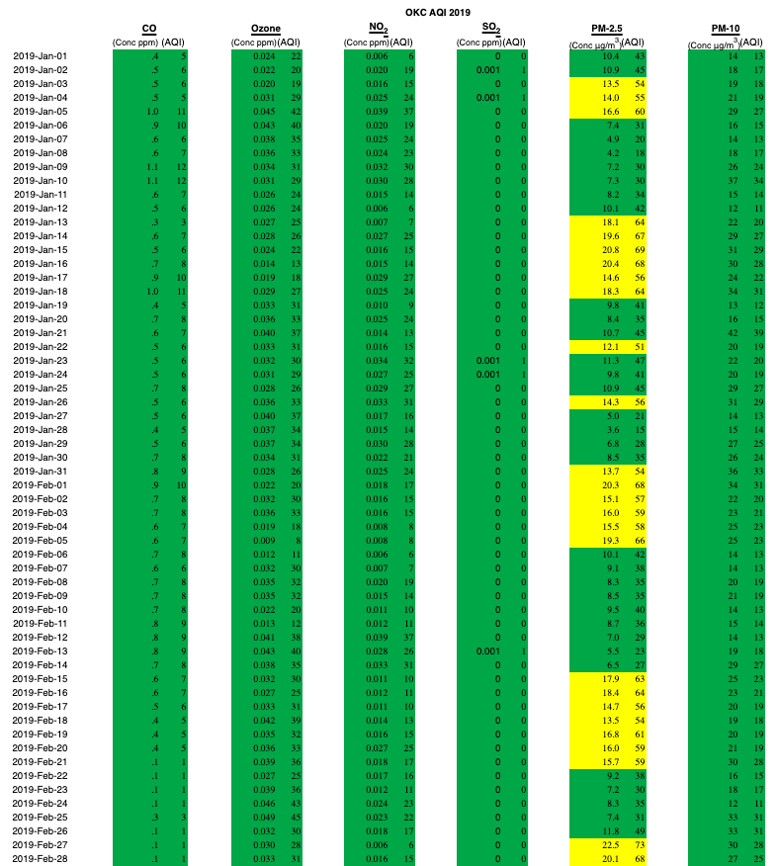
Sample Data
The sample data comes from Oklahoma City, January through February of 2019.
Highlight the data for the timeframe you have been assigned. Copy it. Paste it into a spreadsheet.
Notes:
https://applications.deq.ok.gov/webdata/aqd/monitoring/charts/OKCAQI2019.htm

Slide 7
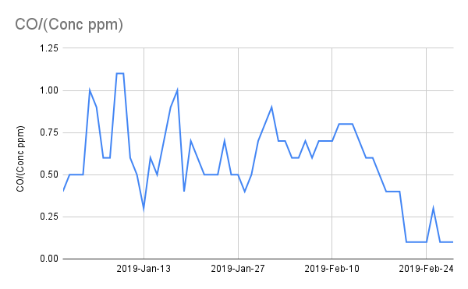
Sample Graph
Highlight the column of data that you are responsible for.
Select “Insert”
Select “Chart”
In the “Chart Editor” add the column information for the dates to be included in the X-axis
  A3:A62

Slide 8

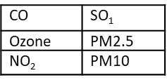
2020 Data Collected from Oklahoma City
Access the following data using the QR Code or the tinyURL:
  Oklahoma City
  2020
Copy the data into a spreadsheet for the two-month period you were assigned.
Individually, create a graph of one of the following data points:
https://tinyurl.com/OKCAirData

Slide 9

Jigsaw
As you read the information pages on your assigned pollutant, you will become an “expert,” recording questions or observations that you want to share with your group.
Notes:
Source: K20 Center. (n.d.). Jigsaw. Strategies. https://learn.k20center.ou.edu/strategy/179

Slide 10
Jigsaw
Group up with others who read about the same pollutant as you.
Share your questions and observations.
Include new observations or ideas as others in your group share what they noticed.

Slide 11
Jigsaw
Go back to your original group.
Share out what you have learned as pollutant expert.
You should all be able to answer the following questions:
  What do we know?
  What does this information mean?
  What additional information do we still need?

Slide 12

Driving Question Board
As you progress with your research, record any questions you may have or any relevant information you may discover.
Add them to either your class “Board” or the Driving Question Board handout.
Notes:
K20 Center. (2021, July). Driving Question Board. Strategies. https://learn.k20center.ou.edu/strategy/1511?rev=8567

Slide 13
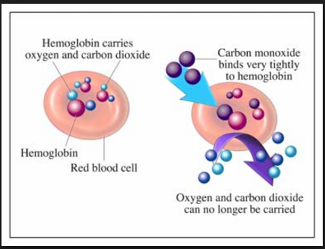
Carbon Monoxide
What do we know?
What does this information mean?
What information do we still need?
Notes:
American Council of Science and Health. (2016, January 27). Here’s why carbon monoxide is so dangerous [Infographic]. Retrieved from https://www.acsh.org/news/2016/01/27/why-carbon-monoxide-is-so-dangerous

Slide 14
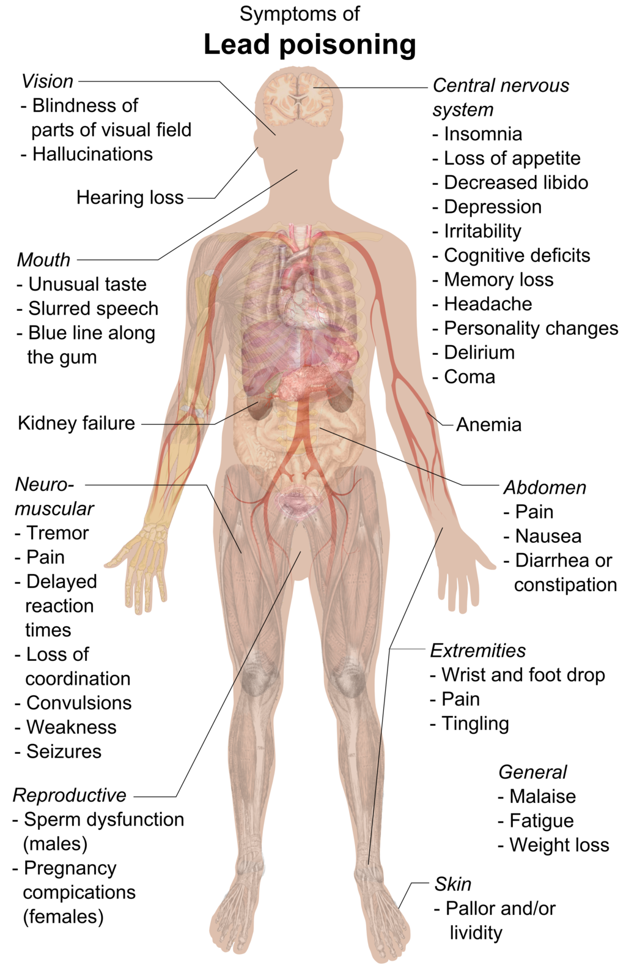
Lead
What do we know?
What does this information mean?
What information do we still need?
Notes:
Haggstrom, M. (2015, June 7). File: Symptoms of lead poisoning (raster). Retrieved April 19, 2021, from https://commons.wikimedia.org/wiki/File:Symptoms_of_lead_poisoning_(raster).png#file

Slide 15
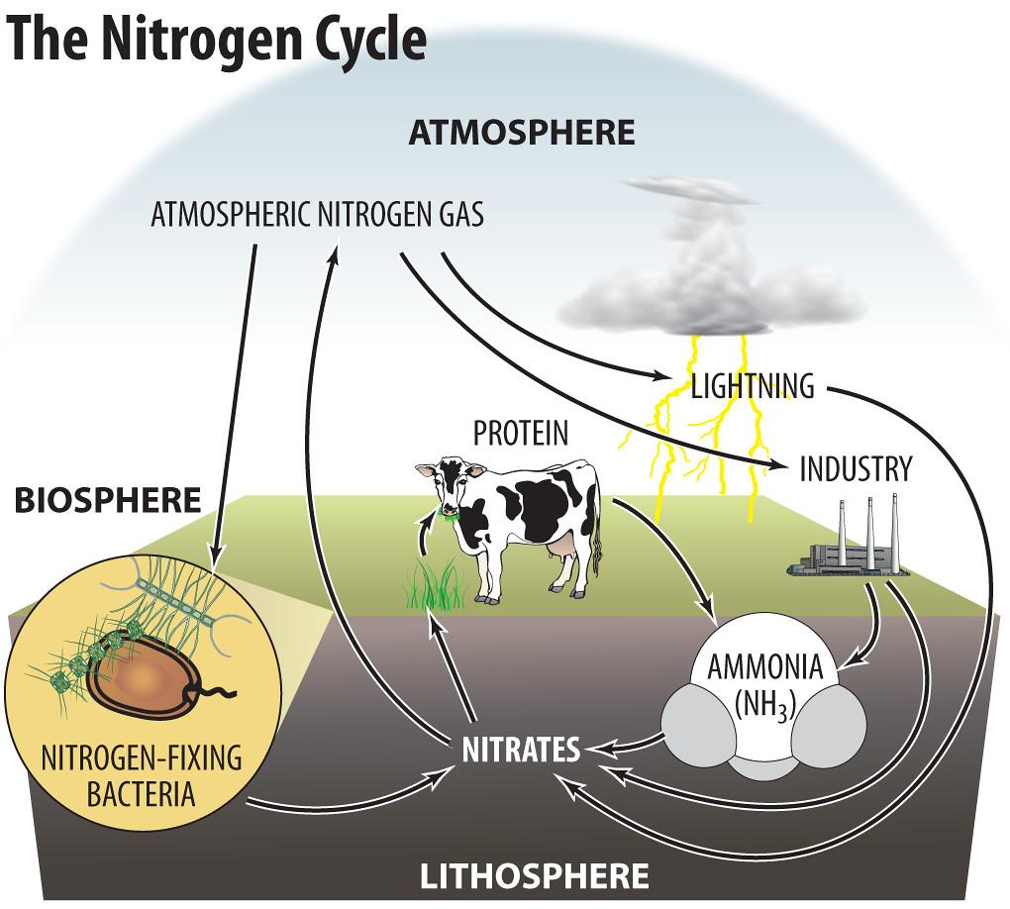
Nitrogen Dioxide
What do we know?
What does this information mean?
What information do we still need?
Notes:
Timmeko. (2011, Sept. 2). The nitrogen cycle. [Image]. Flickr. https://flickr.com/photos/timmeko/6106058553/in/photostream/Flickr

Slide 16
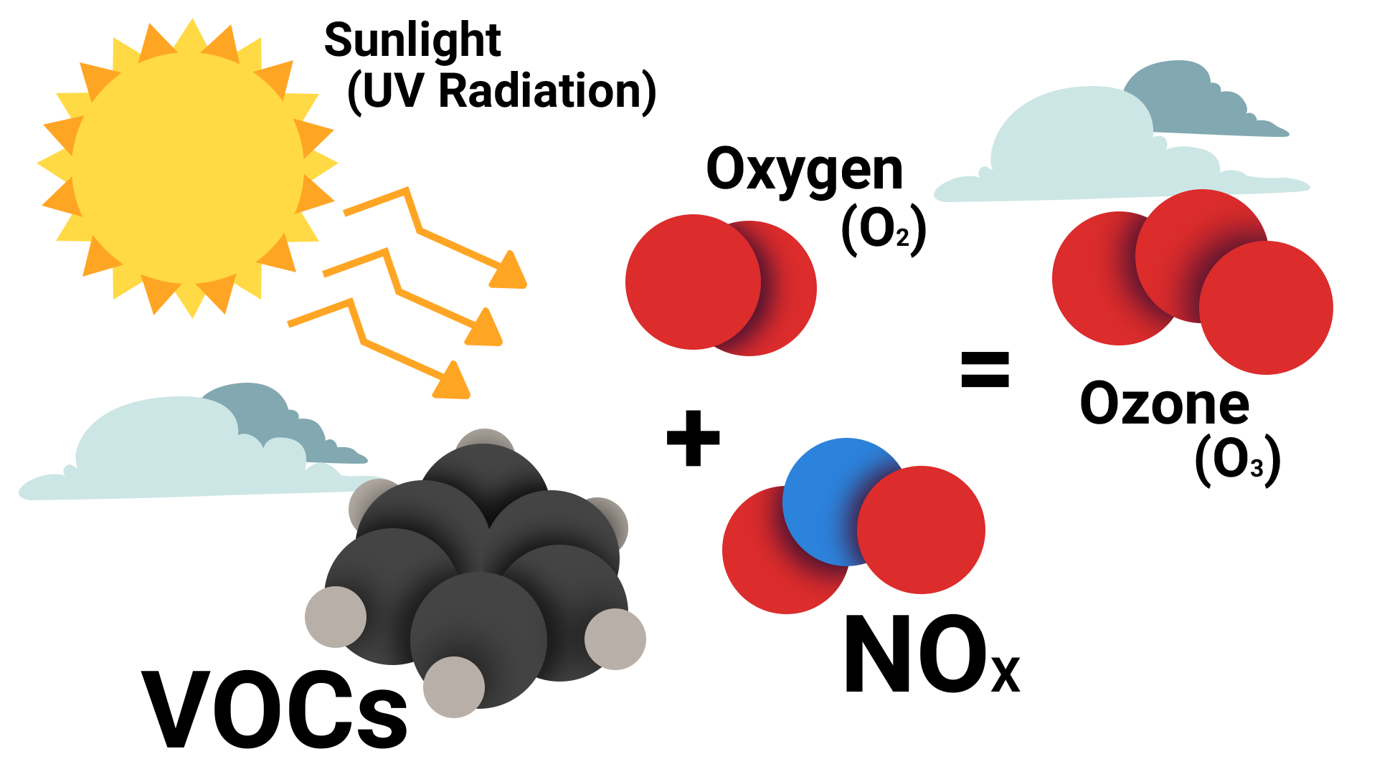
Ozone
What do we know?
What does this information mean?
What information do we still need?
Notes:
Oklahoma Department of Environmental Quality. (2020, April). Ozone [Fact sheet]. https://www.deq.ok.gov/wp-content/uploads/deqmainresources/Ozone_04-2020.pdf

Slide 17
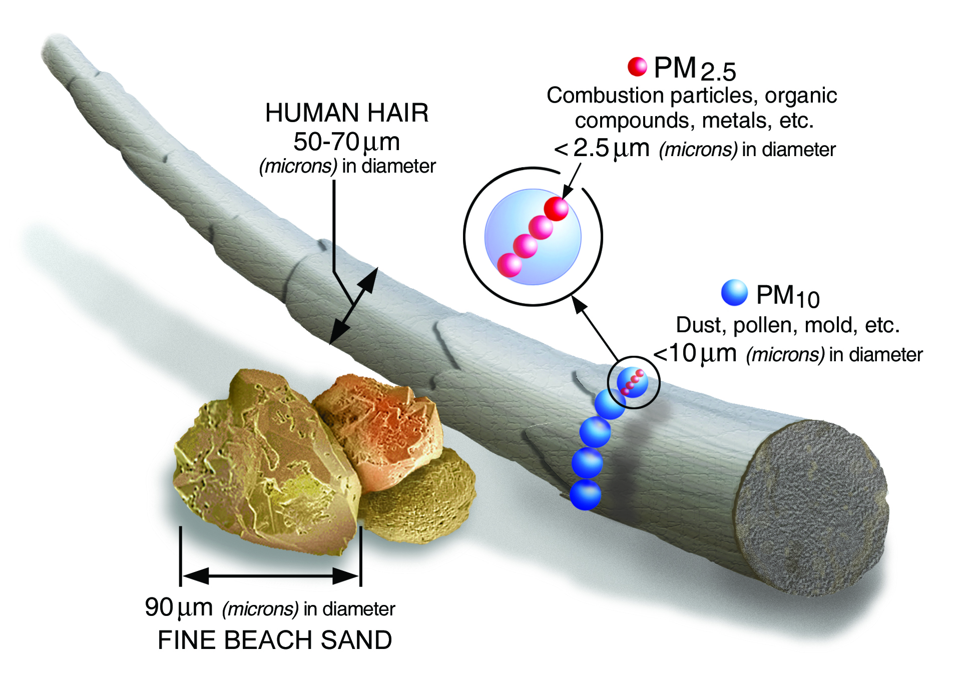
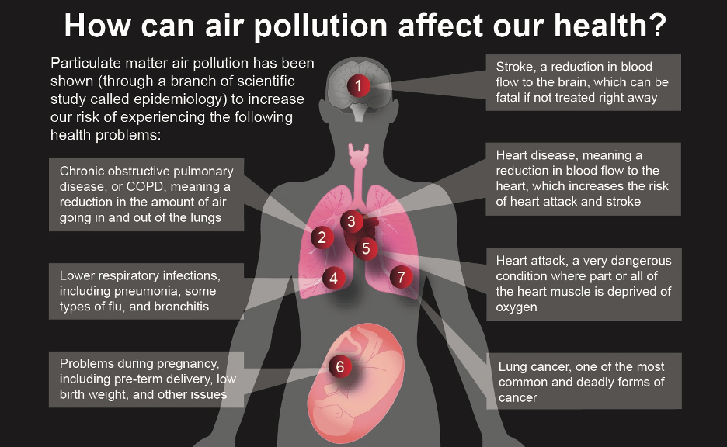
Particulate Matter
What do we know?
What does this information mean?
What information do we still need?
Notes:
United States Environmental Protection Agency. (n.d.). Size Comparisons for PM Particles [Digital image]. Retrieved April 16, 2021, from https://www.epa.gov/pm-pollution/particulate-matter-pm-basics#PM
NASA/JPL-Caltech. (2020, October 21). [Particulate matter air pollution is associated with numerous adverse health effects]. Retrieved April 16, 2021, from https://climate.nasa.gov/news/3027/getting-to-the-heart-of-the-particulate-matter/

Slide 18
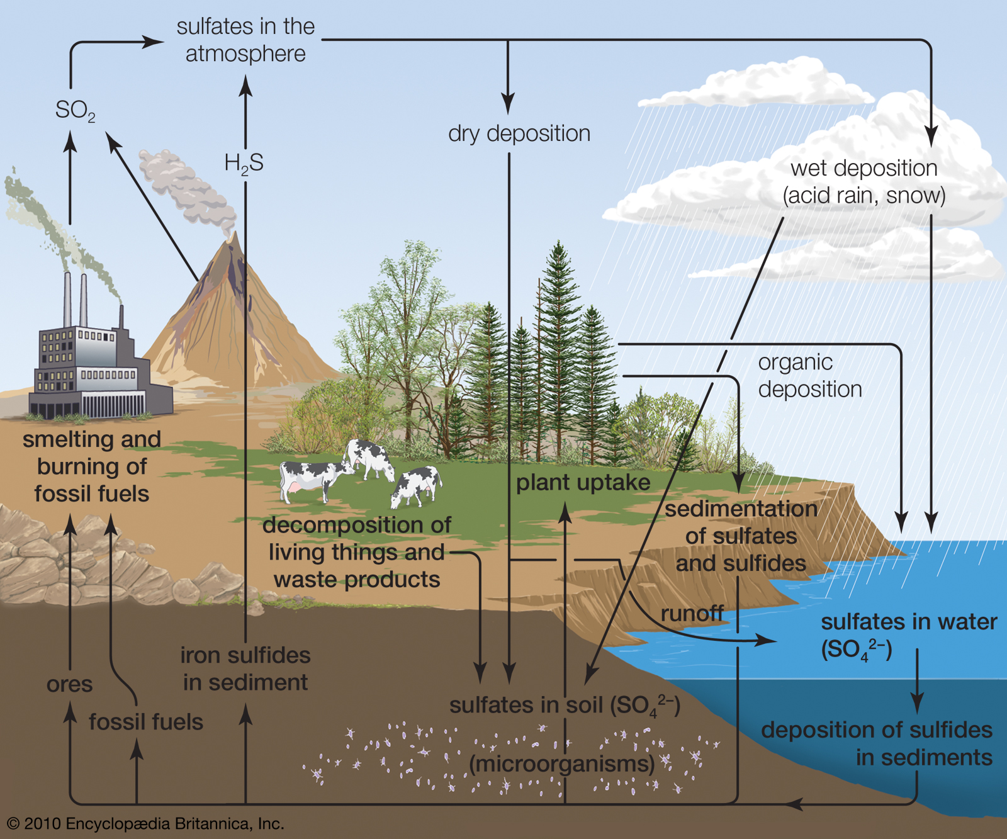
Sulfur Dioxide
What do we know?
What does this information mean?
What information do we still need?
Notes:
Britannica. (2000). Chemistry of acid deposition. [Image]. https://www.britannica.com/science/acid-rain/Chemistry-of-acid-deposition

Slide 19

Anchor Chart
Analyze designated time period.
Understand how pollutants interact with each other and how they affect humans.
Include group answers to the following questions:
  What do we know?
  What does this information mean?
  What information do we still need?

Slide 20

Gallery Walk
Walk around the room to view the information your peers have gathered.
Record observations and questions you still have.

Slide 21
2017 Data Collected from Oklahoma City
Access the following data using the QR Code or the tinyURL:
  Oklahoma City
  2017
Copy the data in a spreadsheet for the two months you were assigned.
Each student will create a graph of one of the data points:
  CO
  Ozone
  NO₂
  SO₁
  PM2.5
  PM10
https://tinyurl.com/OKCAirData

Slide 22
Comparing 2017 and 2020 Data
What does this information mean?
What information do we still need?
What differences do you notice between 2017 and 2020?
What similarities do you notice between 2017 and 2020?
Why would these differences occur?
Why do you think that is?

Slide 23

Driving Question Board
Are there any questions on the Driving Question Board that we can answer right now?

Slide 24
Public Service Announcement
Create a Public Service Announcement that meets the following criteria:
Written at the level a child (age 5-10) would understand;
Relates to air pollution
Includes important info;rmation that you have learned and think the public should know about;
In one of the following formats:
  Book
  Poster
  Podcast
  Song
  Video

