Slide 2
Got Culture? A Look at Zoonotic Diseases
Grades 9-10 STEM

Slide 3
Bell Ringer
Answer the following questions to the best of your knowledge before we begin today’s lesson:
If there were a pandemic/zombie apocalypse, why should we choose you for our survival team?
What causes diseases?
What disease can people get from animals?

Slide 4
Essential Questions
What is a zoonotic disease and what factors lead to their spread in human populations?

Slide 5
Lesson Objectives
Students will be able to:
identify human diseases and their vectors
compare/contrast bacteria vs. virus

Slide 6
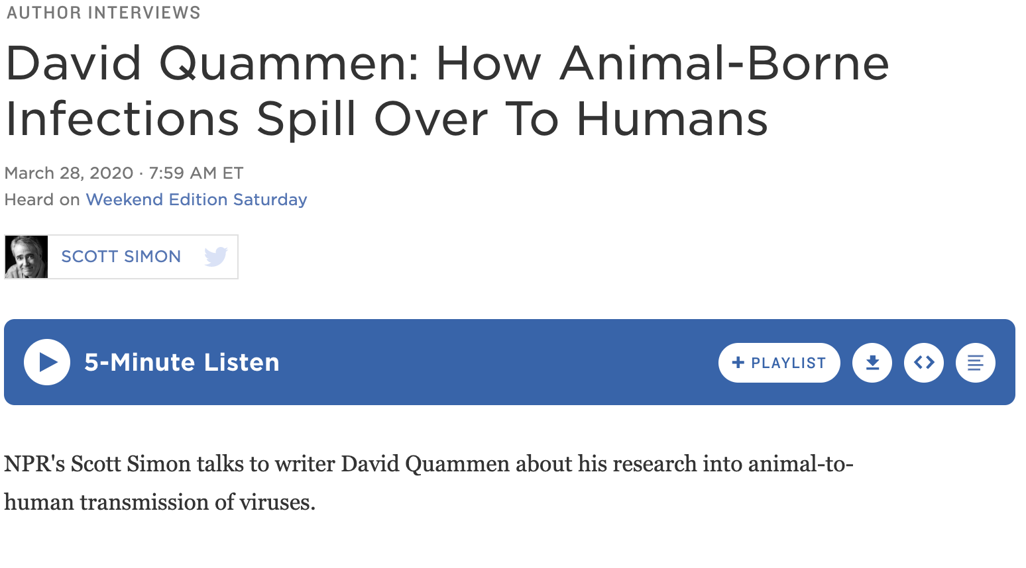
Who Is David Quammen?
David Quammen is a science writer and the author of Spillover Animal Infections and the Next Human Pandemic published in 2012.
Listen to the Interview David Quammen: How Animal-Borne Infections Spill Over To Humans.

Slide 7
TIP Chart
On your handout, document the vocabulary you learn during the breakout.
In the Information column, define the term.
In the Picture column, paste or draw a picture of the species.
Add any additional terms below the prepopulated terms.

Slide 8
Zoonotic Disease Digital Breakout
Notes:
https://sites.google.com/d/1LpE_CybhzkX7SWrV1L5_ScsDe0dBsKHA/p/1WHXTJH583jkTdnNT6A3EW1TICFRxRtOM/edit
Answer Key
Number Lock 60
Letter/ Number Lock SARS-CoV-2
Number Lock- 1976
Word Lock- Vector
Color Lock- GYRB

Slide 9
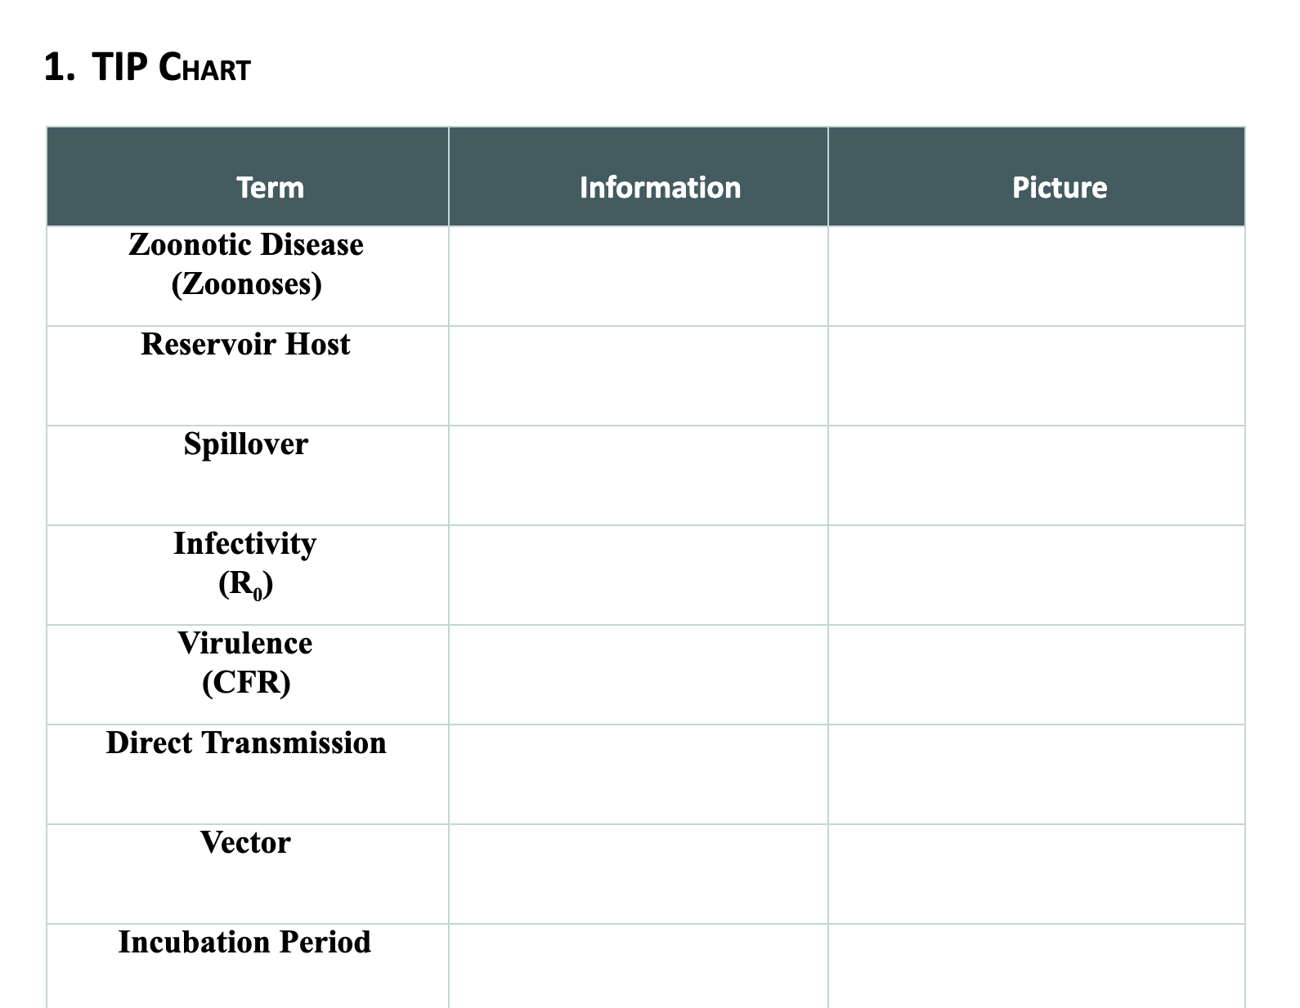
TIP Chart Debrief
Agree on class wide definitions and put on a large poster chart.
Discuss what you noticed during the breakout and what you still wonder.
Notes:
Video source: https://www.youtube.com/watch?v=stU7K1zU0r4

Slide 10
Zoonotic Disease
Research your chosen zoonotic disease and create a webpage about that disease.
Be sure to include
History of the first spillover
Infectious Agent and Hosts
Symptoms
Data Points (CFR, R₀, Incubation period, etc)
Pictures
Notes:
https://sites.google.com/ou.edu/gotcultureplanningforthenextbi/home

Slide 11
Feedback
Exchange webpages with another pair
Read through their entire website
Share 1-2 strengths
Share 1-2 questions you still have
Based on the feedback make final edits to your webpage.

