Slide 2
Unlocking Answers
Keys to Great Research

Slide 3
Essential Questions
How can we make sure we use and share reliable information?
In what ways can a piece of writing be clear and purposeful for the reader?

Slide 4
Lesson Objective
Determine the best way to use and share information.
Analyze sources for trustworthiness and dependability.
Synthesize learning to develop a plan for doing research.

Slide 5
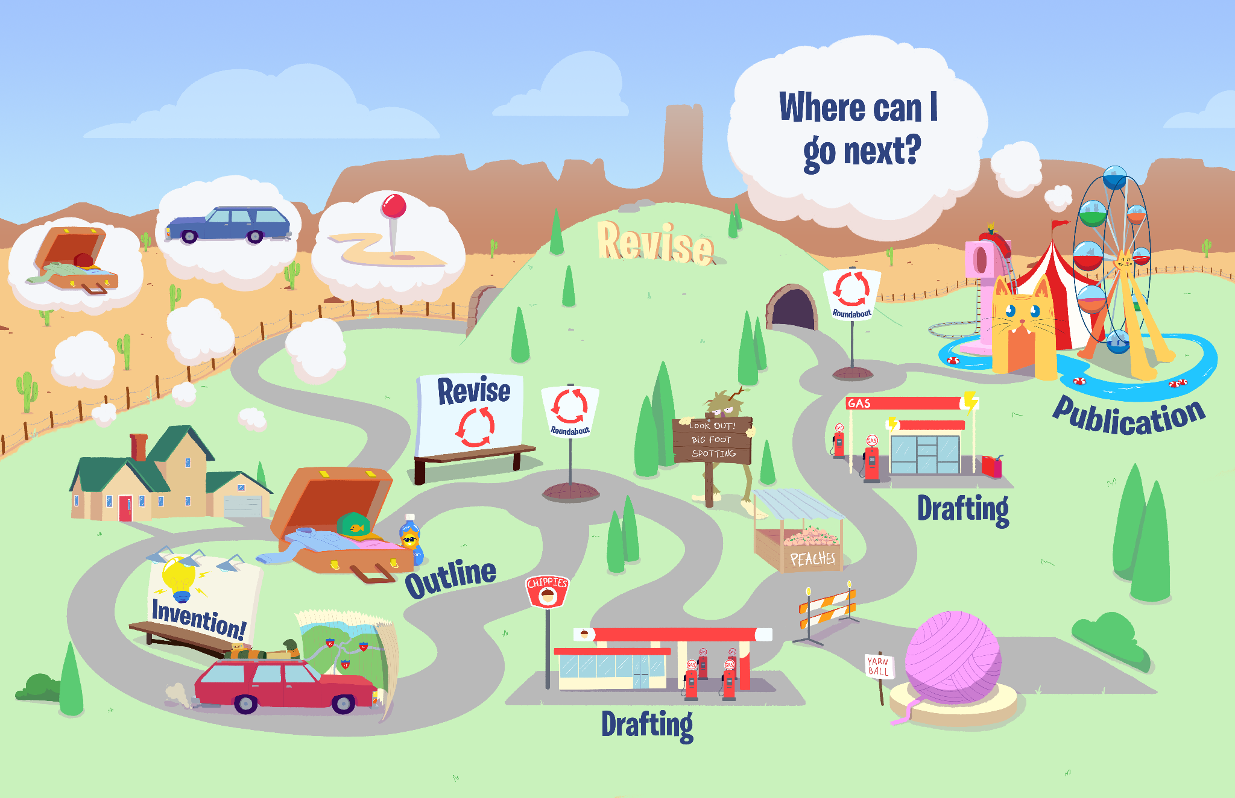
Writing Roadmap

Slide 6
The Hashtag Game
#
The principal has decided to hire one fast food restaurant to provide all the food in the cafeteria during the school year.
In three hashtags, share which place he should choose and why.

Slide 7
The Hashtag Game
#
Your streaming service is glitching and only one movie is available for you to watch this month.
In three hashtags, share which movie you would want to watch and why.

Slide 8
The Hashtag Game
#
You are stranded on a deserted island. One tool floats by close enough for you to grab it.
In three hashtags, share which tool you would want it to be and why.

Slide 9
Notes:
https://youtu.be/E1hNgZGDFwc

Slide 10
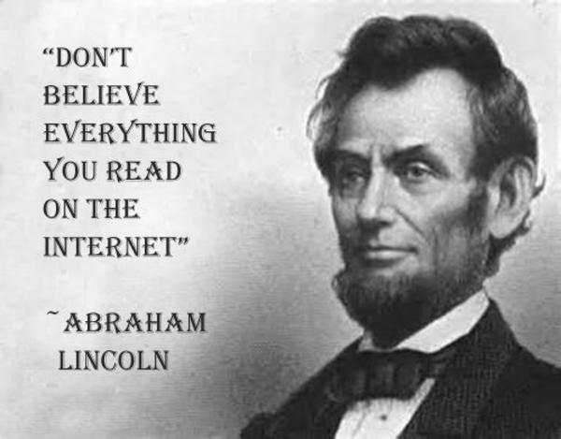
Notes:
img source: https://knowyourmeme.com/photos/1201185-troll-quotes

Slide 11
Notes:
https://youtu.be/NKm8-TR0rQw

Slide 12
Card Sort
Trustworthy
Not Trustworthy
Unsure

Slide 13
To Tell the Truth
Notes:
https://youtu.be/MGzCe9PQGyg

Slide 14
To Tell the Truth
Skim through the book.
Write down a quote from the book on your notecard.
Rewrite the quote in your own words.
Read the actual quote or the version of the quote you wrote in your own words and tell the class:
The quote came from the book.
I wrote that myself.

Slide 15
Create a Research Code of Conduct
Create a code of conduct that will be used when researching information.
Include in your code the following topics:
Keyword searching
Finding reliable sources
Avoiding plagiarism
Citing sources
Include details for each part of the code.

