Slide 2
My Turn Your Turn
Speaking and Listening

Slide 3
Essential Question
How do I know when it is my turn to speak?
How can I listen and make sure others know I am listening?
How does listening make me a better friend?

Slide 4
Lesson Objectives
Explore the traits of being a good listener and taking turns speaking.
Practice and evaluate the best strategies for listening and speaking.

Slide 5

Read Aloud
Notes:
Willems, Mo. (2011). I broke my trunk! (The Cozy Chair, Narrator). [Video]. YouTube. https://www.youtube.com/watch?v=ocubgIGwJeU
Sample of online read aloud: https://www.youtube.com/watch?v=ocubgIGwJeU
img source: https://www.amazon.com/Broke-Trunk-Elephant-Piggie-Book/dp/1423133099

Slide 6
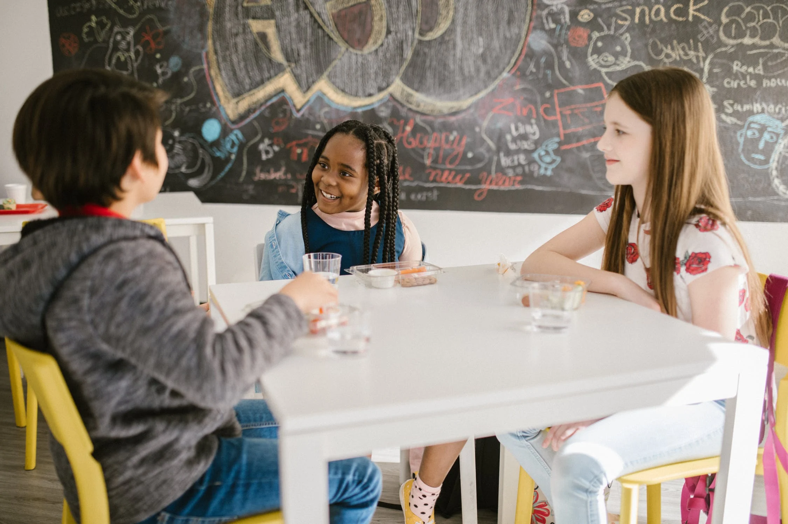
How can you tell they are listening?
Notes:
Rodnae Productions. Three students talking. Pexels. [Digital Image]. https://www.pexels.com/photo/three-students-talking-to-one-another-inside-the-classroom-6936328/

Slide 7

How can you tell they are listening?
Notes:
Duque, C. (n.d.). Boys sitting on floor. Pexels. [Digital Image]. https://www.pexels.com/photo/photo-of-boys-sitting-on-floor-3654176/

Slide 8

How can you tell they are listening?
Notes:
Holmes, K. (n.d.). Happy diverse schoolchildren communicating. Pexels [Digital Image]. https://www.pexels.com/photo/happy-diverse-schoolchildren-communicating-in-corridor-during-break-5905487/

Slide 9
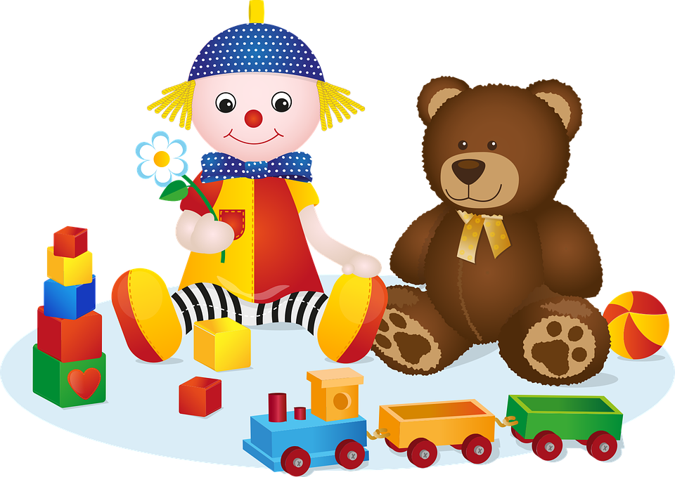
Talking Toy
Only the person holding the toy can talk
Notes:
Pixabay. (n.d.). Doll and teddy bear. [Digital Image]. https://pixabay.com/vectors/toy-toys-doll-teddy-bear-5262311/

Slide 10
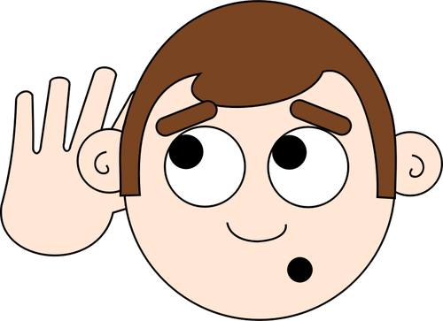
I Hear You
One person shares
A friend raises their hand afterward and repeats what they heard
Notes:
FlyClipart. (n.d.). Listening ears. [Digital Image]. https://flyclipart.com/cartoon-listening-ears-clipart-servant-clipart-290216

Slide 11

POMS
One person shares
A friend tells us the most important thing their friend said

Slide 12

Anchor Chart
Which things we have tried for taking turns speaking and listening will help us learn?
What is the best way for us to take turns speaking and listening in class?

