Slide 2
On Pins and Needles
Effects of the Cold War

Slide 3
Essential Question
How did the Cold War affect citizens of the United States?

Slide 4
Lesson Objective
Students will evaluate the effects of the Cold War on citizens in the United States.

Slide 5
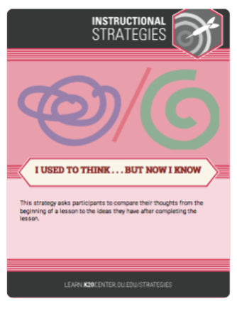
I Used to Think…
In the left-hand column of your handout (“I Used to Think”), write down what you know about how the Cold War affected people within the US.
You will fill in the right-hand column of your handout later.
Notes:
K20 Center. (2020, September 16). I used to think… But now I know. Strategies. https://learn.k20center.ou.edu/strategy/137

Slide 6

S-I-T (Surprising, Interesting, Troubling)
As you read, look for the following:
  One Surprising fact or idea.
  One Interesting fact or idea.
  One Troubling fact or idea.
Once you have completed your S-I-T handout, discuss with an elbow partner what you have discovered.
Notes:
K20 Center. (2021, February 12). S-I-T (Surprising, Interesting, Troubling). Strategies. https://learn.k20center.ou.edu/strategy/926

Slide 7

Inverted Pyramid Graphic Organizer
On the top of your pyramid, include the most important info. In 25-45 words, address the 5 Ws and make a bold statement based on your opinion.
In the middle of your pyramid, add the essential info (i.e., story details, background info, evidence supporting your statement).
At the bottom of your pyramid, list the extras (i.e., interesting facts, ways in which the event in the video relates to the article or events in your life, concluding statement).
Notes:
Rawpixel.com. (n.d.). Neon light frame - Upside down triangle. Freepik. https://www.freepik.com/free-vector/neon-light-frame_4520127.htm#page=1&query=triangle&from_query=upside%20down%20triangle&position=0&from_view=search

Slide 8
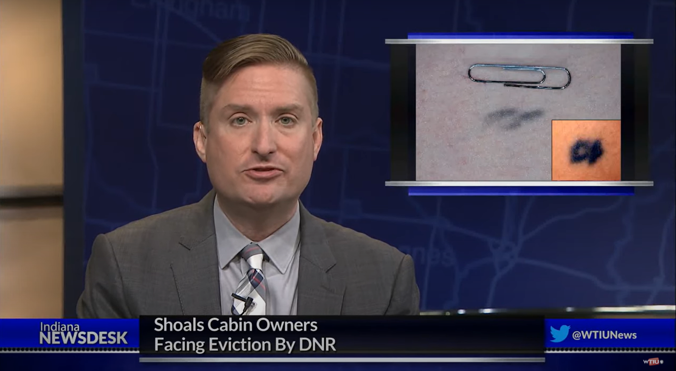
Video
Some Hoosiers Carry Permanent Reminder Of 'Operation Tat-Type’
Notes:
WTIU. (2019, July 5). Some Hoosiers carry permanent reminder of ‘Operation Tat-Type’ [Video]. YouTube. https://www.youtube.com/watch?v=DjitM34Fr1w

Slide 9

Jigsaw
In your group of four, you will split up the four articles:
  1. Punjab Police [India]
  2. Australian Convicts
  3. China
  4. Ancient Greece [Athens]
As you read, summarize in the left-hand column the events that happened in your location.
In the right-hand column, write how those events are similar or different from what happened in the Cold War.
Notes:
K20 Center. (2020, September 16). Jigsaw. Strategies. https://learn.k20center.ou.edu/strategy/179

Slide 10
Jigsaw
As you connect with your group, discuss and complete your Jigsaw handout.
Items to discuss:
  Takeaways from the article
  Questions you still have
  Things you wondered about
Notes:
K20 Center. (2020, September 16). Jigsaw. Strategies. https://learn.k20center.ou.edu/strategy/179

Slide 11

…But Now I Know
In the right-hand column of your handout (“But Now I Know”), write down what you now know about how the Cold War affected citizens in the US.
Notes:
K20 Center. (2020, September 16). I used to think… But now I know. Strategies. https://learn.k20center.ou.edu/strategy/137

