Slide 2
Yours, Mine, and Ours, Part 1
An Introduction to Federalism

Slide 3
True or False?
States can declare war on another country.
States can decide what content is taught in schools.
States decide what day to hold the presidential election.
States can decide what the speed limit is.

Slide 4
Essential Question
How is power shared in a federal system?

Slide 5
Lesson Objective
Explain how power is shared among levels of government.

Slide 6
Government in Daily Life
As you read the first column, think of a law or government agency that has input or control over the event.
Add the name of the agency or the type of law to the second column.
Notes:
Image Source: https://learn.k20center.ou.edu/strategy/192

Slide 7
Federalism Defined
A system of government in which entities such as states share power with a national government.
Notes:
Federalism - definition, meaning & synonyms. Vocabulary.com. (n.d.). https://www.vocabulary.com/dictionary/federalism

Slide 8
What is federalism?
Notes:
Video Source: https://www.youtube.com/watch?v=4PJKe12mUvs

Slide 9
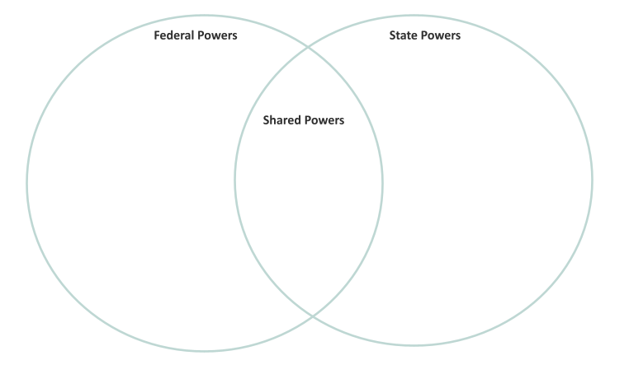
Who has the power?
Read the list of government powers.
Write each power in the appropriate place on the venn diagram.

Slide 10
Socratic Seminar: Preparation
Come prepared to discuss the two issues on the Socratic Seminar handout.
Write two questions per issue that will help you and your classmates have an in-depth discussion.

Slide 11
Socratic Seminar Do’s and Don’ts
Prepare by reading before the seminar.
Focus on the text when conversing.
Make eye contact and be engaged with the speaker.
Be respectful of differing opinions.
Awkward silences are natural.
Build on previous comments.
Expect teacher intervention to redirect as needed.
Don’t dominate the conversation; allow for many voices.
Don’t interrupt your peers.
Don’t treat this as a debate, but as a conversation.
Don’t have a side conversation with another student; focus on the speaker.
Don’t be on your phone or personal device.
Don’t be rude or disrespectful to your peers.
Notes:
Davenport, M. (2016, September 22). Socratic Seminars: Building a culture of student-led discussion. Edutopia. Retrieved January 20, 2022, from https://www.edutopia.org/blog/socratic-seminars-culture-student-led-discussion-mary-davenport

Slide 12
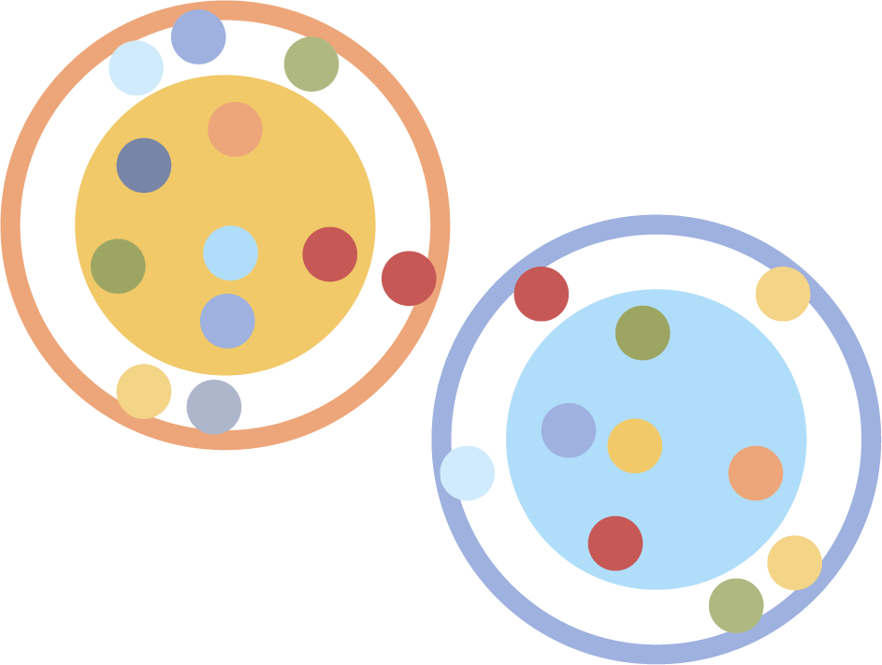
Socratic Seminar: Round 1
• Divide into two groups:
● Group 1: Inner Circle
● Group 2: Outer Circle
• Round 1:
● Inner Circle discusses issues outlined in the handout. (15-30 minutes)
● Outer Circle silently observes dialogue and records observations.
Note: This exercise is NOT a debate. There is no “winner” or “loser” in the discussions.

Slide 13
Socratic Seminar: Round 2
Change roles.
● Inner Circle discusses issues outlined in the handout. (15-30 minutes)
● Outer Circle observes dialogue and records observations.
Reminder: This exercise is NOT a debate. There is no “winner” or “loser” in the discussions.

Slide 14
Exit Ticket
What are the benefits and drawbacks of a federal system?
Notes:
Image source: https://learn.k20center.ou.edu/strategy/125

