Slide 2
The Million Dollar Question
Informative Writing

Slide 3
Essential Question
What makes informative writing different from other writing modes?

Slide 4
Lesson Objectives
Compose essays and reports that introduce and develop topics without bias;
Use evidence, facts, examples, and data to support writing;
Maintain an organized structure and formal style.

Slide 5
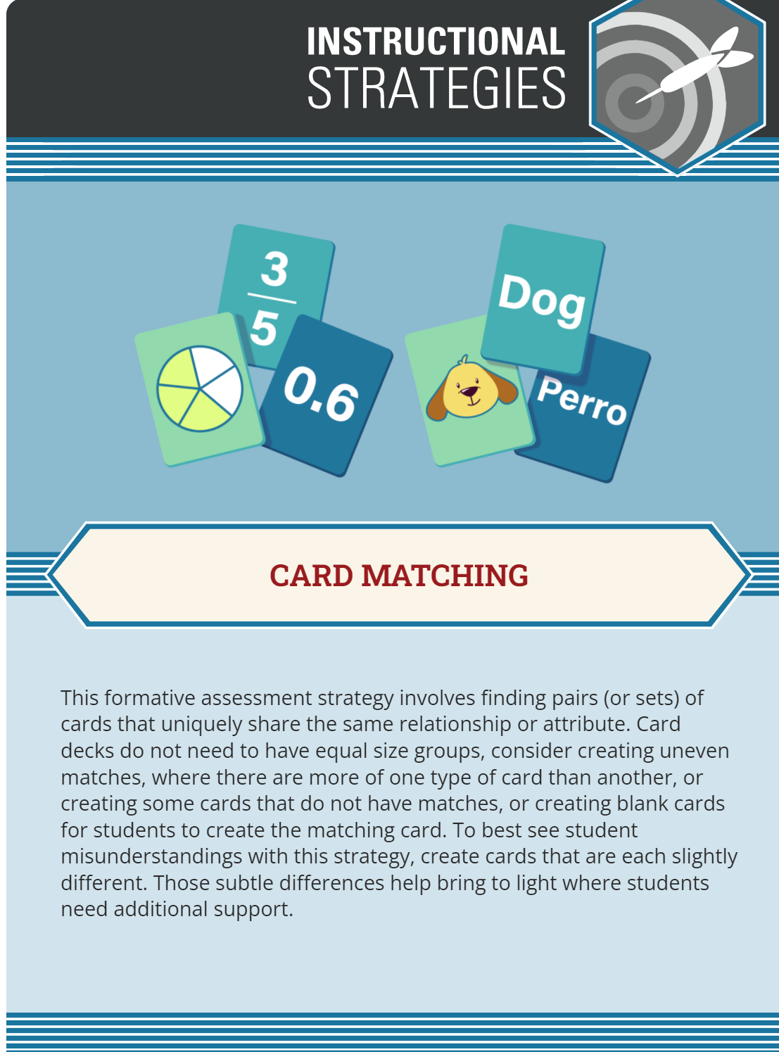
Card Matching
In your group:
Sort through the terms, definitions, and examples.
Match the term with the correct definition and example.
  Helpful Hint: Each mode of writing will have 1 definition,
    1 question, 1 thesis statement, and 3 examples.
Take 3 minutes to do this.
Notes:
K20 Center. (n.d.). Card matching. Strategies. https://learn.k20center.ou.edu/strategy/1837

Slide 6
Guiding Questions
What is the purpose of informative writing?
How does informative writing differ from a research paper or an argumentative essay?
What kind of sources should you use for informative writing?
What are the 5 questions (5 Ws) to answer in informative writing?
What organizational structures should you use for informational writing?

Slide 7
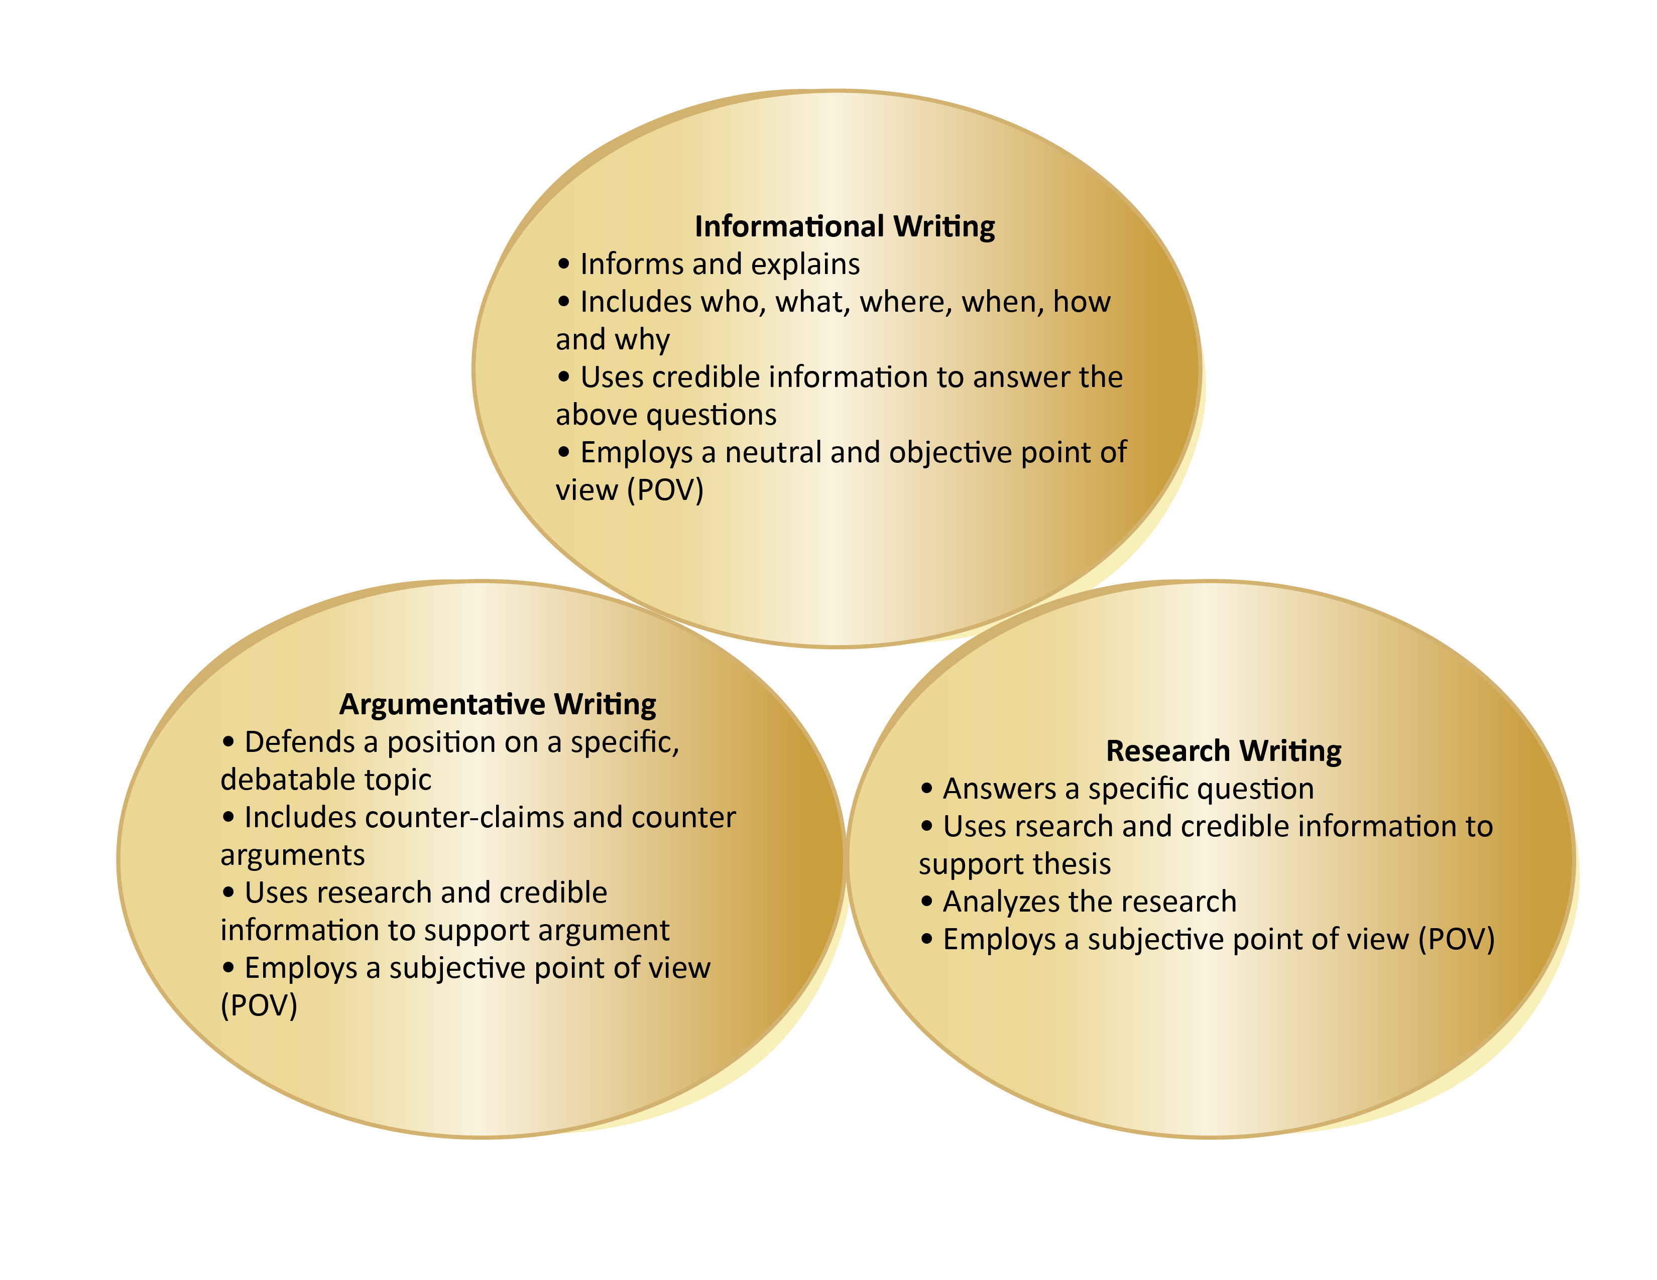
Let’s examine the differences!

Slide 8
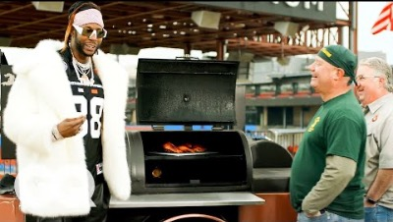
The Most Expensive Grill
As you watch the video, record all of the questions 2 Chainz asks on a sheet of notebook paper.
Notes:
Video link: https://youtu.be/xooZHtfjmYY

Slide 9
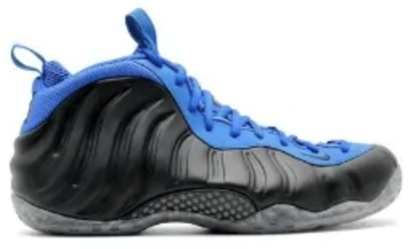
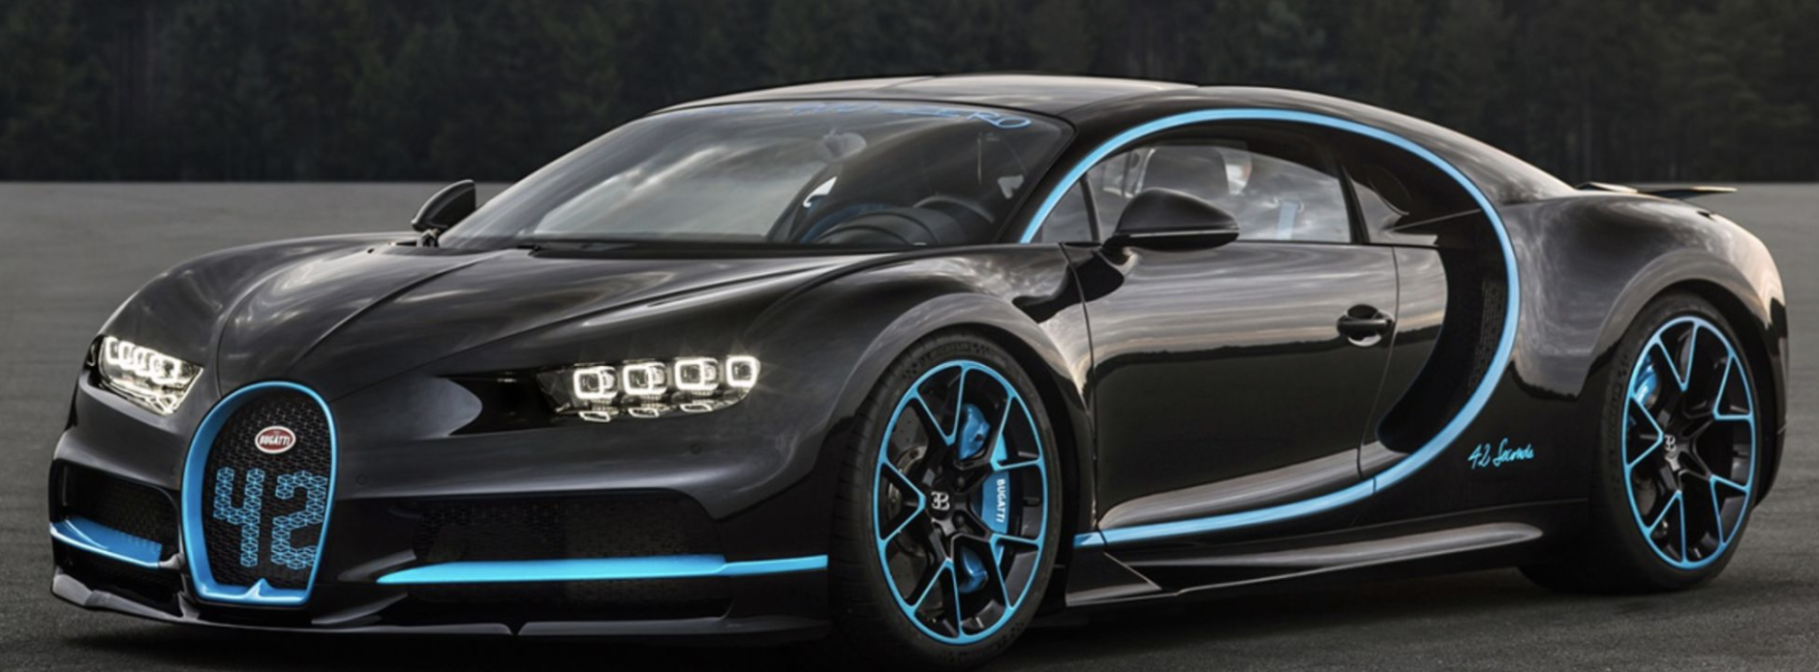




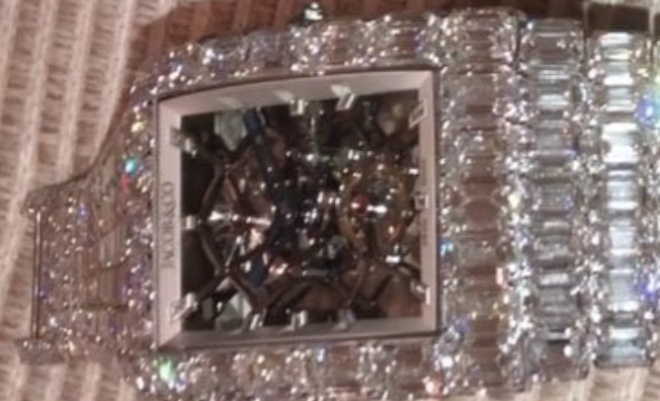


Choice Board
If you had a million dollars to spend, what would you buy?
Shoes
Cars
Fashion
Toys
Boats
Makeup/Hair
Tech Gadgets
Home
Jewelry
Notes:
Strategy: K20 Center. (n.d.). Choice Boards. Strategies. https://learn.k20center.ou.edu/strategy/73

Slide 10
Research
Use credible sources to answer the following questions about your item for your 5-paragraph essay:
What is it?
When was it invented?
How is it made?
How much does it cost?
Where can I get it?
Who else has it or access to it?
How did it get its name?

Slide 11
Outline
Paragraph | Questions to Answer
Introduction | What is it?
Body Paragraph 1 | When was it invented? How did it get its name?
Body Paragraph 2 | How is it made?
Body Paragraph 3 | How much does it cost? Where can I get it?
Conclusion | Recap and explain why this item is desirable.

Slide 12
Q&A
In groups of two, you will be interviewed about your item. This must be done in one of the following formats:
Recorded and Submitted
Presented in-class
Presented after school or during lunch
Use the Q&A Rubric as your guide.

Slide 13

I Used to Think…But Now I Know
What have you thought about informative writing?
  I used to think . . .
What do you know about informative writing now?
  But now I know . . .
Notes:
K20 Center. (n.d.). I Used to Think . . . But Now I Know. Strategies. https://learn.k20center.ou.edu/strategy/137

