Slide 2
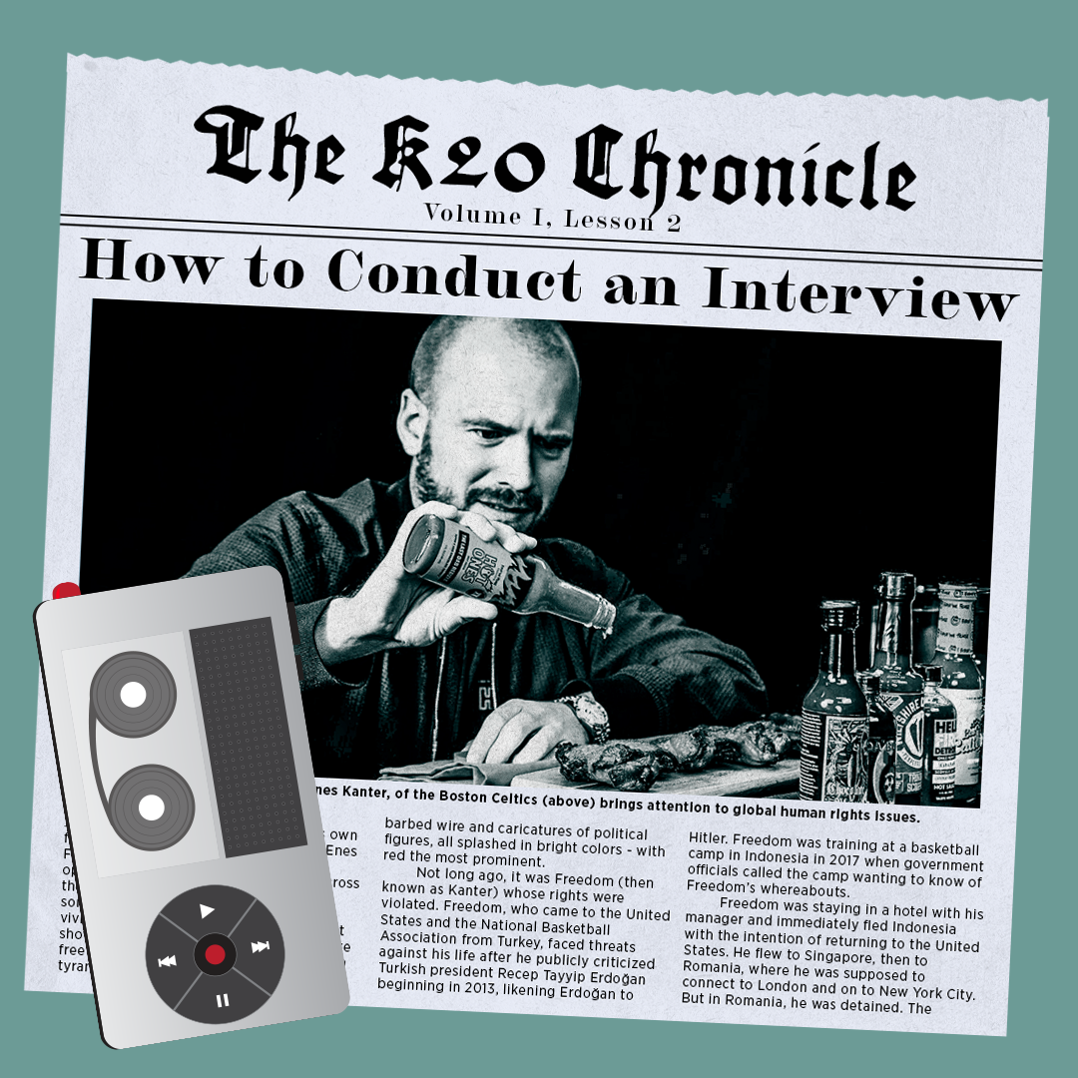
The K20 Chronicle, Lesson 2
How to Conduct an Interview

Slide 3
Essential Questions
What are the components of a journalistic article?
What makes a good article?
How do you create an engaging story?

Slide 4
Lesson Objectives
Develop interviewing techniques and employ best practices in a peer interview.
Analyze a classmate’s interview according to rules and guidelines developed from research.

Slide 5

Dream Interview
If you could interview one person from any time period, who would it be?
Notes:
Art created by K20 Art Department

Slide 6


Chain Notes
Take time with your group and brainstorm a list of questions you would ask the person listed on your paper.
Record as many questions as you can think of.
Notes:
K20 Center. (n.d.). Chain Notes. Strategies. https://learn.k20center.ou.edu/strategy/52
K20 Center. (2021, September 21). K20 Center 5 minute timer. YouTube. https://www.youtube.com/watch?v=EVS_yYQoLJg&list=PL-aUhEQeaZXLMF3fItNDxiuSkEr0pq0c2&index=7

Slide 7

Chain Notes
Read through the questions that have been written already.
Brainstorm a list of additional questions you would ask the person listed on your paper.
Record as many questions as you can think of.
Notes:
K20 Center. (n.d.). Chain Notes. Strategies. https://learn.k20center.ou.edu/strategy/52
K20 Center. (2021, September 21). K20 Center 4 minute timer. YouTube. https://www.youtube.com/watch?v=kpCsfuvzQeY&list=PL-aUhEQeaZXLMF3fItNDxiuSkEr0pq0c2&index=6&t=4s

Slide 8

Chain Notes
Read through the questions that have been written already.
Brainstorm a list of additional questions you would ask the person listed on your paper.
Record as many questions as you can think of.
Notes:
K20 Center. (n.d.). Chain Notes. Strategies. https://learn.k20center.ou.edu/strategy/52
K20 Center. (2021, September 21). K20 Center 3 minute timer. YouTube. https://www.youtube.com/watch?v=iISP02KPau0&list=PL-aUhEQeaZXLMF3fItNDxiuSkEr0pq0c2&index=5

Slide 9

Chain Notes
Read through the questions that have been written already.
Brainstorm a list of additional questions you would ask the person listed on your paper.
Record as many questions as you can think of.
Notes:
K20 Center. (n.d.). Chain Notes. Strategies. https://learn.k20center.ou.edu/strategy/52
K20 Center. (2021, September 21). K20 Center 2 minute timer. YouTube. https://www.youtube.com/watch?v=HcEEAnwOt2c&list=PL-aUhEQeaZXLMF3fItNDxiuSkEr0pq0c2&index=4

Slide 10

Chain Notes
Read through the questions that have been written already.
Brainstorm a list of additional questions you would ask the person listed on your paper.
Record as many questions as you can think of.
Notes:
K20 Center. (n.d.). Chain Notes. Strategies. https://learn.k20center.ou.edu/strategy/52
K20 Center. (2021, September 21). K20 Center 1 minute timer. YouTube. https://www.youtube.com/watch?v=6ilD555O_RE&list=PL-aUhEQeaZXLMF3fItNDxiuSkEr0pq0c2&index=2

Slide 11
Chain Notes
Read through all of the questions that have been written on your chart paper.
  Are there any questions on your paper that you noticed on other groups’ charts?
  Which questions do you absolutely love?
  Which questions are you not sure about?
Notes:
K20 Center. (n.d.). Chain Notes. Strategies. https://learn.k20center.ou.edu/strategy/52

Slide 12

Interviewing Techniques and Guidelines
Notes:
To play the video, click the image on the slide or copy and paste the following link into your web browser: https://www.youtube.com/watch?v=Afpgnb_9bA4
Video: ESPN. (2018, June 11). [Full] Lebron James' ‘The Decision' (7/8/2010) | ESPN archives. YouTube. Retrieved February 28, 2022, from https://www.youtube.com/watch?v=Afpgnb_9bA4

Slide 13

Jigsaw Videos
Watch three other videos from
the Wakelet collection.
As you watch, consider the techniques you see the
interviewers using.
  What kinds of questions are they asking?
  How are they responding to the interviewee?
Notes:
Provide students with the following Wakelet link: https://wke.lt/w/s/RDXwwr
K20 Center. (n.d.). Jigsaw. Strategies. https://learn.k20center.ou.edu/strategy/179
Link, L. (n.d.). How to Conduct an Interview [Video collection]. Wakelet. https://wke.lt/w/s/RDXwwr

Slide 14
Rules for Interviewing
What interviewing techniques did you notice in the videos?
What are some common rules you might follow when conducting your own interview?
Notes:
Art created by K20 Art Department

Slide 15
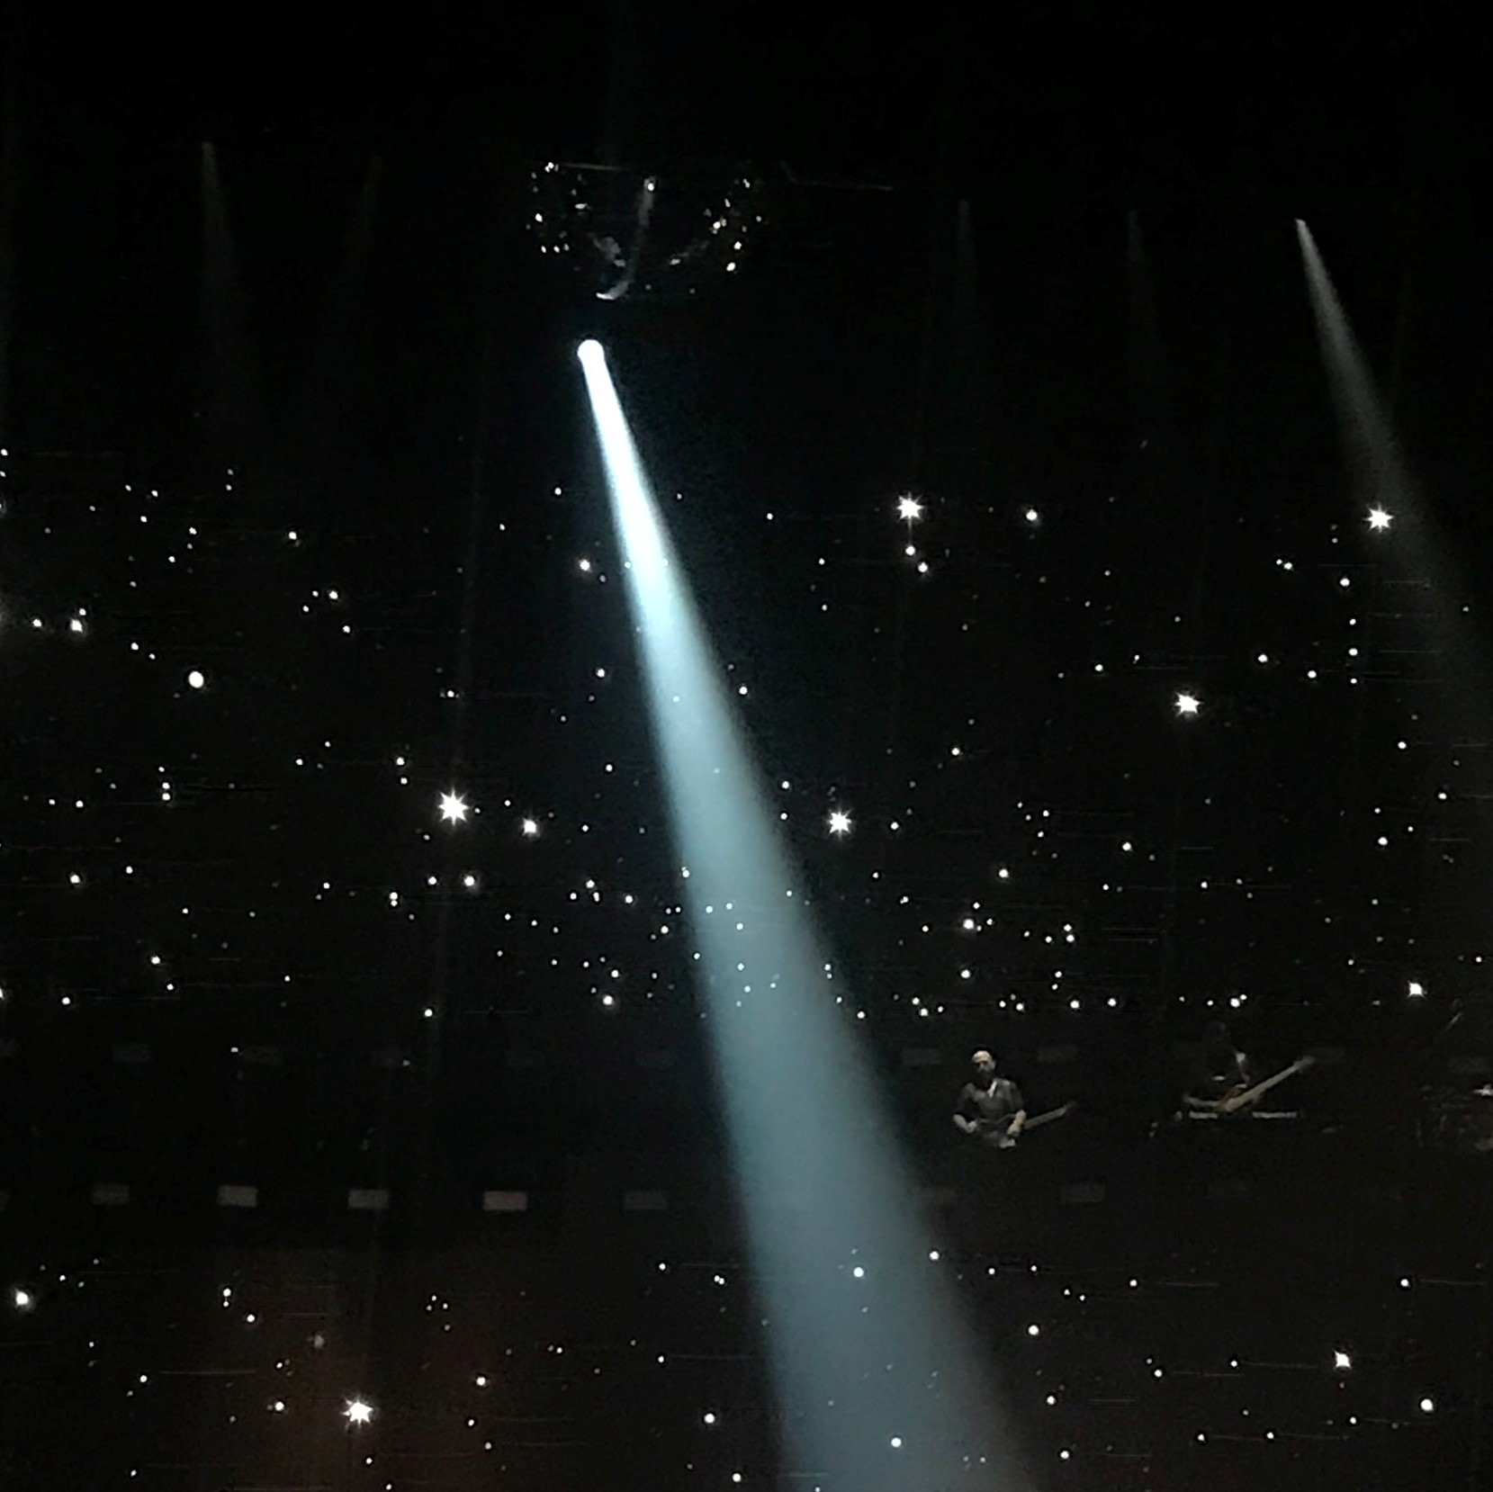
Senior Spotlight
Write 7–10 interview questions that you would like to ask a senior for your Senior Spotlight article.
Notes:
Image: Orlov, R. (2019, June 10). Woman wearing red dress performing stage [Cropped image]. Unsplash. https://unsplash.com/photos/9CO89wTPmOc

Slide 16

Don’t Forget
Record the interview.
During the interview, ask
follow-up questions to get
more information if needed.
Take photos of your senior in a variety of locations around the school.
Notes:
Image: Linojacob. (2021). Gopro, camera, device, gopro hero 6, action camera, technology, photos [Image]. Pixabay. Retrieved March 1, 2022, from https://pixabay.com/photos/gopro-camera-device-gopro-hero-6-6325014/

Slide 17

3-2-1
Watch your partner’s video and give feedback on:
  3 interviewing rules they followed
  2 things they should include in their article
  1 area where they could improve
Make sure to include the timestamps of any sections you’re referencing so they can be found easily.
Notes:
K20 Center. (n.d.). 3-2-1. Strategies. https://learn.k20center.ou.edu/strategy/117

