Slide 2
Lights, Camera, Action!
Media Production, Lesson 1

Slide 3
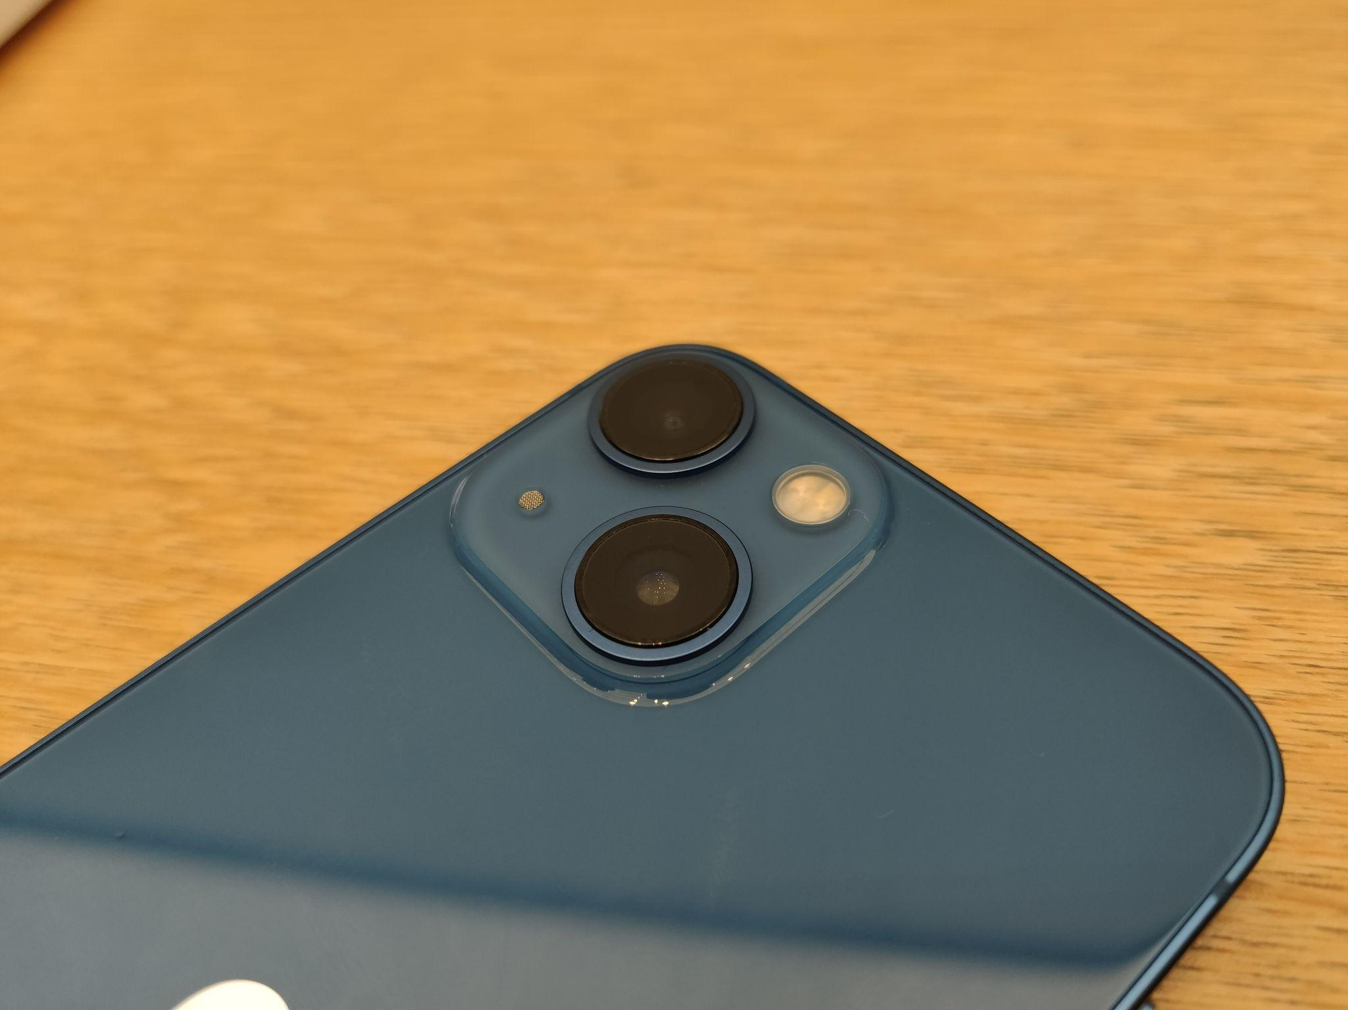
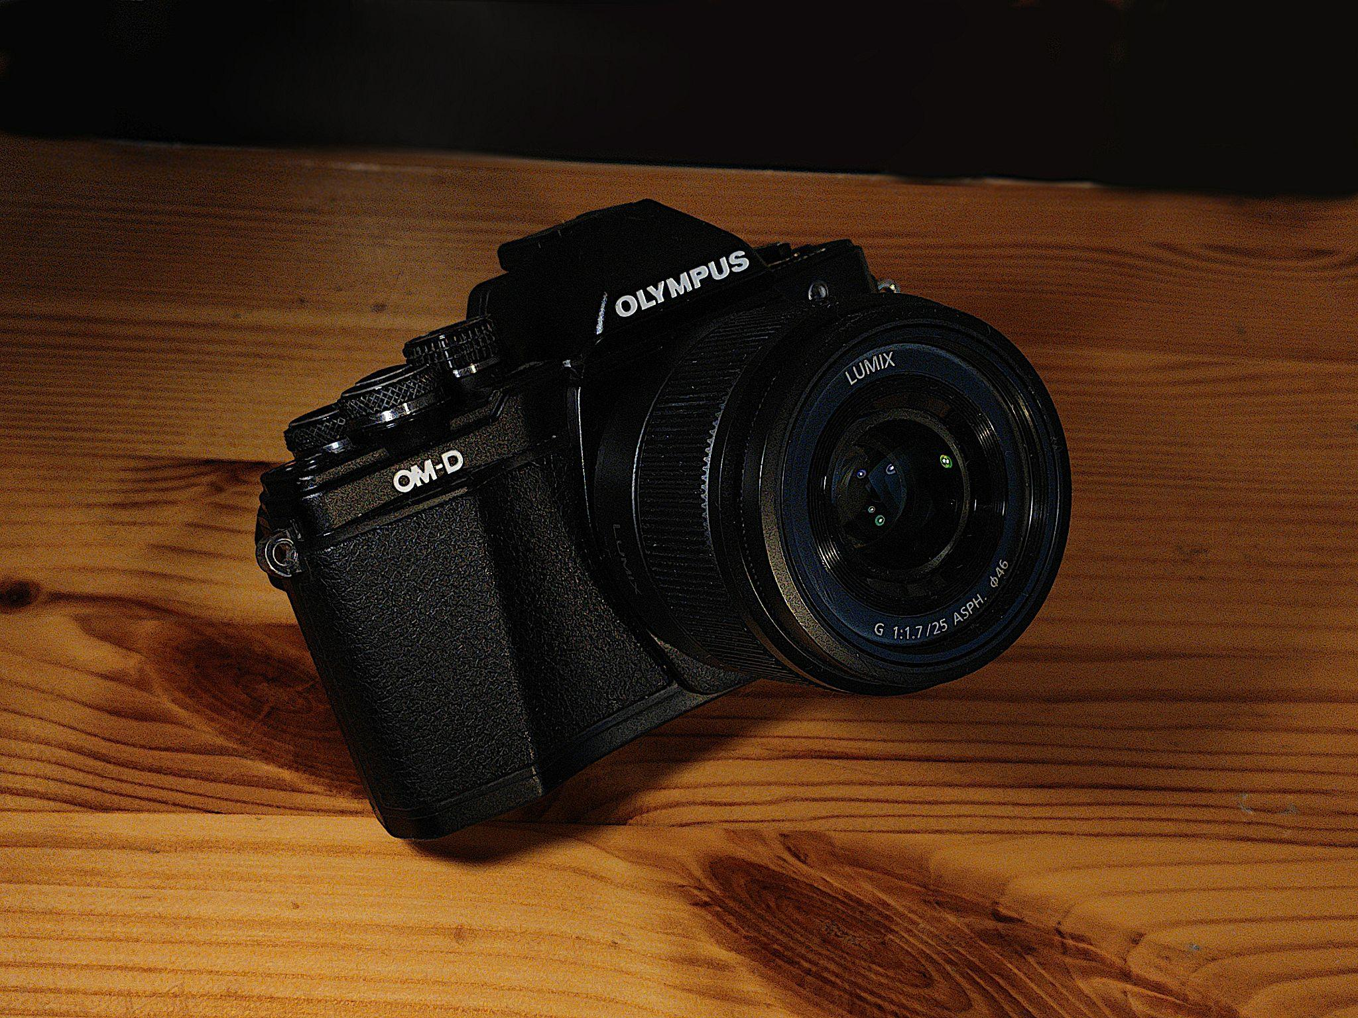
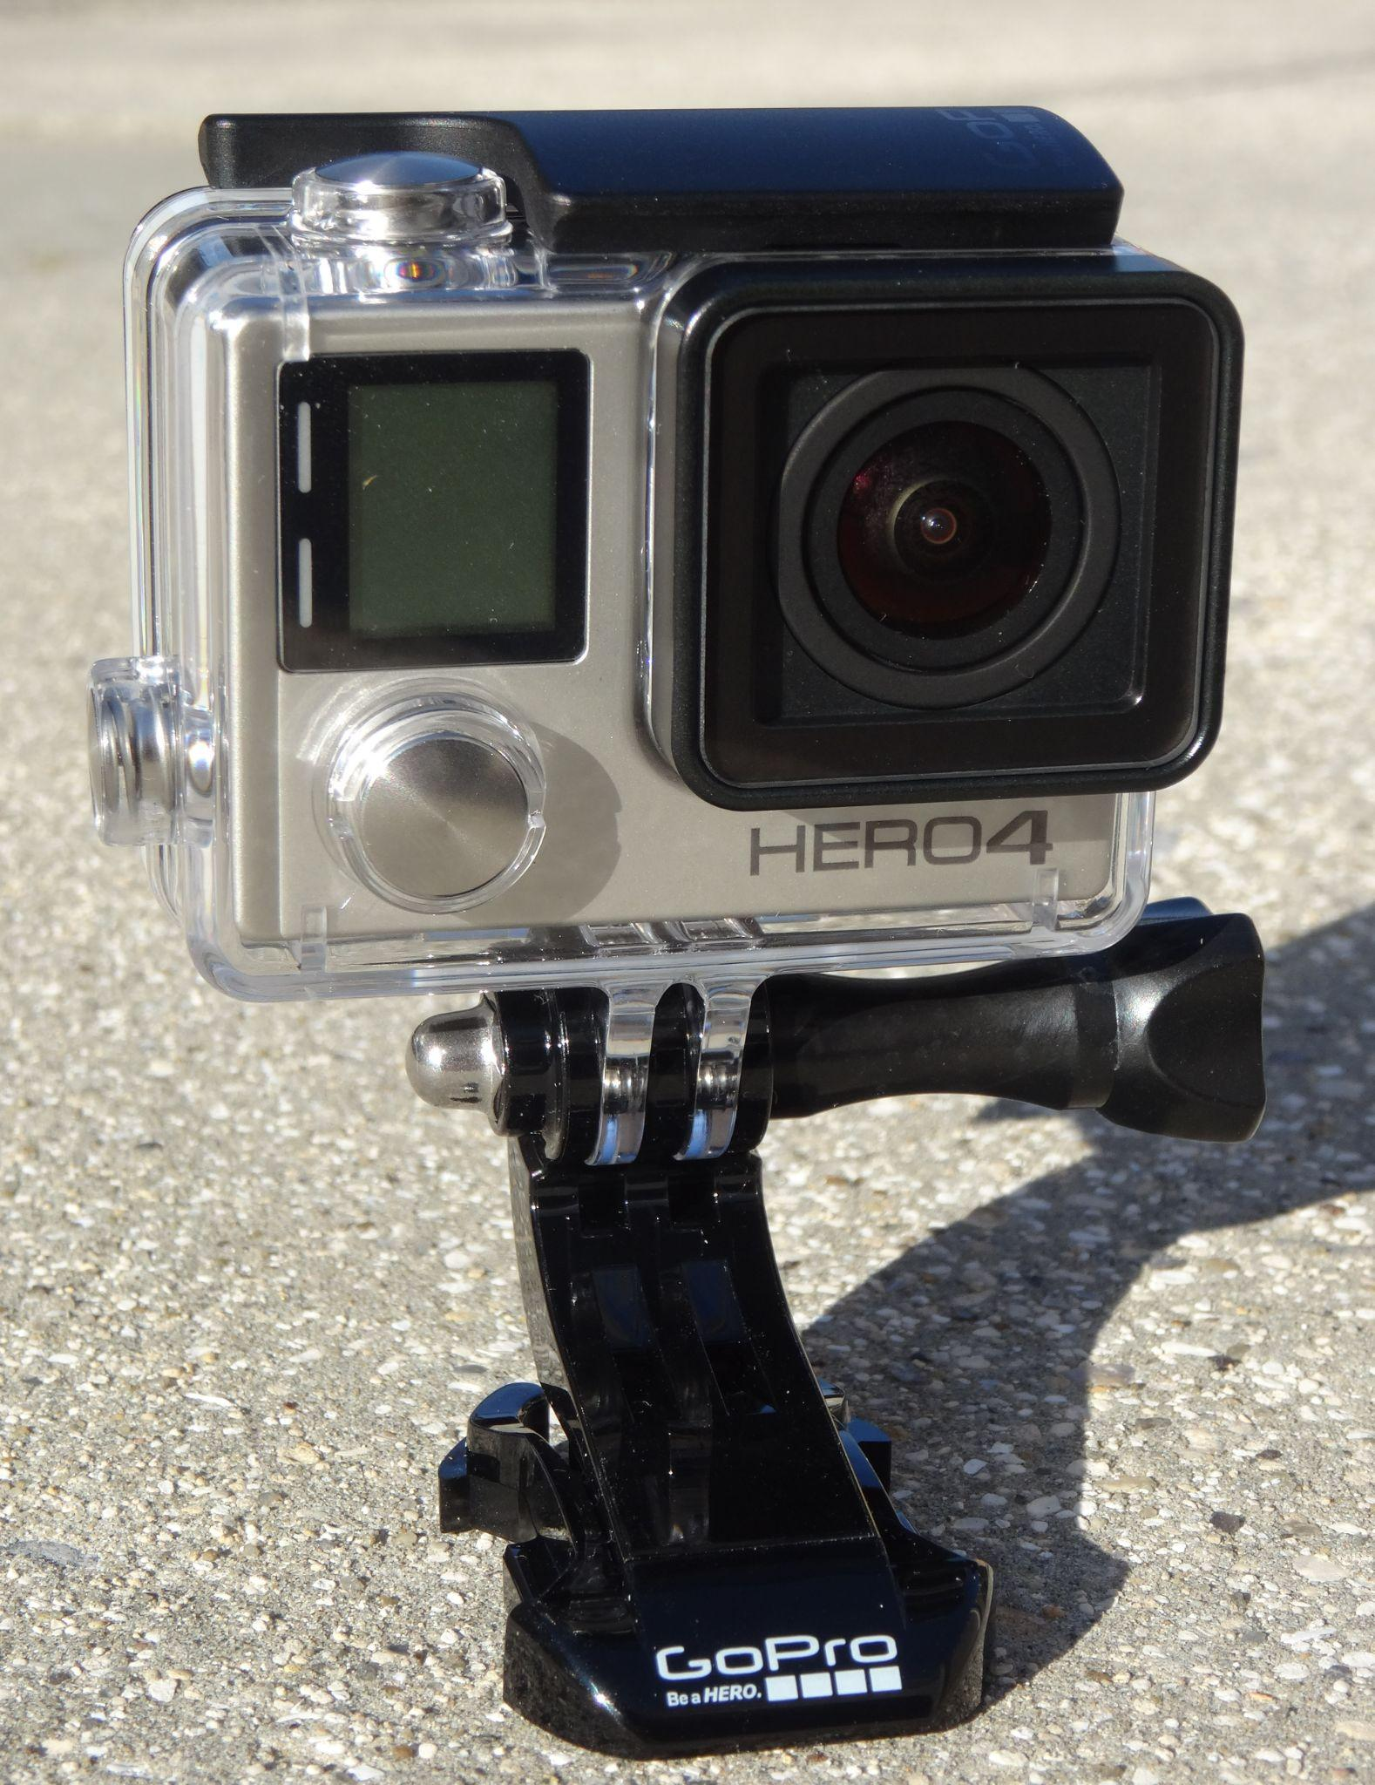
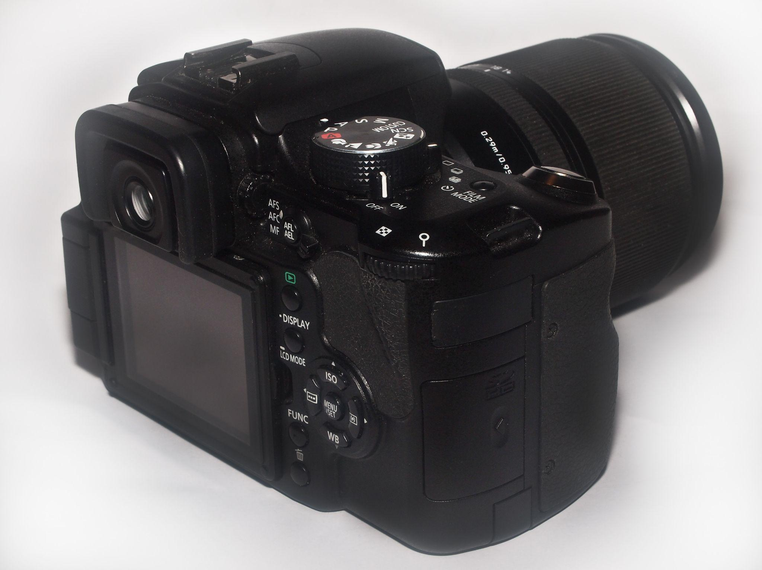
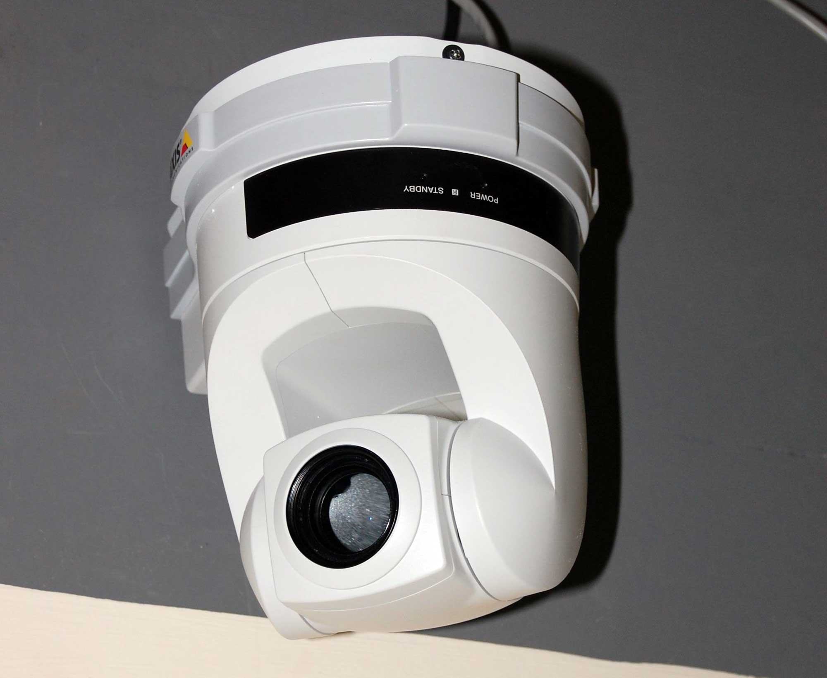
Why are there different types of video cameras?
Notes:
K20 Center. (n.d.). Think-Pair-Share. Strategies. https://learn.k20center.ou.edu/strategy/139

Slide 4
Essential Question
Why do filmmakers use different types of cameras?

Slide 5
Lesson Objective
Compare and contrast types of cameras.

Slide 6
Exploring Types of Cameras
Visit the five stations and interact with each camera.
Talk to other students about the features of each camera.
Use the Note Catcher to write down your observations at each station.
Notes:
K20 Center. (n.d.). Chat Stations. Strategies. https://learn.k20center.ou.edu/strategy/944edu)

Slide 7
Cameras for Filming Reading
As you read the handout, highlight the parts that seem important to your understanding of each camera.
Write notes that explain why you highlighted the text in the margin.
After you have read and highlighted the handout, talk to your group about the parts you highlighted and explain your reasoning.
Add any new information you learn from your group members to your notes in the margin.
Notes:
K20 Center. (n.d.). Why-Lighting. Strategies. https://learn.k20center.ou.edu/strategy/128

Slide 8
Choose a Camera
Read the scenarios that describe different scenes on the Choose a Camera handout.
Decide which camera would be best for filming the scenario.
Explain your reasoning on the handout.

Slide 9
Create a Short Film
Pick a scene from the Choose a Camera handout.
Record and edit the scene with only one or two cameras.
Footage should be no more than 60 seconds in length.
You will have 15 minutes to complete this task.
You will be able to edit your footage after filming.
Notes:
K20 Center. (n.d.). Commit and Toss. Strategies. https://learn.k20center.ou.edu/strategy/119

