Slide 2
The Right Tool for the Job
Media Production: 3D printing

Slide 3
Essential Question
Why do people use 3D printers?

Slide 4
Lesson Objectives
Analyze an existing 3D print and generate solutions for modifying it to fit a need

Slide 5
T-Chart
What I know about 3D printing
Why do people use 3D printing?
Notes:
On a piece of paper, draw a line down the center of the page. Then draw a line across the header area to make a T-Chart. On the left side of the chart, label “What I know about 3D Printing.” On the right side of the chart, label “Why do people use 3D printing?”

Slide 6
How 3-D-Printed Prosthetic Hands Are Changing These Kids’ Lives
Notes:
https://youtu.be/Cl8ijPGEKO8

Slide 7
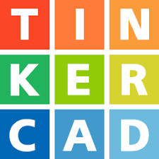
3D Modeling 101 with Tinkercad
How well do you know the Tinkercad site?
Use the scavenger hunt handout to identify and explore key features of the application.
http://k20.ou.edu/3d-tinkercad
Notes:
https://www.tinkercad.com/learn/designs
Pass out scavenger hunt
As you complete this activity raise your hand if you have any questions or run into issues with the training activities.
Mention external printing services like the local library on online printers.

Slide 8
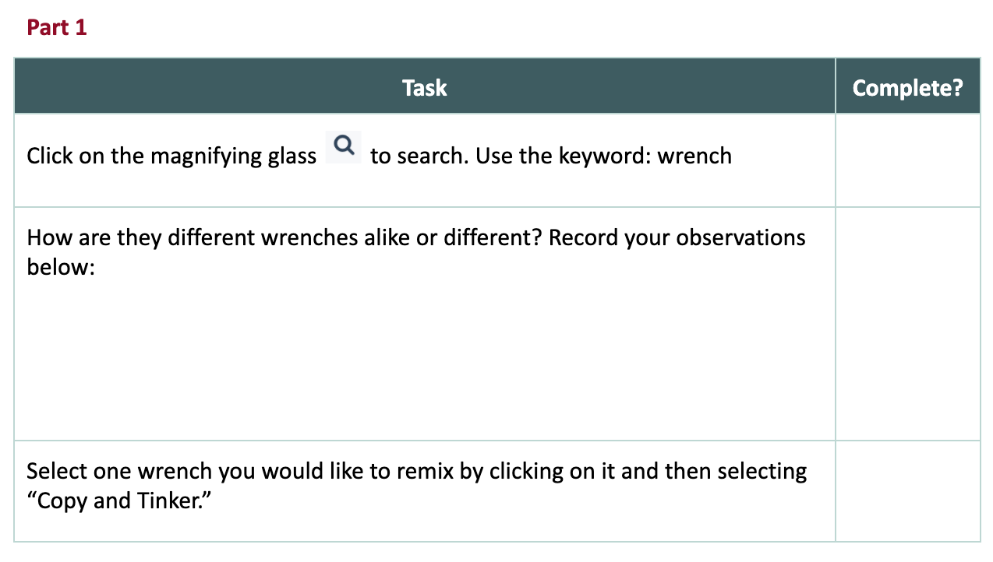
Design Challenge Handout
With your group, take a few minutes to complete the Part 1 of the handout.

Slide 9
Design Challenge Handout
Using the bolt provided to you, complete the remaining objectives on the handout.

Slide 10
Design Notes and Revisions
Answer the questions on the handout:
What part(s) of the design worked well?
What part(s) of the design didn’t work well?
If I were to refine this design, I would do the following things differently:

Slide 11
Final Changes and Reflection
Answer the questions on the handout:
What changes did you make after formulating your plan in the previous step?
Did your idea of what 3D printing is or can do change during the lesson?
What lessons did you learn about 3D printing a tool from your first design?
Why did you make the changes to your final design? Be specific.

