Slide 2
The Best Candy
Persuasive Writing
Lesson written by Chrissy Waldhoer
5.2.W.1 Students will apply components of a recursive writing process for multiple purposes to create a focused, organized, and coherent piece of writing.
5.2.W.3 Students will develop drafts by choosing an organizational structure (e.g., description, compare/contrast, sequential, problem/solution, cause/effect, etc.) and building on ideas in multi-paragraph essays.

Slide 3
Essential Question
How is writing used to persuade or change other’s ideas or opinions?

Slide 4
Lesson Objectives
Use descriptive language and specific details to enhance your writing
Write a persuasive paragraph using the writing process
Use your five senses to create a list of words that are detailed and descriptive

Slide 5
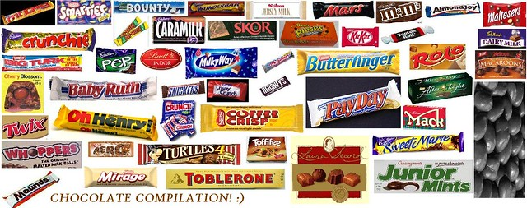
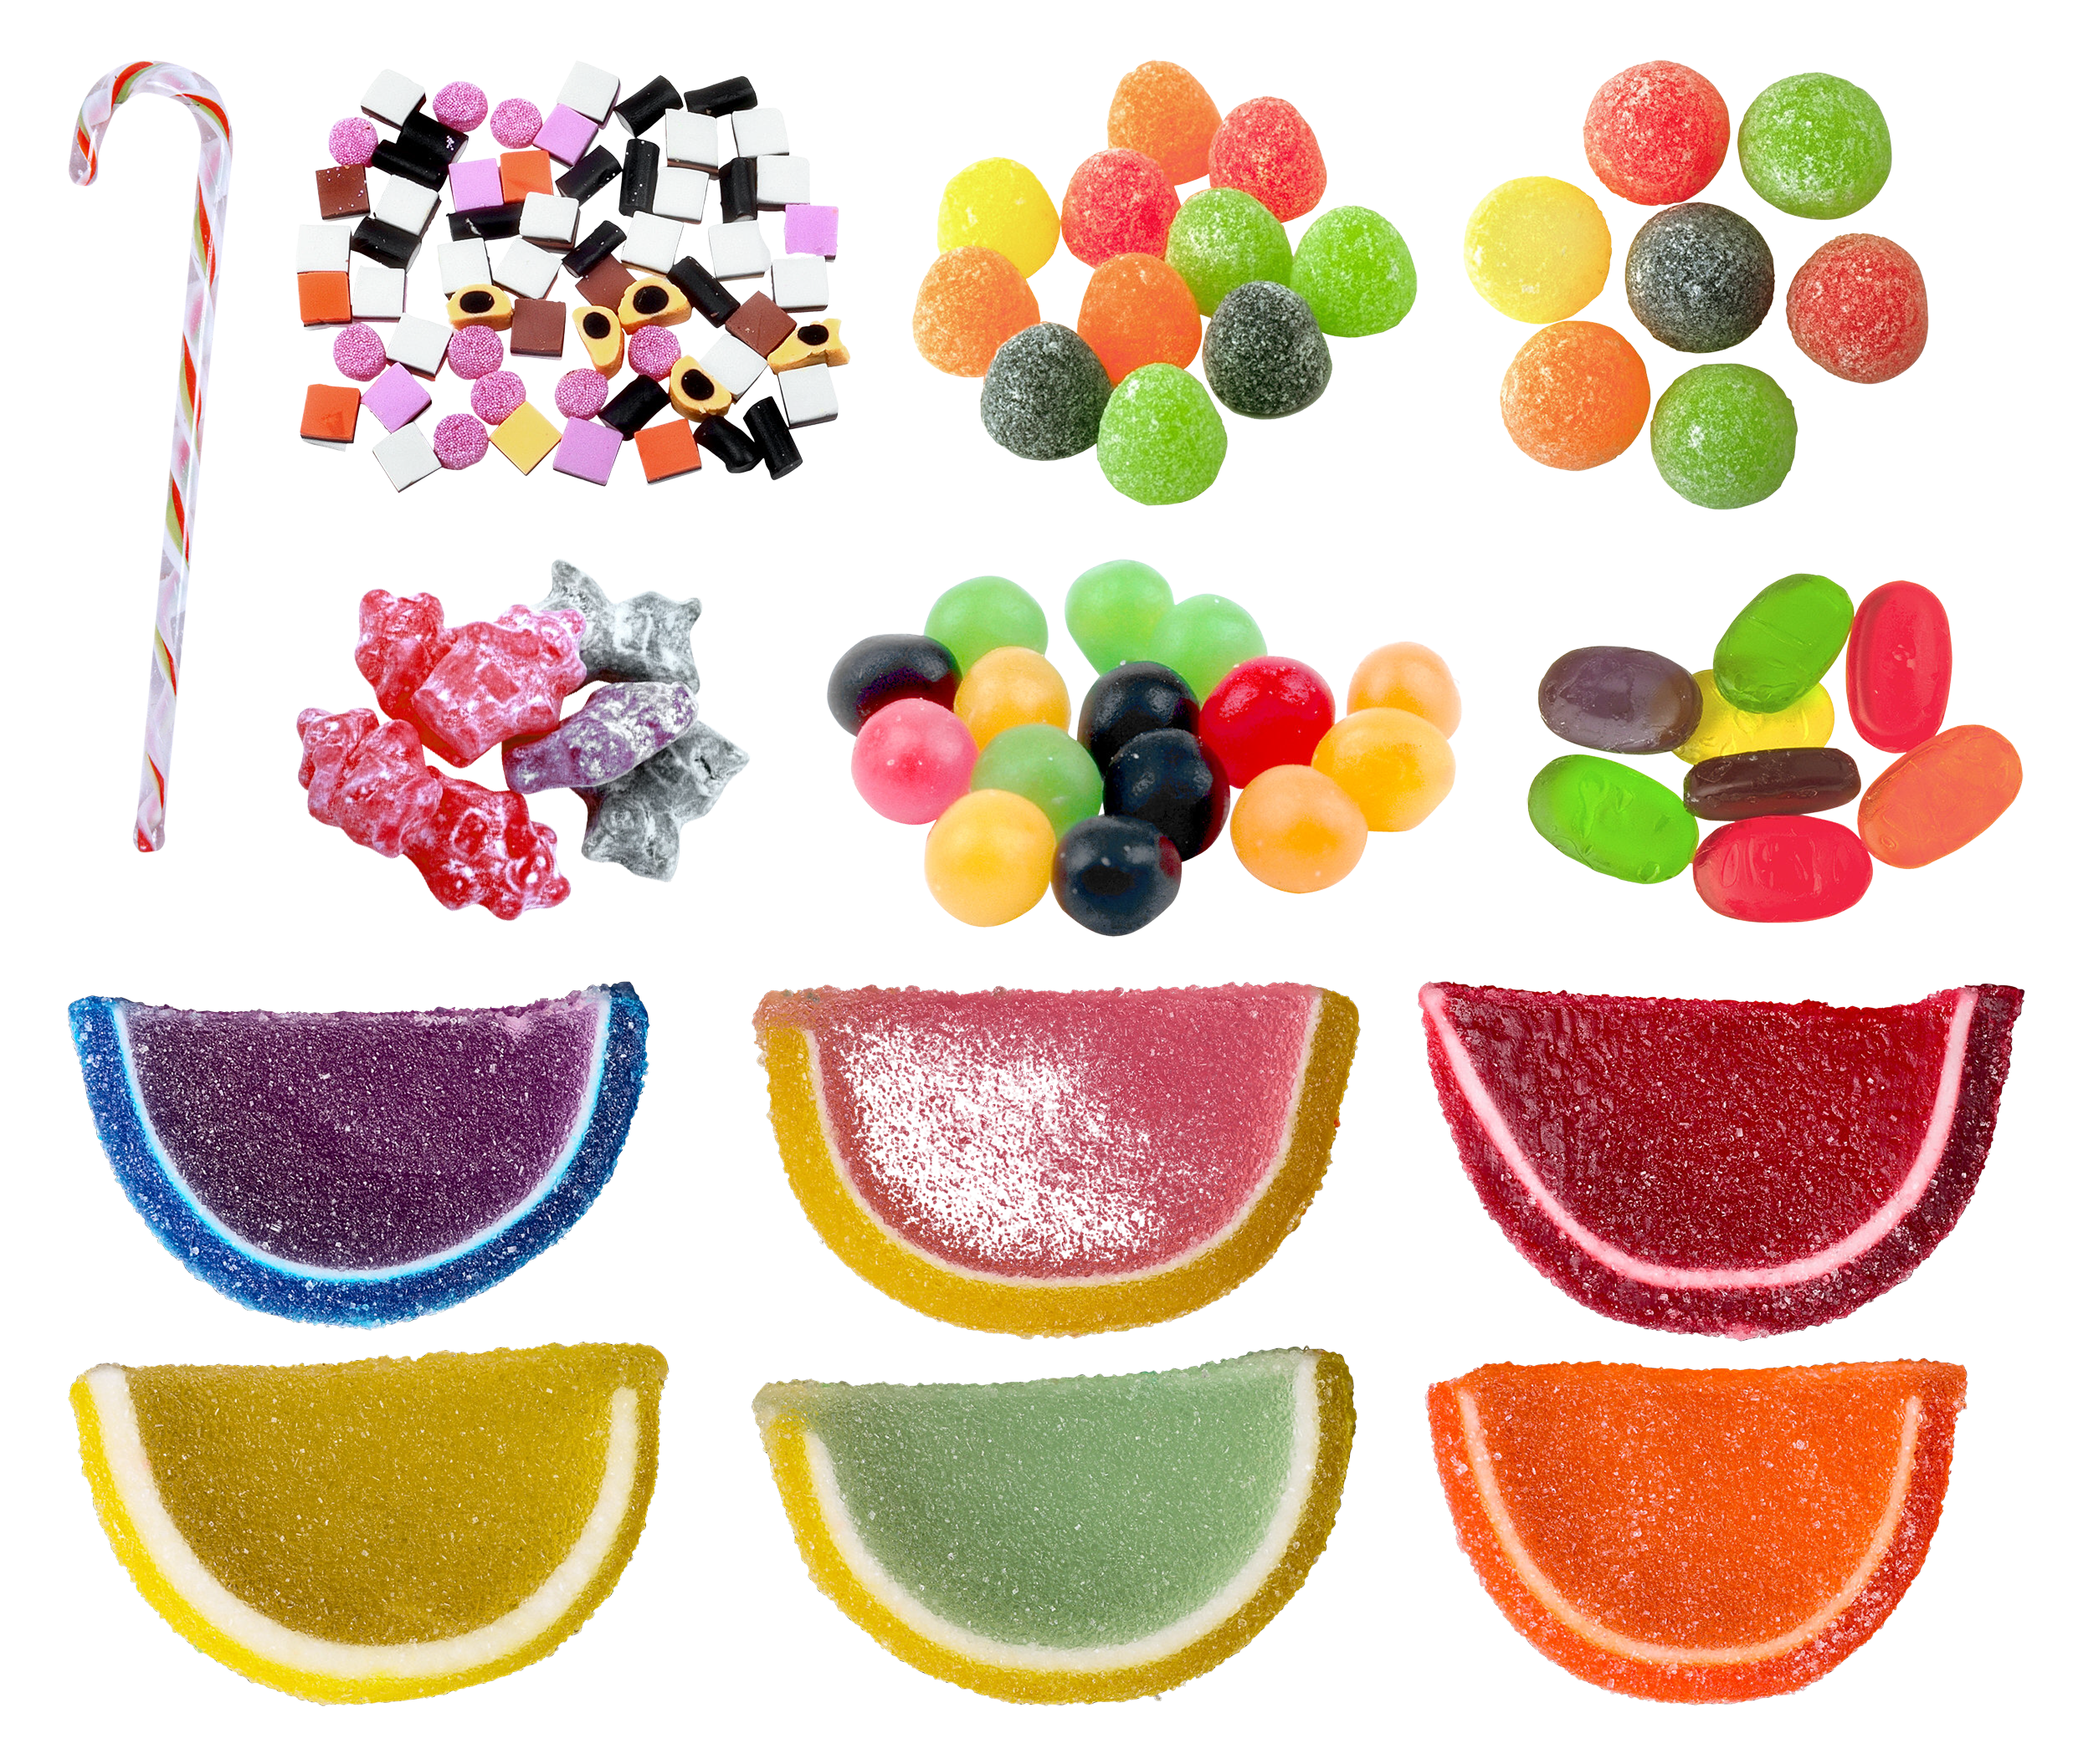
We Love Candy
Notes:
t.ly/cDOy
http://pngimg.com/uploads/jelly_candies/jelly_candies_PNG126.png

Slide 6
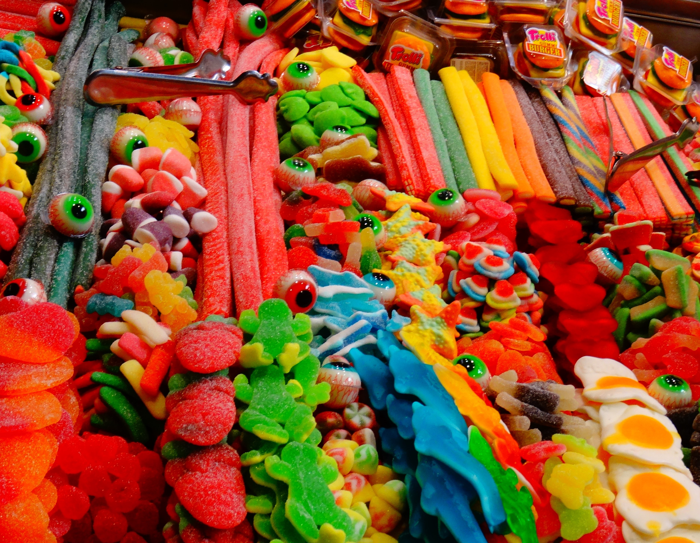
Which candy do these words describe?
Delicious
Yummy
Sweet
Delectable
Nice
Good
Notes:
https://pxhere.com/en/photo/599314?utm_content=shareClip&utm_medium=referral&utm_source=pxhere

Slide 7
Type adjectives here
Type adjectives here
Type adjectives here
Type adjectives here

Slide 8
What makes a good opinion or persuasive paragraph?

Slide 9
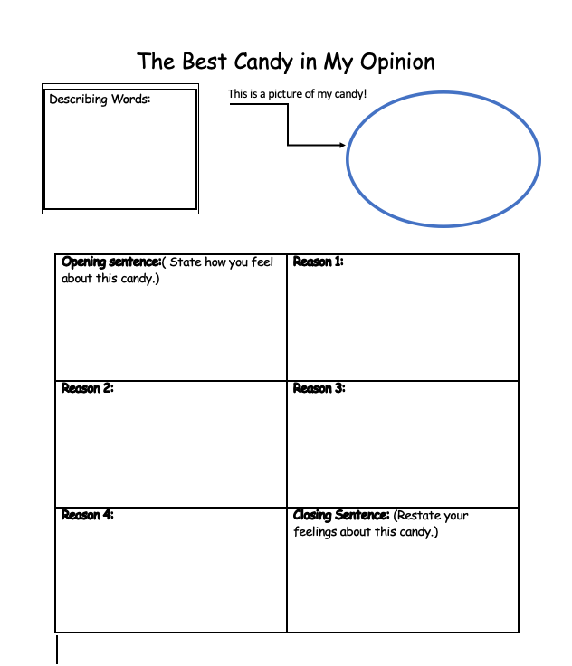
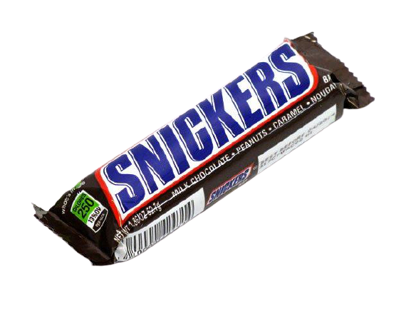
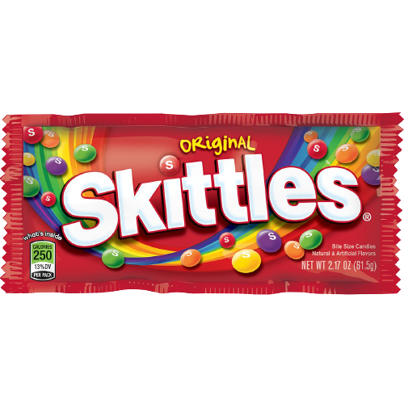
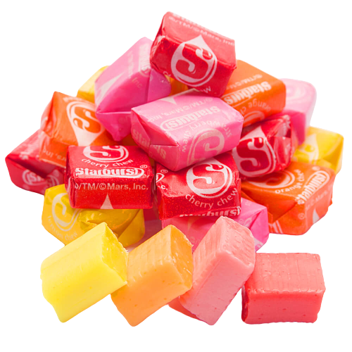
Get Your Thoughts Organized!

Slide 11
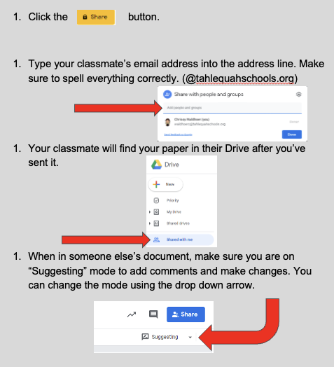
How to revise/edit your classmate’s work.

Slide 12
What makes the best persuasive sentence?
What makes those sentences stand out?
What made others agree/disagree with your candy choice?
What do you notice about the sentence structure and word choice?
What could you have written to make your candy choice more convincing?

Slide 13
Exit Ticket?
Answer the following question in a paragraph using details from our lesson.
"What makes a good opinion/persuasive paragraph?"
Notes:
K20 Center. (n.d.). Bell Ringers and Exit Tickets. Strategies. https://learn.k20center.ou.edu/strategy/125

