Slide 1
Move, Flip, & Slide!
Building Relationships & Community in the Classroom

Slide 2
Essential Question
How does social media help build relationships and community?

Slide 3
Lesson Objectives
Understand how Flipgrid can be used in and out of the classroom
Communicate clearly using Flipgrid
Listen and learn about peers through the use of Flipgrid

Slide 4
“All About Me” Name Tents
At your desk, you will find a folded piece of cardstock.
Please put your name on one side in bold letters and answer the following questions on the back:
How many years have you lived in this town?
What is your favorite activity or hobby?
What is your favorite genre, novel, short story, poem, or play?
What is your favorite part of ELA: reading, writing, listening, speaking, or viewing?
What is most important to you as a student in this class?
What is your favorite type of social media?

Slide 5
Partner Speaks
Choose a partner.
Share the information from your “All About Me” Name Tent while your partner listens.
Switch places.
Each person shares one detail about their partner’s name tent while using their partner’s name:
My partner is Joey, and Joey likes the novel Fahrenheit 451 by Ray Bradbury.
Notes:
K20 Center. (n.d.). Partner Speaks. Strategies. https://learn.k20center.ou.edu/strategy/62

Slide 6
Social Media: What/Who/Why?
WHAT social media platforms do you use?
WHOM do you communicate with regularly?
WHY do you use this platform?
Example:
Facebook is my favorite platform.
I communicate with my friends, family and a few groups I have joined.
I like that I can use gifs, emojis, videos, etc.
Notes:
https://k20center.padlet.org/pbase/p7eklmumt6rtj71q

Slide 7
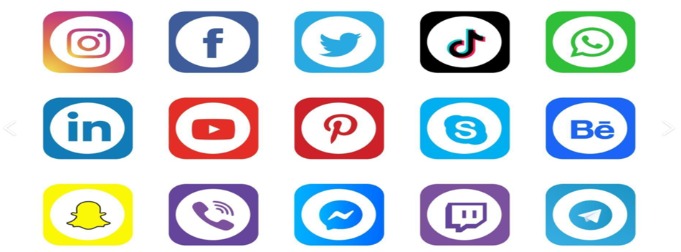
View Results
Use the Padlet link or QR code to post your answer.
https://k20center.padlet.org/pbase/p7eklmumt6rtj71q

Slide 8
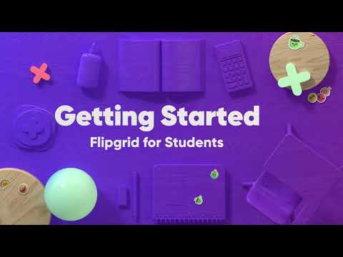
How-To Flipgrid Video
Be prepared to share as many details from the video as possible.
Notes:
K20 Center. (n.d.). Flipgrid. Strategies. https://learn.k20center.ou.edu/tech-tool/1075

Slide 9
30-Second Expert
What did you learn from the Flipgrid video?
Get together with your previous partner.
The first person will take 30 seconds to share everything they learned from the video.
Switch places.
The second person will repeat what they heard and add anything else they learned from the video.
Questions?
Notes:
K20 Center. (n.d.). 30-Second Expert. Strategies. https://learn.k20center.ou.edu/strategy/1048

Slide 10
Flipgrid Time
Go to Flipgrid.com
Click on the green + sign
Enter the Join Code:

Slide 11
Elevator Speech
🎯 You have 60 seconds to share your Name Tent with your classmates. Have fun using the Video Effects to create an “All About Me” post!
CREATIVE OPTIONS:
🔮 Choose a Filter to change the tone.
🔠 Use Text to share your name or adjectives/short phrases to describe you.
✏️ Use the Pen to draw or sketch whatever you wish.
📈 Use a Board to create a split-screen effect.
📷 Upload a Photo from your device or camera roll.
🔳 Use a Frame to add a pop of style.
🎬 Transform your response with a Backdrop or add your own custom Backdrop.
😃 Add emoji Stickers that represent your interests.
🦄 Animate your response with GIFs.
Notes:
K20 Center. (n.d.). Elevator Speech. Strategies. https://learn.k20center.ou.edu/strategy/57

Slide 12
Share, View and Post
Who will volunteer to share their video with the class?
Next steps:
View three classmates’ videos.
Post one video responding to a classmate.
Click on the blue camera tab.
Post one positive comment responding to a classmate.
Type in the “Add a public comment” box.
Post one clarifying question responding to a classmate.
Clarify something you were curious about after viewing the video in the “Add a public comment” box.

Slide 13
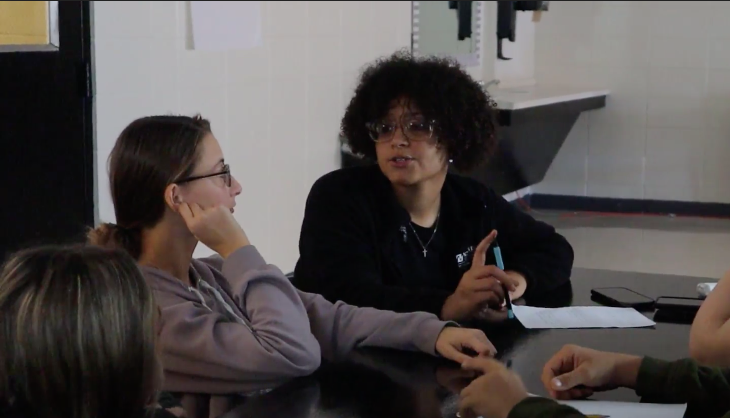
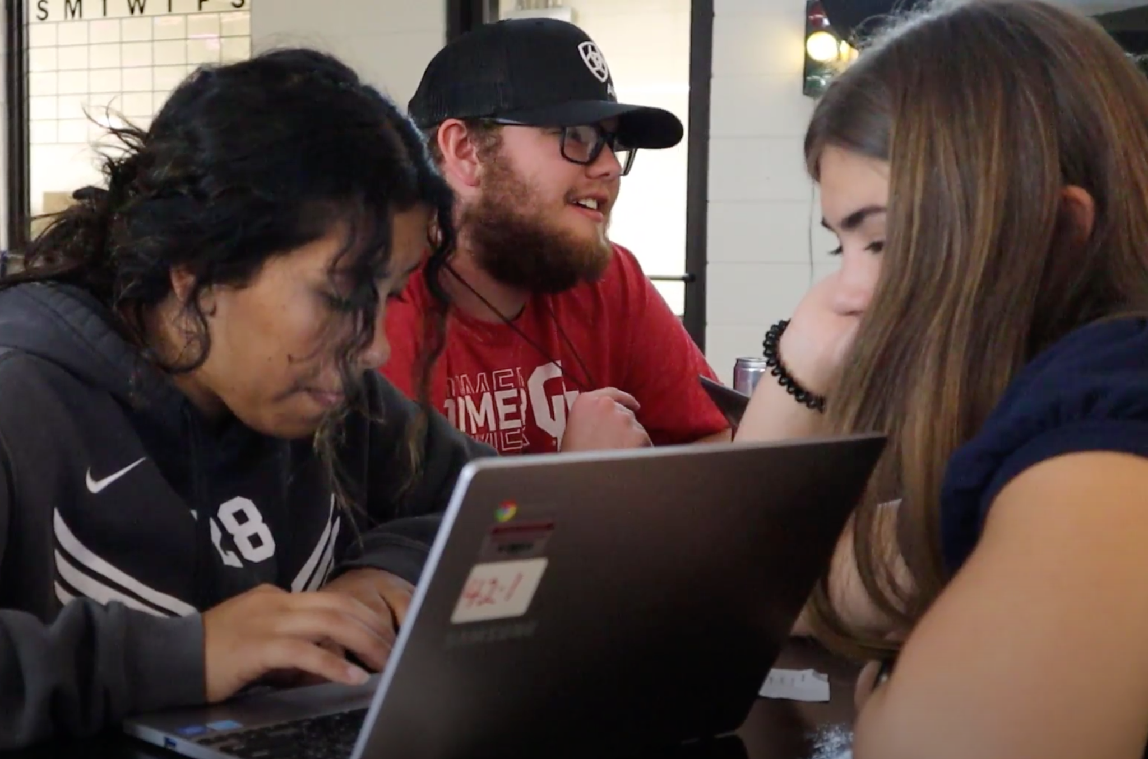
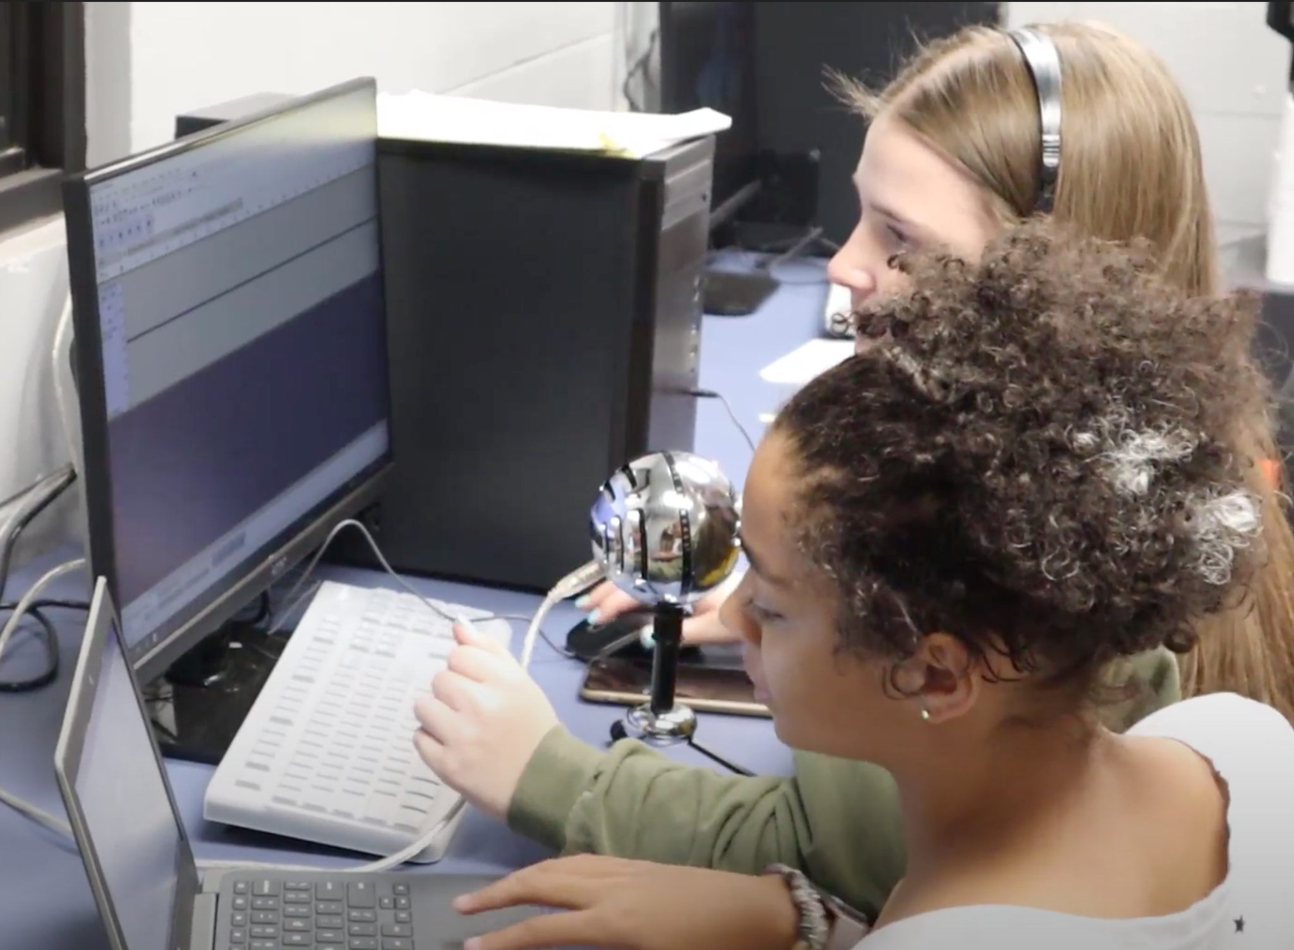
Exit Ticket
How does social media help build relationships and community?

