Slide 2


You’re Not Like Me
To Kill a Mockingbird Part One

Slide 3
Essential Question
How does the author use symbolism to develop characterization and theme?

Slide 4
Lesson Objectives
Analyze a text for symbols of prejudice.
Categorize evidence from the text to support the claim that either the mad dog or the camellia were the ultimate symbol of prejudice.

Slide 5
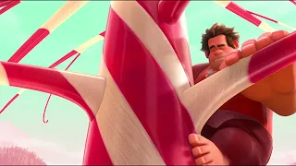
Notes:
YouTube. (2017). Thor vs Odin - Odin Takes Thor's Power (Scene) Movie Clip Hd. YouTube. https://www.youtube.com/watch?v=_IfYZZDTays.

Slide 6
Mad Dog and Camellia T-Chart
Look through the Part One of the novel for examples that identify the mad dog and camellia as symbols of prejudice.
Write your examples on your T-Chart.
Notes:
https://learn.k20center.ou.edu/strategy/86

Slide 7
Mad dog or Camellia—Tug-of-War
On a sticky note, write your name and a quote from the novel that supports your choice: mad dog or camellia?
Place your sticky note under the appropriate image on the next slide.
Notes:
https://learn.k20center.ou.edu/strategy/98

Slide 8
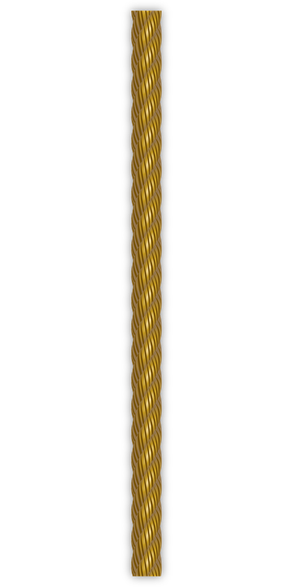
Which is a better symbol for prejudice in the story?
Type here
Type here
Type here
Type here
Type here
Type here
Type here
Type here
Type here
Type here
Type here
Type here
Type here
Type here
Type here
Type here
Type here
Type here
Type here
Type here
Type here
Type here
Notes:
OpenClipart-Vectors. (2013). Rope. https://pixabay.com/vectors/rope-cord-sisal-string-material-160161/.
https://learn.k20center.ou.edu/strategy/98

Slide 9

Collaborative Word Cloud
What are some other symbols of prejudice that appear in the novel?
Add a word or two that captures the concept of “prejudice” to the Word Cloud.
Notes:
https://www.mentimeter.com/
https://learn.k20center.ou.edu/strategy/103

Slide 10
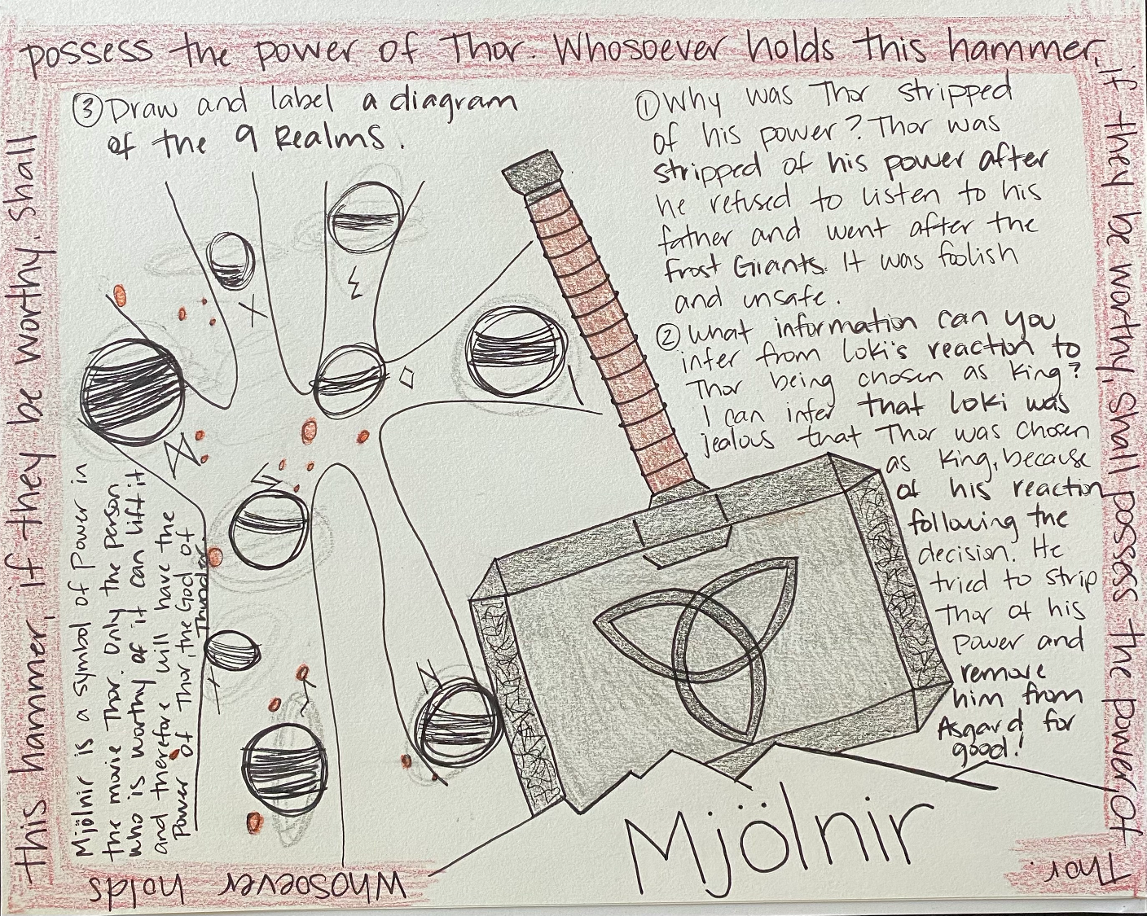
One-Pager
Example One-Pager from Thor
Choose an example of prejudice from a movie and include the following:
Title
Border around the page that includes the theme
Image of the symbol of prejudice
Three or more questions with the answers included
A statement about why you believe this to be a symbol of prejudice
Notes:
https://learn.k20center.ou.edu/strategy/72

Slide 11
Border
Question 3
Question 1
A statement about why you believe this to be a symbol of power
Question 2
Image of the symbol of power
Title
Notes:
https://learn.k20center.ou.edu/strategy/72

Slide 12
One-Pager
Example One-Pager from Thor
Choose an example of power from a movie and include the following:
Title
Border around the page that includes the theme
Image of the symbol of power
Three or more questions with the answers included
A statement about why you believe this to be a symbol of power
Notes:
https://learn.k20center.ou.edu/strategy/72

