Slide 2
But I Need It!
Want vs. Need

Slide 3
Essential Questions
What is the difference between a want and a need?
What should I spend my money on?
How do I get what I need?

Slide 4
Lesson Objectives
Recognize wants and needs as different.
Express the importance of budgeting for needs.

Slide 5
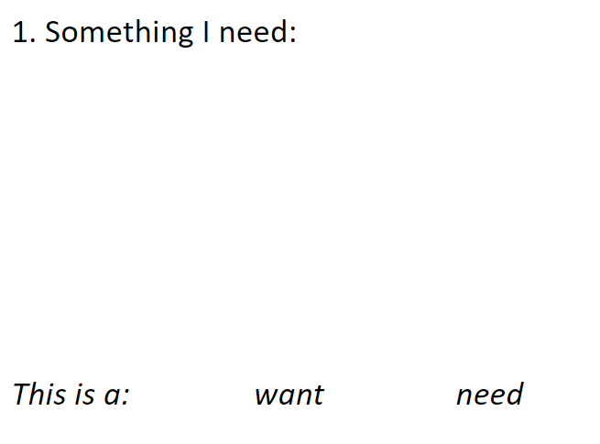

Slide 6
Let’s play “Do I Need It?”!
Need
Want

Slide 7
Let’s play “Do I Need It?”!
Keep track of your answers on your reflection sheet.
Need
Want
Notes:
Optional modification: Have students move to one side of the room based on their answers. Gets some energy out, but you may have students change their answers based on where others are standing.

Slide 8
Transportation
Need
Want

Slide 9
Headphones
Need
Want

Slide 10
Water
Need
Want

Slide 11
Computer
Need
Want

Slide 12
Candy
Need
Want

Slide 13
Groceries
Need
Want

Slide 14
Need
to require something because it is essential, or very important.
I need to drink water.

Slide 15
Notes:
Link to video: https://youtu.be/6OAqNtueu0U

Slide 16
Did your answers change? Reflect in box #3.
Notes:
Have students share responses and write them in Box #3 or model writing the response in the box after answers have been shared.

Slide 17
Budget activity
You may not move your counters after you place them!

Slide 18
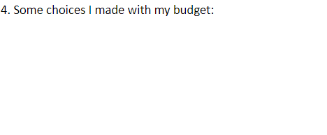
Did you run out?
Reflect in box #4.
Let’s try again. You may move your counters around.
Notes:
Ask:
What will you do differently?
Did your answers change? How?
What cost more than you expected?
What did you decide against?

Slide 19
Your toilet is broken. It costs 2 counters to fix. Can you fix it?

Slide 20
A birthday gift for your sister costs 1 counter. Can you buy it?

Slide 21
You need a new shirt.
It costs 2 counters.
Can you buy it?

Slide 22
What do those emergencies tell you about budgets?

Slide 23
Need
Want
Something that is essential to survival or a task.
Something that is desired, but not essential.

Slide 24
Return to box #1. Do you still think your answer was a need?

Slide 25
Reflect on your sheet.
Notes:
This can be done through drawings, words, or a group discussion.

