Slide 2
Writing is Elementary,
My Dear Watson
English language arts
Grade 9

Slide 3
Essential Question
Why is it important to construct a strong, logical argument that is supported by evidence?

Slide 4
Learning Objective
Students will be able to write a strong, logically constructed argumentative paragraph.

Slide 5
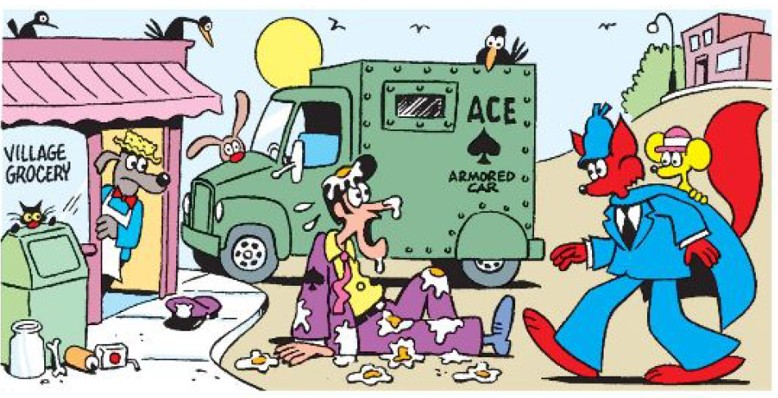
Two Minute Free Write
Smitty was hired by a security company. On his first day on the
job, Smitty Claims a robber pelted him with eggs from a carton
and grabbed the sack of money he was carrying to the truck.
Do you believe Smitty’s story? What evidence can you find to
support or contradict his story?
May 11, 2014 Slylock Fox Brain boggler. (n.d.). Retrieved June 09, 2016, from
http://www.kidcartoonists.com/2014/05/11/may112014slylockfoxbrainboggler/#.
V1m3Z5MrKu4

Slide 6
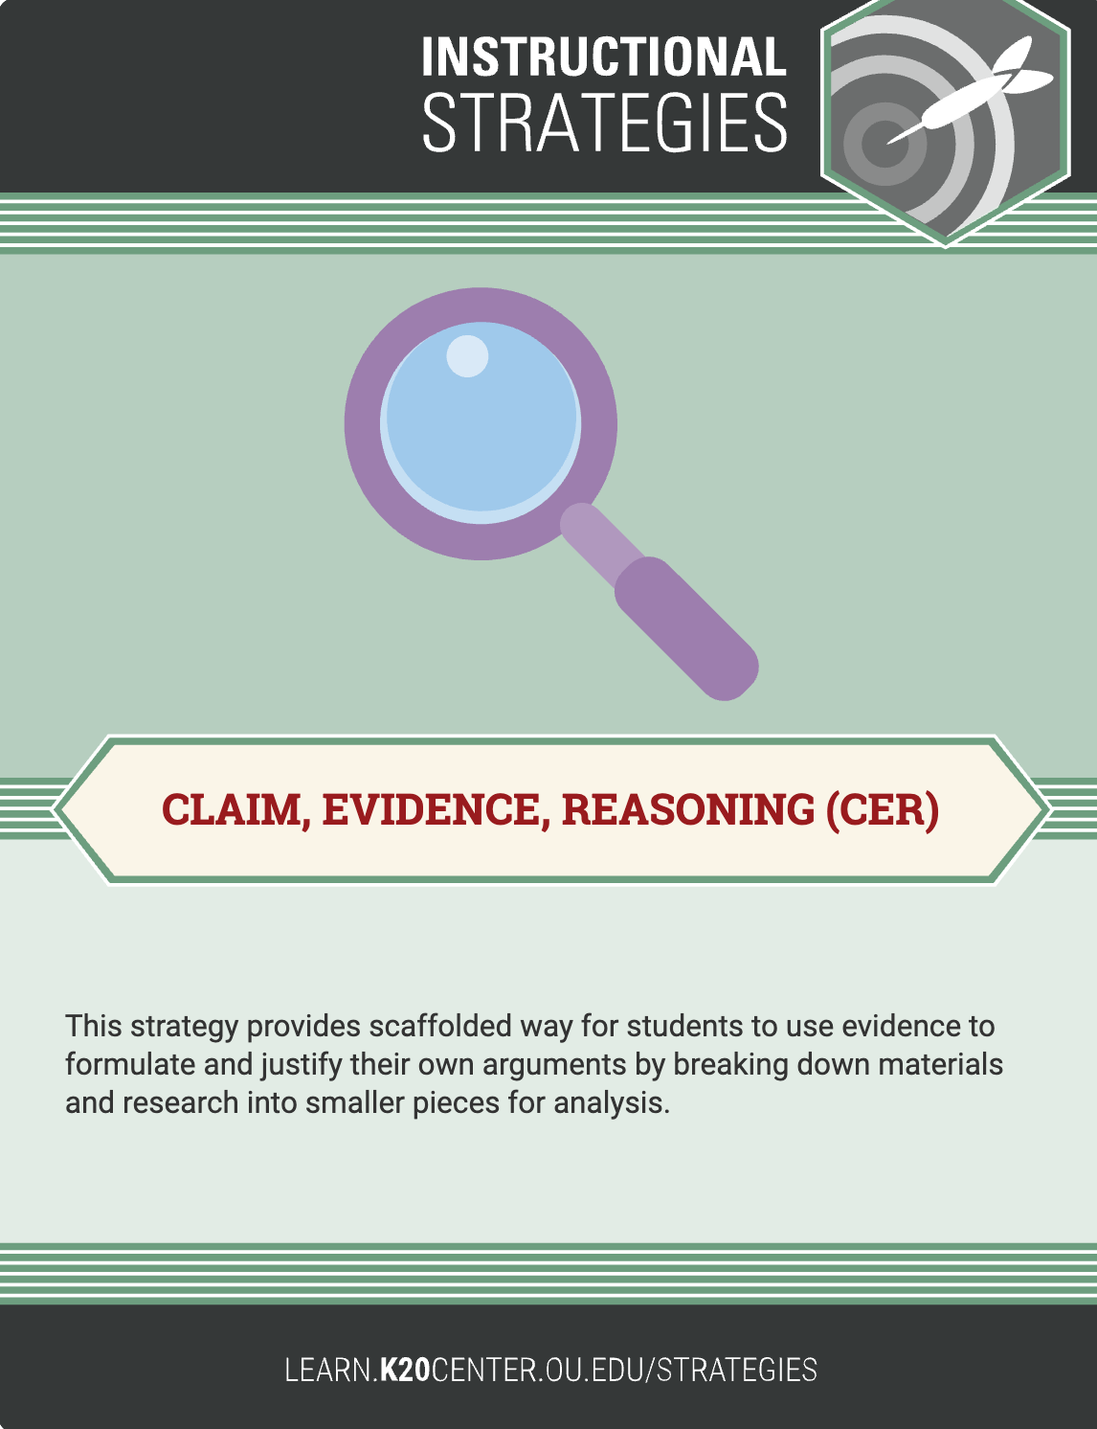
Claim Evidence Reasoning (CER)
CLAIM: Is Smitty telling the truth?
EVIDENCE: Find facts from the comic to back up your claim.
REASONING: Comment on the evidence with explanation to connect it to your claim.

Slide 7
Claim Evidence Reasoning (CER) EXAMPLE
CLAIM: Smitty is telling the truth.
EVIDENCE: Smitty is covered in eggs.
REASONING: Obviously, someone threw eggs all over Smitty. No one would do that to themselves.

Slide 8
Defend Your Claim
If you believe Smitty, stand on the right. If you think he’s lying, stand on the left.
Take turns sharing out one piece of evidence with your reasoning to defend your claim.

Slide 9
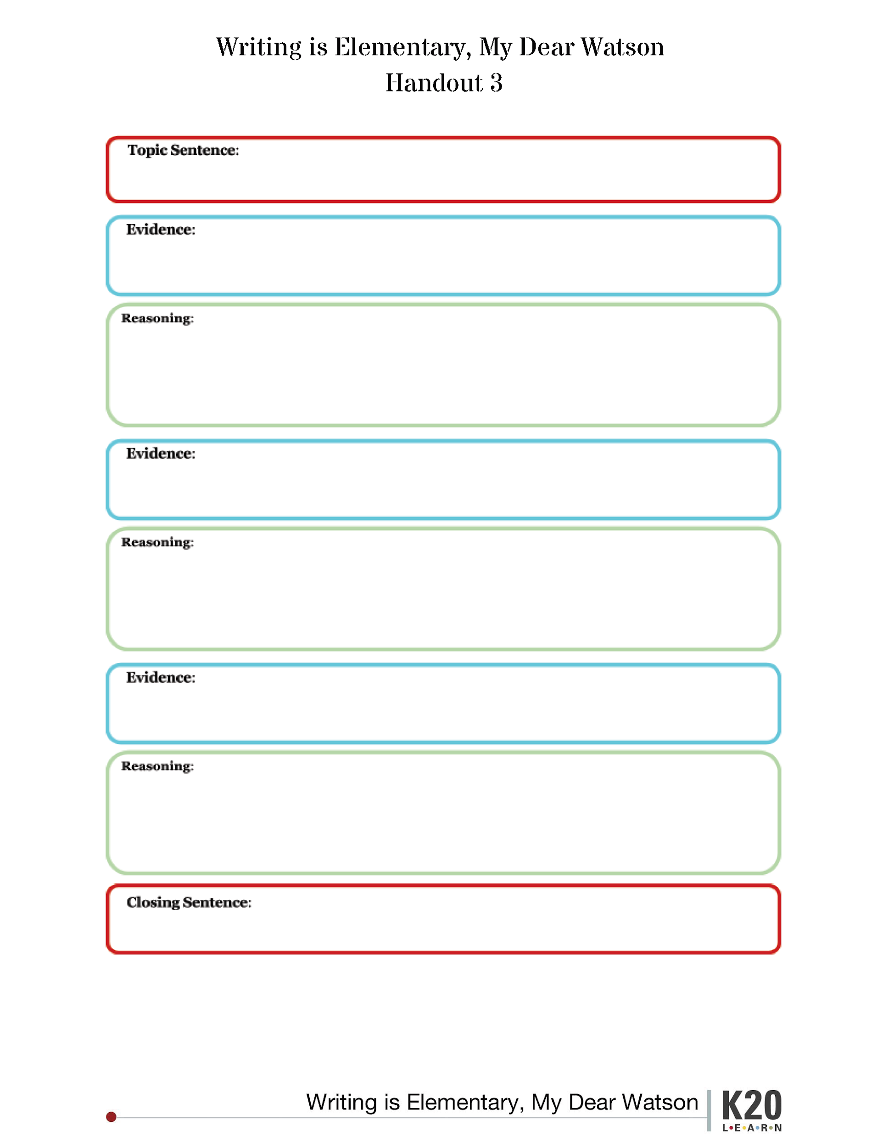
Paragraph Writing
Is Smitty telling the truth? Use your outline to compose a paragraph supporting your claim.
Paurian. (May 21, 2009). The Detective. [Digital Image]. Retrieved September 03, 2020, from https://www.flickr.com/photos/70387215@N00/3550755709

Slide 10
Peer Review
Read through your partner’s paragraph. Use the Peer Review Rubric to discuss the use of evidence and reasoning.
How did using evidence and reasoning help you argue your claim during Lines of Agreement?
How did using evidence and reasoning help or hinder your writing process?

Slide 11
Tweet Up
Using 140 characters:
How can you use evidence and reasoning outside of writing?
*Remember, spaces count as characters!
*Create a hashtag!

