Slide 2
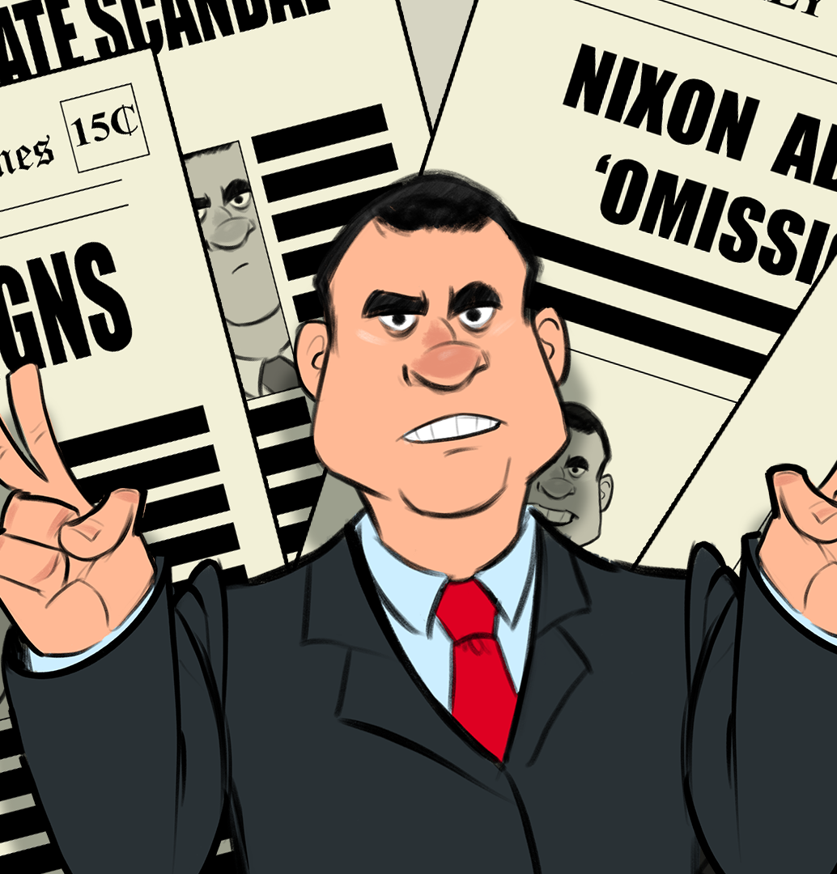
Why Can’t We Be Friends?
Nixon’s Diplomatic Policy

Slide 3
diplomacy
[dih-ploh-muh-see]
noun
The conduct by government officials of negotiations and other relations between nations.
The art or science of conducting such negotiations.
Skill in managing negotiations, handling people, etc., so that there is little or no ill will; tact:
Seating one’s dinner guests often calls for considerable diplomacy.
Notes:
https://www.dictionary.com/browse/diplomacy

Slide 4

Magnetic Statements
Read each of the statements around the room.
Choose one of the statements that you are most attracted to.
Discuss your reasons with the others gathered around your statement.

Slide 5
Magnetic Statements
Diplomacy is the art of saying 'Nice doggie' until you can find a rock.
Franklin Rodman

Slide 6
Magnetic Statements
War is failure of diplomacy.
John Dingell

Slide 7
Magnetic Statements
Speak softly and carry a big stick; you will go far.
President Theodore Roosevelt

Slide 8
Magnetic Statements
America has no permanent friends or enemies, only interests.
Henry Kissinger

Slide 9
Magnetic Statements
Move to a different statement that repels you.
Discuss with others in your group why you felt repelled by that statement.

Slide 10
Magnetic Statements
Diplomacy is the art of saying 'Nice doggie' until you can find a rock.
Franklin Rodman

Slide 11
Magnetic Statements
War is failure of diplomacy.
John Dingell

Slide 12
Magnetic Statements
Speak softly and carry a big stick; you will go far.
President Theodore Roosevelt

Slide 13
Magnetic Statements
America has no permanent friends or enemies, only interests.
Henry Kissinger

Slide 14
Essential Question
What actions make for effective diplomacy?

Slide 15
Lesson Objectives
Students will analyze the political and economic impact of President Nixon’s foreign policies.

Slide 16

C.R.U.S.H. & Smush
As you read your article:
C- circle and new vocabulary and write those words in the margin with the definition
R- read the article
U- underline the vocabulary you already know
S- star the main ideas
H- highlight the evidence that supports the main idea
Smush the article into a summary in your own words

Slide 17

Jigsaw
Work with your group-each person has read a different article.
Share your expertise with your group.
As others share, complete your Jigsaw graphic organizer, making notes over each reading.

Slide 18
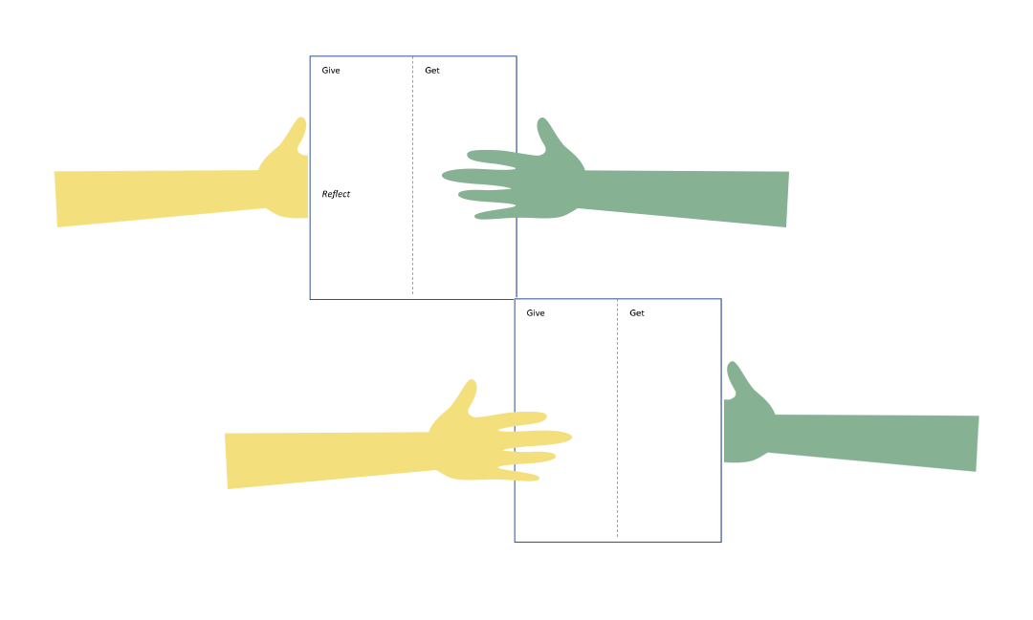
Give, Get, Reflect
As you watch the video, think about how you might answer the Essential Question:
What actions make for effective diplomacy?

Slide 19
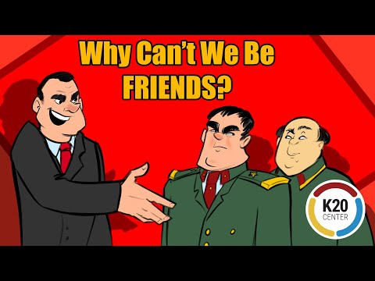
Notes:
K20 Center. (2022). Why can’t we be friends? Video. YouTube. https://www.youtube.com/watch?v=-Tn6lQwA4IE

Slide 20
Give, Get, Reflect - Give Round
On your handout in the “Give” section, answer the Essential Question:
What actions make for effective diplomacy?

Slide 21
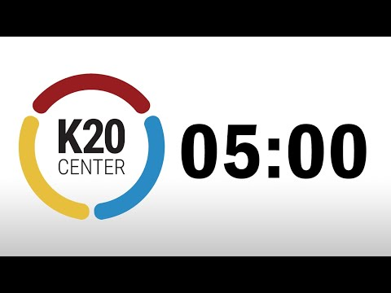
Give, Get, Reflect - Get Round 1
Partner up with one (1) classmate.
Decide who will be Partner 1 and who will be Parner 2.
Partner 1 will share their “Give” response while Partner 2 listens and then summarizes it on their handout.
Partner 2 will then share their “Give” response while Partner 1 listens and summarizes it on their handout.

Slide 22
Give, Get, Reflect - Get Round 2
Partner up with one (1) NEW classmate.
Decide who will be Partner 1 and who will be Parner 2.
Partner 1 will share their “Give” response while Partner 2 listens and then summarizes it on their handout.
Partner 2 will then share their “Give” response while Partner 1 listens and summarizes it on their handout.

Slide 23
Give, Get, Reflect - Get Round 3
Partner up with one (1) NEW classmate.
Decide who will be Partner 1 and who will be Parner 2.
Partner 1 will share their “Give” response while Partner 2 listens and then summarizes it on their handout.
Partner 2 will then share their “Give” response while Partner 1 listens and summarizes it on their handout.

Slide 24
Give, Get, Reflect - Get Round 4
Partner up with one (1) NEW classmate.
Decide who will be Partner 1 and who will be Parner 2.
Partner 1 will share their “Give” response while Partner 2 listens and then summarizes it on their handout.
Partner 2 will then share their “Give” response while Partner 1 listens and summarizes it on their handout.

Slide 25
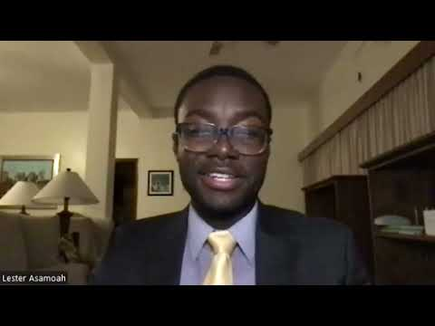
Notes:
K20 Center. (2022). Lester Asamoah. Interview. YouTube. https://www.youtube.com/watch?v=bT_W-xcqblY&list=PL-aUhEQeaZXLg0yYwLKeUT2Ud1sC0inzo&index=21&t=625s

Slide 26
Give, Get, Reflect - Get Round 5
Lester Asamoah shared with you some valuable information about his career working at the American Embassy in Jakarta, Indonesia.
In the “Get Round 5” box, summarize what you learned.

Slide 27
Give, Get, Reflect - Reflect Round 1
Review all of the summaries your wrote from each partner you spoke with.
On your handout in the “Reflect Round 1” section, provide one summary statement that best reflects your understanding of the essential question at this time.

Slide 28

Painting A Picture
As you examine the photographs, record your observations in the “observations” column of the chart.
  An observation is anything you see in the photographs and their captions.
Using your observations plus your prior knowledge, record your inferences in the “inferences” column of the chart.
  An inference is a conclusion you make based on your observations and prior knowledge.

Slide 29
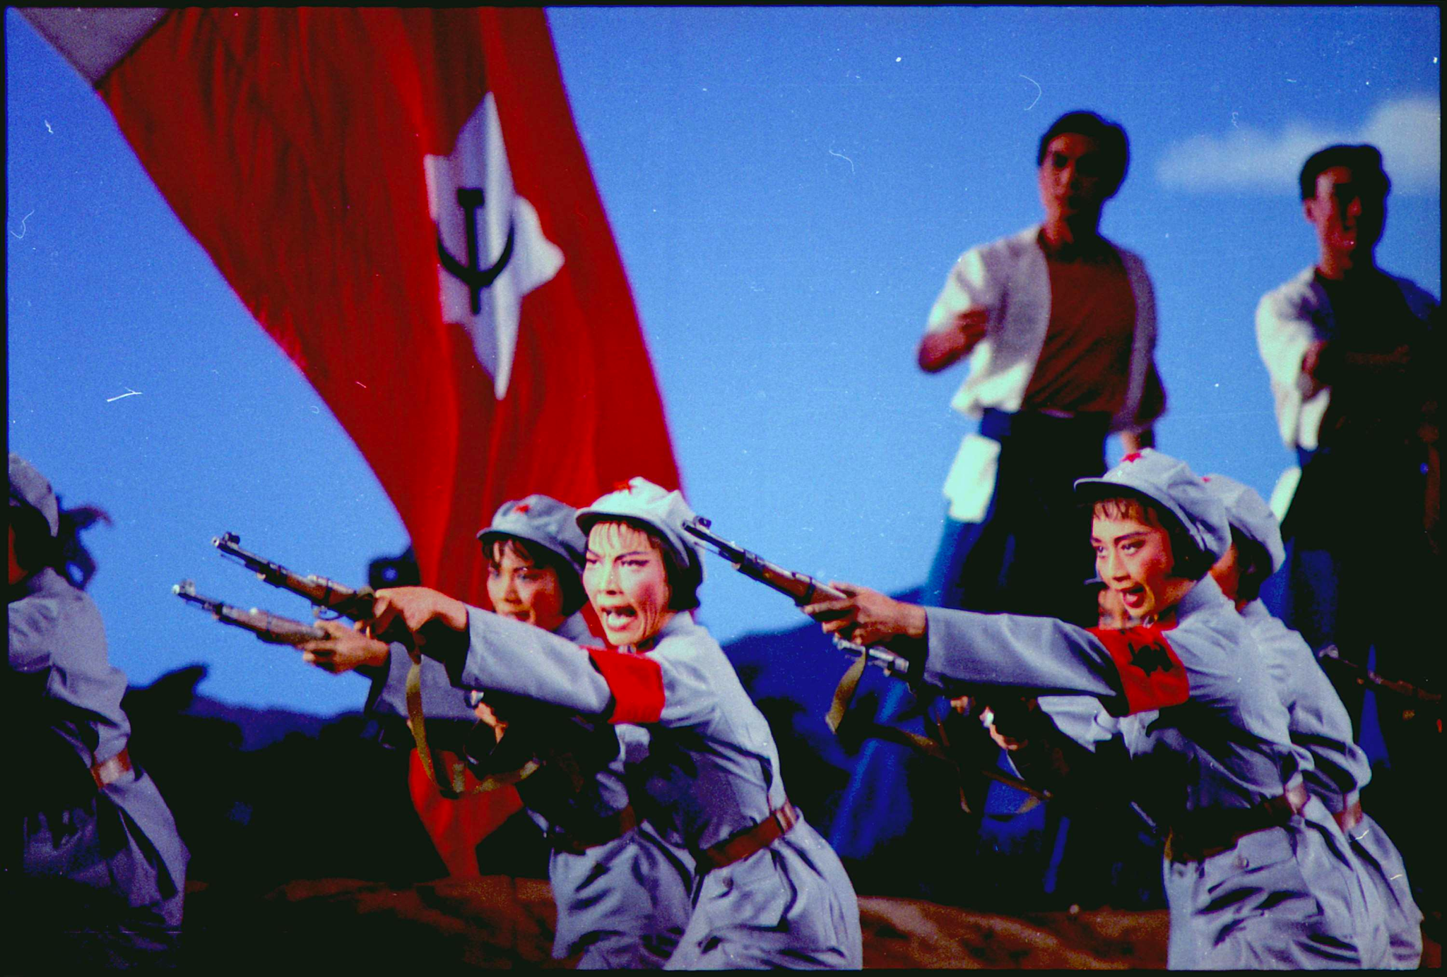
Image 1: Ballet scene at the Great Hall of the People attended by President and Mrs. Nixon during their trip to Peking, China
2/22/1972
Notes:
Schumaker, B. E. (1972). Ballet scene at the Great Hall of the People attended by President and Mrs. Nixon during their trip to Peking, China - Nara - 194416. Wikimedia. Retrieved August 2, 2022, from https://commons.wikimedia.org/wiki/File:Ballet_scene_at_the_Great_Hall_of_the_People_attended_by_President_and_Mrs._Nixon_during_their_trip_to_Peking,_China_-_NARA_-_194416.tif.

Slide 30
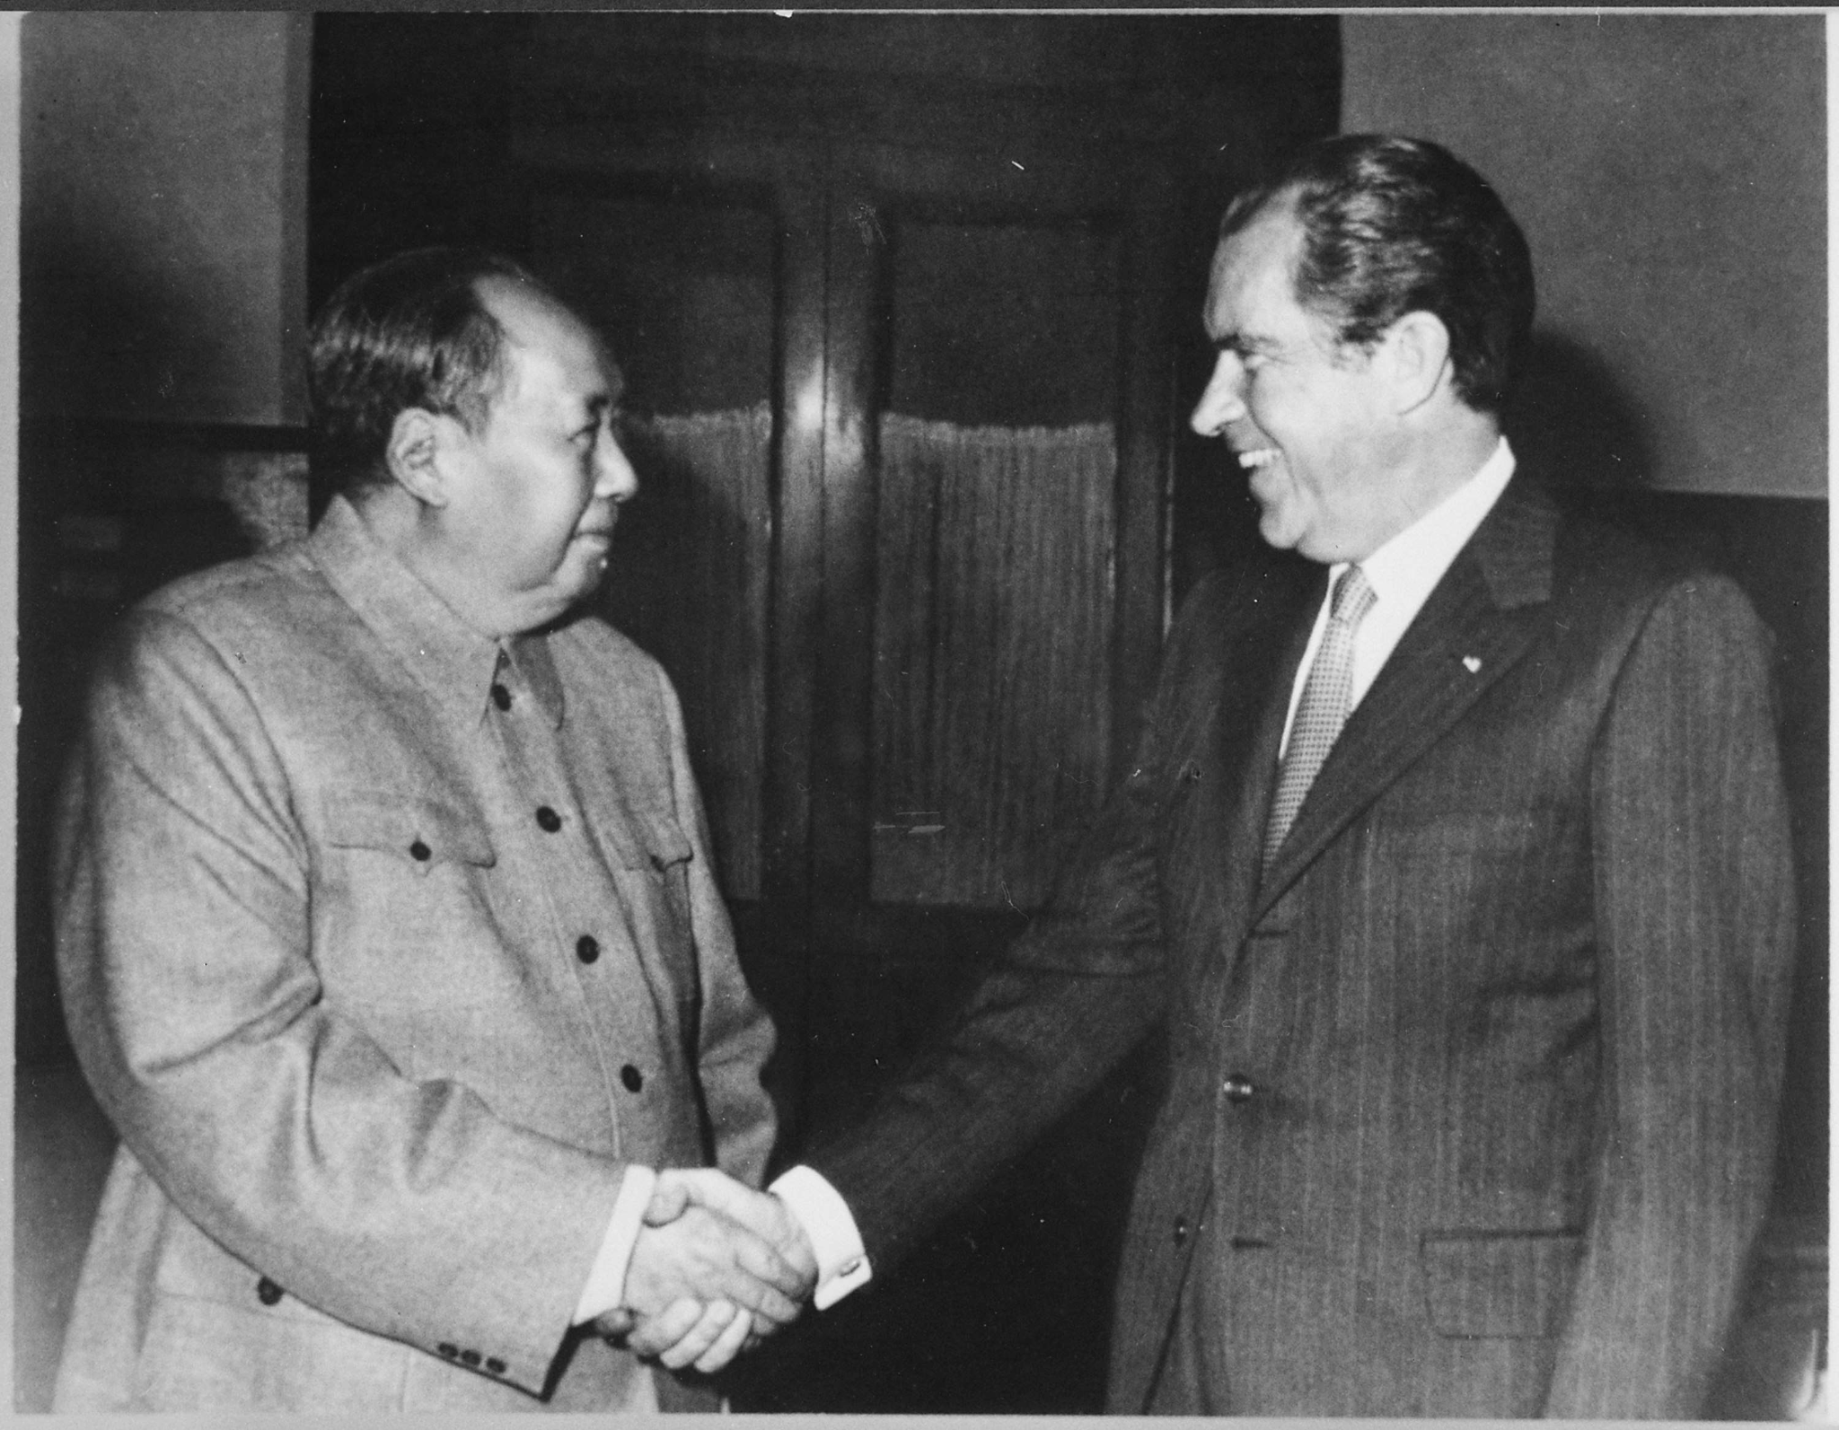
Image 2: President Nixon meets with China's Communist Party Leader, Mao Tse-Tung
2/29/1972
Notes:
President Nixon meets with China's Communist Party Leader, Mao Tse- Tung, 02-29-1972 - Nara - 194759. (1072). Wikimedia. Retrieved August 2, 2022, from https://commons.wikimedia.org/wiki/File:President_Nixon_meets_with_China's_Communist_Party_Leader,_Mao_Tse-_Tung,_02-29-1972_-_NARA_-_194759.tif.

Slide 31
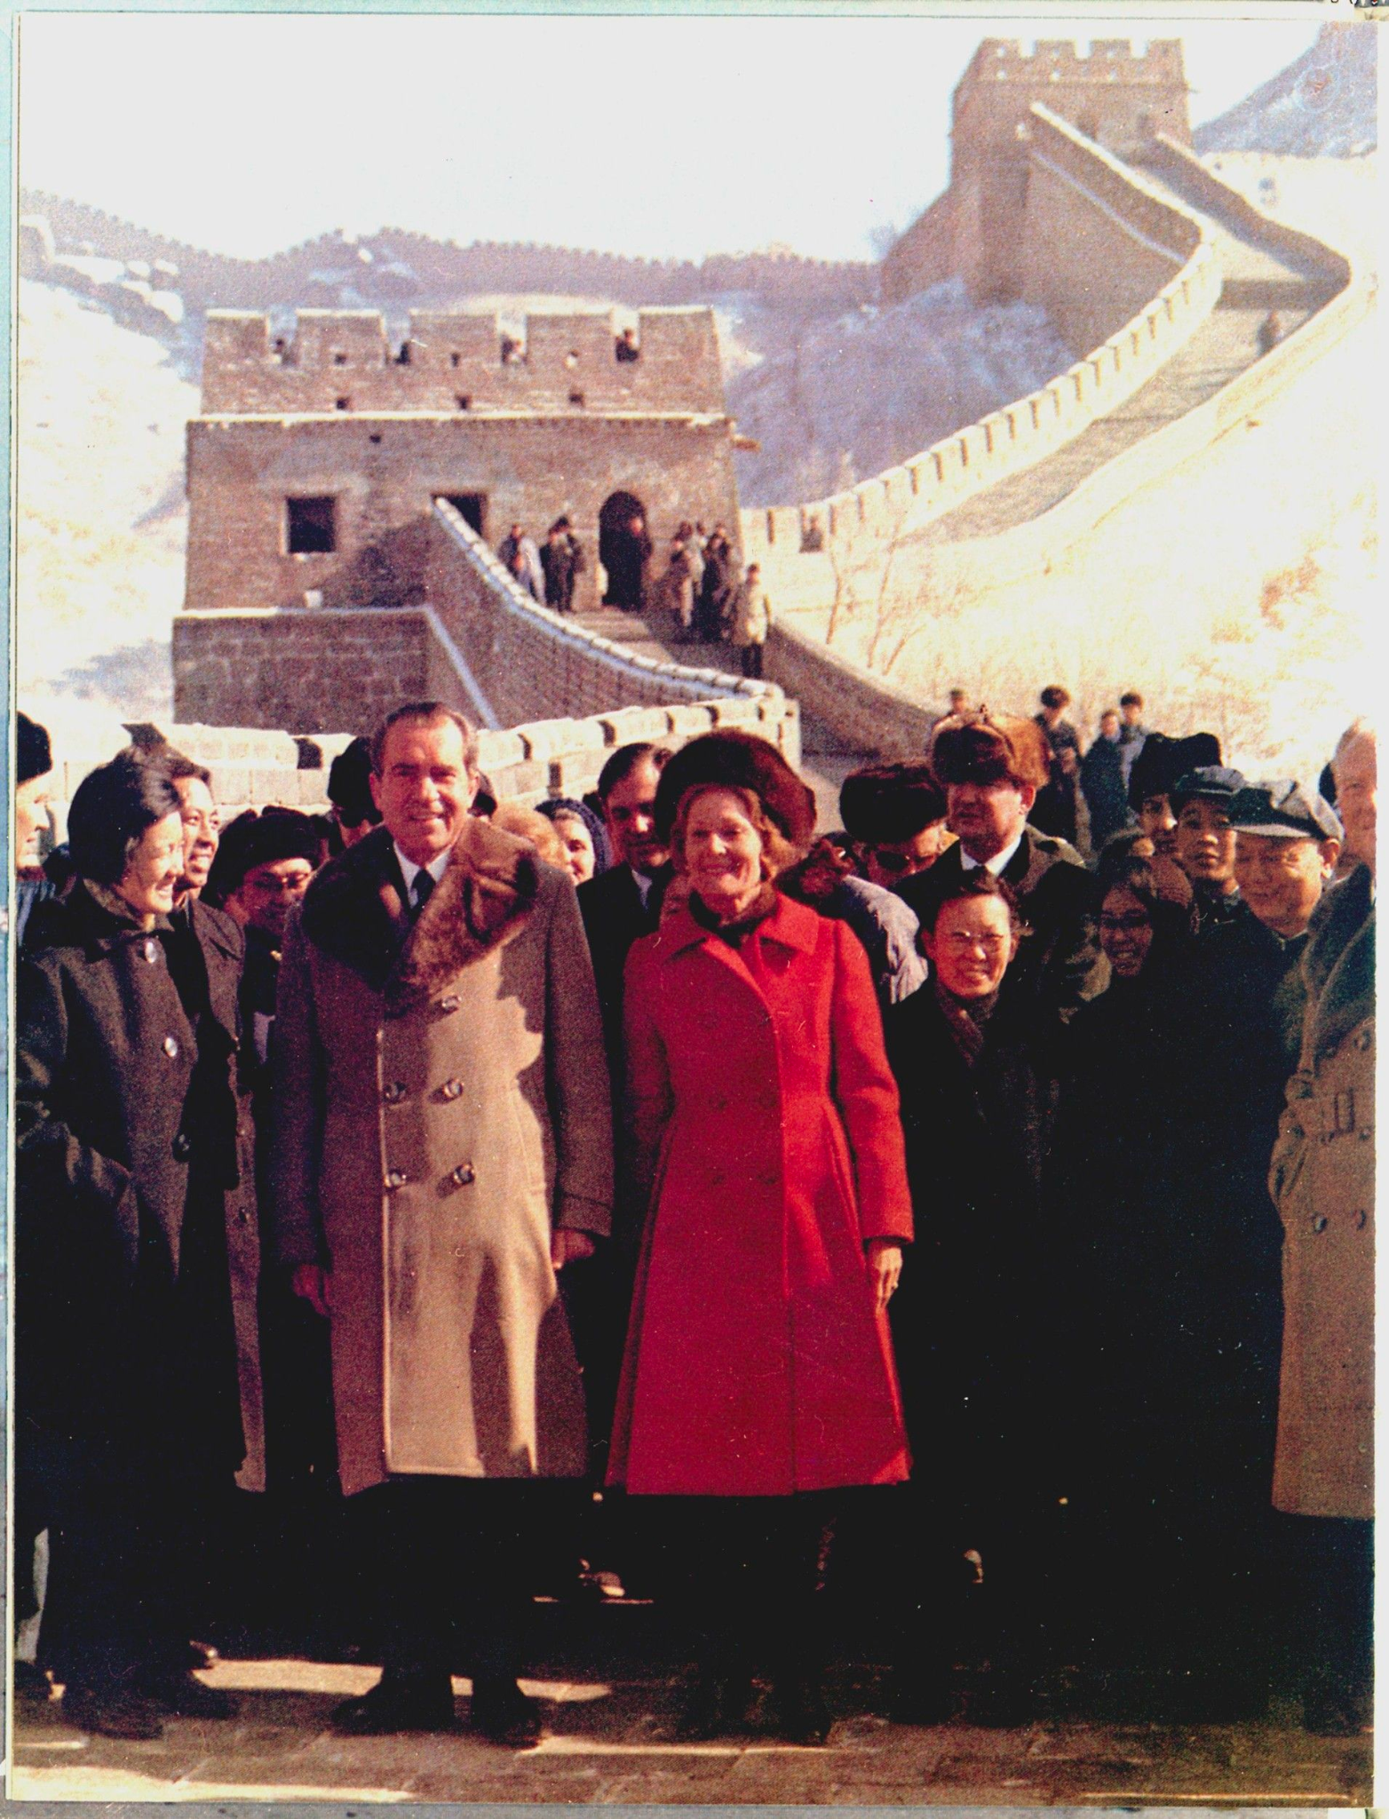
Image 3: President and Mrs. Nixon visit the Great Wall of China and the Ming tombs
2/24/1972
Notes:
Schumaker, B. E. (1972). President and Mrs. Nixon visit the Great Wall of China and the Ming tombs - Nara - 194421. Wikimedia. Retrieved August 2, 2022, from https://en.wikipedia.org/wiki/File:President_and_Mrs._Nixon_visit_the_Great_Wall_of_China_and_the_Ming_tombs_-_NARA_-_194421.tif.

Slide 32
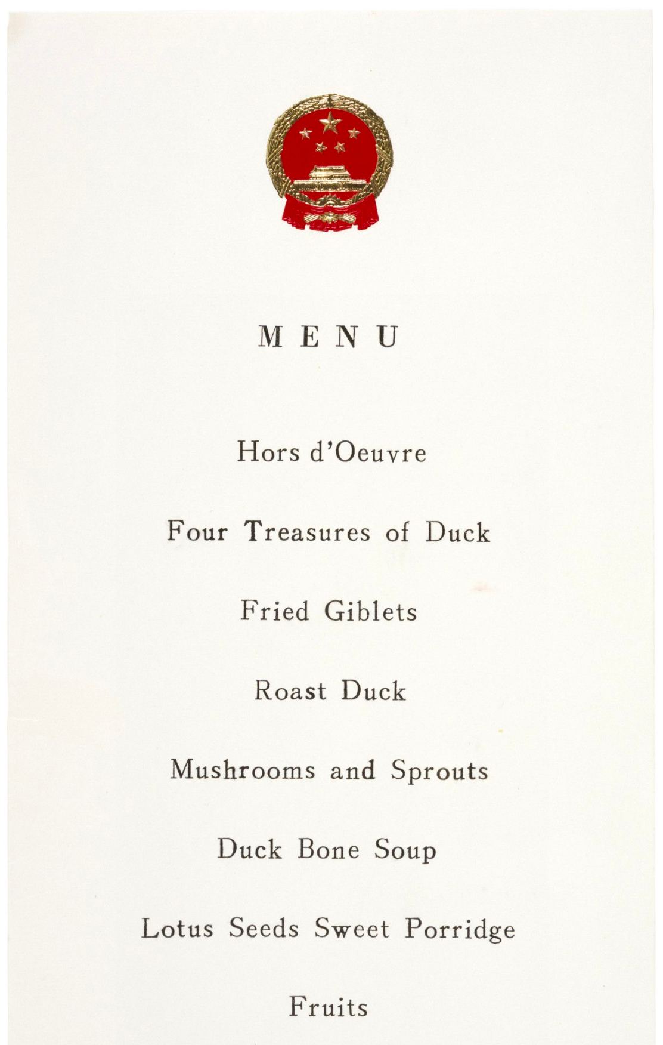
Image 4: This menu was printed for a formal dinner hosted by President Richard Nixon and Mrs. Nixon for Chinese Premier Chou En-lai during the President’s trip to Beijing in February 1972. The formal visit launched improved relations between the United States and China after decades of the Cold War.
2/1972
Notes:
Menu from Dinner Given During President Nixon's Visit to Peking, China. (1972). National Archives Catalog. Retrieved August 2, 2022, from https://catalog.archives.gov/id/595300.

Slide 33
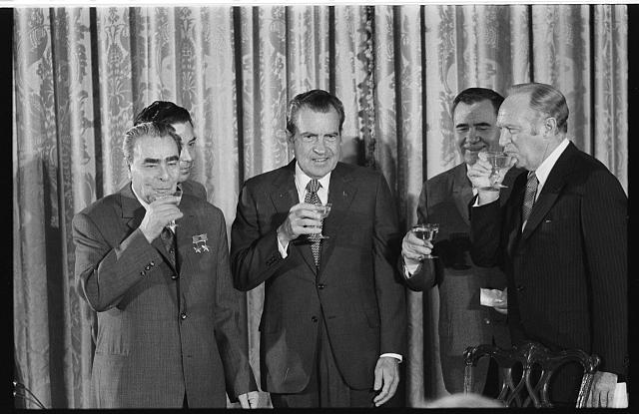
Image 5 - President Richard Nixon with (left to right) Soviet leader Leonid Brezhnev, Soviet Minister of Foreign Affairs Andrei Gromyko, and Secretary of State William P. Rogers, toasting the signing of agreements between the two countries on oceanography, transportation and cultural exchange.
June 19, 1973
Notes:
Leffler, W. K. (n.d.). [President Richard Nixon with (left to right) Soviet leader Leonid Brezhnev, Soviet Minister of Foreign Affairs Andrei Gromyko, and Secretary of State William P. Rogers, toasting the signing of agreements between the two countries on oceanography, transportation and cultural exchange] / Wkl. Library of Congress. Retrieved August 2, 2022, from https://www.loc.gov/item/2015647013/.

Slide 34
Give, Get, Reflect - Reflect Round 2
How has diplomacy changed in the last 50 years?
Add to the “Reflect Round 2” section of your Give, Get, Reflect handout using evidence from the lesson materials

