Slide 2
Adjectives Can Make Things: Bigger, Brighter, More Beautiful!

Slide 3
Essential Question
What are adjectives and how can they make stories and writing more interesting?

Slide 4
Lesson Objectives
Learn what an adjective is.
Use adjectives to make writing more interesting.
Learn to identify adjectives in different forms of texts.

Slide 5
Is it a person, place, or thing?
Person
Thing
Place
A noun is ______________________________________________

Slide 6
My dog sleeps in a bed.
My fluffy white dog sleeps in an old dirty bed.

Slide 7
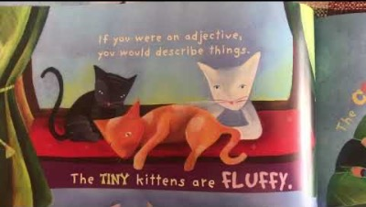
Notes:
Link to video: https://youtu.be/RmDnez0eduw

Slide 8
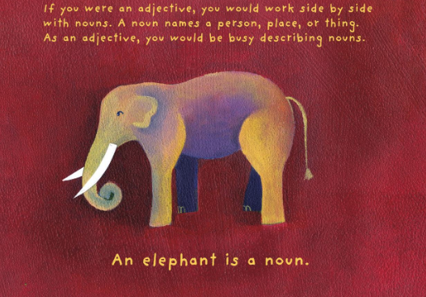

Slide 9
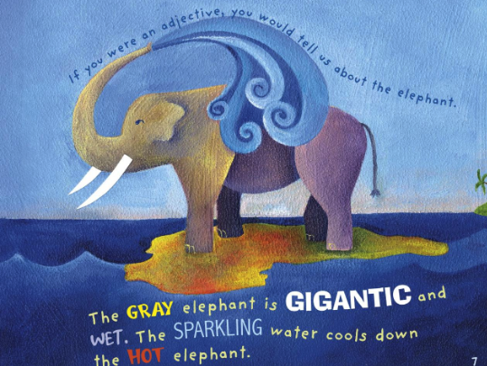
Notes:
page 7 in the book

Slide 10
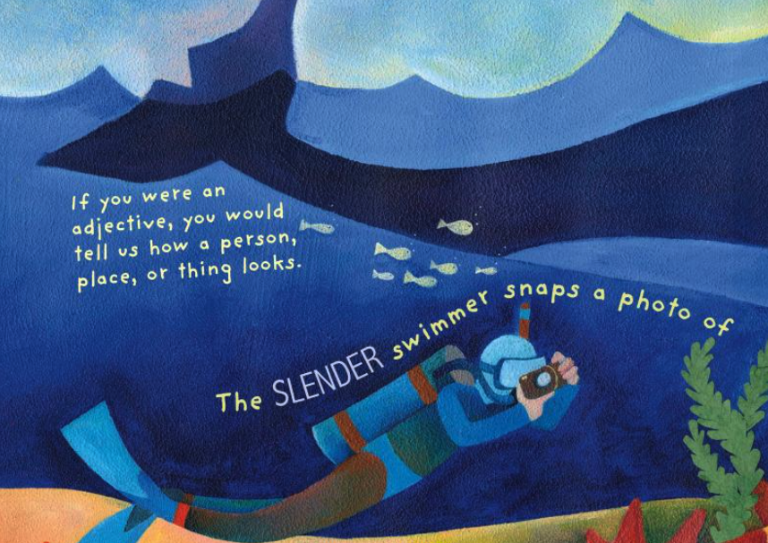
Notes:
page 8 in the book

Slide 11
As a class, let’s decide what an adjective does.
An adjective is a word that _____________.

Slide 12
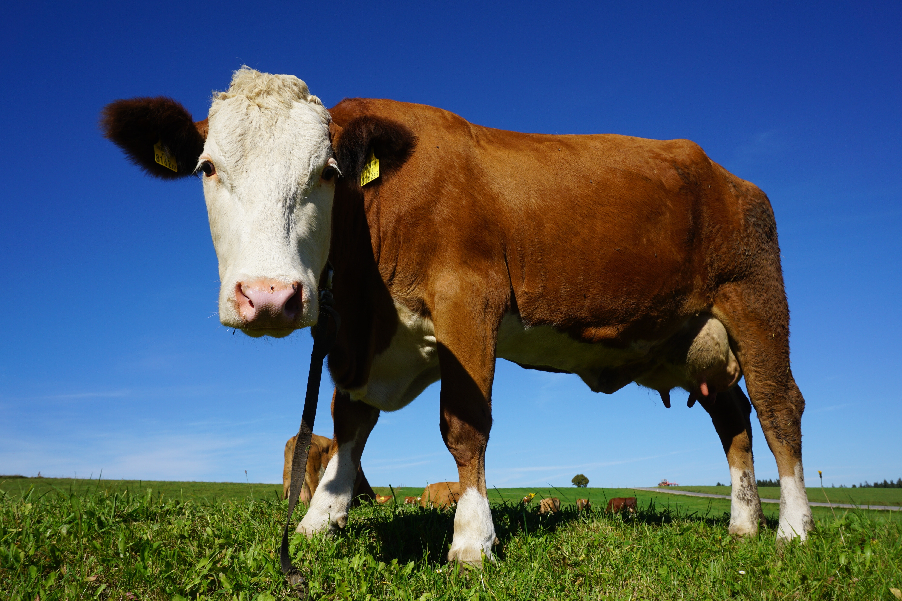
This is a cow.
Adjectives that describe the cow:
Write a sentence about the cow using adjectives and nouns.
What word is the noun?

Slide 13
Fun with adjectives!
Write your name from top to bottom on your paper.
L
O
G
A
N

Slide 14
Now think of adjectives that describe you.
Use the letters in your name as the first letters of the adjectives.
L is for Likeable
O is for Outgoing
G is for Green bean eater
A is for Adorable
N is for Nice

