Slide 2
¡Sí Se Puede!
United Farm Workers Union and the Delano Grape Strike

Slide 3
Lesson Objective
Examine the creation of the United Farm Workers labor union and the actions taken by labor union leaders.

Slide 4
“We don’t need perfect political systems; we need perfect participation.”
—César Chávez

Slide 5
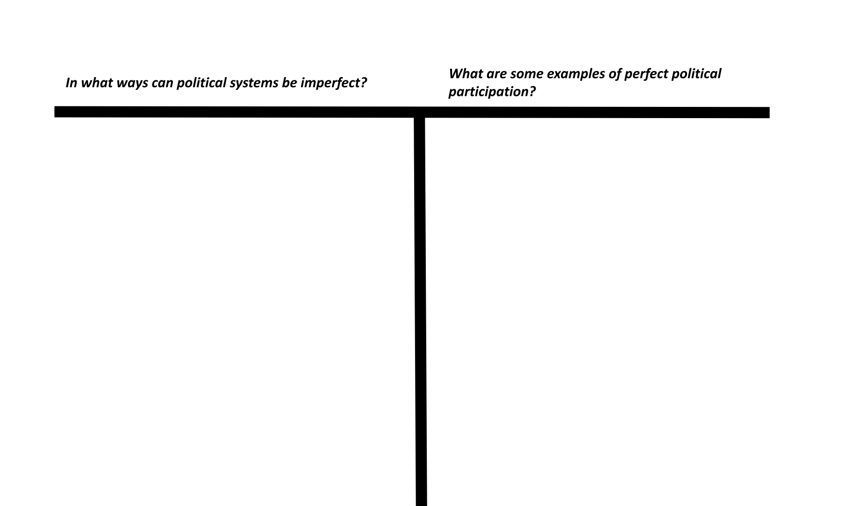

Slide 6
Left Side
In what ways can political systems be imperfect?

Slide 7
Right Side
What are some examples of perfect political participation?

Slide 8
Essential Question
How can political participation effect change?

Slide 9

Painting a Picture: Photograph Observations
An observation is anything you see in the photographs and their captions.
An inference is something that you conclude based on your observations.
As you examine each photograph set (A/B), record your observations and inferences in the correct columns of your handout.
Notes:
K20 Center. (n.d.) Painting a picture. Strategies. https://learn.k20center.ou.edu/strategy/1331

Slide 10
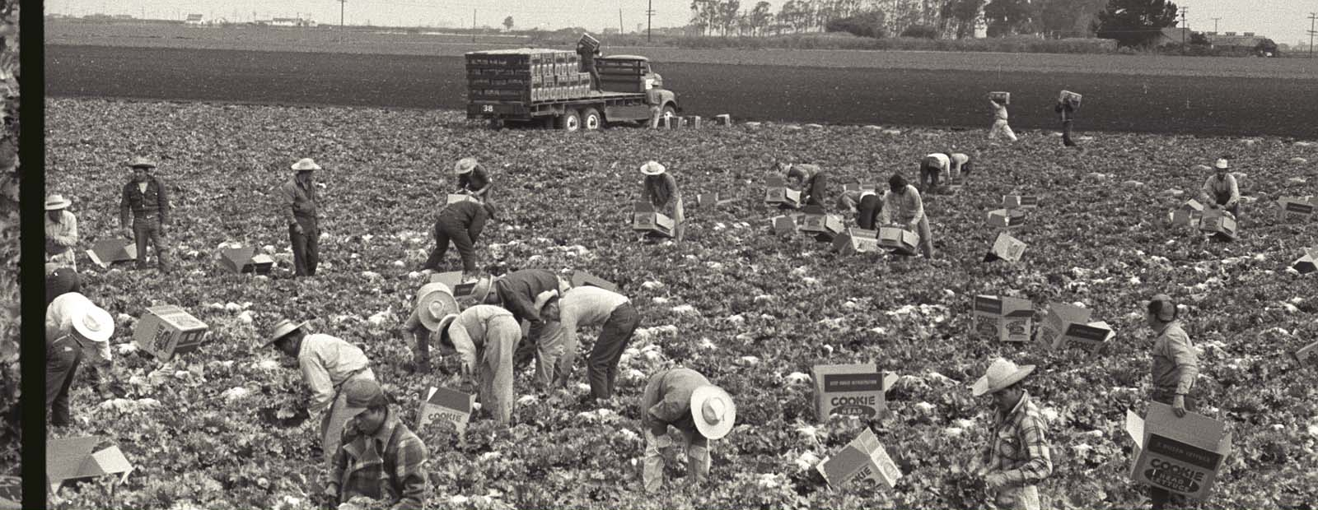
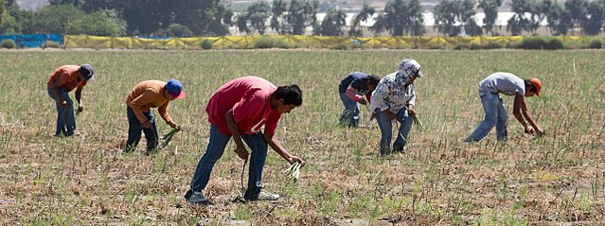
Picture 1A
Picture 1B
Notes:
(Photo A): Nadel, L. (1956). Braceros pick lettuce and fill it into Cookie head lettuce boxes in a field in California. The Leonard Nadel Collection, NMAH. https://braceroarchive.org/files/original/NAD-200401385618.jpg
(Photo B): Tomascastelazo. (2014, August 31). Sparragus pickers. Photo taken in the valley of Maneadero, south of Ensenada, Baja California. Wikimedia Commons. https://commons.wikimedia.org/wiki/File:Sparragus_pickers.jpg

Slide 11
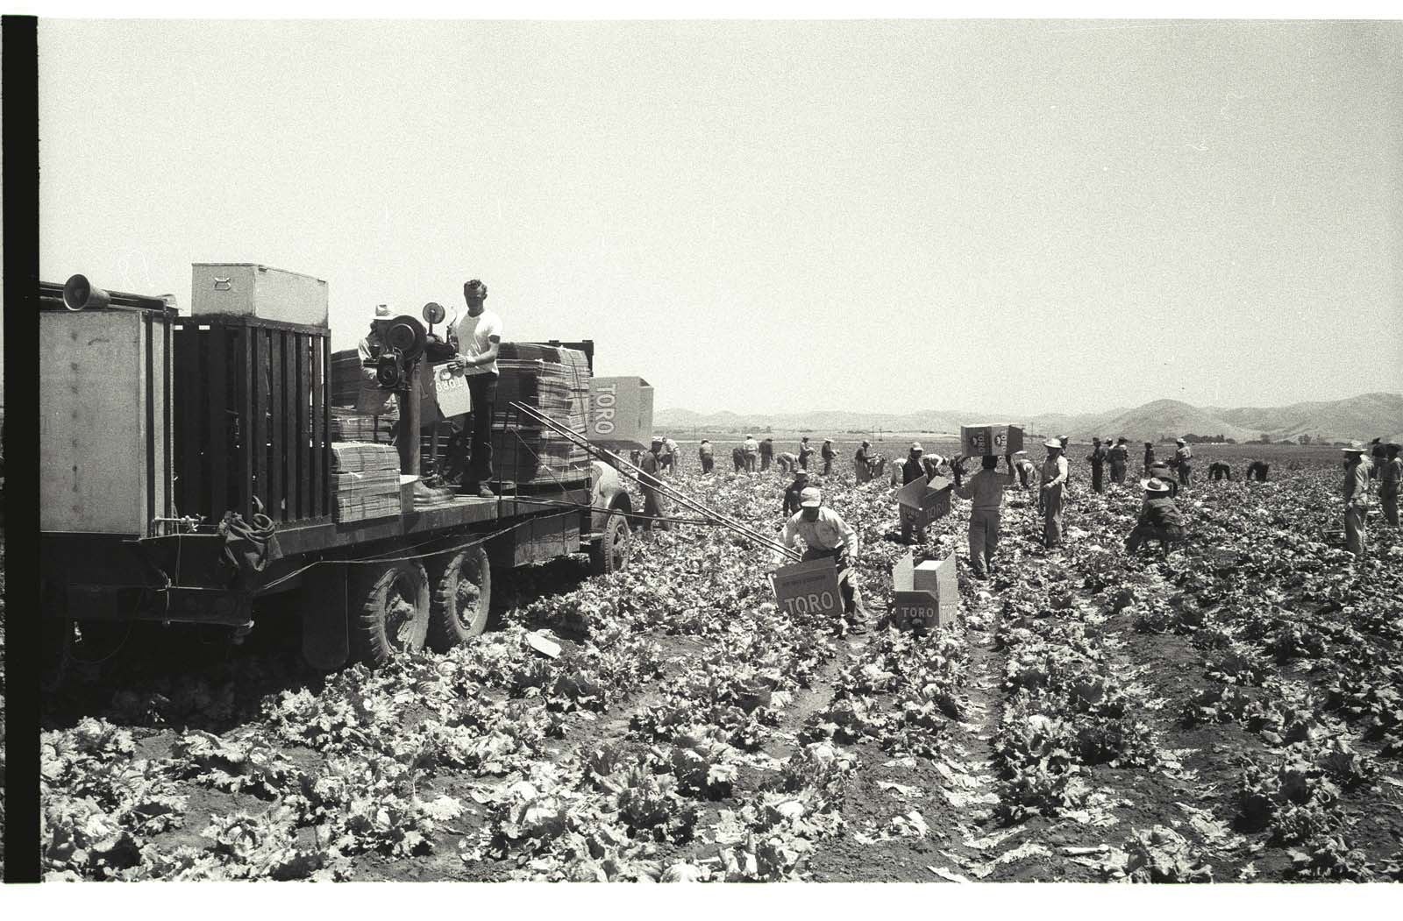
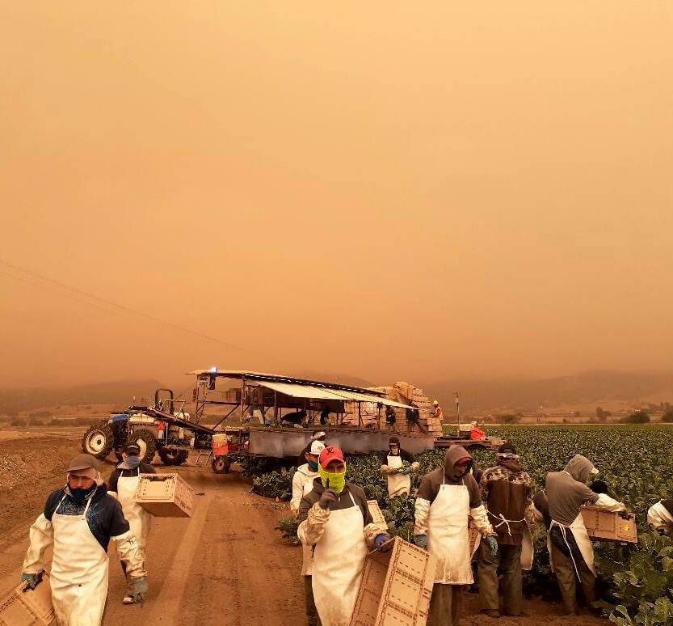
Picture 2B
Picture 2A
Notes:
(Photo A): Nadel, L. (1956). Braceros load Toro lettuce boxes on a truck on a lettuce field in the Salinas Valley, California. The Leonard Nadel Collection, NMAH. https://braceroarchive.org/files/original/NAD-200401383703.jpg
(Photo B): United Farm Workers. (2020, September 10). Erick shared this photo arriving to work in King City CA. He shares “There is nothing heroic about what we do. We work out of necessity.” If the air quality index surpasses 150, employers must provide respiratory protection equipment such as N95 masks or similar. Twitter. https://twitter.com/UFWupdates/status/1304196728208461825/photo/1

Slide 12
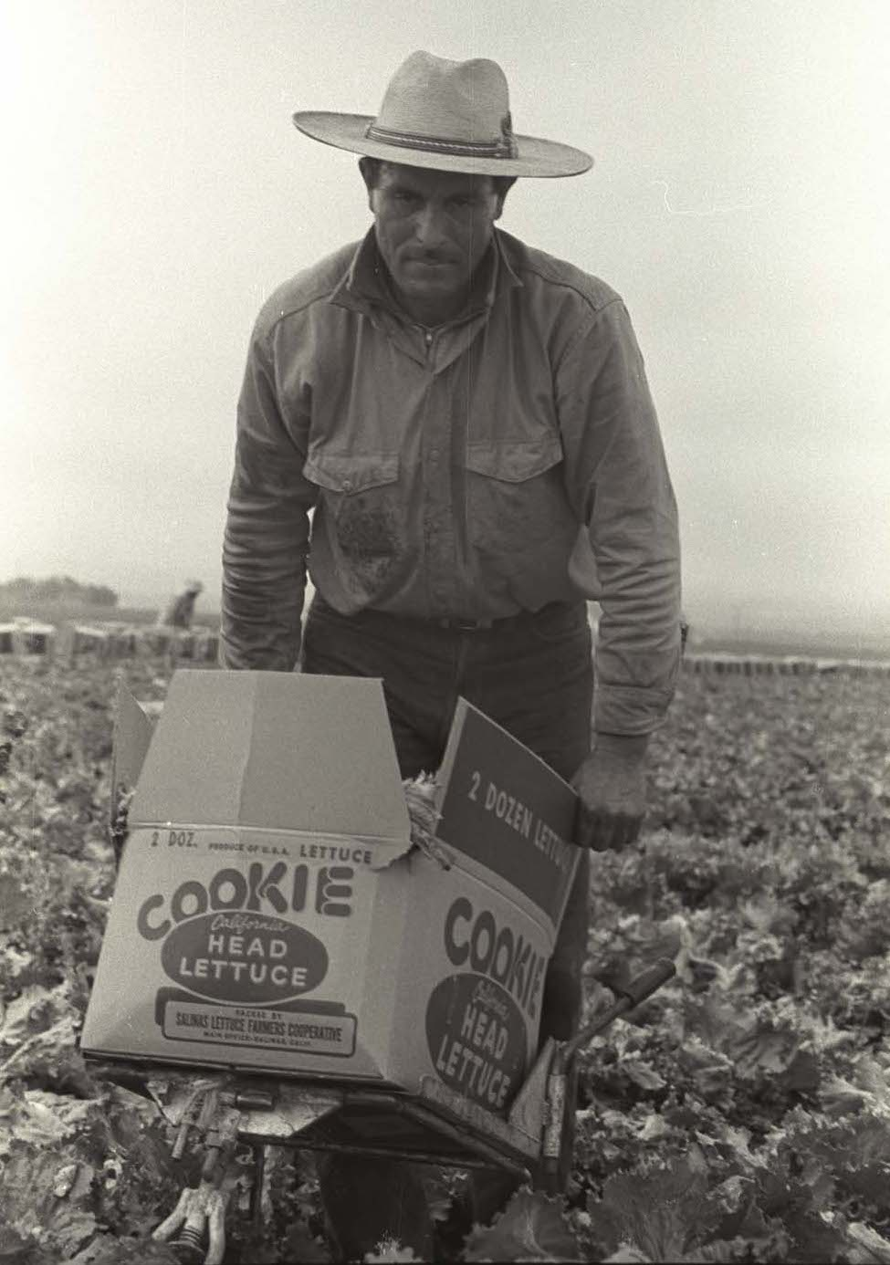
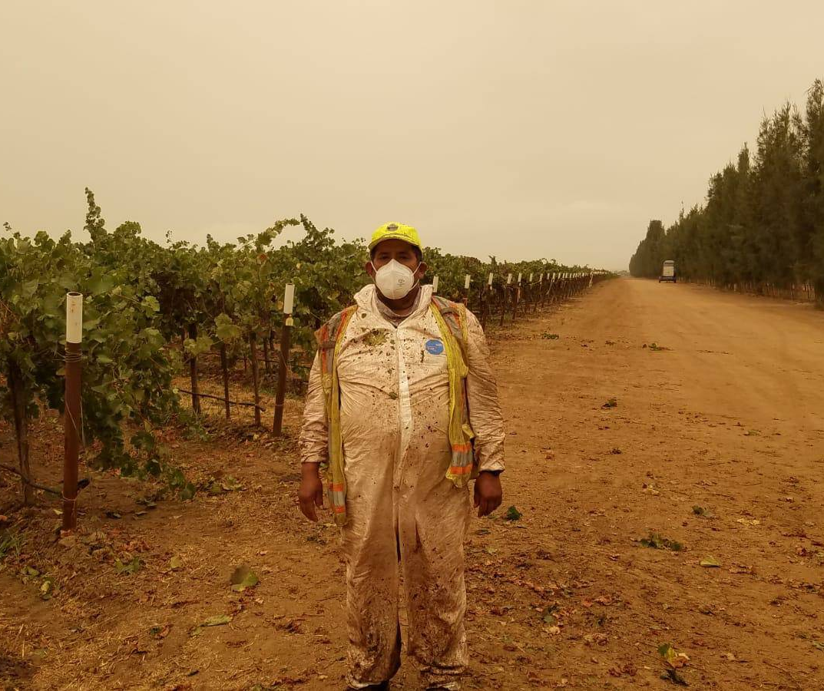
Picture 3A
Picture 3B
Notes:
(Photo A): Nadel, L. (1956). A bracero carries a full Cookie Head lettuce box on a trolley in a field in the Salinas Valley, California. The Leonard Nadel Collection, NMAH. https://braceroarchive.org/files/original/NAD-200401385634.jpg
(Photo B): United Farm Workers. (2020, September 13). The UFW distributed P95 masks to farmworkers in Monterey County CA who are laboring despite poor air quality from nearby fires. If the air quality index exceeds 150, employers must provide protective equipment such as N95 masks or equivalent, but many are not. Twitter. https://twitter.com/UFWupdates/status/1305189651230187521/photo/1

Slide 13
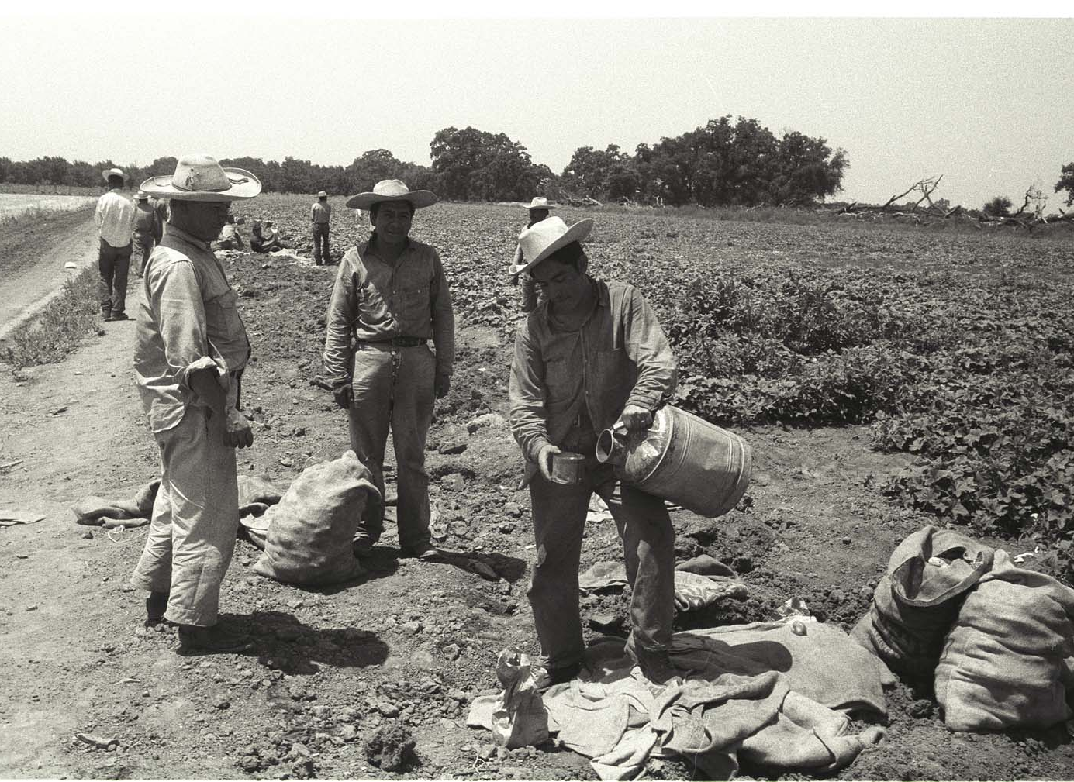
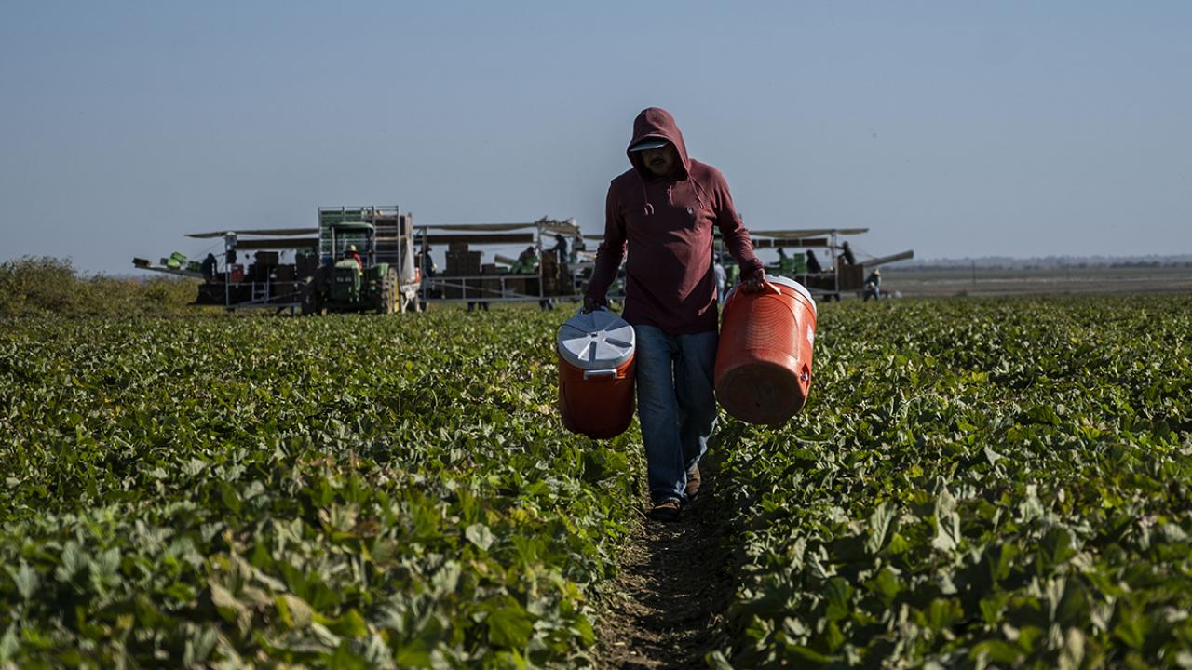
Picture 4B
Picture 4A
Notes:
(Photo A): Nadel, L. (1956). A bracero fills water from a vat into a cup on the edge of a field in California. The Leonard Nadel Collection, NMAH. https://braceroarchive.org/files/original/NAD-200401384515.jpg
(Photo B): Amezcua, H. (2019, October 25). Research highlight: Stressors and psychological distress of Latino immigrant agricultural workers in California. College of Agriculture and Environmental Sciences at UC Davis. https://aghealth.ucdavis.edu/news/research-highlight-stressors-and-psychological-distress-latino-immigrant-agricultural-workers

Slide 14
Infogram
Type one of the following URLs into your web browser:
k20.ou.edu/sisepuede (English)
k20.ou.edu/sisepuede-esp (Spanish)
Notes:
If the short links are not working, provide students with the following links. English: https://infogram.com/si-se-puede-1h8n6m39knm9j4x?live
Spanish: https://infogram.com/si-se-puede-spanish-1h7g6k0o1gx7o2o?live

Slide 15

Infogram S-I-T
Based on the information you learned from the Infogram, work with your partner to come up with the following:
One Surprising fact or idea.
One Interesting fact or idea.
One Troubling fact or idea.
Notes:
K20 Center. (n.d.). S-I-T (surprising, interesting, troubling). Strategies. https://learn.k20center.ou.edu/strategy/926

Slide 16

Laborers’ International Union of North America-LiUNA!
Arturo Delgado serves as the
Business Manager for Laborers
Local 107 chapter.
It’s an American and Canadian labor union with over half a million members.
It primarily represents construction workers and public service employees.
Notes:
https://www.facebook.com/390521307823505/photos/a.390521331156836/692493257626307/

Slide 17

ICAP: LiUNA Local Union Leader
Notes:
To play the video, click the image on the slide or paste this link into your web browser: https://youtu.be/bI-n7kGomck
K20 Center. (2022, June 21). ICAP-LiUNA local union leader [Video]. YouTube. https://www.youtube.com/watch?v=bI-n7kGomck

Slide 18
Discussion Questions
What stood out to you the most from Delgado’s interview?
What connections can we make between what we’ve learned about the United Farm Workers and what Delgado mentioned regarding labor unions today?

Slide 19

Exit Ticket
In 3–5 sentences, write a response to the following question:
How can political participation
effect change?
Notes:
K20 Center. (n.d.). Bell ringers and exit tickets. Strategies. https://learn.k20center.ou.edu/strategy/125

