Slide 2
Triangles and Circles and Squares, Oh My!
Shapes in Character Design

Slide 3
Warm-Up
Draw three different, contrasting, shapes.
Fill each with one solid, contrasting color.
You can use markers, pens, pencils, or pastels, but stick to one medium throughout the lesson.

Slide 4
Essential Question
How does shape inform character design?

Slide 5
Lesson Objective
Develop a portfolio of three original characters using contrasting color palettes, styles, etc.

Slide 6
Preflection
Answer the essential question:
How does shape inform character design?

Slide 7
Transform Your Shapes
Turn each shape into a character.
What is the shape? Is it a face? A body? A creature?
You can alter the proportions of the shape.
You can alter the shade of the color.
Each time you make a change, make it next to the previous version of the drawing so we can see progress.
Notes:
K20 Center. (2021, September 21). K20 Center 5 minute timer [Video]. YouTube. https://www.youtube.com/watch?v=EVS_yYQoLJg

Slide 8
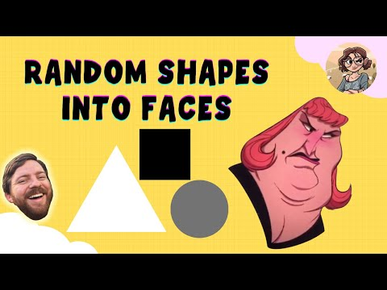
Notes:
Audity. (2021, August 5). Drawing shapes into faces! [Video]. YouTube. Retrieved June 7, 2022, from https://www.youtube.com/watch?v=FQd3h9tTMvk

Slide 9
Resume Your Work!
Notes:
K20 Center. (2021, September 21). K20 Center 10 minute timer [Video]. YouTube. https://www.youtube.com/watch?v=9gy-1Z2Sa-c

Slide 10
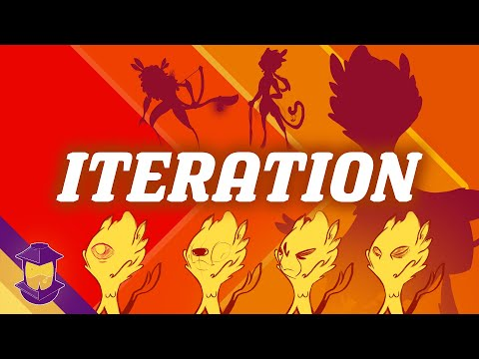
Notes:
Brookes Eggleston - Character Design Forge. (2021, June 6). Iteration: An essential character design tool! [Video]. YouTube. Retrieved June 7, 2022, from https://www.youtube.com/watch?v=KCF0-PBtHAA

Slide 11
Point of Most Significance
Think about the iteration process.
What is the most important factor of using iteration to create characters?

Slide 12
Pass the Problem
Make a new iteration of one of your characters.
Pass the drawing to a partner.
Your partner will make a new version of your character and offer some design suggestions. They can change aspects of the character, including the color, to help you see a different perspective.
Pass the paper back.
Make another iteration of your character incorporating your partner’s design suggestions.

Slide 13
Accessorize
Using only one extra color per character, add an accessory that helps to better define who the character is. At this point, you can also decide if you want to keep the original color or if you think another color better suits your character and the accessory.
Check out the following slides for examples of what your paper might look like.

Slide 14
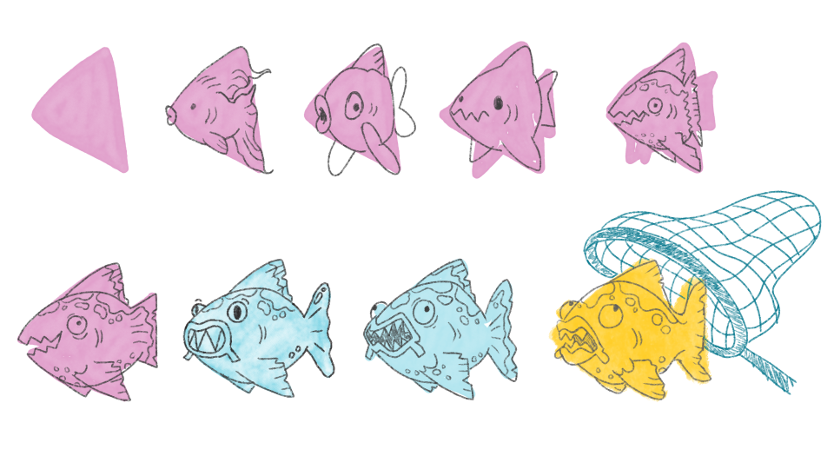

Slide 15
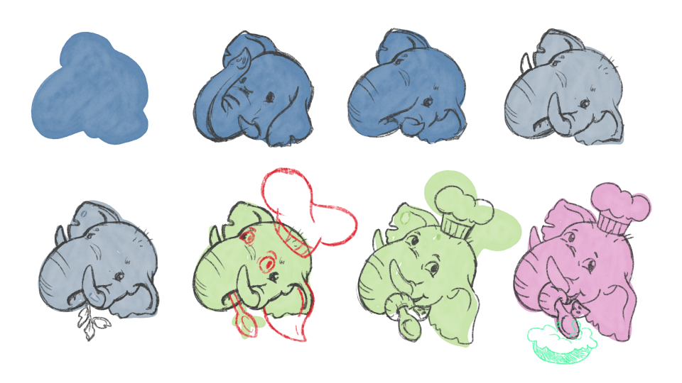

Slide 16
Preflection Revisited
Answer the essential question:
How does shape inform character design?

Slide 17
Chat Stations
Find your Pass the Problem partner and pair up with another pair to make a group of four.
Visit each of the three question posters and write a complete answer for each question.

