Slide 2
Make Some Waves
Exploring the Science of Synthesizers

Slide 3
Essential Question
How do synthesizers manipulate the properties of waves to create different sounds?

Slide 4
Lesson Objectives
Understand how wave interference affects waves
through creation of sounds on a synthesizer

Slide 5
Wakelet
Use the provided link to navigate to the Wakelet choice board and follow the directions provided by your teacher.
Notes:
Wakelet. (n.d.). Synthesizer choice board. https://wakelet.com/wake/pD6nwxnB-Iel99Upt0yDt

Slide 6

Stop and Jot
Stop and Jot is an activity where you pause and reflect on what you have experienced or read. Navigate to the Chrome Music Lab Oscillator activity and experiment for the next few minutes. When you have finished, follow the instructions on the handout.

Slide 7
Stop and Jot, part 2
Flip to the reverse side of the Stop and Jot Handout.
Navigate to the Izotope article The Beginner's Guide to Synths for Music Production by Daniel Dixon.
Use the handout to summarize each section as indicated, using one or two sentences.
Notes:
Dixon, D. (2018, July 17). The beginner’s guide to synths for music production. Izotope. https://www.izotope.com/en/learn/the-beginners-guide-to-synths-for-music-production.html

Slide 8
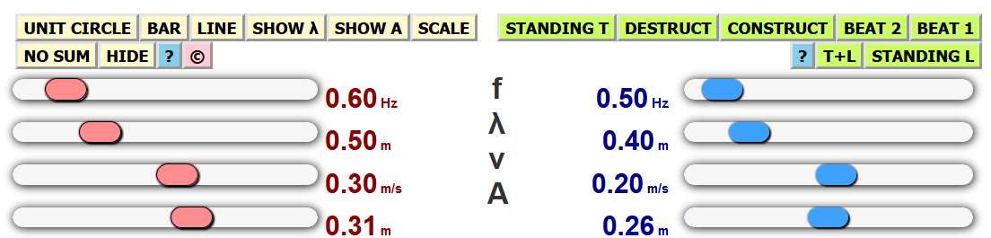
Wave Addition Simulation
Use the variable slider bars to change the properties of waves 1 and 2.
Explore the Standing T, Destruct, and Construct modes.
Notes:
Kirby, M. (n.d.). The physics classroom. (interactive website). https://www.physicsclassroom.com/Physics-Interactives/Waves-and-Sound/Wave-Addition/Wave-Addition-Interactive

Slide 9
Discussion
What happens when two crests pass each other? Two troughs?
How does the wave sum change when crests and troughs do not align perfectly?
How does changing the amplitude affect the wave sum? The frequency? The wavelength?

Slide 10
Wave Interference
Wave Interference: The interaction of two waves when they meet.
Principle of Superposition: When waves interact, they overlap one another; the resulting wave has an amplitude that is the sum of the individual waves.
  Constructive Interference: Waves in the same phase (e.g., 2 peaks) produce a wave with an increased amplitude
  Destructive Interference: Waves in different phases (e.g., a peak and a trough) produce a wave with a decreased amplitude; waves with identical frequency and wavelength will cancel each other out
Notes:
Destructive interference: https://dr282zn36sxxg.cloudfront.net/datastreams/f-d%3A9b7ccadf72690e76ae27034a6fbcd74d1d7c5a57fc240ee0b2dc336a%2BIMAGE_THUMB_POSTCARD_TINY%2BIMAGE_THUMB_POSTCARD_TINY.1
Constructive interference: https://dr282zn36sxxg.cloudfront.net/datastreams/f-d%3A9ea4f5d51edbf1b0b4a267ee5fa60d268d8a874d46bbaaafa48e43fa%2BIMAGE_THUMB_POSTCARD_TINY%2BIMAGE_THUMB_POSTCARD_TINY.1

Slide 11
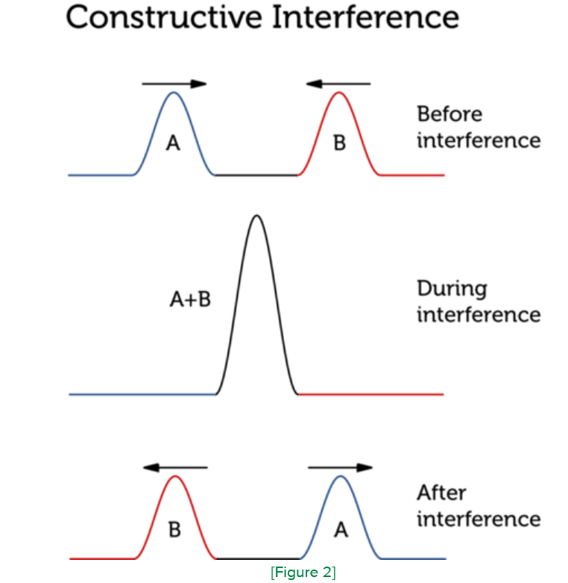
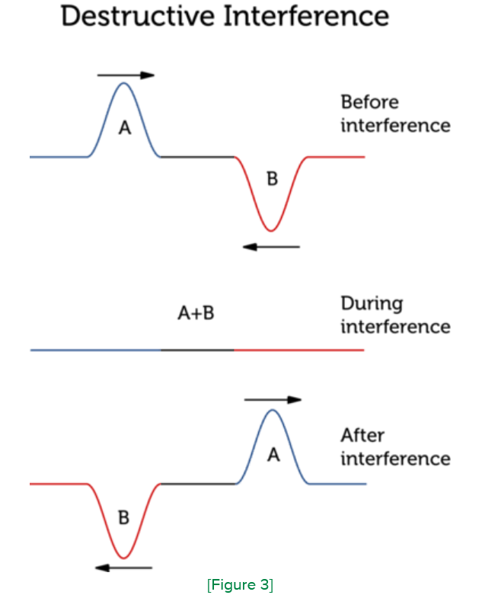
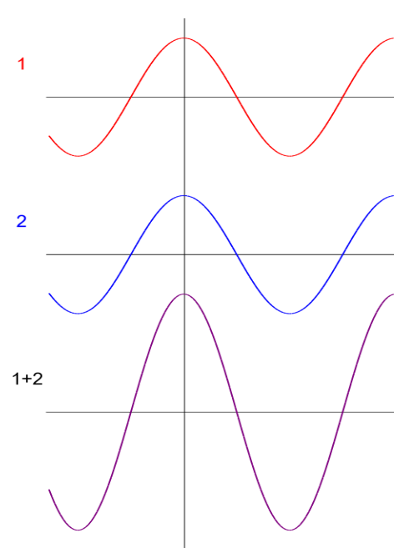
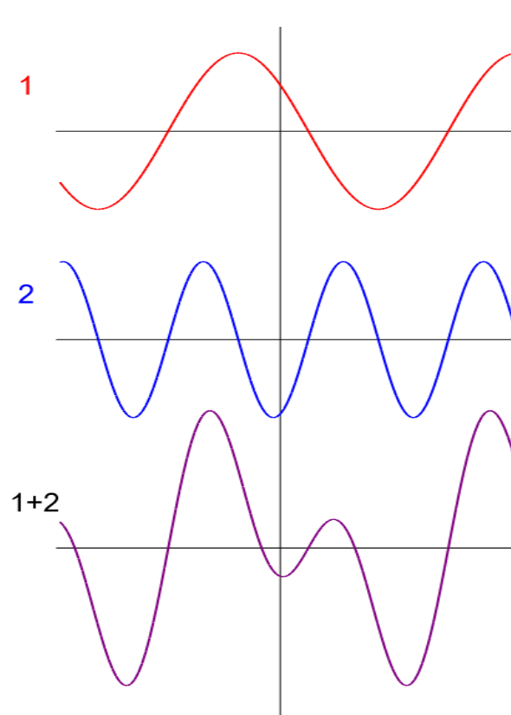
Constructive vs. Destructive Interference

Slide 12
Additive Synthesis
The Wave Addition and Interference Simulator shows what happens during additive synthesis, or when multiple waves are created by oscillators on a synthesizer and the sound changes.

Slide 13
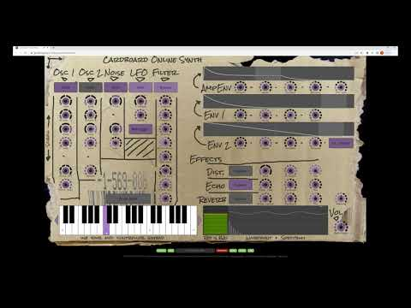
Cardboard Synth
Notes:
K20 Center. (2022, Aug 22). Carboard synthesizer tutorial. YouTube. https://www.youtube.com/watch?v=L2g38xtag9Q
Cardboard online synth website. (n.d). https://www.gsn-lib.org/apps/cardboardsynth/index.html

Slide 14
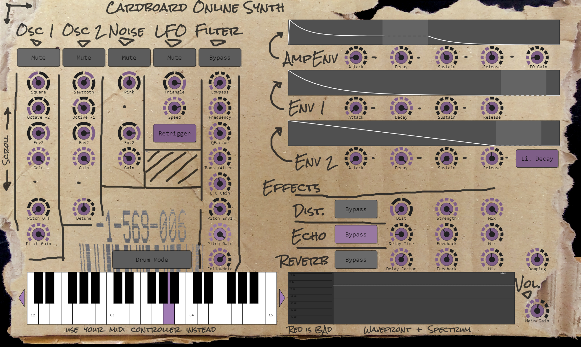
Cardboard Synth
Now manipulate the parameters to explore the following different moods: angry, growl, and sleepy.

Slide 15
Exit Ticket
On a sheet of paper, answer each of the following questions:
  What did you change to make each patch sound?
  Why did you select those parameters?
  What does changing the frequency do? The wavelength? The amplitude?

