Slide 2
Remembering Emmett Till
The Early Struggles Against Jim Crow and Racism

Slide 3
Lesson Objectives
Analyze the impact of Jim Crow laws in America.
Examine the history of lynching and the murder of Emmett Till.

Slide 4
“Playground Elegy”
What words from the poem stuck out to you the most?
What do you think this poem is about?

Slide 5
“Playground Elegy”
What do you think the word elegy means?

Slide 6
Definition of Elegy
A song or poem expressing sorrow or lamentation especially for one who is dead
Notes:
Merriam-Webster. (n.d.). Elegy. In Merriam-Webster.com dictionary. Retrieved July 11, 2022, from https://www.merriam-webster.com/dictionary/elegy

Slide 7
“Playground Elegy”
After reading the poem again and knowing the definition of elegy, does this change your understanding of the poem? If so, how?
What do you think the author's purpose was for writing this poem?

Slide 8
Essential Question
How can one individual influence a movement?

Slide 9
Paired Texts H-Chart
Each group will receive the Document Set containing two readings:
“Jim Crow Laws in Mississippi” and “Lynching in America.”
With your group, read and analyze both documents using your H-Chart handout.
Begin by reading “Jim Crow Laws in Mississippi” and complete the left side of the H-Chart.
Next, read “Lynching in America” and complete the right side of the H-Chart.
Lastly, use both texts to answer the middle section.
Notes:
K20 Center. (2020, September 16). Paired texts H-chart. Strategies. https://learn.k20center.ou.edu/strategy/132

Slide 10
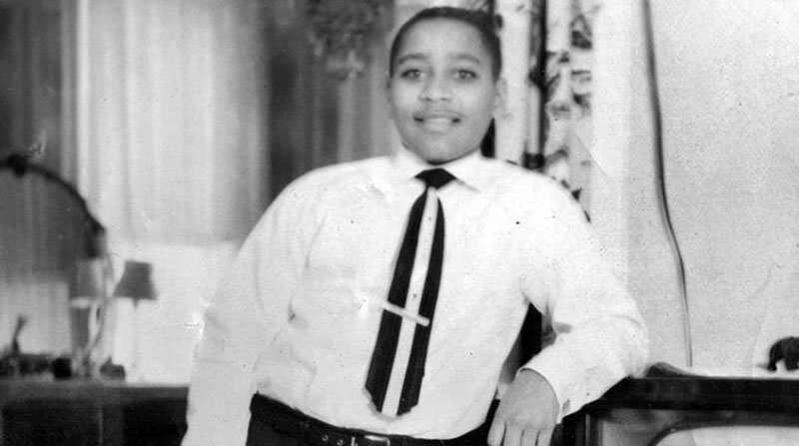
Emmett Louis Till
Born in Chicago on July 25, 1941.
The only child of Louis, a soldier who died in WWII, and Mamie Till.
In August of 1955, Emmett was 14 when he went to Money, MS, to visit family.
Before he left, Mamie gifted him a ring that had belonged to his father.
This would later be used to identify Till following his brutal murder.
Notes:
PBS. (n.d.). Who was Emmett Till? American experience. https://www.pbs.org/wgbh/americanexperience/features/biography-emmett-till/

Slide 11

Window Notes
As you watch the video, use your
Window Notes handout to follow along.
Facts: What facts from the video stood out to you the most?
Feelings: What feelings are you experiencing now that you have learned these facts?
Questions: Now that you have watched the video, what questions do you have that need to be answered?
Lasting Impact: How did this event have a lasting impact?
Notes:
K20 Center. (2020, September 16). Window notes. Strategies. https://learn.k20center.ou.edu/strategy/189

Slide 12
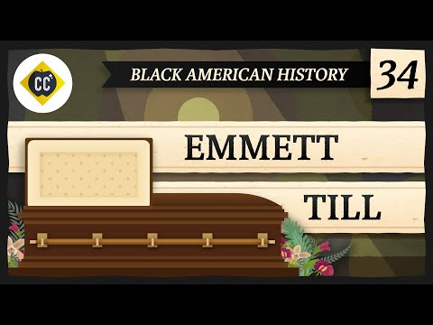
Emmett Till: Crash Course Black American History #34
Notes:
CrashCourse. (2022, March 12). Emmett Till: Crash course Black American history #34 [Video]. YouTube. https://youtu.be/4HljsKwpv3g

Slide 13

Emmett Till’s Mother Speaks
Notes:
American Experience | PBS. (2020, September 3). Emmett Till’s mother speaks | The murder of Emmett Till | American experience | PBS [Video]. YouTube. https://youtu.be/4DE22TfEMEg

Slide 14

Point of Most Significance (POMS)
With your partner, discuss what stood out to you the most from the video.
What was your “point of most significance” from the video?
Notes:
K20 Center. (2020, September 16). POMS: Point of most significance. Strategies. https://learn.k20center.ou.edu/strategy/101

Slide 15

S-I-T: Public Law 117-107
With your Elbow Partner, read “Public Law 117-107” and come up with a response for the following:
A suprising fact or idea
An interesting fact or idea
A troubling fact or idea
Notes:
K20 Center. (2021, February 12). S-I-T (Surprising, interesting, troubling). Strategies. https://learn.k20center.ou.edu/strategy/926

Slide 16

Exit Ticket
How can one individual influence a movement?
Notes:
K20 Center. (2020, September 16). Bell ringers and exit tickets. Strategies. https://learn.k20center.ou.edu/strategy/125

