Slide 2
American Exclusivity
The Chinese Exclusion Act

Slide 3
Purpose
Students will be able to explain why the Chinese Exclusion Act was passed and the effects it had on America.

Slide 4
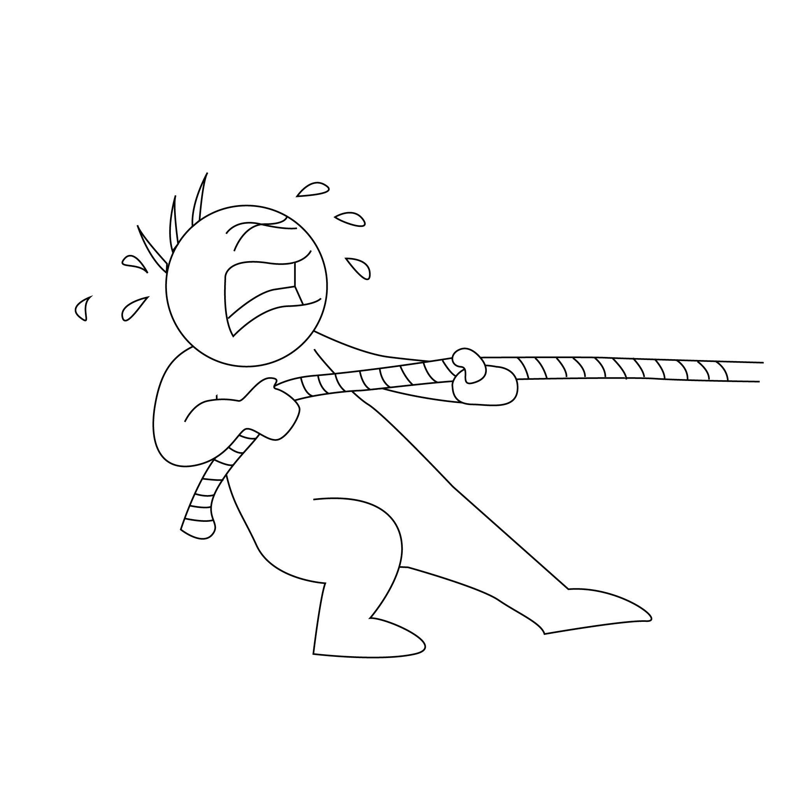
Why Immigrate?
What are some pull factors that contribute to immigration?
What are some push factors that contribute to immigration?

Slide 5
Essential Question
How did the Chinese Exclusion Act impact Asian-Americans?

Slide 6
Stop and Jot
Using your copy of the Chinese Exclusion Act Timeline handout, stop and jot down the summary of events leading up to the Chinese Exclusion Act.
Next, summarize the outcomes that occurred in the United States as a result of this law.
Notes:
K20 Center. (2020, September 16). Stop and jot. Strategies. https://learn.k20center.ou.edu/strategy/168

Slide 7
Day One H-Chart
As you read through Documents A and B, highlight parts of the text you deem important to answer the following question:
What factors contributed to the Chinese Exclusion Act?
Be sure to examine the cartoons and the text carefully for evidence to support your answers.
Summarize your findings on the left side of the H-Chart.
Notes:
K20 Center. (2020, September 16). Paired texts H-chart. Strategies. https://learn.k20center.ou.edu/strategy/132

Slide 8
Day 1 Student Survey
Notes:
https://www.youtube.com/watch?v=KUqHWMUljSw

Slide 9
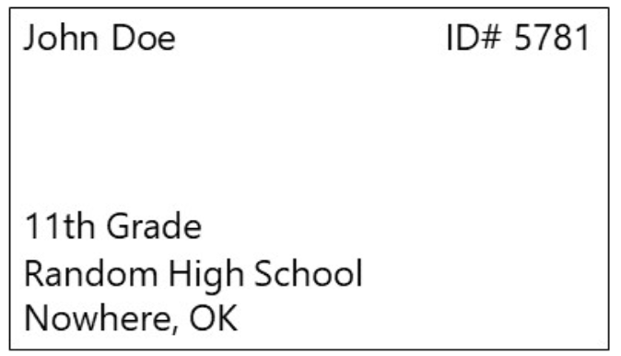
Day 1 Student Survey
https://bit.ly/day1-k20Lesson

Slide 10
Check for Understanding
Why did the Chinese Exclusion Act happen?
What were some of the conditions in the United States that led to the creation of this law?

Slide 11
Day Two H-Chart
As you read through Documents C and D, highlight parts of the text you deem important to answer the following question:
What factors contributed to the Chinese Exclusion Act?
Be sure to examine the cartoons and the text carefully for evidence to support your answers.
Summarize your findings on the right side of the H-Chart.
Once you have completed both sides of the H-Chart, use the knowledge you gained both all of the documents to respond to the middle section.
Notes:
K20 Center. (2020, September 16). Paired texts H-chart. Strategies. https://learn.k20center.ou.edu/strategy/132

Slide 12
S-I-T
Identify the following in the passage:
One item you found Surprising
One item you found Interesting
One item you found Troubling
Notes:
K20 Center. (2021, February 12). S-I-T (Surprising, interesting, troubling). Strategies. https://learn.k20center.ou.edu/strategy/926

Slide 13
A Chinese View of the Statue of Liberty
After you have read Saum Song Bo’s letter to the editor and you have completed the S-I-T analysis, how would you answer the following question:
Notes:
Newspapers.com. (1885, June 28). Letter from Saum Song Bo re Statue of Liberty fund raising. [Digital Image]. https://www.newspapers.com/clip/16261363/letter-from-saum-song-bo-re-statue-of/

Slide 14
Reflection
Why does Saum Song Bo feel both honored and insulted by the call for contributions to the Statue of Liberty?

Slide 15
Day 2 Student Survey
Notes:
https://www.youtube.com/watch?v=hHqmk_9XVR0

Slide 16
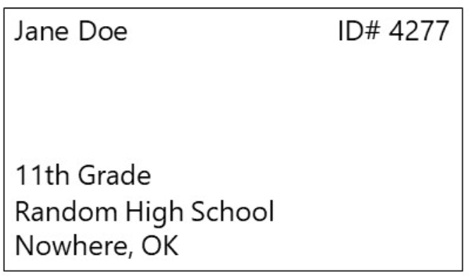
Day 2 Student Survey
https://bit.ly/day2-k20lesson

