Slide 2
Loved or Feared?
The Political Thoughts of Machiavelli

Slide 3
Essential Question
How should leaders treat people whom they govern?

Slide 4
Purpose
Students will be able to evaluate Machiavelli’s impact on political thought.

Slide 5
Agree or Disagree?
Read each statement and respond on notebook paper how much you agree by writing:
    Strongly Agree
    Agree
    Disagree
    Strongly Disagree
Most people are honest.
To get someone to like you, tell that person what they want to hear.
There are no absolute right or wrongs, right is what works.

Slide 6
How much did you agree with Machiavelli?
Statements Machiavelli would agree with:
To get someone to like you, tell that person what they want to hear.
There are no absolute rights or wrongs, right is what works.
Statements Machiavelli would not agree with:
Most people are honest.

Slide 7
Political Thought During the Renaissance
The Renaissance was a period from about 1400 to 1600.
During this time, there was a large number of philosophy, literature, and art created.
Thinkers looked to science and reason to explain the world rather than relying on religion.
Many of these people are still studied today.

Slide 8
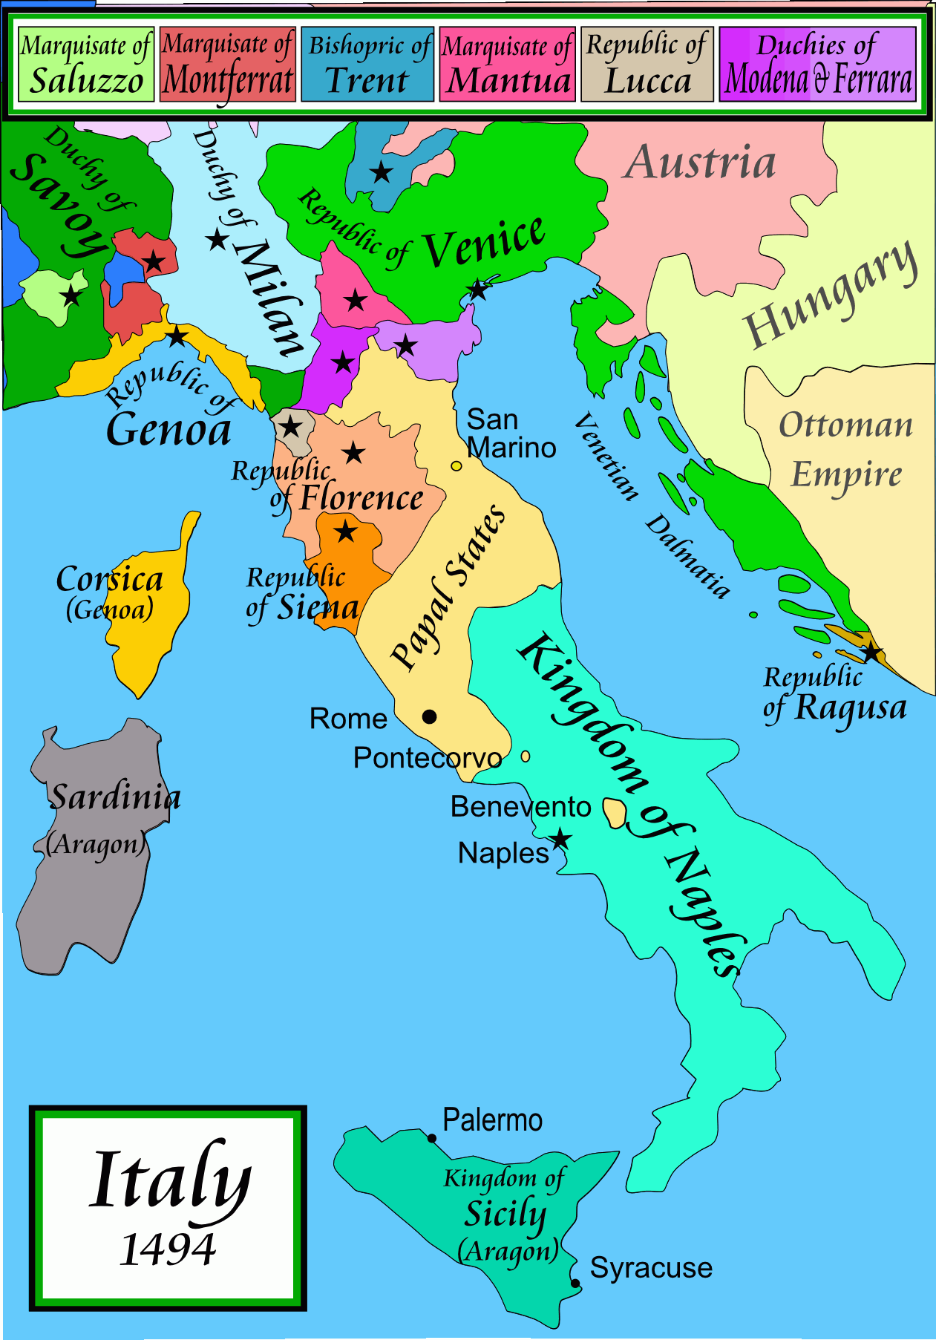
Niccolò Machiavelli
Born in Florence on May 3, 1469
Served as a diplomat for the Florence government.
Later was exiled when a new family came to power and was briefly put in jail for conspiring against the new family in control of the government
While exiled, wrote his most famous book, The Prince, as a guidebook for monarchs
Often referred to as the “father of modern political theory”
Notes:
Information source: Biography. (2020, June 16). Niccolò Machiavelli. https://www.biography.com/scholar/niccolo-Machiavelli
Image source: Wikimedia Commons. (2009, April 21). Italy 1494 AD. https://commons.wikimedia.org/wiki/File:Italy_1494_AD.png

Slide 9
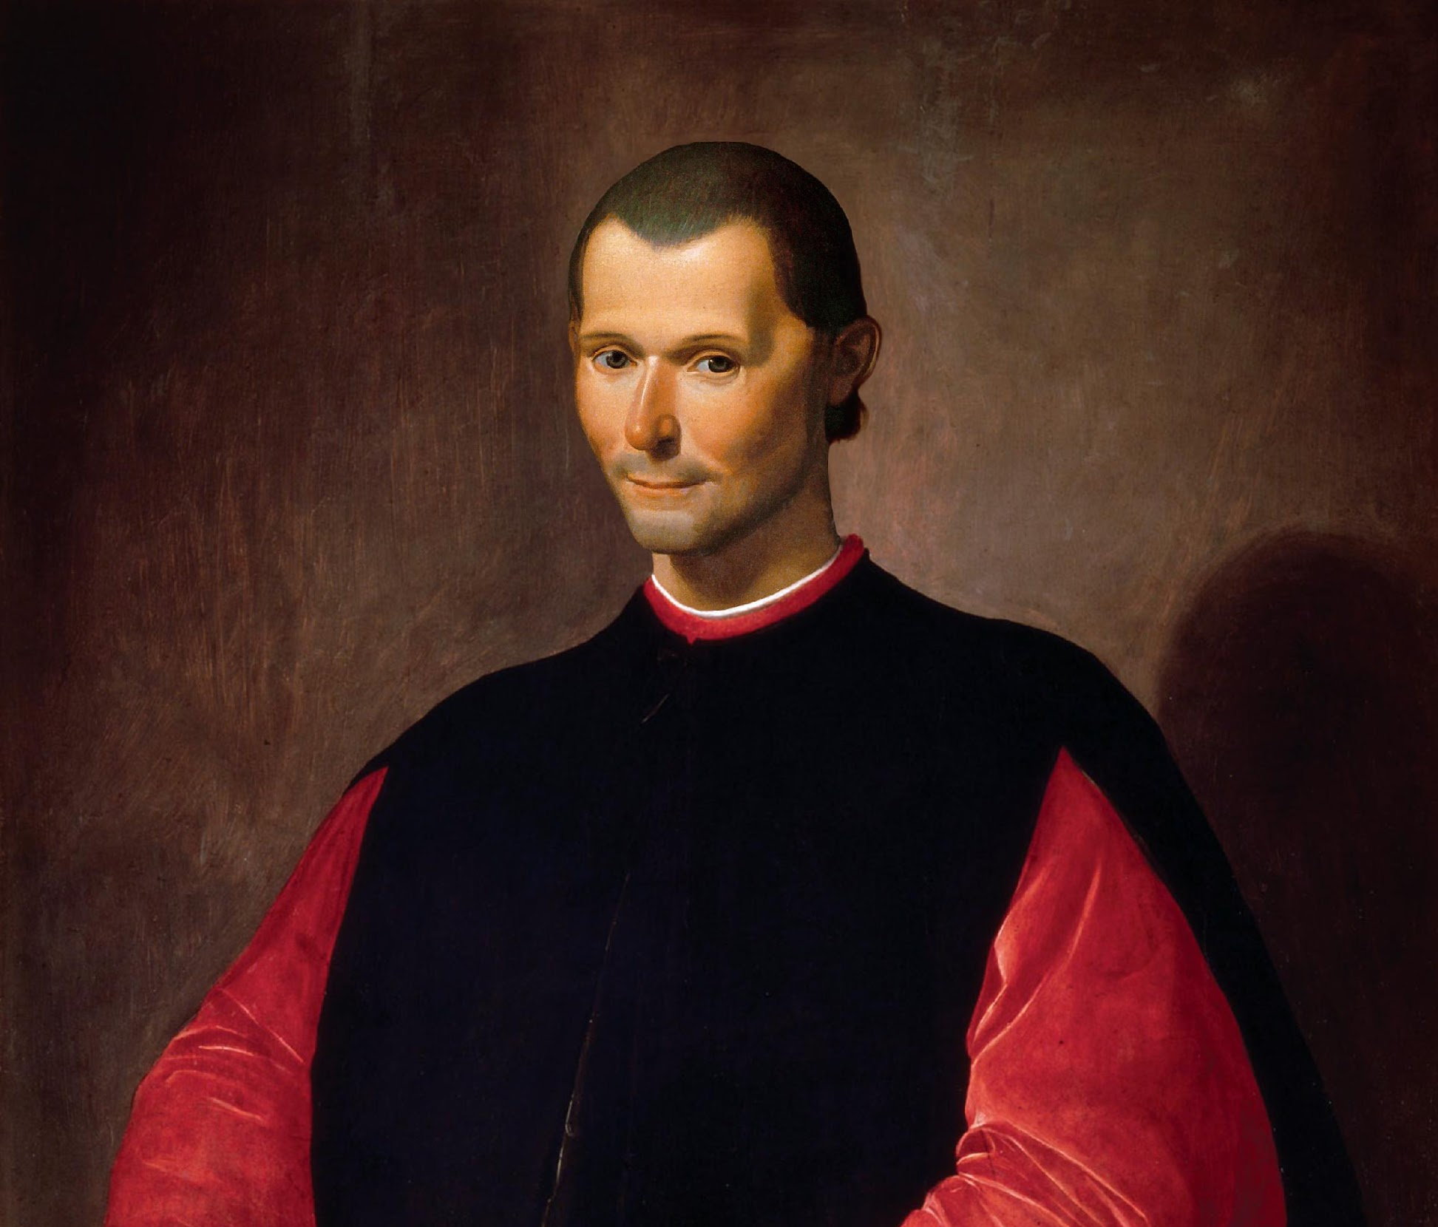
Analyzing Excerpts from The Prince
Read the three excerpts from Machiavelli’s book The Prince.
Highlight any phrases that discuss how Machiavelli thought leaders should behave.
In the margins, explain the reason for highlighting each statement.
Notes:
Image Source: Nickniko. (2019, November 25). Portrait of Niccolò Machiavelli. Wikimedia Commons. https://commons.wikimedia.org/wiki/File:Portrait_of_Niccol%C3%B2_Machiavelli.jpg

Slide 10

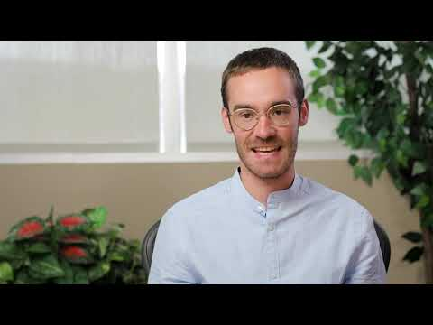
Day 1 Student Survey
Notes:
https://www.youtube.com/watch?v=KUqHWMUljSw

Slide 11

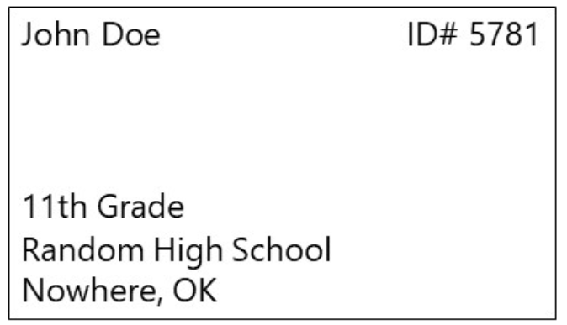
Day 1 Student Survey
https://bit.ly/day1-k20Lesson

Slide 12
3-2-1
As you watch the video, look for:
3 ideas from The Prince.
2 reasons Machiavelli might have written The Prince.
1 lesson for readers from The Prince.

Slide 13

What “Machiavellian” Really Means
Notes:
TED-Ed. (2019, March 25). What “Machiavellian” really means - Pazit Cahlon and Alex Gendler [Video]. YouTube. https://www.youtube.com/watch?v=fUlGtrHCGzs

Slide 14
Loved or Feared?
  Choose the statement you most agree with.
  Write a response explaining your reasoning using evidence from The Prince Excerpts.
  A leader should be loved.
  A leader should be feared.

Slide 15
Leaders Today…
Are today’s leaders loved or feared?
  Provide evidence in your response.

Slide 16
Machiavelli’s Legacy
How did Machiavelli and his work affect political thought?

Slide 17

Day 2 Student Survey
Notes:
https://www.youtube.com/watch?v=hHqmk_9XVR0

Slide 18

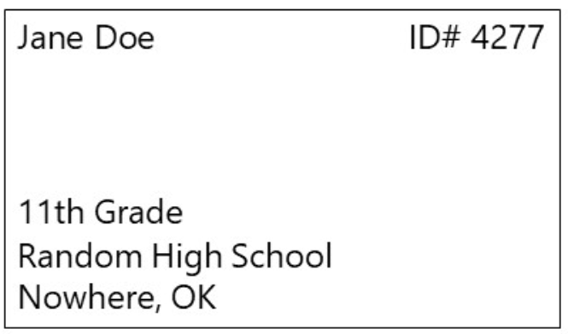
Day 2 Student Survey
https://bit.ly/day2-k20lesson

