Slide 1
The Root of It Is . . .
Examining Greek & Latin Roots and Affixes

Slide 2
Essential Question
Why is learning Greek and Latin roots and affixes valuable?

Slide 3
Lesson Objectives
Students use context clues to identify the meaning of a Greek or Latin root/prefix/suffix.
Students explore linguistic patterns across languages.
Students examine the role of linguistics in their everday lives.

Slide 4

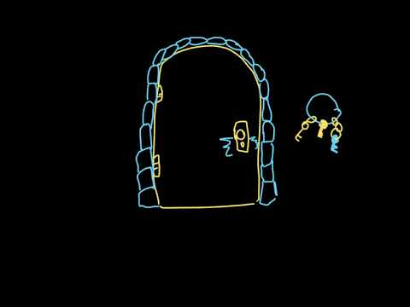
Bell Ringer
As we watch the video, write down 10 things you learned from this video.
What questions do you have about Greek and Latin roots and affixes?
Notes:
Khan Academy. (2020). Latin and Greek roots and affixes. YouTube. Retrieved September 8, 2022, from https://youtu.be/fiaPqgwJFo4.

Slide 5
It's ROOT-imentary Directions
Look at each row.
Review the word part in the first column and its examples in the second column.
  What do all of these words have in common?
  What does the word part mean?
Use a dictionary or thesaurus to look up the word examples if they are unfamiliar.
Write the meaning of the word part in the far right column.

Slide 6
It's ROOT-imentary! Example:
Word Part | Examples | Meaning
Cred- | Incredible, Credible, Incredulous, Sacred, Credit, Accreditations | ?
Incredible - Impossible to believe
Credible - Able to be believed; convincing
Incredulous - Unwilling or unable to believe something
Sacred - Highly valued and important; entitled to reverence and respect; of or relating to religion
Credit - The ability of a customer to obtain goods or services before payment, based on the trust that payment will be made in the future
Accreditations - The action or process of officially recognizing someone or something as having a particular status or being qualified to perform a particular activity

Slide 7
It's ROOT-imentary!
Work with a partner to complete the handout.
Review the word part in the first column and its examples in the second column.
  What do all of these words have in common?
  What does the word part mean?
Use a dictionary or thesaurus to look up the word examples if they are unfamiliar.
Write the meaning of the word part in the far right column.
We will spend 15 minutes on this activity.

Slide 8
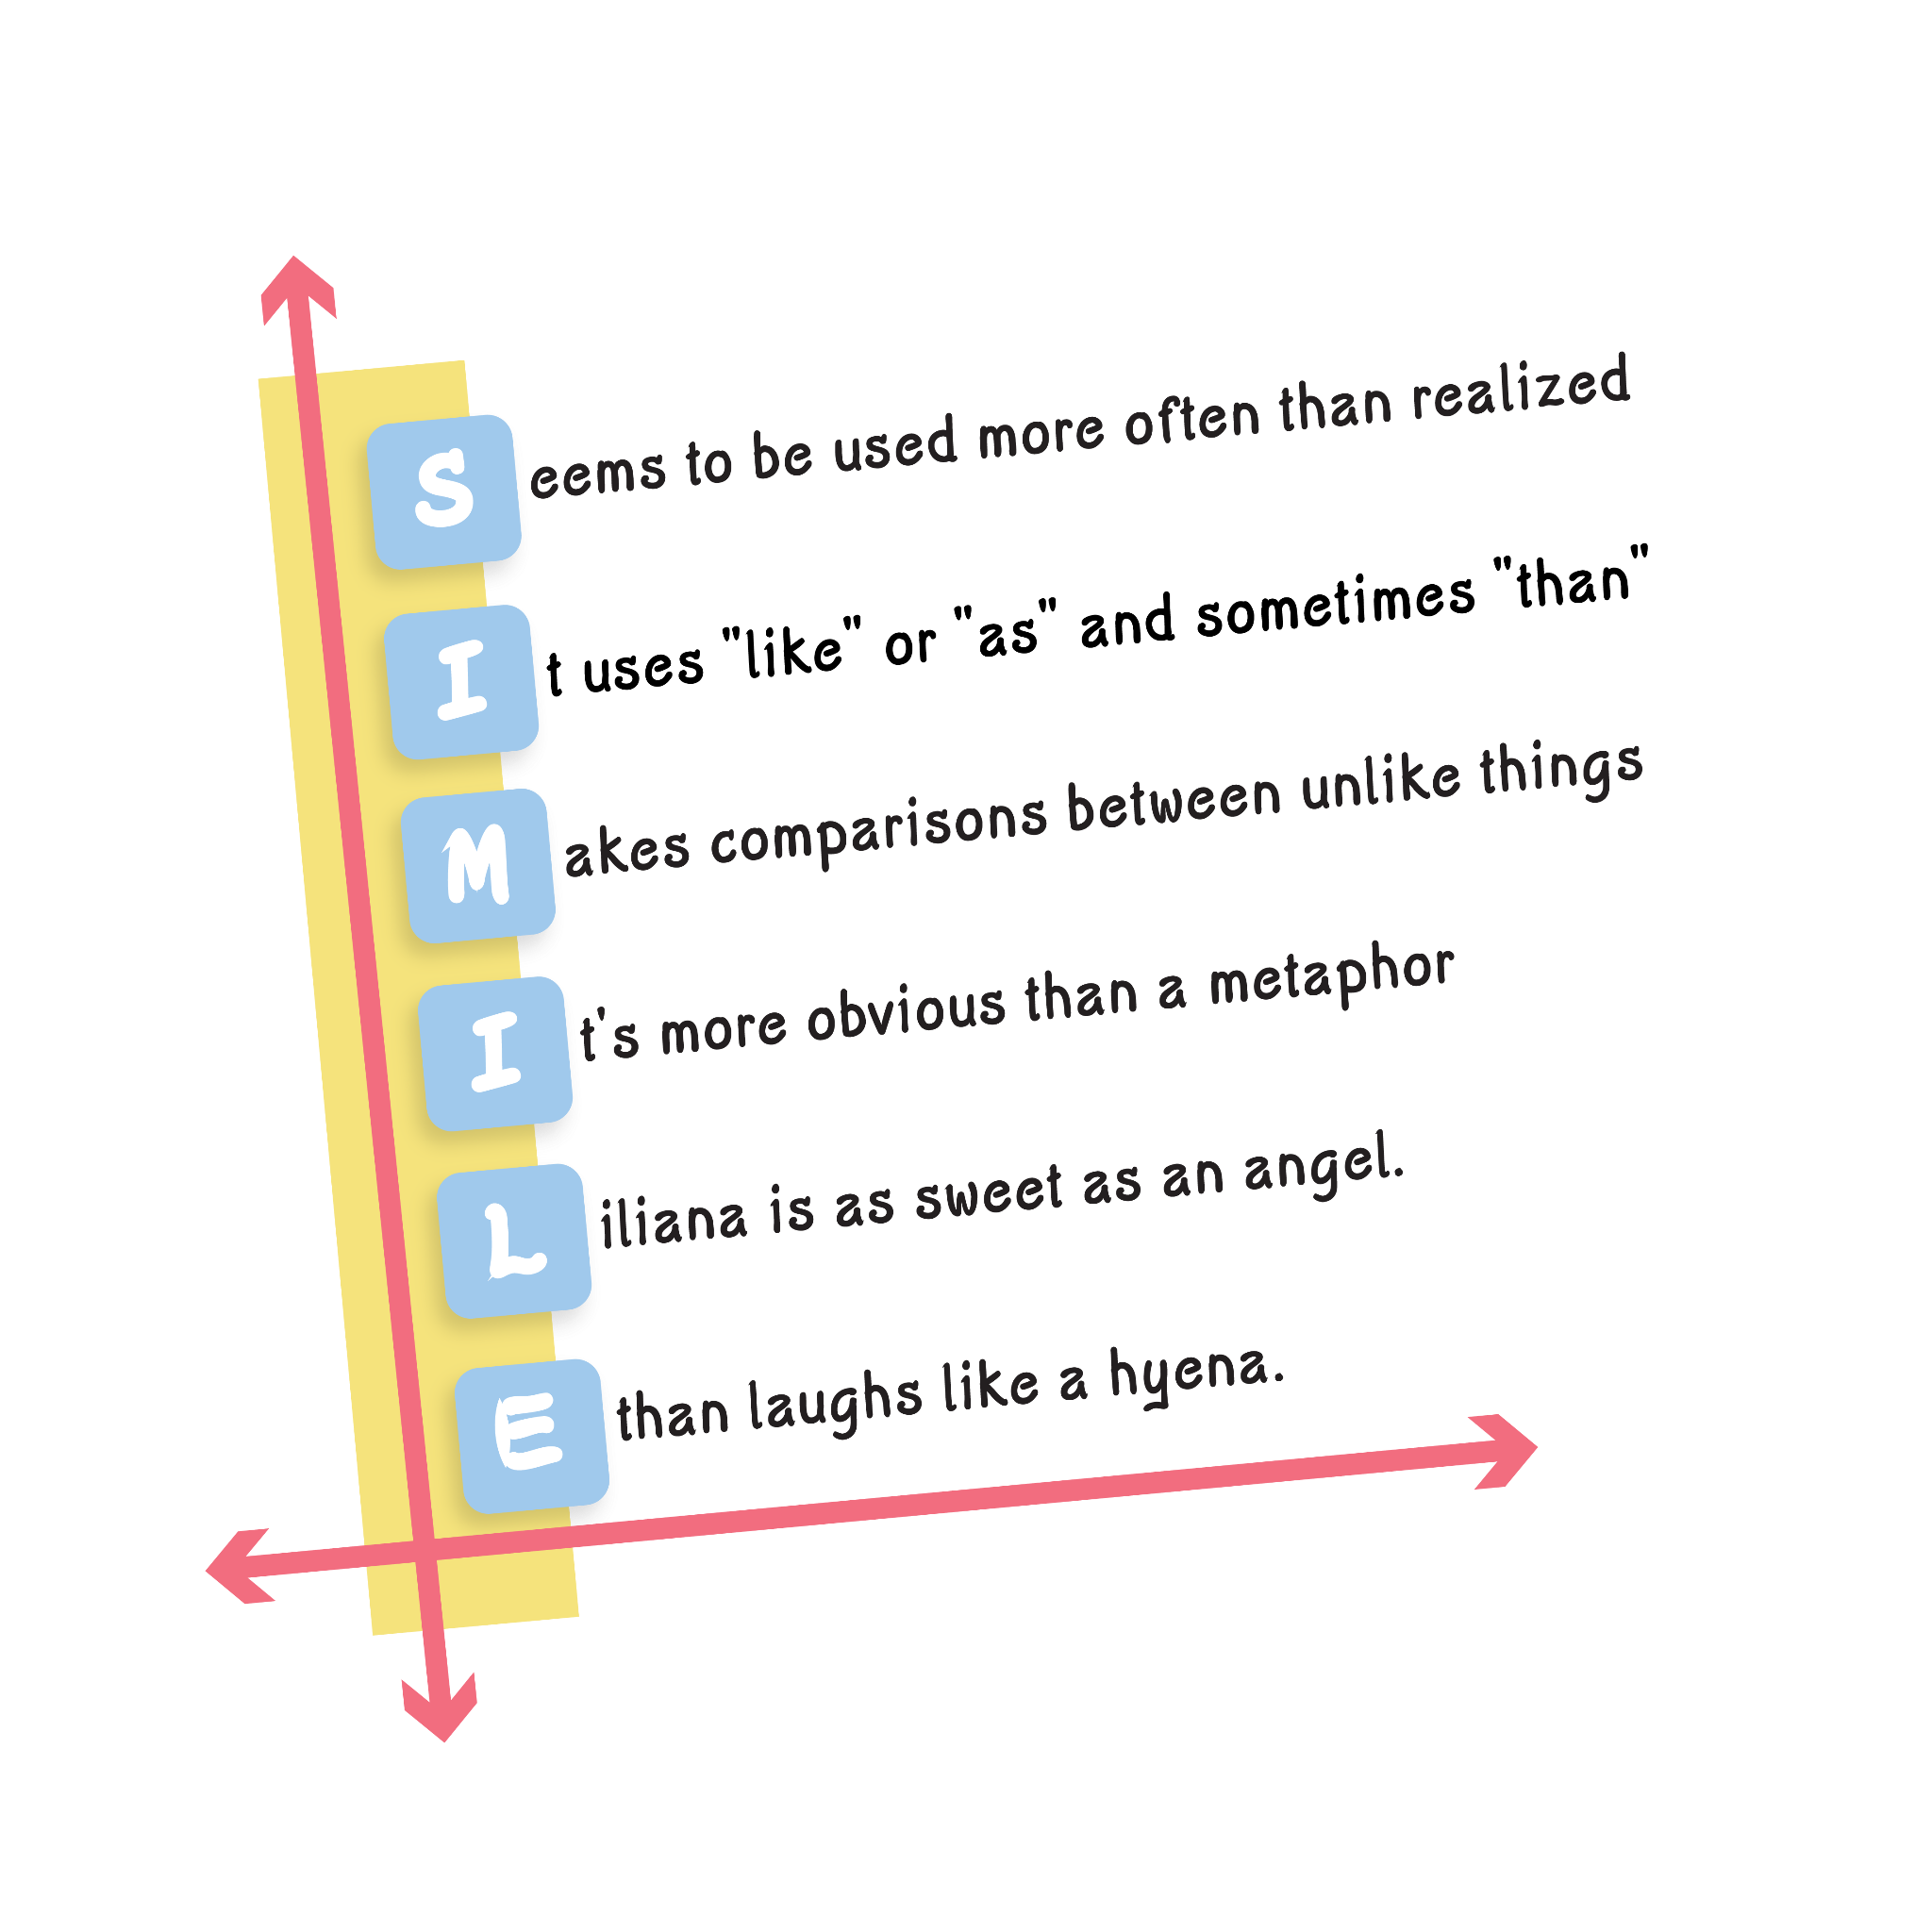
Root of the Matter: Vocabulary Acrostics
Create a vocabulary acrostic word puzzle using the word part assigned.
Write the word part and its meaning at the top of the paper.
Write the word part vertically on the left side of the paper.
Explain the meaning of the word part with examples that begin with the letters that make up the word part.

Slide 9
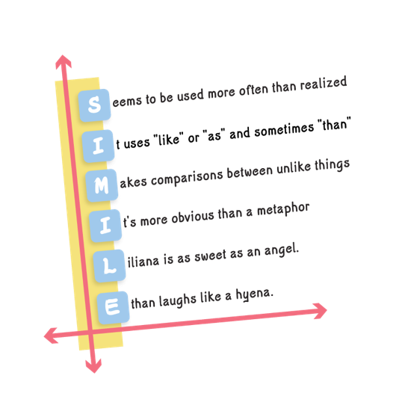
Root of the Matter: Vocabulary Acrostics Example
Root: PATH
Origin: Greek​
Meaning: Feeling or disease​
Examples: Sympathy, apathy, empathy, sociopath, pathological​
Passion​
Always changing and evolving​
Ties back to your mental state​
Happiness

Slide 10
Root of the Matter: Vocabulary Acrostics Example
Cred (to believe; trust)
C
R
E
D

Slide 11
Root of the Matter: Vocabulary Acrostics
Create a vocabulary acrostic word puzzle using the word part assigned.
Write the word part and its meaning at the top of the paper.
Write the word part vertically on the left side of the paper.
Explain the meaning of the word part using examples that begin with the letters that make up the word part.

Slide 12
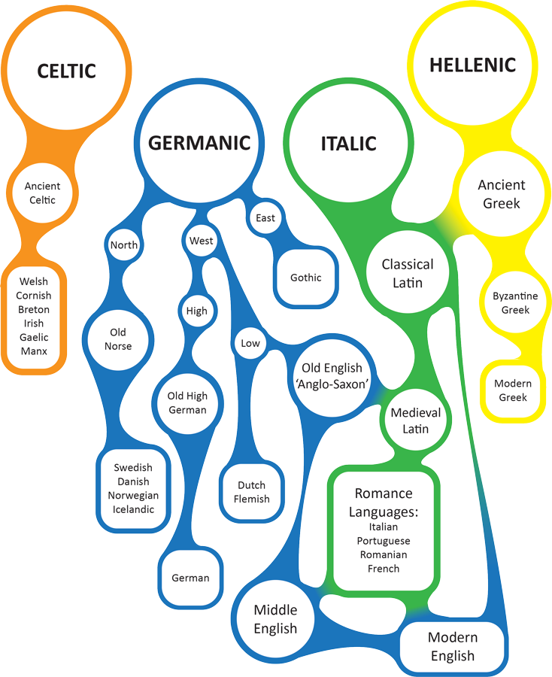
Origins of English
Where did modern English originate?
How do Greek and Latin roots influence how we speak and write today?

Slide 13
Put Down Those Roots: Card Matching Example
Let’s look at some common words and how their spelling and pronunciation shift across languages.
English | Spanish | French | Portuguese | Afrikaans | German | Swedish
Egg | Huevo | Œuf | Ovo | Eier | Ei | Ägg
Shoes | Zapatos | Des Chaussures | Sapato | Skoene | Schuhe | Skor
Notes:
Consider using Google translate’s “Listen” feature so students can hear the pronunciation.

Slide 14
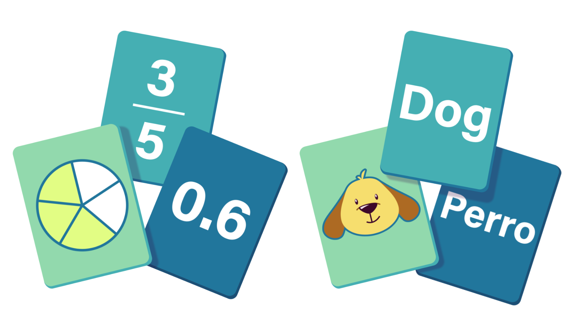
Put Down Those Roots: Card Matching
Match the English word with its 6 foreign counterparts.
Pay attention to how the word is spelled and how it’s pronounced.
It’s okay if you are unsure. Try your best!

Slide 15
Put Down Those Roots: Card Matching
English | Spanish | French | Portuguese | Afrikaans | German | Swedish
Egg
Bread
Milk
Night
School
Sugar

Slide 16
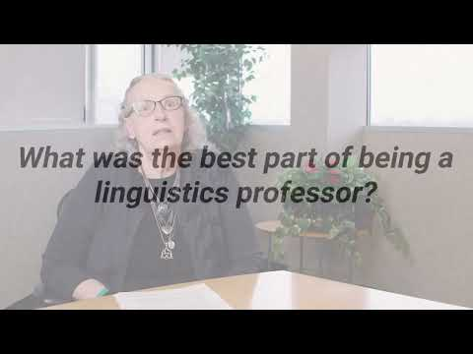
ICAP
Notes:
K20 Center. (2023, January 12). ICAP-Linguistics [Video]. YouTube. https://youtu.be/INqfuE3UoQQ

Slide 17
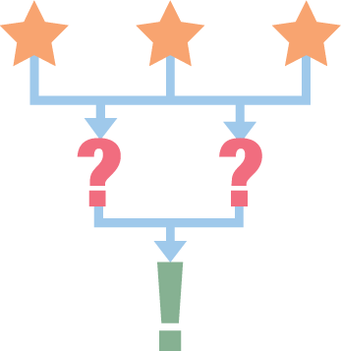
3-2-1
List 3 things you learned from the interview with the linguist.
List 2 ways you can use what you have learned from this interview/lesson in school or in your personal life.
Write one question you still have regarding the interview, careers in linguistics, or Greek & Latin roots.

