Slide 1
The Gift of the Magi
Madeline Hunter Lesson Version

Slide 2
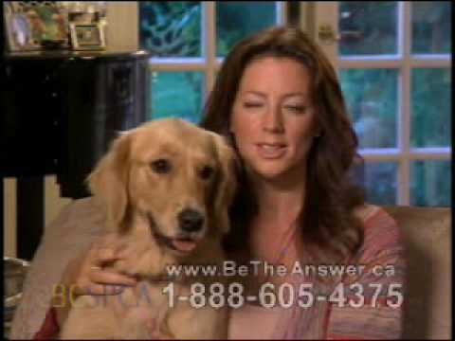
Notes:
(2008). YouTube. Retrieved August 3, 2022, from https://youtu.be/IO9d2PpP7tQ.

Slide 3
Essential Questions
What motivates people to take action?
How do we determine selfless actions?

Slide 4
Learning Objectives
Students will be able to:
Understand character motivation.
Translate character’s motivations from “The Gift of the Magi,” into a written present day situation.

Slide 5
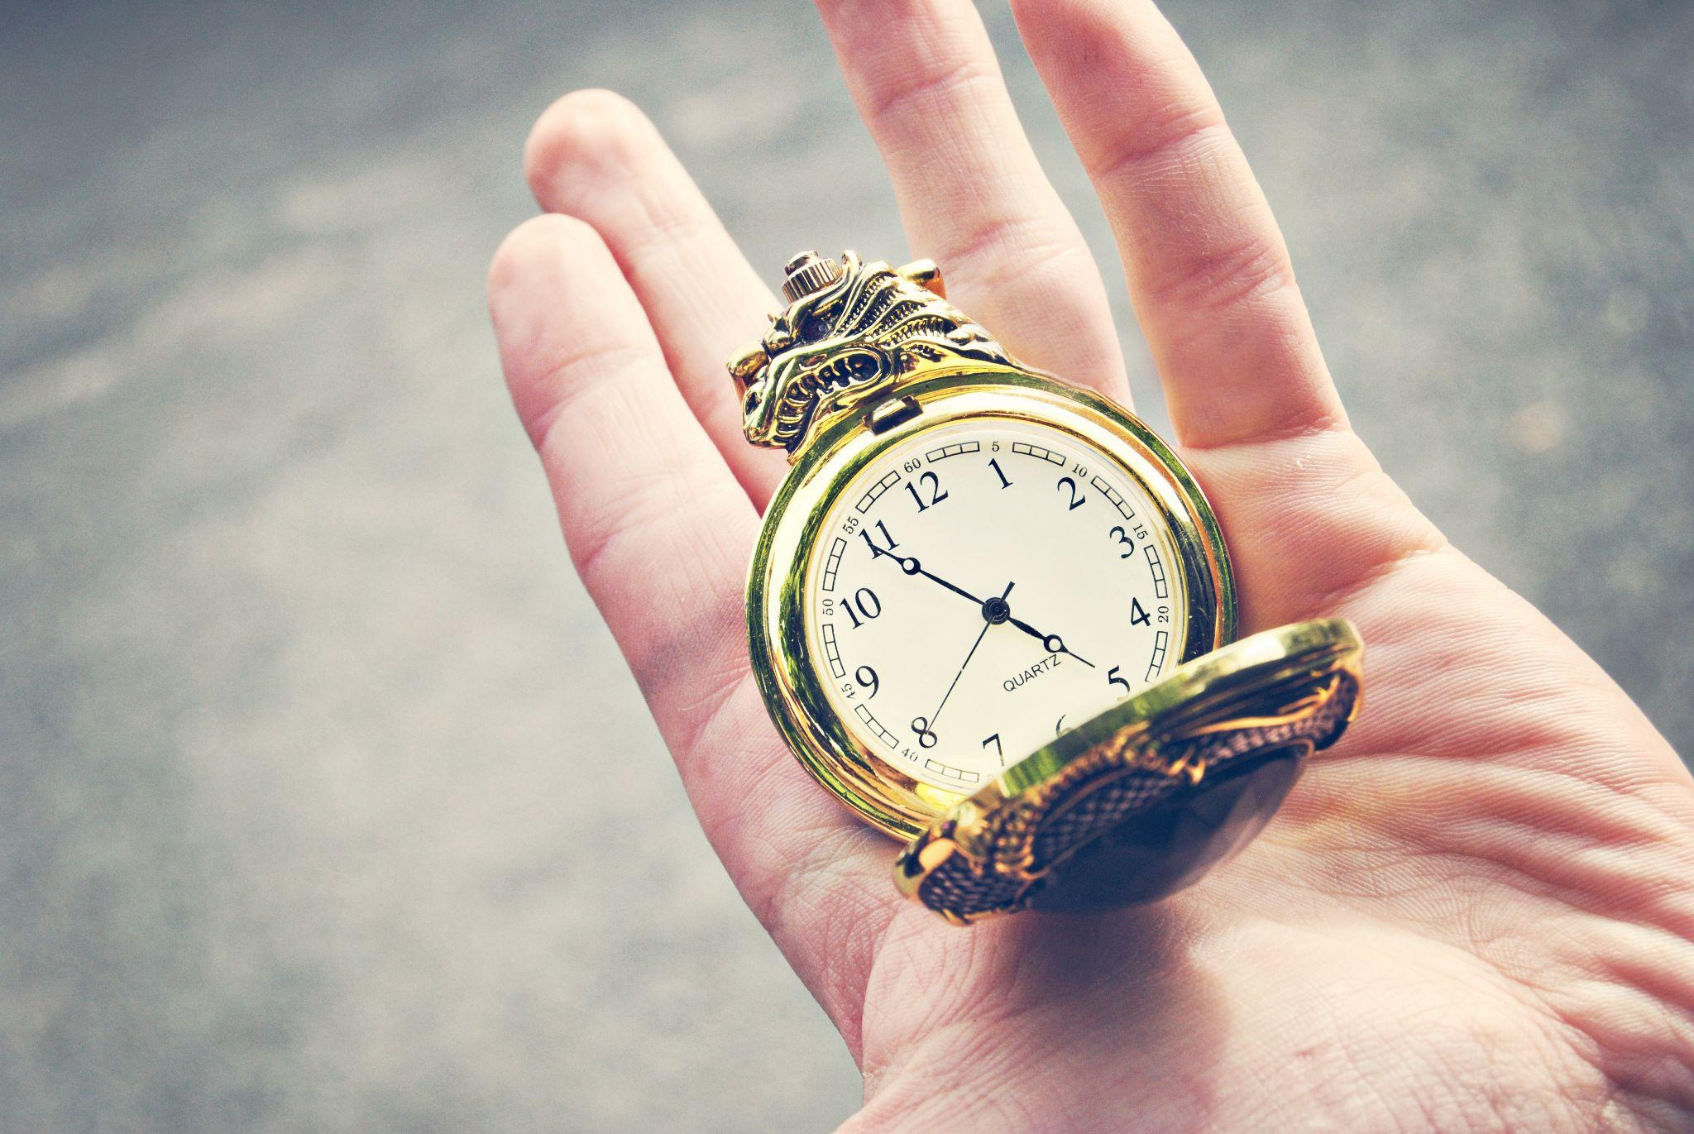
“The Gift of the Magi” by O. Henry
As you read the story, highlight examples of character motivation.
Notes:
Hammond, L. (2010). Insomnia. Flickr. Retrieved July 28, 2022, from https://www.flickr.com/photos/sleepyjeanie/5738474150.

Slide 6
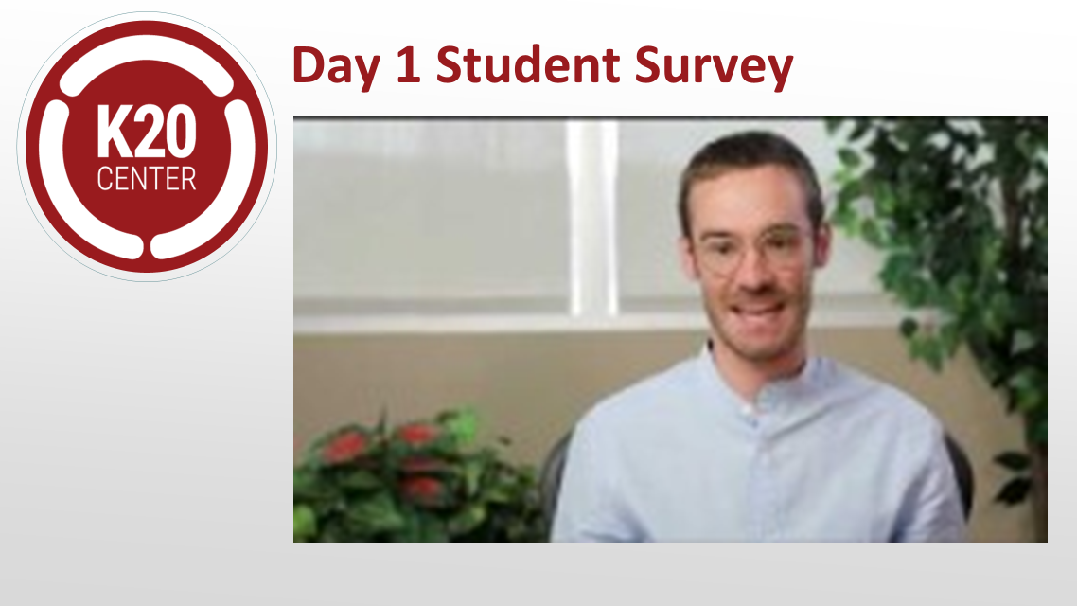
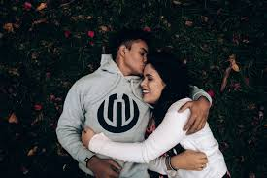
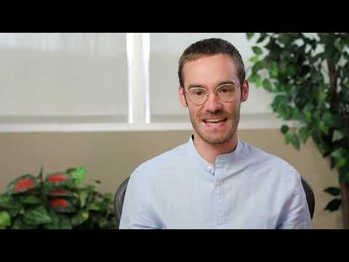
How do you think this couple is feeling?
Notes:
Image source: https://www.pexels.com/photo/happy-multiracial-couple-hugging-on-waterfront-while-having-romantic-date-in-city-3775605/

Slide 7
Survey
<include QR and bit.ly for survey>

Slide 8
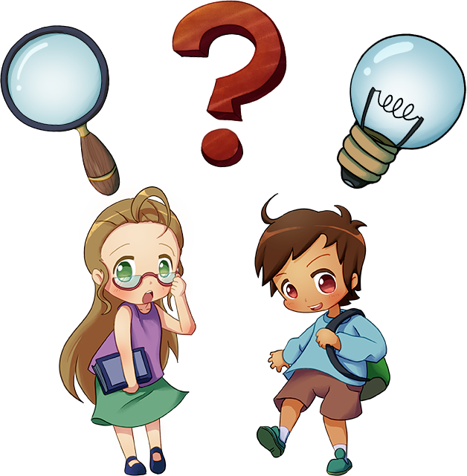
What Are You Doing and Why?
Listen and follow along to the revisions made to the sentence.
What revisions are being made?
Why are these revisions being made?

Slide 9
Original Sentence
“Jim, darling,” she cried, “don’t look at me that way. I had my hair cut off and sold because I couldn’t have lived through Christmas without giving you a present. It’ll grow out again—you won’t mind, will you? I just had to do it. My hair grows awfully fast. Say ‘Merry Christmas!’ Jim, and let’s be happy. You don’t know what a nice—what a beautiful, nice gift I’ve got for you.”

Slide 10
Let’s Update the Sentence!
“Jim, darling Honey,” she cried, “don’t look at me that way like that. I had my hair cut off and sold because I couldn’t have lived through Christmas without giving you a present. I had to sell my wedding ring. I just couldn't stand not getting you a present for Valentine’s Day. It’ll grow out again—you won’t mind, will you? I just had to do it. My hair grows awfully fast. We can get a silicone wedding band that’s cheaper for now. Say ‘Merry Christmas!’ Jim, and let’s be happy. You don’t know what a nice—what a beautiful, nice gift I’ve got for you. Say, ‘Happy Valentine’s Day!’ Jim, and let’s just enjoy our night. I can’t wait to give you your gift.”

Slide 11
Updated Sentence
“Honey,” she cried, “don’t look at me like that. I had to sell my wedding ring. I just couldn’t stand not getting you a present for Valentine’s Day. We can get a silicone wedding band that’s cheaper for now. It was too big of a ring for me anyways so I just had to do it . Say, ‘Happy Valentine’s Day!’ Jim, and let’s just enjoy our night. I can’t wait to give you your gift.”

Slide 12
What Are You Doing and Why?
Let’s make revisions together!
What revisions do we want to?
Why are we making these revisions?

Slide 13
Original Sentence
Jim drew a package from his overcoat pocket and threw it upon the table. “Don’t make any mistake, Dell,” he said, “about me. I don’t think there’s anything in the way of a haircut or a shave or a shampoo that could make me like my girl any less. But if you’ll unwrap that package you may see why you had me going a while at first.” White fingers and nimble tore at the string and paper. And then an ecstatic scream of joy; and then, alas! a quick feminine change to hysterical tears and wails, necessitating the immediate employment of all the comforting powers of the lord of the flat.

Slide 14
What Are You Doing and Why?
Time to give it a try on your own!
What revisions do you want to?
Why are you making these revisions?

Slide 15
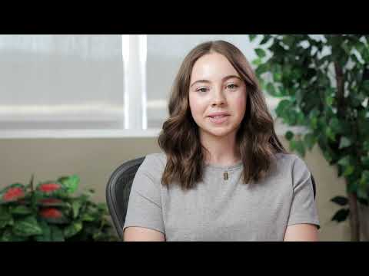
How do you think this couple is feeling?

Slide 16
