Slide 2
From Apples to Oranges
Examining Literary Devices

Slide 3
Essential Questions
How does understanding literary devices help our understanding of a text?
How do we use literary devices in our everyday lives?

Slide 4
Lesson Objectives
Define the meaning of a literary device.
Create examples of literary devices.

Slide 5

Literary Devices
As the definitions are shared, fill in the blanks on your handout.

Slide 6
Allegory
[ˈaləˌɡôrē]
noun
Work that symbolizes or represents an idea or event used to convey a political or spiritual meaning
A story, poem, or picture that can be interpreted to reveal a hidden meaning, typically a moral or political one

Slide 7
Alliteration
[əˌlidəˈrāSH(ə)n]
noun
Repetition of the same or similar consonant sounds in succession
The occurrence of the same letter or sound at the beginning of adjacent or closely connected words

Slide 8
Allusion
[əˈlo͞oZHən]
noun
Indirect reference to a person, place, thing, event or idea
An expression designed to call something to mind without mentioning it explicitly; an indirect or passing reference

Slide 9
Anthropomorphism
[ˌanTHrəpəˈmôrfizəm]
noun
Interpretation of a non-human animal, event, or object as embodying human qualities or characteristics
The attribution of human characteristics or behavior to a god, animal, or object

Slide 10
Colloquialism
[kəˈlōkwēəˌlizəm]
noun
Informal piece of dialogue or turn of phrase that used in everyday conversation
A word or phrase that is not formal or literary, typically one used in ordinary or familiar conversation
The use of ordinary or familiar words or phrases

Slide 11
Diction
[ˈdikSH(ə)n]
noun
Word choice and speaking style of a writer or character
The choice and use of words and phrases in speech or writing
The style of enunciation in speaking or singing

Slide 12
Epiphany
[əˈpifənē]
noun
Moment of sudden realization or insight by a character

Slide 13
Foreshadowing
[fôrˈSHadō]
verb
Hinting at future or subsequent events to come to build tension in a narrative
Be a warning or indication of (a future event)

Slide 14
Hyperbole
[hīˈpərbəlē]
noun
Statement that is obviously and intentionally exaggerated
Exaggerated statements or claims not meant to be taken literally

Slide 15
Idiom
[ˈidēəm]
noun
Figure of speech that is indecipherable based on the words alone, but which has metaphorical or symbolic meaning
A group of words established by usage as having a meaning not deducible from those of the individual words

Slide 16
Imagery
[ˈimij(ə)rē]
noun
Compilation of sensory details which enables the reader to visualize the event
Visually descriptive or figurative language, especially in a literary work

Slide 17
Irony
[ˈīrənē]
noun
The opposite of what is expected to happen. This can occur in language, in situations, or in the behavior of characters
The expression of one's meaning by using language that normally signifies the opposite, typically for humorous or emphatic effect

Slide 18
Simile
[ˈsiməlē]
noun
Comparison between objects, events, or people, which uses “like” or “as”
A figure of speech involving the comparison of one thing with another thing of a different kind, used to make a description more emphatic or vivid

Slide 19
Juxtaposition
[ˌjəkstəpəˈziSH(ə)n]
noun
Ideas, people, images, or object placed next to one another to highlight their differences and similarities
The fact of two things being seen or placed close together with contrasting effect

Slide 20
Metaphor
[ˈmedəˌfôr]
noun
Exact comparison between two unrelated things; used for dramatic or poetic effect, does not use “like” or “as”
A figure of speech in which a word or phrase is applied to an object or action to which it is not literally applicable

Slide 21
Mood
[mo͞od]
noun
General feeling the narrator evokes in the reader through the atmosphere, descriptions, and other features
A temporary state of mind or feeling

Slide 22
Onomatopoeia
[ˌänəˌmadəˈpēə,ˌänəˌmädəˈpēə]
noun
Word that it is closely associated or identical to the sound it describes
The formation of a word from a sound associated with what is named

Slide 23
Oxymoron
[ˌäksəˈmôrˌän]
noun
Pairing of seemingly contradictory terms used to convey emphasis or tension
A figure of speech in which apparently contradictory terms appear in conjunction

Slide 24
Paradox
[ˈperəˌdäks]
noun
Apparent contradiction that, upon further unraveling, may contain truth; used for effect on the reader
A seemingly absurd or self-contradictory statement or proposition that when investigated or explained may prove to be well founded or true

Slide 25
Personification
[pərˌsänəfəˈkāSH(ə)n]
noun
Attribution of human characteristics to something nonhuman, or the representation of an abstract quality in human form; differs from anthropomorphism is that in anthropomorphism involves non-humans displaying literal human traits and being capable of human behavior

Slide 26
Satire
[ˈsaˌtī(ə)r]
noun
Phrase or entire work that uses irony to critique behaviors, events, people, or vices
The use of humor, irony, exaggeration, or ridicule to expose and criticize people's stupidity or vices, particularly in the context of contemporary politics and other topical issues

Slide 27
Symbolism
[ˈsimbəˌlizəm]
noun
Something used to represent a larger concept or idea
The use of symbols to represent ideas or qualities

Slide 28
Synecdoche
[səˈnekdəkē]
noun
Instance of a part representing a whole or vice versa
A figure of speech in which a part is made to represent the whole or vice versa

Slide 29
Tone
[tōn]
noun
Speaker or narrator’s attitude toward the subject of the piece distinct from mood in that it is not used to evoke a particular feeling in the reader
The general character or attitude of a place, piece of writing, situation, etc

Slide 30
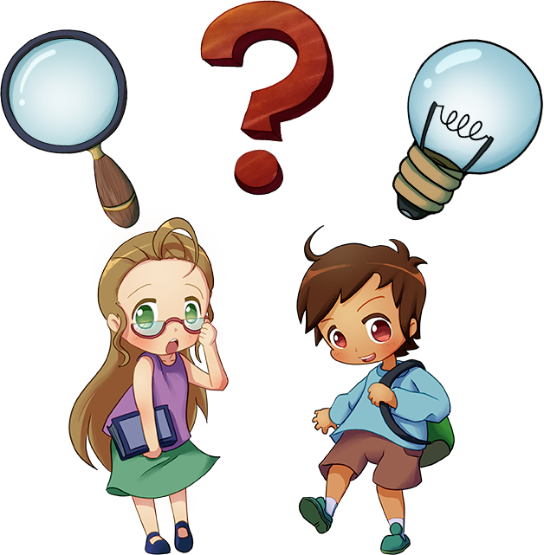
What Are You Doing and Why?
Listen and follow along to the thought process as examples are thought up.
What would a good example for the literary device?
Why does this example fit with this literary device?

Slide 31
Allegory
[ˈaləˌɡôrē]
noun
Work that symbolizes or represents an idea or event used to convey a political or spiritual meaning
A story, poem, or picture that can be interpreted to reveal a hidden meaning, typically a moral or political one
Example: Pilgrim's Progress is an allegory of the spiritual journey.

Slide 32


Day 1 Student Survey
Notes:
Day 1 Student Survey - https://www.youtube.com/watch?v=KUqHWMUljSw

Slide 33

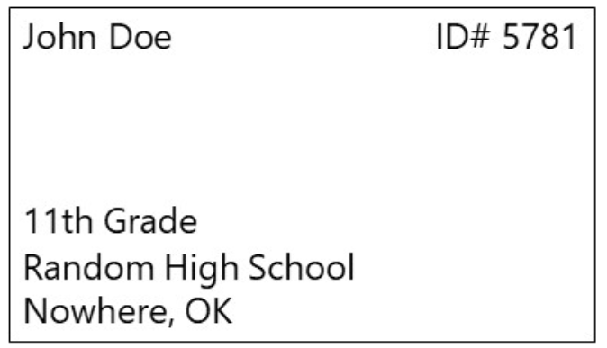
Day 1 Student Survey
https://bit.ly/day1-k20Lesson

Slide 34
What Are You Doing and Why?
Listen and follow along to the thought process as examples are thought up.
What would a good example for the literary device?
Why does this example fit with this literary device?

Slide 35
Alliteration
[əˌlidəˈrāSH(ə)n]
noun
Repetition of the same or similar consonant sounds in succession
The occurrence of the same letter or sound at the beginning of adjacent or closely connected words
Example: Sally sold seashells by the seashore.

Slide 36
Allusion
[əˈlo͞oZHən]
noun
Indirect reference to a person, place, thing, event or idea
An expression designed to call something to mind without mentioning it explicitly; an indirect or passing reference
Example: Saying “We’re not in Kansas anymore,” is an
allusion to The Wizard of Oz.

Slide 37
Anthropomorphism
[ˌanTHrəpəˈmôrfizəm]
noun
Interpretation of a non-human animal, event, or object as embodying human qualities or characteristics
The attribution of human characteristics or behavior to a god, animal, or object
Example: Olaf from Frozen is a snowman that has come to
life.

Slide 38
What Are You Doing and Why?
Listen and follow along to the thought process as examples are thought up.
What would a good example for the literary device?
Why does this example fit with this literary device?

Slide 39
Colloquialism
[kəˈlōkwēəˌlizəm]
noun
Informal piece of dialogue or turn of phrase that used in everyday conversation
A word or phrase that is not formal or literary, typically one used in ordinary or familiar conversation
The use of ordinary or familiar words or phrases
Example: Y'all, Finna, Gonna, Wanna, No cap

Slide 40
Diction
[ˈdikSH(ə)n]
noun
Word choice and speaking style of a writer or character
The choice and use of words and phrases in speech or writing
The style of enunciation in speaking or singing
Example: I speak to my boss differently than how I speak to
my friends.

Slide 41
Epiphany
[əˈpifənē]
noun
Moment of sudden realization or insight by a character
Example: Your "lightbulb" or "aha" moment.

Slide 42
Foreshadowing
[fôrˈSHadō]
verb
Hinting at future or subsequent events to come to build tension in a narrative
Be a warning or indication of (a future event)
Example: “I have a bad feeling about this,” he says as they walk down the dark, damp basement.

Slide 43
Hyperbole
[hīˈpərbəlē]
noun
Statement that is obviously and intentionally exaggerated
Exaggerated statements or claims not meant to be taken literally
Example: I am dying from embarrassment.

Slide 44
Idiom
[ˈidēəm]
noun
Figure of speech that is indecipherable based on the words alone, but which has metaphorical or symbolic meaning
A group of words established by usage as having a meaning not deducible from those of the individual words
Example: It’s raining cats and dogs. = It's raining really hard.

Slide 45
Imagery
[ˈimij(ə)rē]
noun
Compilation of sensory details which enables the reader to visualize the event
Visually descriptive or figurative language, especially in a literary work
Example: The white snow glistened as it began to melt in
the warm sunlight.

Slide 46
Irony
[ˈīrənē]
noun
The opposite of what is expected to happen. This can occur in language, in situations, or in the behavior of characters
The expression of one's meaning by using language that normally signifies the opposite, typically for humorous or emphatic effect
Example: The teacher failed the test.

Slide 47
Simile
[ˈsiməlē]
noun
Comparison between objects, events, or people, which uses “like” or “as”
A figure of speech involving the comparison of one thing with another thing of a different kind, used to make a description more emphatic or vivid
Example: She is powerful like the ocean.

Slide 48
Juxtaposition
[ˌjəkstəpəˈziSH(ə)n]
noun
Ideas, people, images, or object placed next to one another to highlight their differences and similarities
The fact of two things being seen or placed close together with contrasting effect
Example: All is fair in love and war.

Slide 49
Metaphor
[ˈmedəˌfôr]
noun
Exact comparison between two unrelated things; used for dramatic or poetic effect, does not use “like” or “as”
A figure of speech in which a word or phrase is applied to an object or action to which it is not literally applicable
Example: The early bird gets the worm.

Slide 50
Mood
[mo͞od]
noun
General feeling the narrator evokes in the reader through the atmosphere, descriptions, and other features
A temporary state of mind or feeling
Example: Steven examined the tattered umbrella and let out
a defeated sigh as the rain began to pour.

Slide 51
Onomatopoeia
[ˌänəˌmadəˈpēə,ˌänəˌmädəˈpēə]
noun
Word that it is closely associated or identical to the sound it describes
The formation of a word from a sound associated with what is named
Example: Buzz

Slide 52
Oxymoron
[ˌäksəˈmôrˌän]
noun
Pairing of seemingly contradictory terms used to convey emphasis or tension
A figure of speech in which apparently contradictory terms appear in conjunction
Example: Jumbo shrimp

Slide 53
Paradox
[ˈperəˌdäks]
noun
Apparent contradiction that, upon further unraveling, may contain truth; used for effect on the reader
A seemingly absurd or self-contradictory statement or proposition that when investigated or explained may prove to be well founded or true
Example: Less is more.

Slide 54
Personification
[pərˌsänəfəˈkāSH(ə)n]
noun
Attribution of human characteristics to something nonhuman, or the representation of an abstract quality in human form; differs from anthropomorphism is that in anthropomorphism involves non-humans displaying literal human traits and being capable of human behavior
Example: The wind was howling during the storm.

Slide 55
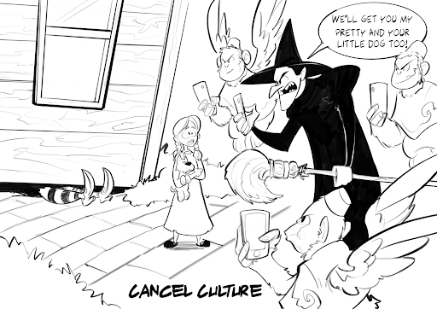
Satire
Example:
[ˈsaˌtī(ə)r]
noun
Phrase or entire work that uses irony to critique behaviors, events, people, or vices
The use of humor, irony, exaggeration, or ridicule to expose and criticize people's stupidity or vices, particularly in the context of contemporary politics and other topical issues
Notes:
Webster, S. (2022). Cancel culture. K20 Center.

Slide 56
Symbolism
[ˈsimbəˌlizəm]
noun
Something used to represent a larger concept or idea
The use of symbols to represent ideas or qualities
Example: A ring represents marriage and commitment.

Slide 57
Synecdoche
[səˈnekdəkē]
noun
Instance of a part representing a whole or vice versa
A figure of speech in which a part is made to represent the whole or vice versa
Example: I got a new set of wheels.
"Wheels” represents a whole car even though it is one part
of the car.

Slide 58
Tone
[tōn]
noun
Speaker or narrator’s attitude toward the subject of the piece distinct from mood in that it is not used to evoke a particular feeling in the reader
The general character or attitude of a place, piece of writing, situation, etc.
Example: “Winter will pass, the days will lengthen, the ice will melt in the pasture pond. The song sparrow will return and sing, the frogs will awake, the warm wind will blow again.” - Charlotte’s Web

Slide 59
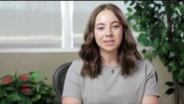
Day 2 Student Survey
Notes:
Day 2 Student Survey - https://www.youtube.com/watch?v=hHqmk_9XVR0&t=2s

Slide 60

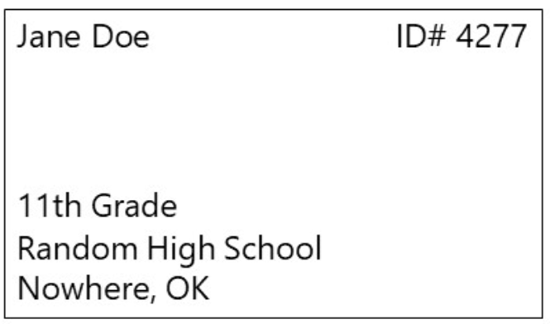
Day 2 Student Survey
https://bit.ly/day2-k20lesson

