Slide 2
#Summarize
Summary Writing

Slide 3
Essential Question
What do the effects of life events look like?

Slide 4
Learning Objective
Students will be able to summarize the effects of various life events.

Slide 5

First Word, Last Word
What do you already know about summaries?
S
U
M
M
A
R
Y
Summaries are not multiple pages long.

Slide 6
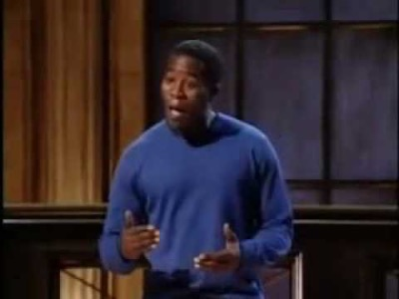

Slide 7
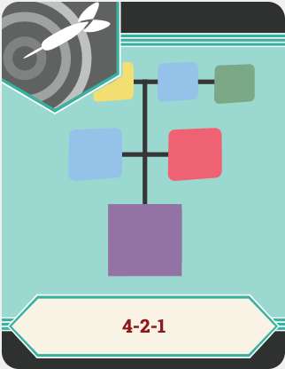
4-2-1
With your partner:
Share the four (4) main ideas you wrote down
Agree on the two (2) most important ideas

Slide 8
4-2-1
With your group:
Share the two (2) most important ideas from each partnership
Use them as guiding sentences to write a summary with the essential question in mind

Slide 9

Gallery Walk
Read the summaries from each group
Choose two to leave feedback for:
  I noticed that…
  What about...

Slide 10
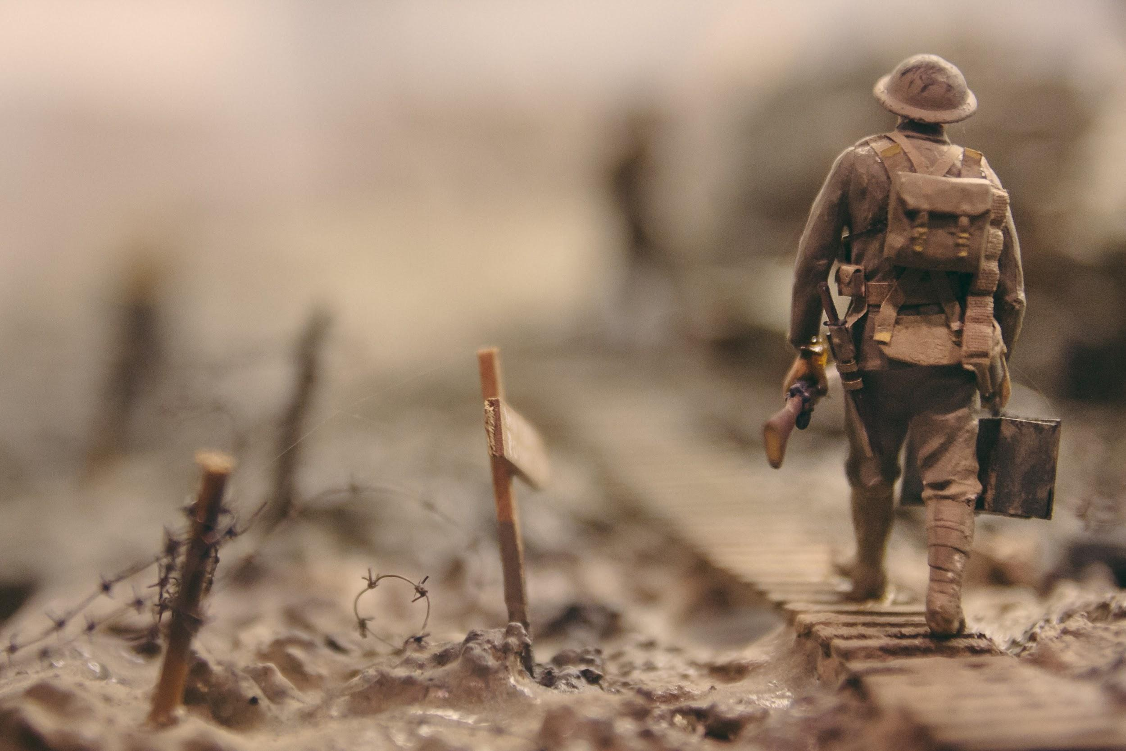
“Why Soldiers Won’t Talk”
Main Idea
Key Details
Place main ideas here
Place key details here
Notes:
Swinnen, S. (2017, May 16). Lost in the wilderness [Digital image]. Retrieved August 19, 2020, from https://unsplash.com/photos/qwe8TLRnG8k

Slide 11

Elbow Partners
Read through your partner’s Main Ideas and Key Details.
What similarities did you notice to yours?
What differences did you find?

Slide 12
Summary Writing
What do the effects of life events look like?
Make sure to include the following in your summary:
Minimum of ten (10) sentences
Original sentences only; do NOT copy from the text
Must reflect the essential question above
Paints a clear picture of the material

Slide 13

Summary Peer Review
Read your partner’s summary and provide feedback
  I notice…
  I wonder…
When you receive back your paper, make any revisions or edits to your summary based on the feedback

Slide 14
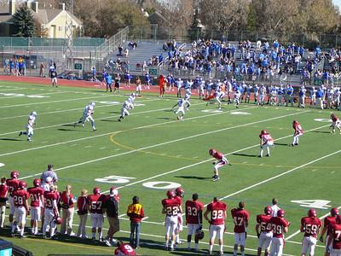
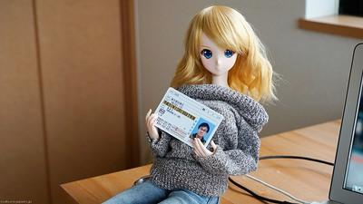
Brainstorm: Life Events
Notes:
Left photo: Dineen, P. L. (2009, October 17). RMHS football, game 3 [Digital image]. Retrieved August 19, 2020, from https://www.flickr.com/photos/pauldineen/4021077298/in/photolist-78k5bW-78g9bM-78k4jo-WeGkqK-dhmRxc-29ym64s-dkt6Kx-29ym6js-dhmRMK-29ym6yf-29ym5XL-Qc2WiW-dkt92j-NyFCSg-pYef9L-dkt6FZ-dkt6DZ-2cfoRw7-XoukrF-Qc2W4C-2aWaoSF-Qc2VG5-dkt9fG-Qc2W47-N8wQFj-6sbijE-29ym6hy-dd8HAB-Uh9Aby-pgVRCy-dhmS4t-29ym68W-29ym6Bb-26ssHHH-29ym6us-2cfoRyS-29ym66w-qfHTco-NyFCAK-29ym6qE-PGBuKC-dhmSnG-78k5Gm-pYnhbx-2cfoRnQ-Qc2Wcy-Qc2VQ1-dhmS2X-dhmRvn-dhmSvq
Right photo: Photo by Danny Choo on Flickr

Slide 15
TWEETS
Harry Styles. ✔ @Harry_Styles
I don't know about you, but I'm feeling 22. #younglife
Barack Obama ✔ @BarackObama
Four more years. #finishwhatyoustart
They say "you snooze, you lose," which means I start every morning failing multiple times in 9-minute intervals. #notamorningperson
Deep Life Quotes ‏@DeepLifeQuotes Jun 22
Nobody is worth stressing over. People come and go. Move on and go find yourself, the world is yours. Life goes on. #carpediem
Deep Life Quotes ‏@DeepLifeQuotes Jun 27
Sometimes you just need to relax and trust that things will work out. Let go a little and let life happen. – Unknown #breathedeeply

Slide 16

Tweet Up Summaries
Using 140 characters:
Reflect on your life event
Create a clear picture
What distinct words can be used for someone to understand?
*Remember, spaces count as characters!

Slide 17
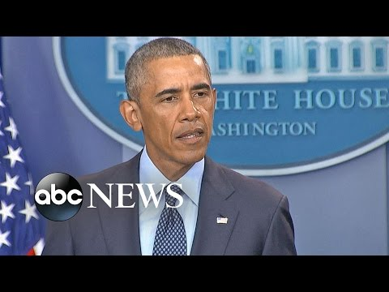

Slide 18
Life Event Text | Effects
“Knock Knock” Poem
“Why Soldiers Won’t Talk”
Your Own Life Events
President Obama’s Speech

Slide 19
Summary Writing
What do the effects of life events look like?
Make sure to include the following in your summary:
Minimum of ten (10) sentences
Original sentences only; do NOT copy from the text
Must reflect the essential question above
Paints a clear picture of the material

Slide 20
First Word, Last Word
What do you already know about summaries?
S
U
M
M
A
R
Y
Summaries are not multiple pages long.

