Slide 2
Prove Me Wrong
Two-Column and Paragraph Proofs

Slide 3
Essential Question
How can we use our knowledge of definitions, theorems, and postulates to justify our reasoning?

Slide 4
Lesson Objectives
Construct and complete two-column and paragraph proofs.
Use mathematical definitions, postulates, theorems, and properties as reasons to solve problems.

Slide 5
Opening Statements
With your group, visit each station to read and discuss each question.
Individually, answer the question on one of your sticky notes and place it on the wall next to the poster.
Repeat the process at each poster.

Slide 6
Opening Statements
Return to the poster you started at.
Read the sticky notes posted next to it and organize them based on common themes and ideas.
Be ready to share the common themes your group sees.

Slide 7
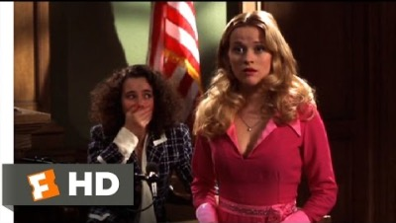
Legally Blonde
Elle wins! Scene (11/11) | Movieclips
Notes:
Movieclips. (2015, November 30). Legally blonde (2001) - Elle wins! Scene (11/11) | Movieclips. YouTube. https://youtu.be/GSu7BGbyJqc

Slide 8
Witness Testimony
Recall the line of questioning Elle used in the scene.
With your partner, remember as much as you can and recreate her line of questioning on the Witness Testimony handout.
For each question Elle asked, decide the reason Elle had for asking that question.

Slide 9
Witness Testimony
Argument | Line of Questioning | Reason
Building the Argument
Tracy and the Perm
Objection
Conclusion

Slide 10
Witness Testimony
What were the reasons for Elle’s questions?

Slide 11
Witness Testimony
What were the reasons for Elle’s questions?
What would have happened if Elle started her line of questioning by accusing the witness of the crime?

Slide 12
Witness Testimony
What were the reasons for Elle’s questions?
What would have happened if Elle started her line of questioning by accusing the witness of the crime?
Should a statement be included in an argument if there is not a reason? Why or why not?

Slide 13
Witness Testimony
What were the reason for Elle’s questions?
What would have happened if Elle started her line of questioning by accusing the witness of the crime?
Should a statement be included in an argument if there is not a reason? Why or why not?
What must be present for an argument to be effective?

Slide 14
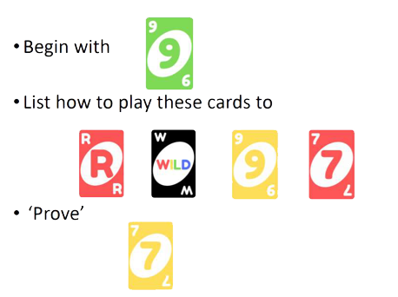
UNO Proofs
Begin with
Use these cards to…
Prove this end result
Play a card if it has…
The same color
OR
The same number
OR
Is a Wild card
Notes:
Uno®. Mattel Shop. (n.d.). Retrieved August 25, 2022, from https://shop.mattel.com/products/uno-gdj85

Slide 15
UNO Proofs
Card Played | Reason
1. | Given
2. | 2. Same number
3. | 3. Wild: Red
Card Played | Reason
4. | 4. Same color
5. | 5. Same color
6. | 6. Same number
Notes:
Uno®. Mattel Shop. (n.d.). Retrieved August 25, 2022, from https://shop.mattel.com/products/uno-gdj85

Slide 16
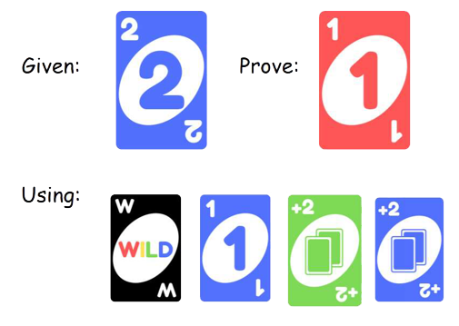
UNO Proofs
Card Played | Reason
1. 2. 3. 4. 5. 6.
Notes:
Uno®. Mattel Shop. (n.d.). Retrieved August 25, 2022, from https://shop.mattel.com/products/uno-gdj85

Slide 17
UNO Proofs
Card Played | Reason
1. | 1. Given
2. | 2. Same color
3. | 3. Same color
Card Played | Reason
4. | 4. Same number
5. | 5. Wild: Red
6. | 6. Same color
Notes:
Uno®. Mattel Shop. (n.d.). Retrieved August 25, 2022, from https://shop.mattel.com/products/uno-gdj85

Slide 18
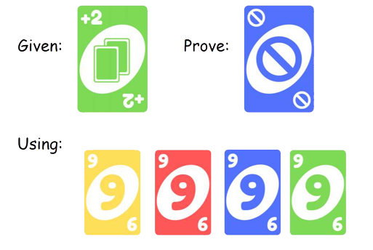
UNO Proofs
Card Played | Reason
1. 2. 3. 4. 5. 6.
Notes:
Uno®. Mattel Shop. (n.d.). Retrieved August 25, 2022, from https://shop.mattel.com/products/uno-gdj85

Slide 19
UNO Proofs
Card Played | Reason
1. | 1. Given
2. | 2. Same Color
3. | 3. Same Number
Card Played | Reason
4. | 4. Same Number
5. | 5. Same Number
6. | 6. Same Color
Notes:
Uno®. Mattel Shop. (n.d.). Retrieved August 25, 2022, from https://shop.mattel.com/products/uno-gdj85

Slide 20
Evidence – Vocabulary
Proof – logical argument that shows a statement is true
  Geometric Proofs
  Algebraic Proofs
  Etc.
Justify – to layout your mathematical thought process, step by step

Slide 21
Evidence – Vocabulary
Two-Column Proof
  Most used in geometry
  Left side holds all statements and conclusions
  Right side explains why we know what we know
Paragraph Proof
  Holds all the same information as a two-column proof
  Written in complete sentences

Slide 22
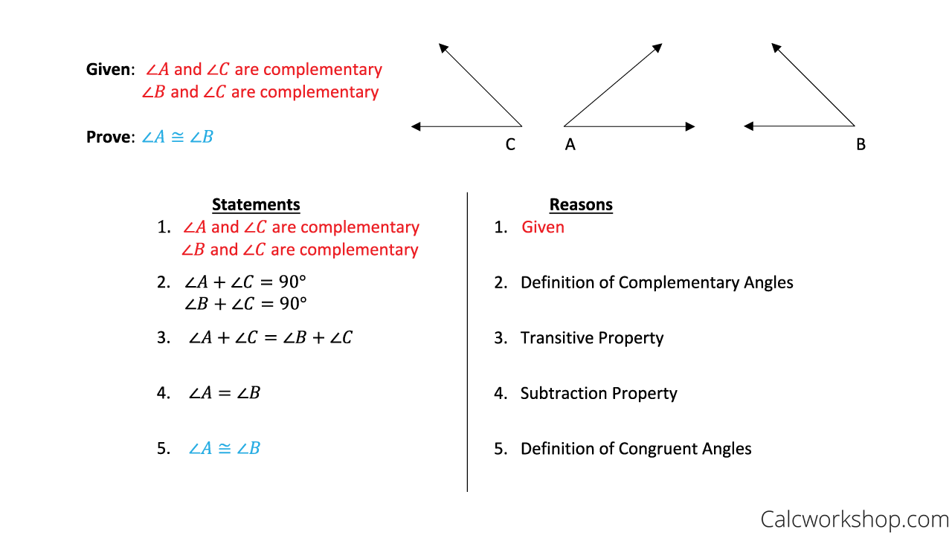
Two-Column Proof vs. Paragraph Proof
Given that ∠A and ∠C and ∠B and ∠C are complementary, then ∠A + ∠C = 90° and ∠B +∠C = 90° because of the definition of complementary angles. Both statements in line two equal 90°, so ∠A + ∠C = ∠B + ∠C because of the transitive property. I see that ∠C is in both sides of the equation so I can use the subtraction property to eliminate the repeated information. Because of the definition of congruent angles, I know that any angle that is equal must also be congruent and vice versa.
Notes:
Two column proof. Calcworkshop. (2020, January 21). https://calcworkshop.com/reasoning-proof/two-column-proof/

Slide 23
Reasons – ✓ what you know, ★ what you don’t
Definitions | Properties
Definition of Angle Bisector Definition of Complementary Angles Definition of Congruent Angles Definition of Congruent Segments Definition of Linear Pair Definition of Midpoint Definition of Right Angles Definition of Segment Bisector Definition of Supplementary Angles Definition of Vertical Angles | Addition Property of Equality Distributive Property Division Property of Equality Multiplication Property of Equality Reflexive Property Substitution Property of Equality Subtraction Property of Equality Symmetric Property Transitive Property

Slide 24
Reasons – ✓ what you know, ★ What you don’t
Postulates | Theorems
Angle Addition Postulate Linear Pair Postulate Segment Addition Postulate | Alternate Exterior Angles Theorem Alternate Interior Angles Theorem Angle Bisector Theorem Consecutive Interior Angles Theorem Corresponding Angles Theorem Midpoint Theorem Vertical Angles Theorem

Slide 25
Evidence
There are more reasons you can use for proofs than are listed in the table.
Every time we learn a new definition, postulate, property, or theorem, it becomes a possible reason.
What matters in a proof is a correct line of thinking.

Slide 26
Evidence – Information
There is more than one way to answer a proof.
If you write a proof and it is different from someone else’s proof, that does not mean that you are wrong.
Because there is more than one way to write a proof, you will often see examples where people ask you to complete a proof. This makes your proofs easier to compare and discuss.

Slide 27
Algebraic Proof
Statement | Reason
1. 2x + 5 = 20 – 3x
2.
3.
4. x = 3
Given: 2x + 5 = 20 – 3x
Prove: x = 3
Using:
  Subtractions Property of Equality
  Addition Property of Equality
  Division Property of Equality

Slide 28
Algebraic Proof
Statement | Reason
1. 2x + 5 = 20 – 3x | 1. Given
2. 5x + 5 = 20
3. 5x = 15
4. x = 3
Given: 2x + 5 = 20 – 3x
Prove: x = 3
Using:
  Subtractions Property of Equality
  Addition Property of Equality
  Division Property of Equality

Slide 29
Algebraic Proof
Statement | Reason
1. 2x + 5 = 20 – 3x | 1. Given
2. 5x + 5 = 20 | 2. Addition Property of Equality
3. 5x = 15
4. x = 3
Given: 2x + 5 = 20 – 3x
Prove: x = 3
Using:
  Subtractions Property of Equality
  Addition Property of Equality
  Division Property of Equality

Slide 30
Algebraic Proof
Statement | Reason
1. 2x + 5 = 20 – 3x | 1. Given
2. 5x+ 5 = 20 | 2. Addition Property of Equality
3. 5x = 15 | 3. Subtraction Property of Equality
4. x = 3
Given: 2x + 5 = 20 – 3x
Prove: x = 3
Using:
  Subtractions Property of Equality
  Addition Property of Equality
  Division Property of Equality

Slide 31
Algebraic Proof
Statement | Reason
1. 2x + 5 = 20 – 3x | 1. Given
2. 5x+ 5 = 20 | 2. Addition Property of Equality
3. 5x = 15 | 3. Subtraction Property of Equality
4. x = 3 | 4. Division Property of Equality
Given: 2x + 5 = 20 – 3x
Prove: x = 3
Using:
  Subtractions Property of Equality
  Addition Property of Equality
  Division Property of Equality

Slide 32

Creating the Proof
Given: AC = AB + AB
Prove: AB = BC
Statement | Reason
1. | 1.
2. | 2.
3. | 3.
4. | 4.
As you go, always number all statements and reasons.

Slide 33
Creating the Proof
Given: AC = AB + AB
Prove: AB = BC
Statement | Reason
1. AC = AB + AB | 1.
2. | 2.
3. | 3.
4. | 4.
As you go, always number all statements and reasons.

Slide 34
Creating the Proof
Given: AC = AB + AB
Prove: AB = BC
First Statement
Last Statement
Statement | Reason
1. AC = AB + AB | 1.
2. | 2.
3. | 3.
4.AB = BC | 4.
As you go, always number all statements and reasons.

Slide 35
Creating the Proof
Given: AC = AB + AB
Prove: AB = BC
First Statement
Last Statement
Statement | Reason
1. AC = AB + AB | 1. Given
2. | 2.
3. | 3.
4.AB = BC | 4.
First Reason
As you go, always number all statements and reasons.

Slide 36
Creating the Proof
Given: AC = AB + AB
Prove: AB = BC
First Statement
Last Statement
Write a logical sequence of steps from the first to last statement.
Don’t forget to write a reason for each statement.
Statement | Reason
1. AC = AB + AB | 1. Given
2. AC = AB + BC | 2. Segment Addition Postulate
3. | 3.
4.AB = BC | 4.

Slide 37
Creating the Proof
Given: AC = AB + AB
Prove: AB = BC
First Statement
Last Statement
Write a logical sequence of steps from the first to last statement.
Don’t forget to write a reason for each statement.
Statement | Reason
1. AC = AB + AB | 1. Given
2. AC = AB + BC | 2. Segment Addition Postulate
3. AB + AB = AB + BC | 3. Transitive Property
4.AB = BC | 4.

Slide 38
Creating the Proof
Given: AC = AB + AB
Prove: AB = BC
First Statement
Last Statement
Write a logical sequence of steps from the first to last statement.
Don’t forget to write a reason for each statement.
Statement | Reason
1. AC = AB + AB | 1. Given
2. AC = AB + BC | 2. Segment Addition Postulate
3. AB + AB = AB + BC | 3. Transitive Property
4.AB = BC | 4. Subtraction Property

Slide 39
Creating the Proof
Given the two-column proof, write the same proof in paragraph form on the lines provided.
Statement | Reason
1. AC = AB + AB | 1. Given
2. AC = AB + BC | 2. Segment Addition Postulate
3. AB + AB = AB + BC | 3. Transitive Property
4.AB = BC | 4. Subtraction Property

Slide 40
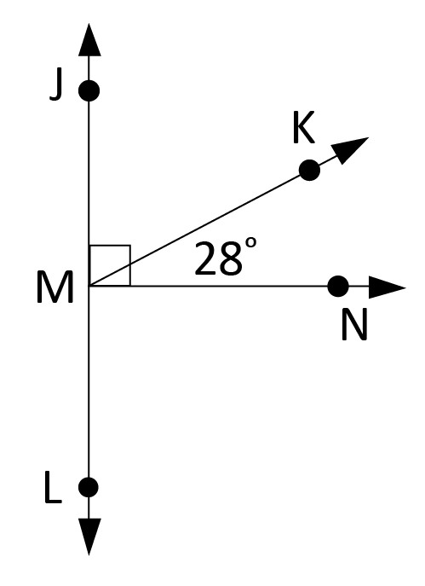
Completing the Proof
Given: ∠KMN = 28°
Prove: ∠JMN = 90°
Statement | Reason
1. | 1.
2. ∠JMK and ∠KMN are complementary angles. | 2. Given
3. ∠JMK + ∠KMN = ∠JMN | 3.
4. ∠JMK + ∠KMN = 90° | 4. Definition of Complementary Angles
5. | 5.

Slide 41
Completing the Proof
Given: ∠KMN = 28°
Prove: ∠JMN = 90°
Statement | Reason
1. ∠KMN = 28° | 1.
2. ∠JMK and ∠KMN are complementary angles. | 2. Given
3. ∠JMK + ∠KMN = ∠JMN | 3.
4. ∠JMK + ∠KMN = 90° | 4. Definition of Complementary Angles
5. | 5.

Slide 42
Completing the Proof
Given: ∠KMN = 28°
Prove: ∠JMN = 90°
Statement | Reason
1. ∠KMN = 28° | 1.
2. ∠JMK and ∠KMN are complementary angles. | 2. Given
3. ∠JMK + ∠KMN = ∠JMN | 3.
4. ∠JMK + ∠KMN = 90° | 4. Definition of Complementary Angles
5. ∠JMN = 90° | 5.

Slide 43
Completing the Proof
Given: ∠KMN = 28°
Prove: ∠JMN = 90°
Statement | Reason
1. ∠KMN = 28° | 1. Given
2. ∠JMK and ∠KMN are complementary angles. | 2. Given
3. ∠JMK + ∠KMN = ∠JMN | 3.
4. ∠JMK + ∠KMN = 90° | 4. Definition of Complementary Angles
5. ∠JMN = 90° | 5.

Slide 44
Completing the Proof
Given: ∠KMN = 28°
Prove: ∠JMN = 90°
Statement | Reason
1. ∠KMN = 28° | 1. Given
2. ∠JMK and ∠KMN are complementary angles. | 2. Given
3. ∠JMK + ∠KMN = ∠JMN | 3. Angle Addition Postulate
4. ∠JMK + ∠KMN = 90° | 4. Definition of Complementary Angles
5. ∠JMN = 90° | 5.

Slide 45
Completing the Proof
Given: ∠KMN = 28°
Prove: ∠JMN = 90°
Statement | Reason
1. ∠KMN = 28° | 1. Given
2. ∠JMK and ∠KMN are complementary angles. | 2. Given
3. ∠JMK + ∠KMN = ∠JMN | 3. Angle Addition Postulate
4. ∠JMK + ∠KMN = 90° | 4. Definition of Complementary Angles
5. ∠JMN = 90° | 5. Transitive Property

Slide 46
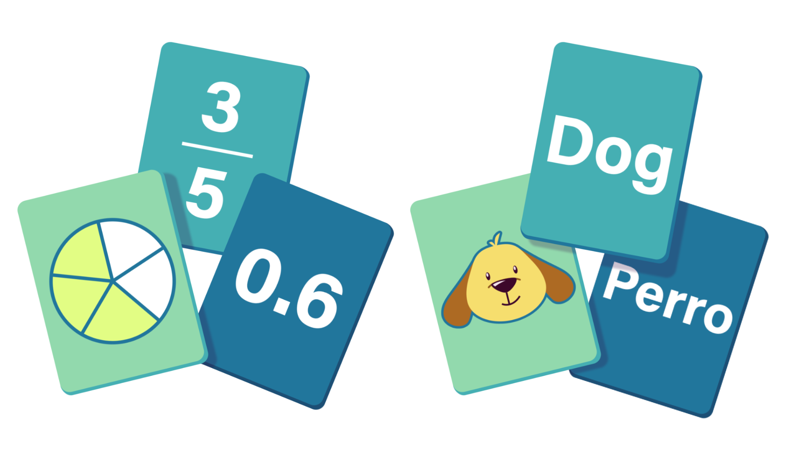
Cross-Examination
In groups, complete the given proofs using
the provided statement and reason cards.
There is one card for each missing
statement and each missing reason.
No card can be used more than once.
When you are done, raise your hand so I can check your work.

Slide 47

Interview with Kate Loughlin
Kate Loughlin Interview
Notes:
K20 Center. (2022, September 22). K20 ICAP - Prove Me wrong [Video]. YouTube. https://www.youtube.com/watch?v=RW4SVMW5pgg

Slide 48
Closing Arguments
Complete the proof on your task card.
Use a separate sheet of paper if you need more room.
Be ready to share!

Slide 49

Verdict
Write your name on the back of your task card.
Under the proof you completed, write the letter that best represents your feelings towards your answer.
  G: Guessed
  U: Unsure
  S: Sure

