Slide 2
Law of Sines
AAS, ASA, SSA

Slide 3
Essential Question
How can indirect measurements help calculate unknown distances and angle measurements?

Slide 4
Lesson Objectives
Use the Law of Sines to solve problems.
Identify the number of solutions when given SSA.

Slide 5
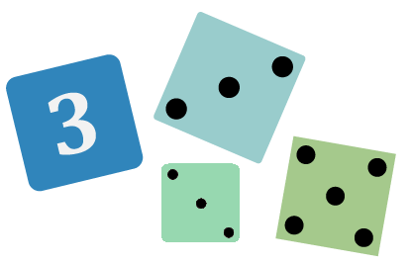
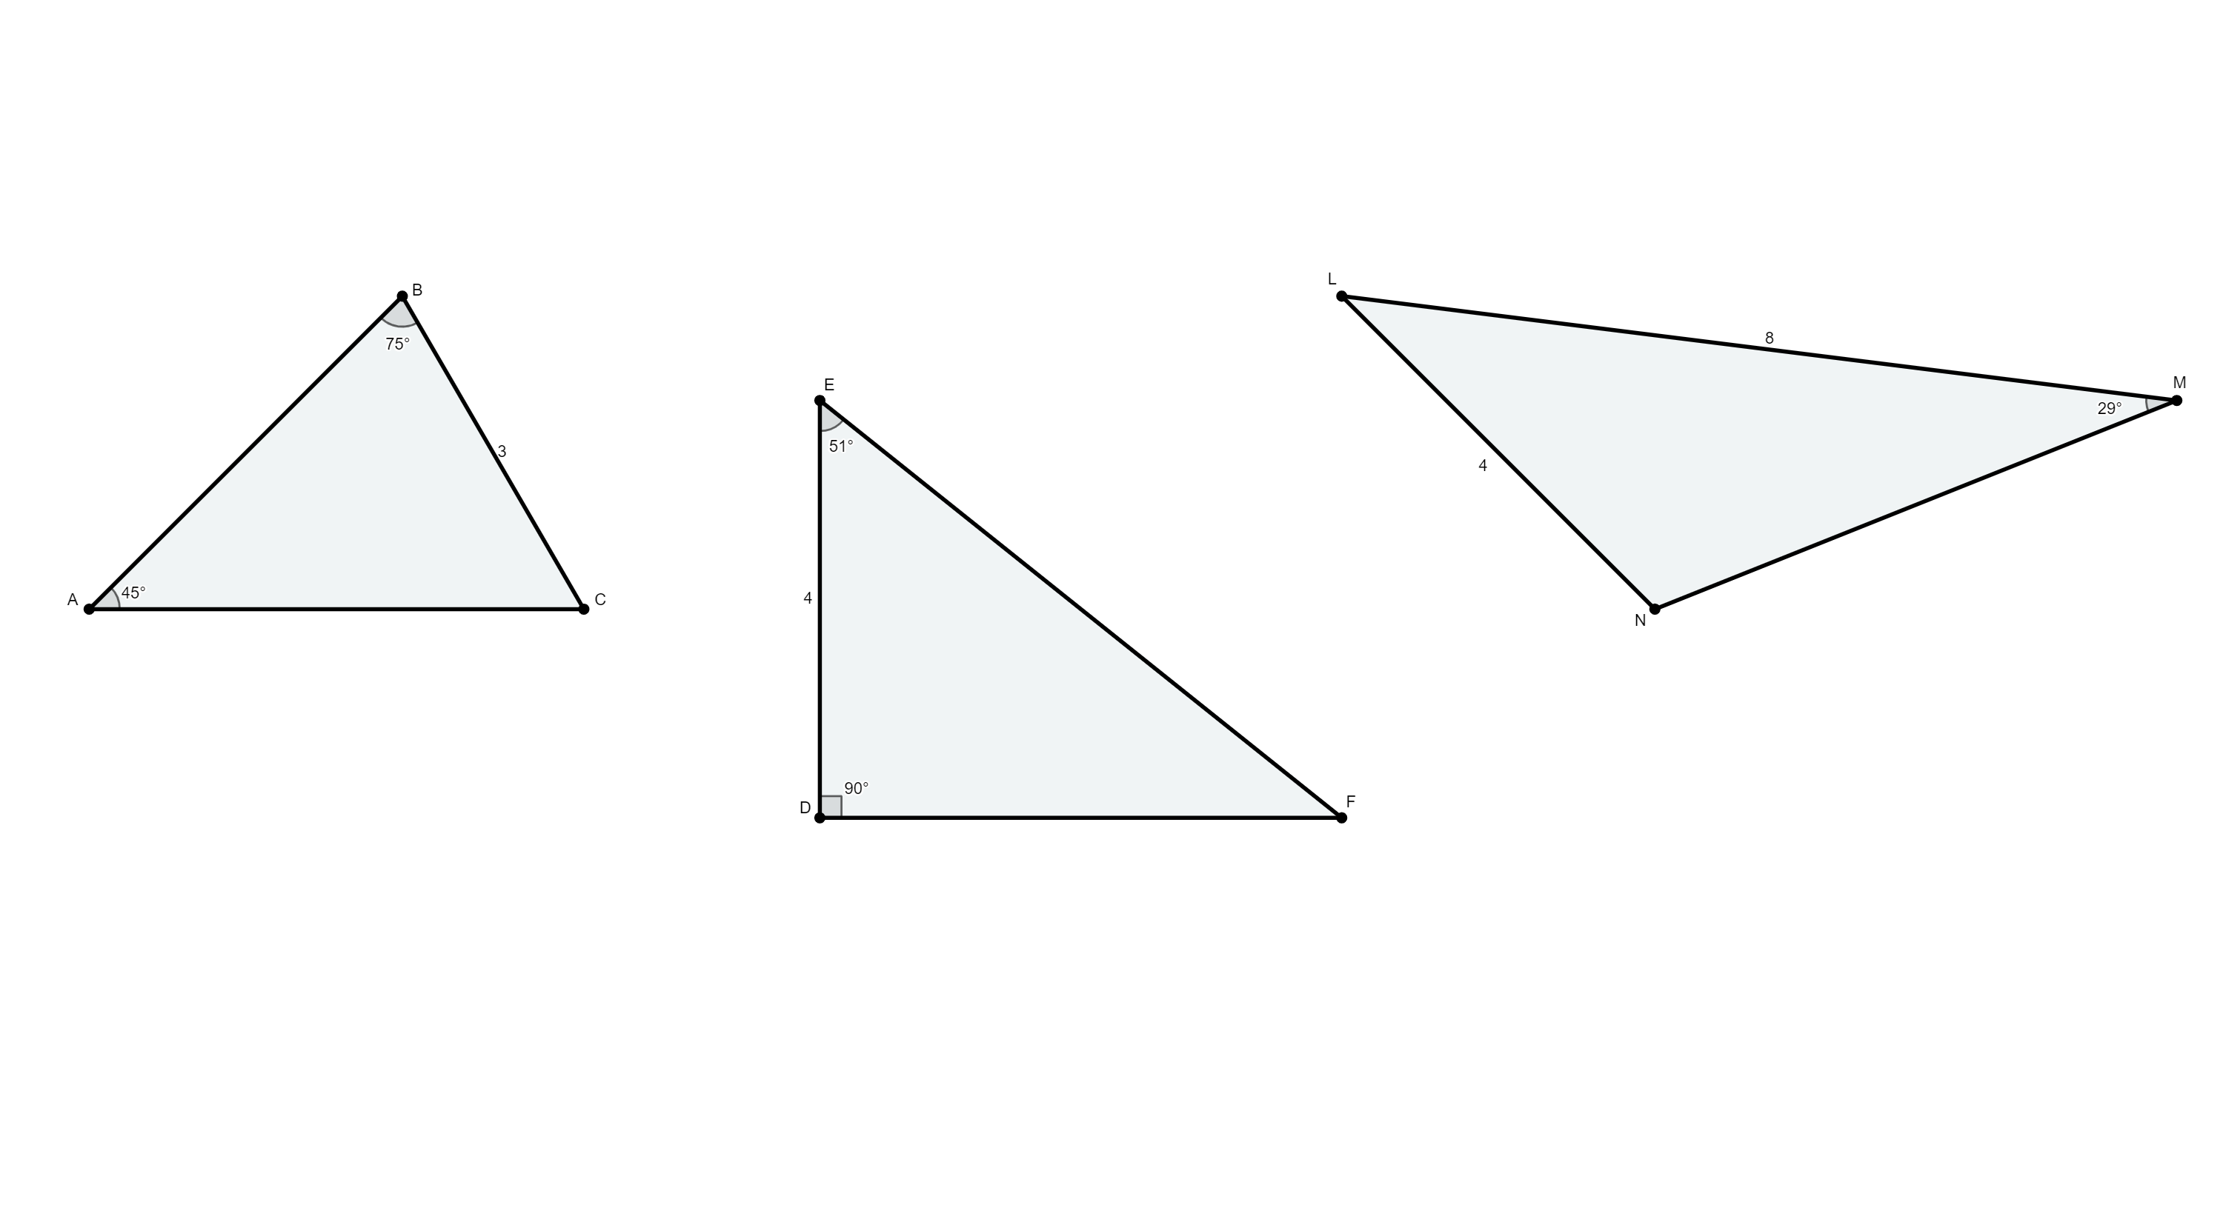
Not Like the Others
Which triangle is not like the others?
Explain your reasoning.
Notes:
K20 Center. (n.d.). Not Like the Others. Strategies. https://learn.k20center.ou.edu/strategy/77

Slide 6

Given Side-Side-Angle
You might recall from Geometry class, that there was not a SSA congruence theorem.
There are some interesting things that can happen when given two side lengths and the angle measure of an angle not between the given sides.
Go to geogebra.org/m/rsw7dspt to investigate SSA.
Record your observations on your handout.
Notes:
K20 Center. (n.d.). Think-Pair-Share. Strategies. https://learn.k20center.ou.edu/strategy/139

Slide 7
GeoGebra Reflection: Acute Angle
What patterns did you notice?

Slide 8
GeoGebra Reflection: Right & Obtuse Angles
What patterns did you notice?

Slide 9
Guided Notes
Can we write general rules that would help us determine when there are 0, 1, or 2 triangles?
Let’s record our final thoughts on our Guided Notes.

Slide 10
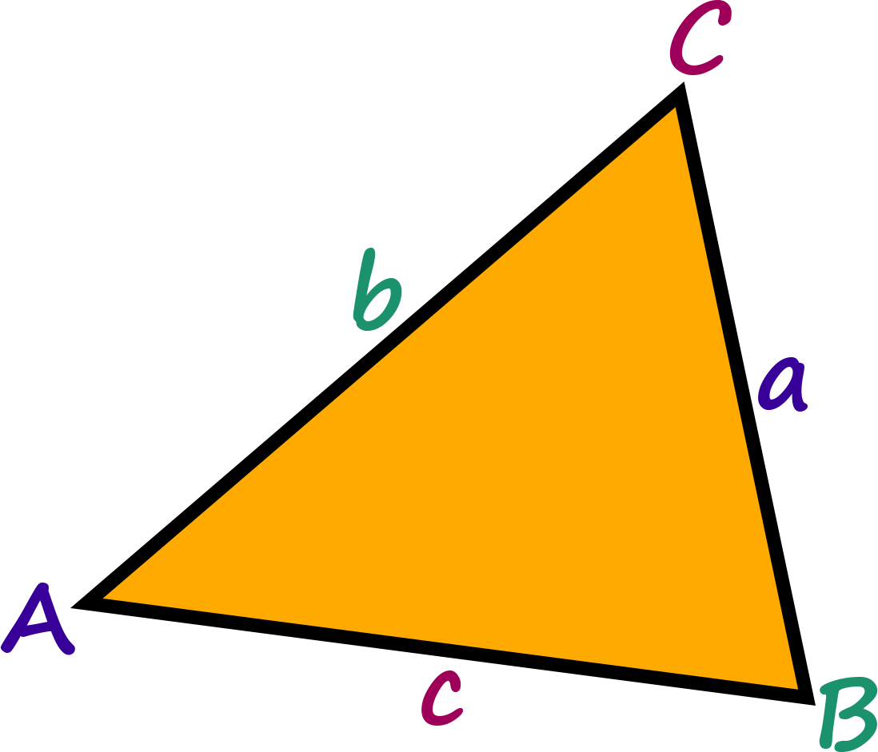
Guided Notes
Let’s complete the Guided Notes together.

Slide 11
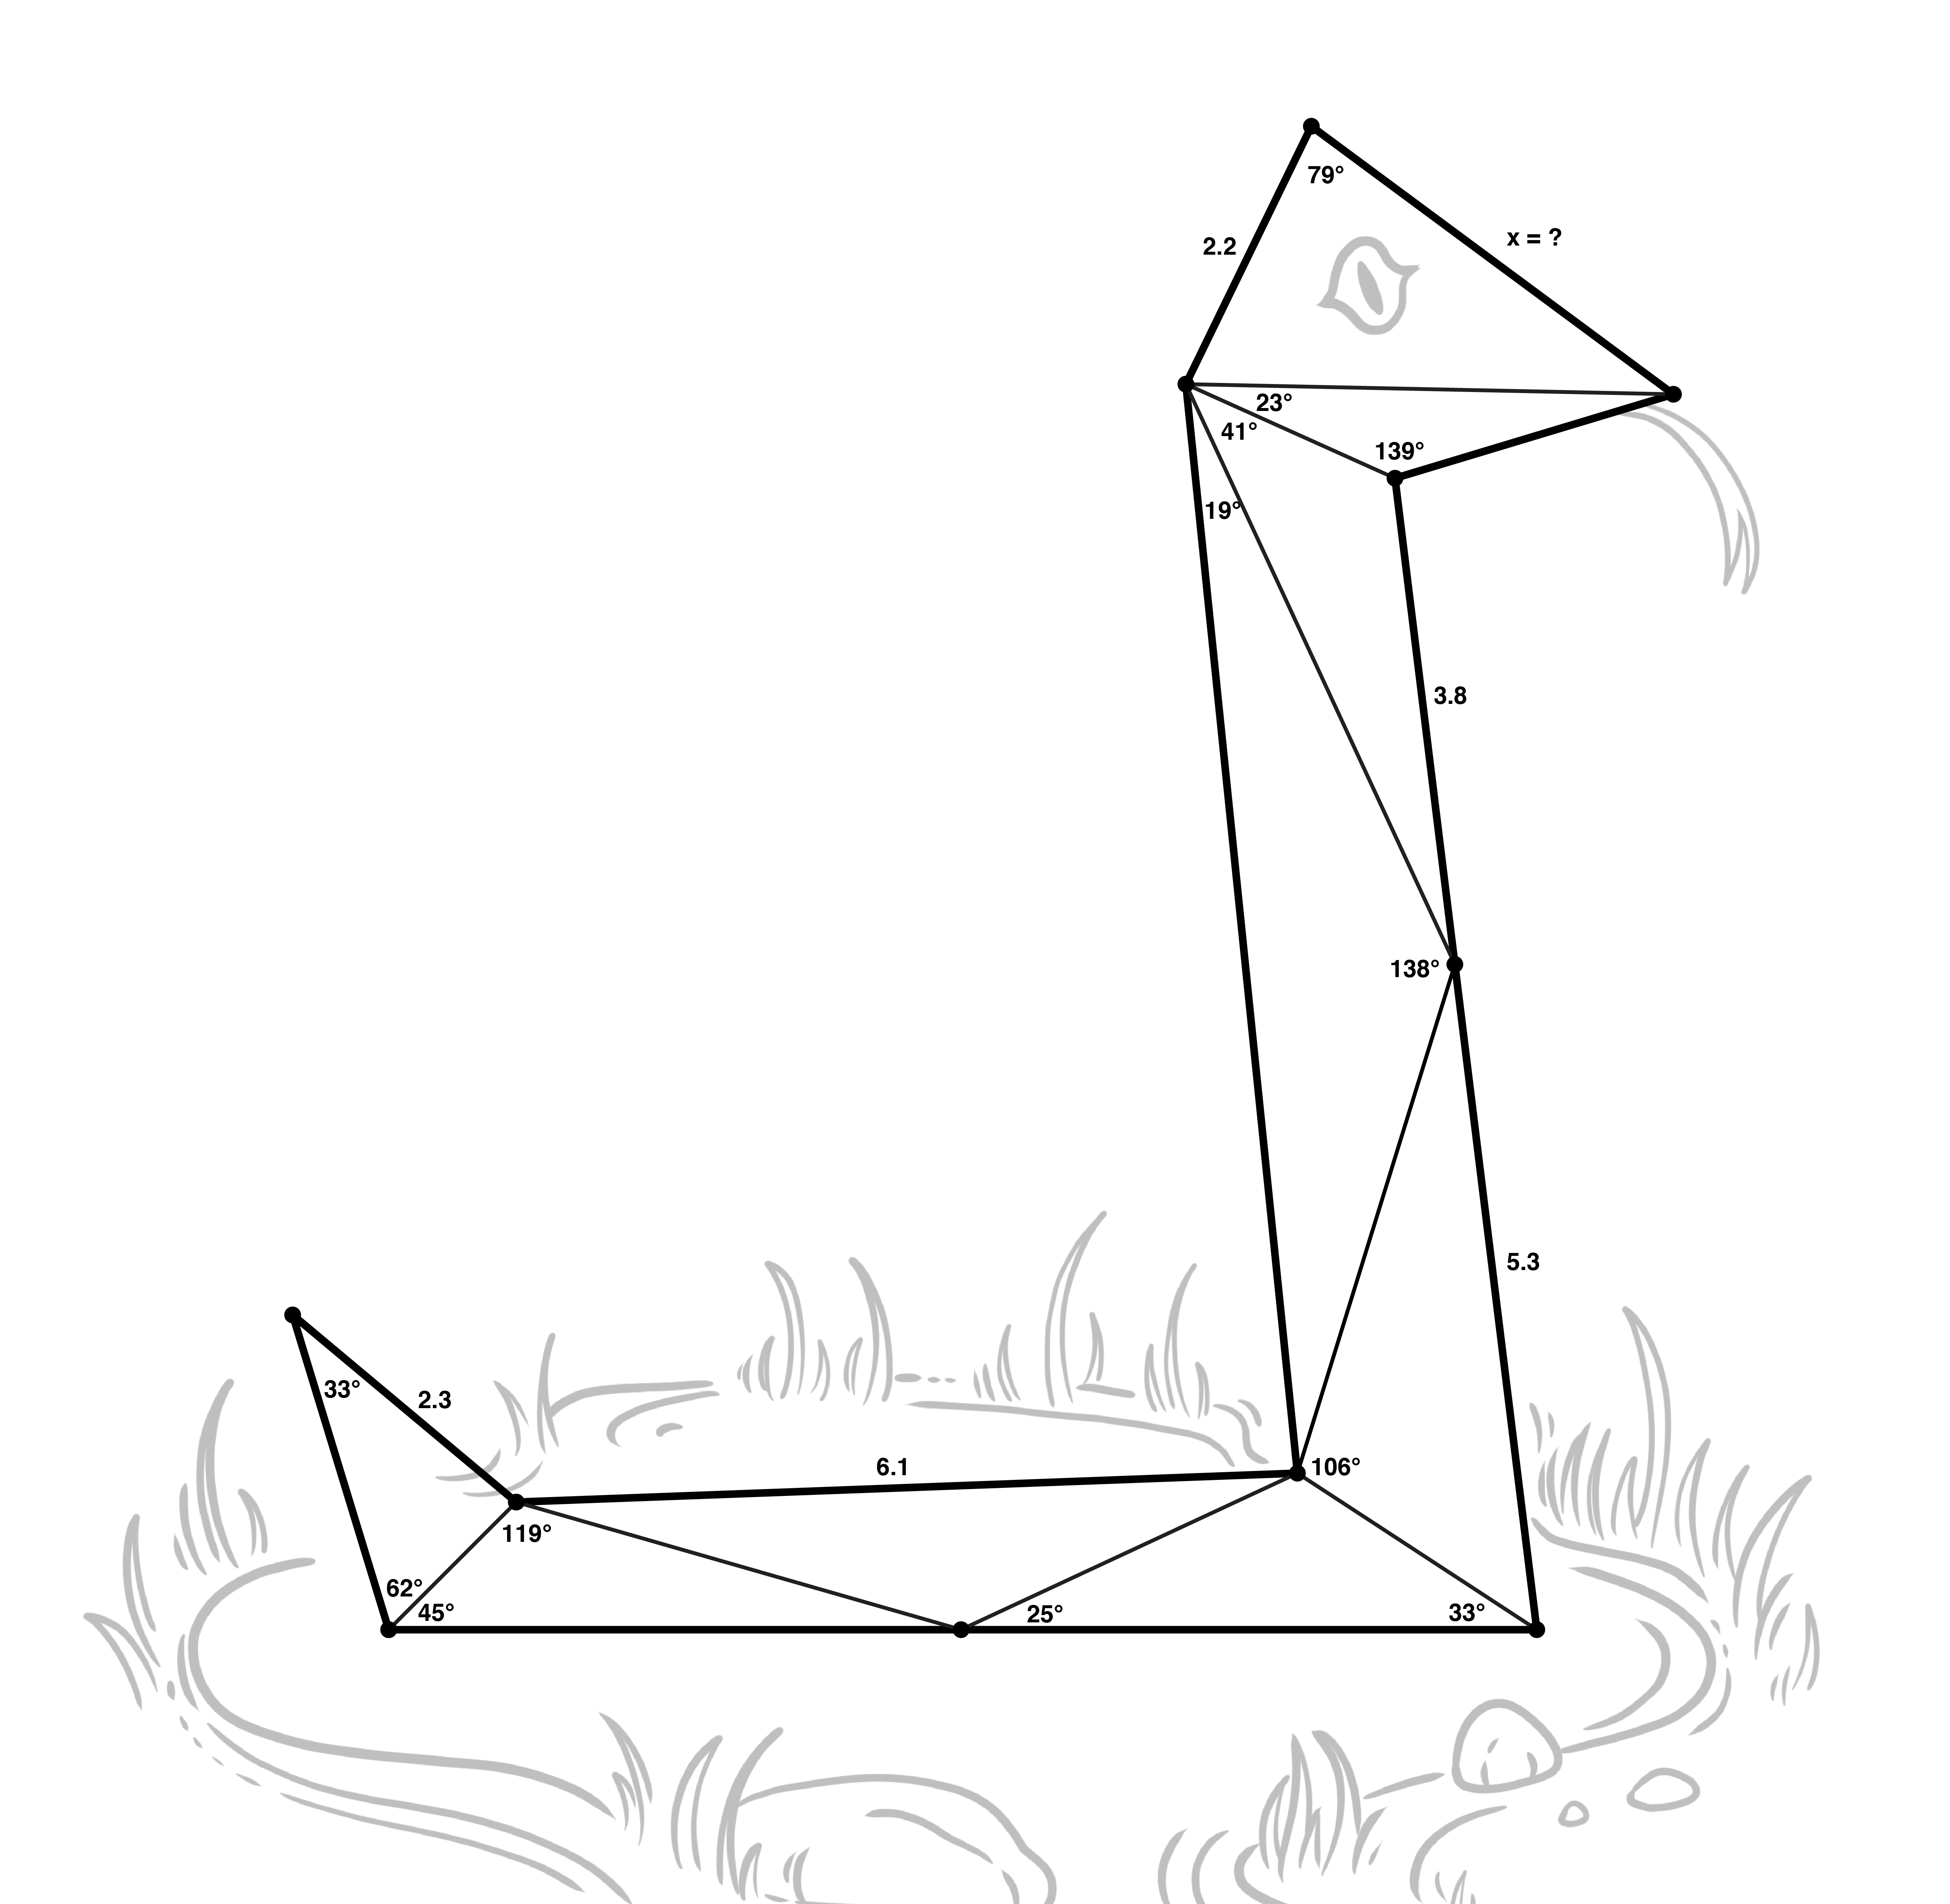
Using Law of SSSSines
With a partner, use what you
have learned to solve for x.

Slide 12

Stoplight Stickies
How confident are you in your ability to use the Law of Sines to solve a triangle?
  Write a question or comment that represents your response on one sticky note.
Notes:
K20 Center. (n.d.). Stoplight Stickies. Strategies. https://learn.k20center.ou.edu/strategy/92

