Slide 2
What’s the Sitch?
Using Multimedia to Communicate Weather Hazards

Slide 3
Essential Questions
How is risk communicated?
Why are some messages more persuasive than others?

Slide 4
Lesson Objectives
Compare various communication tactics
Synthesize multiple sources of information
Create a multimedia message to communicate to a specific audience for a specific purpose

Slide 5
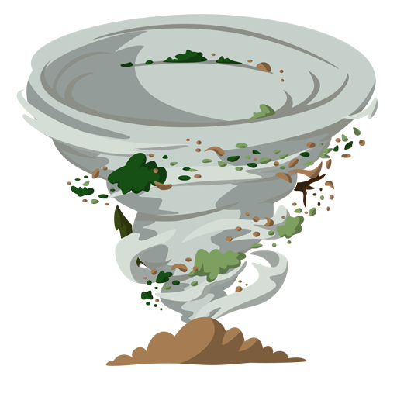
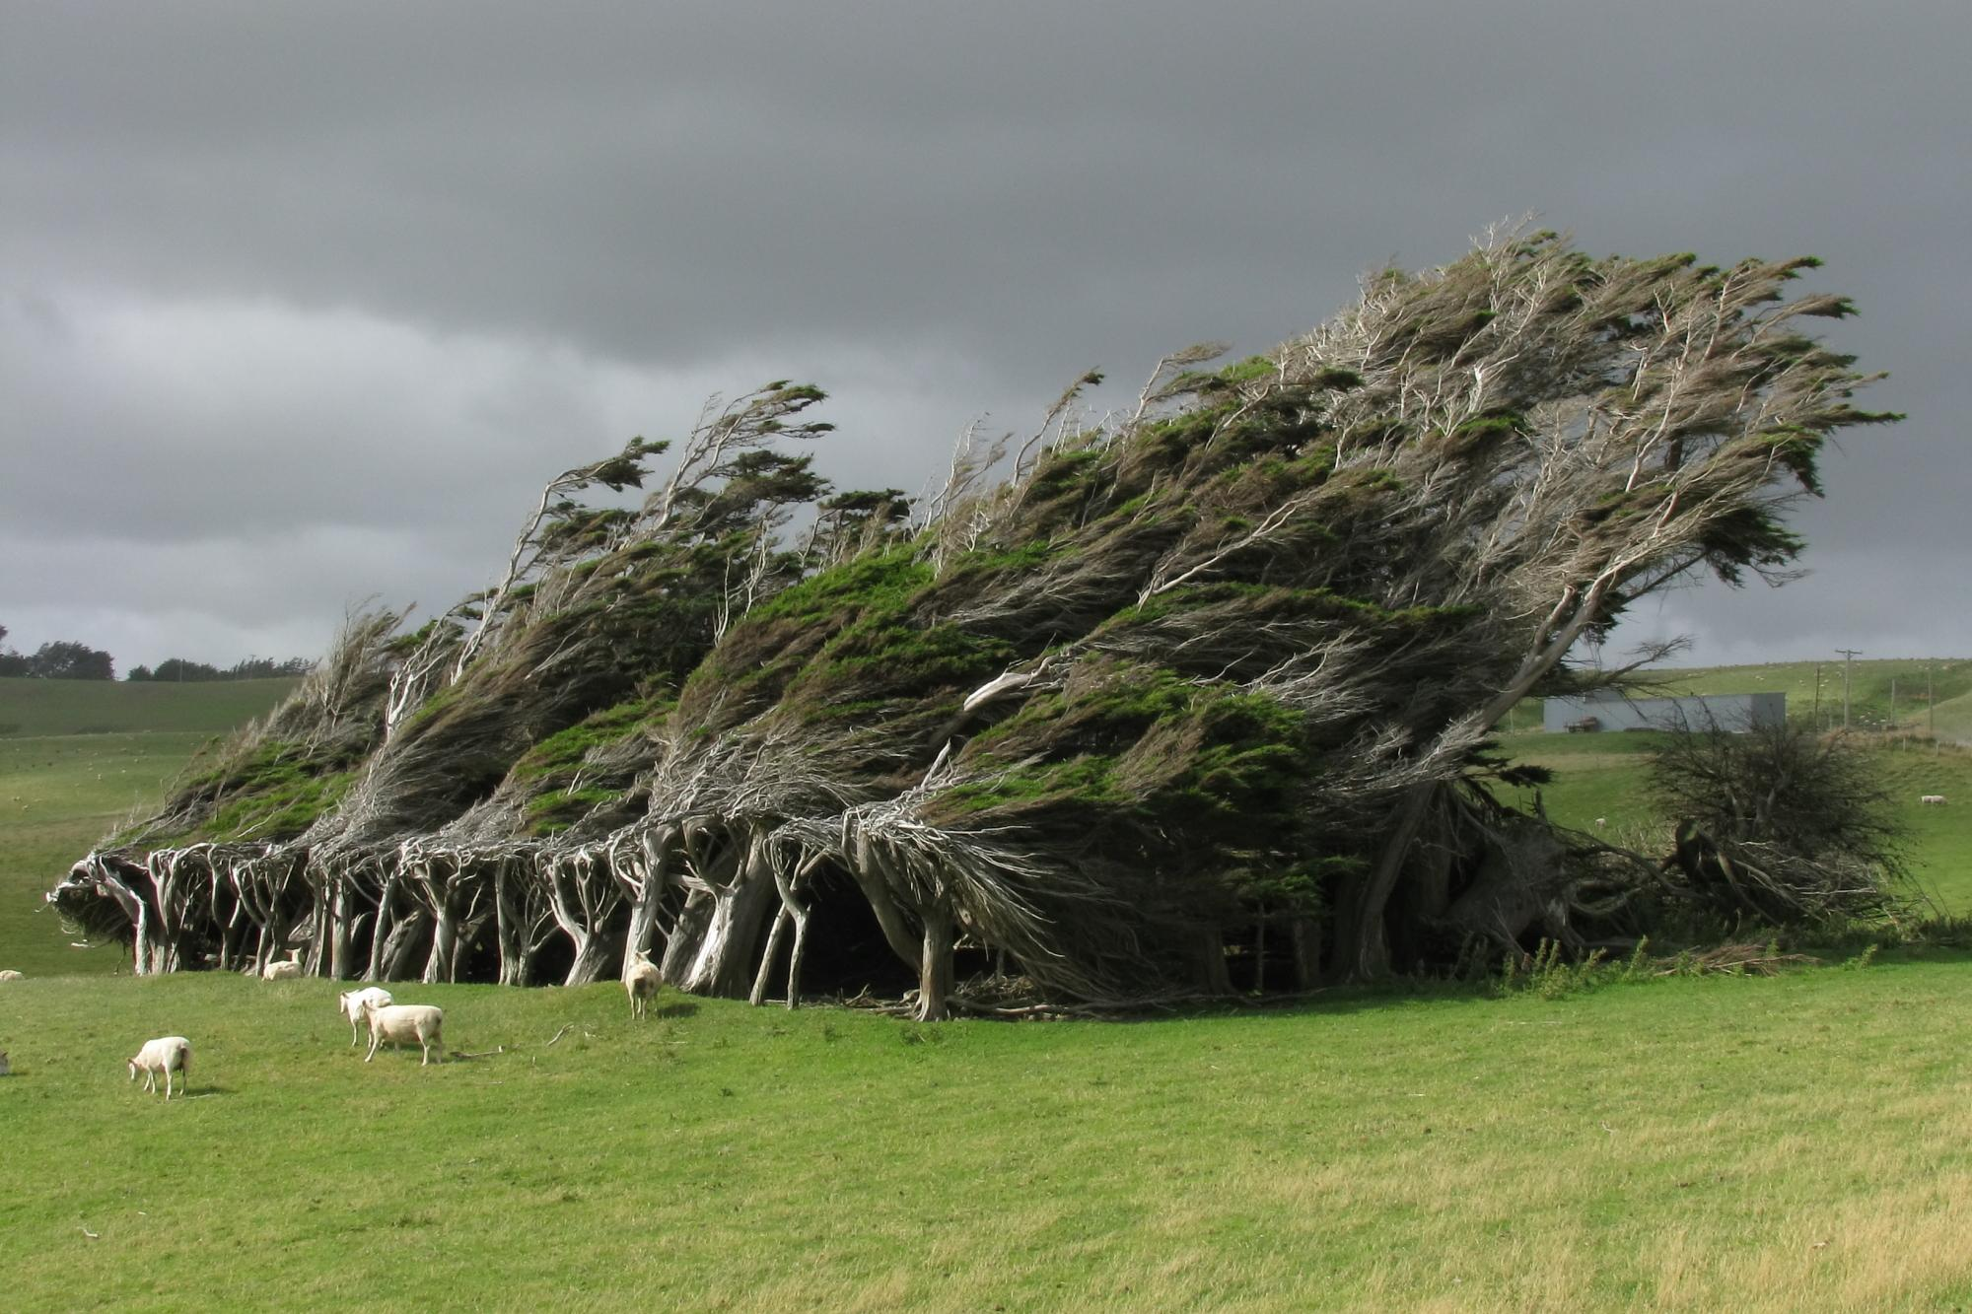
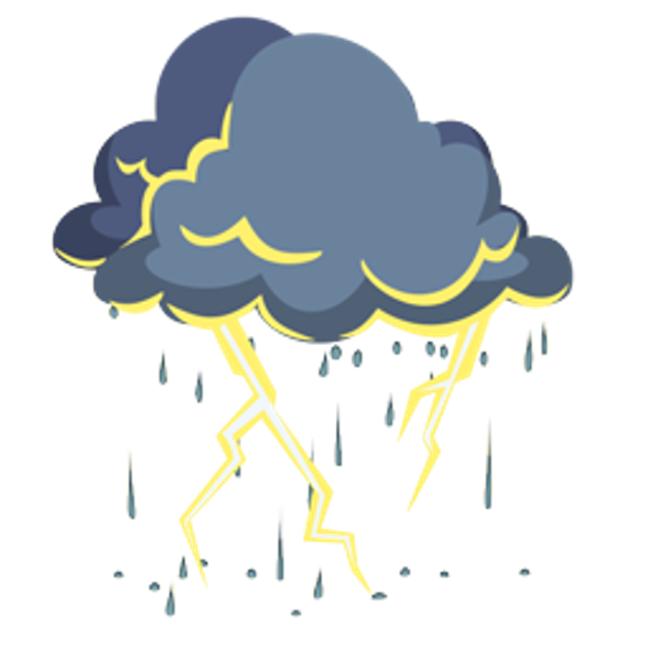
Which hazard has been the most impactful in your life?
Tornado | Fire | Hail | Flood | Wind | Drought | Lightning
Stand by the sign with the type of weather you find the most impactful in your life.

Slide 6
Which hazard has been the least impactful in your life?
Tornado | Fire | Hail | Flood | Wind | Drought | Lightning
Stand by the sign with the type of weather you find the least impactful in your life.

Slide 7
Where do you get information about weather and potential hazards?

Slide 8
Scenarios
Scenario 1: sites.google.com/ou.edu/aware1
Scenario 2: sites.google.com/ou.edu/aware2
Scenario 3: sites.google.com/ou.edu/aware3
Scenario 4: sites.google.com/ou.edu/aware4

Slide 9
For each scenario, consider the following:
What weather hazards are the authors concerned about?
What information is being shared, and why?
What is the author's intent? Is it to persuade, inform, or entertain?
Who is the intended audience?
What types of media are being used? (E.g., graphics, text, videos, etc.)

Slide 10
Scenario 1: May 15, 2022
Note: This video depicts a similar hailstorm but was not actually taken on May 15, 2022.
Notes:
Beatlesfanxxl. (2010, May 16). Hail storm Oklahoma City [Video]. YouTube. https://youtu.be/OFv2W7Duqiw

Slide 11
Scenario 1: May 15, 2022
Multiple locations in central and eastern Oklahoma experienced large hail.
The small town of Gore was hit with hail damages estimated to be over $100,000.
Notes:
https://youtu.be/OFv2W7Duqiw

Slide 12
Scenario 2: May 5, 2022
Notes:
News On 6/KOTV. (2022, May 7). First responders help Bixby families find shelter after flooding [Video]. YouTube. https://www.youtube.com/watch?v=M7Hb26KKz6E

Slide 13
Scenario 2: May 5, 2022
Bixby, OK, had a significant flood.
Damages were estimated to be $2 million dollars.

Slide 14
Scenario 3: March 7–8, 2020
Notes:
KFOR Oklahoma’s News 4. (2020, March 9). Beaver County homes destroyed in fire [Video]. YouTube. https://www.youtube.com/watch?v=UWF0dXhg5No

Slide 15
Scenario 3: March 7–8, 2020
The Oklahoma Panhandle experienced a catastrophic wildfire.
The wildfire was a result of high winds, low humidity, and drought.
At least 15 residences were damaged.
No fatalities were reported, but a few people suffered from smoke inhalation.
The fire consumed approximately 29,030 acres.

Slide 16
Scenario 4: May 4, 2022
Notes:
KOCO 5 News. (2022, May 4). Tornado causes widespread damage in Seminole [Video]. YouTube. https://www.youtube.com/watch?v=Bl22lBT9Zhw

Slide 17
Scenario 4: May 4, 2022
13 confirmed tornadoes hit Oklahoma that day.
Seminole suffered the most damage.
No fatalities or injuries were reported.
This is thanks in large part to the accurate and understandable weather information provided to residents.

Slide 18
Let’s play, but first…

Slide 19
Collecting Data
You will receive a graphic organizer to collect data for your assigned turn and era
After you finish collecting data from your turn, you will make a weather communication using images, maps, videos, graphics, etc. to alert your residents about the upcoming hazardous weather.
Be sure to collect enough data from your assigned turn to make an accurate and high-quality message.

Slide 20
Graphic Organizer

Slide 21
Turn Assignment
Era 2, Turn 1
Era 2, Turn 3
Era 2, Turn 5
Era 2, Turn 10
Era 3, Turn 2
Era 3, Turn 5
Era 3, Turn 7
Era 3, Turn 8

Slide 22
Let’s play!

Slide 23
Make a Message to Warn Residents
Imagine it is the day before your assigned era and turn, and you need to warn residents about the upcoming hazardous weather.
Create a compelling multimedia weather communication using images, maps, videos, graphics, etc. to alert your residents.
Recall the various types of forecasts and weather communications from earlier in the lesson to help guide your work.

