Slide 1
Things are Lit at Thornfield!
Jane Eyre

Slide 2
Essential Question
How do context clues, connotation, denotation, and different takes on a text help you clarify the meaning of words?

Slide 3
Learning Objectives
Determine the meanings of words from the text using context clues, connotation, and denotation.
Analyze the techniques used in classical literature compared to comic book writing to determine how they contribute to meaning of the vocabulary words.

Slide 4
Honeycomb Harvest
Each hexagon has one of the following on it:
Word
Image
Synonyms
With your group, organize these into groups to determine their relationships and how they all connect with each other
Notes:
K20 Center. (n.d.). Honeycomb harvest. Strategies. https://learn.k20center.ou.edu/strategy/61

Slide 5
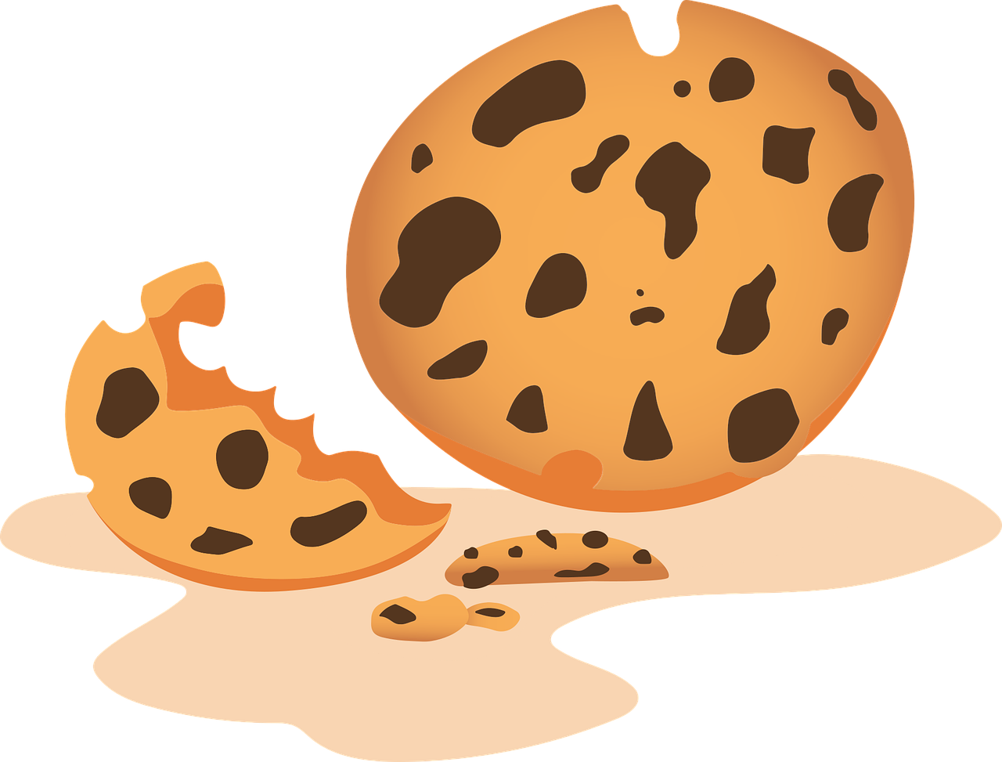
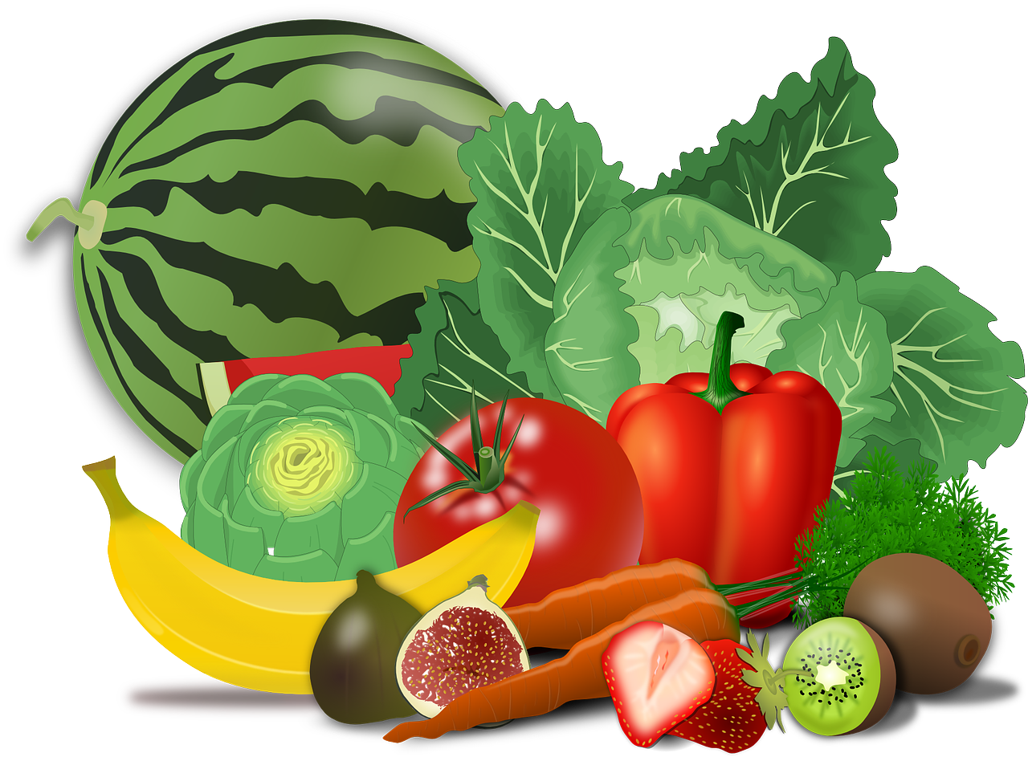
Example Honeycomb Harvest
e
food
d
B
a
b
D
c
apple
f
F
C
Egg-
plant
banana
E
cookie
donut
A
Notes:
https://pixabay.com/illustrations/teacher-apple-school-elementary-1202735/
https://pixabay.com/vectors/banana-bunch-fruit-food-bananas-25339/
https://pixabay.com/vectors/cookie-dessert-snack-biscuits-6035822/
https://pixabay.com/vectors/donut-snack-dessert-sweet-sugary-5985274/
https://pixabay.com/vectors/aubergine-egg-plant-food-greens-1298730/
https://pixabay.com/vectors/vegetables-fruits-food-artichoke-155616/

Slide 6
Egg-
plant
cookie
A
E
c
apple
e
C
a
donut
D
d
banana
f
B
F
b
food

Slide 7
Fire
What does that mean?

Slide 8
Fire
What does that mean?
Flame
Awesome
To terminate from a position of employment

Slide 9
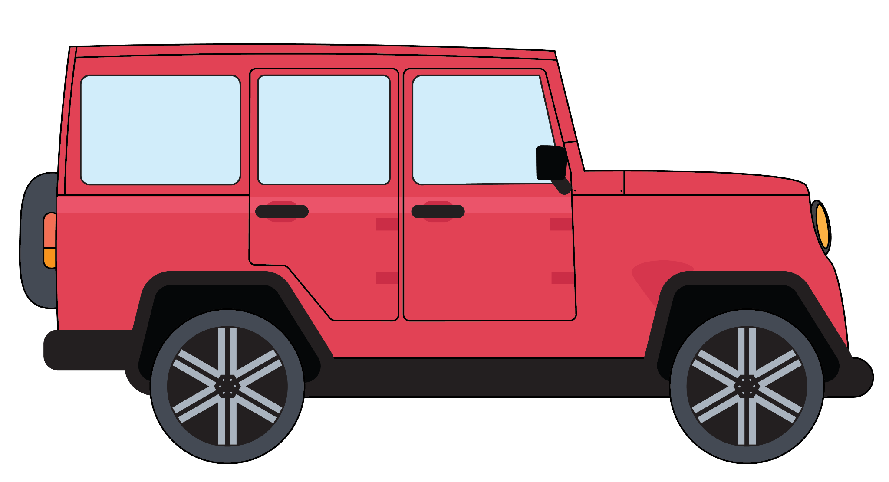
Whip
What does that mean?

Slide 10
Whip
What does that mean?
Hair tossing
Car
Something Indiana Jones carries with him.

Slide 11
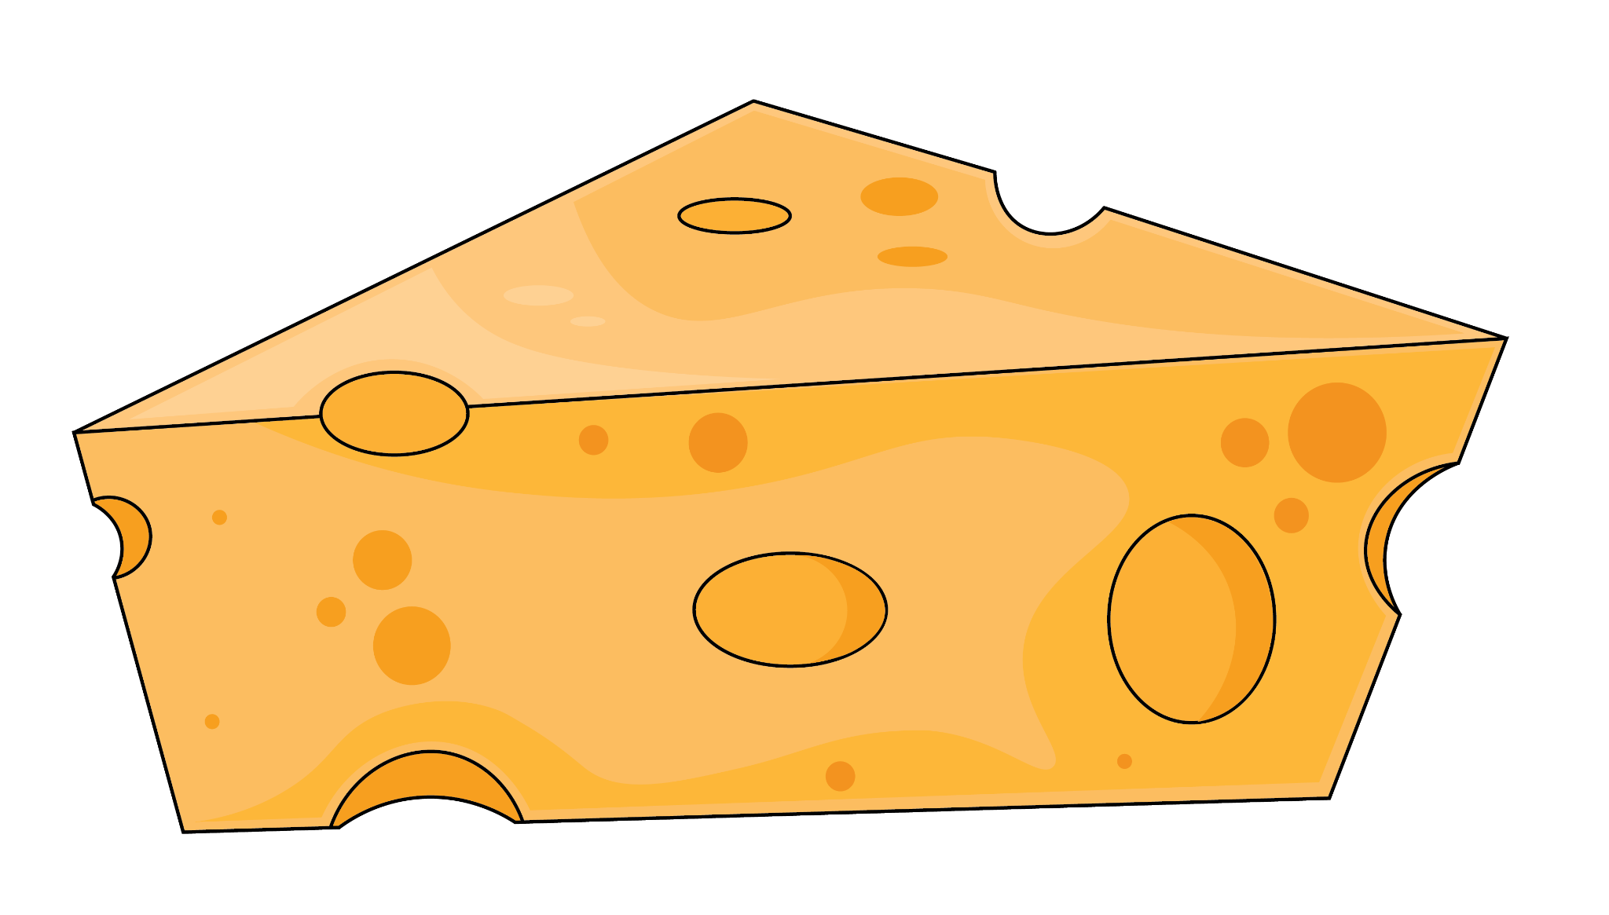
Cheese
What does that mean?

Slide 12
Cheese
What does that mean?
Food
Smile
Mad

Slide 13
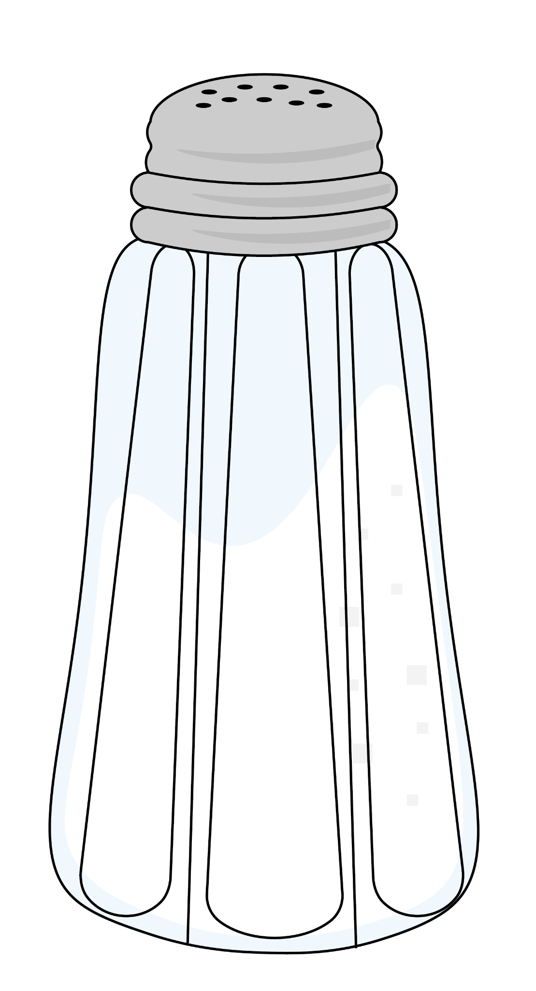
Salty
What does that mean?

Slide 14
Salty
What does that mean?
Mad
Taste
Vulgar language

Slide 15
Ghost
What does that mean?

Slide 16
Ghost
What does that mean?
Disappear
Not respond
Casper the Friendly

Slide 17
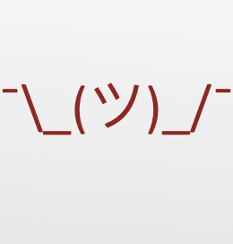
Unknown Vocabulary
What do you think the term on your paper means?
Write down your best guess at a definition in the space provided on your paper.

Slide 18
Unknown Vocabulary
Read the excerpt from Jane Eyre by Charlotte Brontë.
Find where the term is used in a sentence:
What do you think the term means now?
What context clues help you understand the meaning of the term?
Update your definition if necessary.

Slide 19
Unknown Vocabulary
Read the pages from the graphic novel.
Read the scene where your term is portrayed visually:
What do you think the term means now?
What context clues help you understand the meaning of the term?
Update your definition if necessary.

Slide 20
Context Clues
Context clues are hints found within a sentence, paragraph, or passage that a reader can use to understand the meanings of new or unfamiliar words.

Slide 21
Denotation
The literal or primary meaning of a word, in contrast to the feelings or ideas that the word suggests.

Slide 22
Connotation
An idea or feeling that a word invokes in addition to its literal or primary meaning.

Slide 23
Known Vocabulary
Look up the definition of your term in a dictionary.
How is this definition similar to or different from what you thought it would be?

Slide 24
Frayer Model
On your chart paper include:
Your term
The definition
A new example of your term used in a sentence
Examples
Non-examples
Notes:
K20 Center. (n.d.). Frayer Model. Strategies. https://learn.k20center.ou.edu/strategy/126

Slide 25
How am I Feeling? What am I Thinking?
Review the following:
What is the meaning of your vocabulary word?
How is the word used in the original text?
How is the word visually represented in the graphic novel?
What feelings does this word conjure?
Place those feelings on sticky notes around your chart paper.
Notes:
K20 Center. (n.d.). How am I feeling? What am I thinking. Strategies. https://learn.k20center.ou.edu/strategy/187

Slide 26
Quick Write
Respond to the following question in 2-3 sentences:
How do context clues, connotation, denotation, and different interpretations of a text help clarify the meanings of words?
Notes:
K20 Center. (n.d.). Quick Write. Strategies. https://learn.k20center.ou.edu/strategy/1127

