Slide 1
Image Mashup
Digital Photo Editing and Fair Use

Slide 2
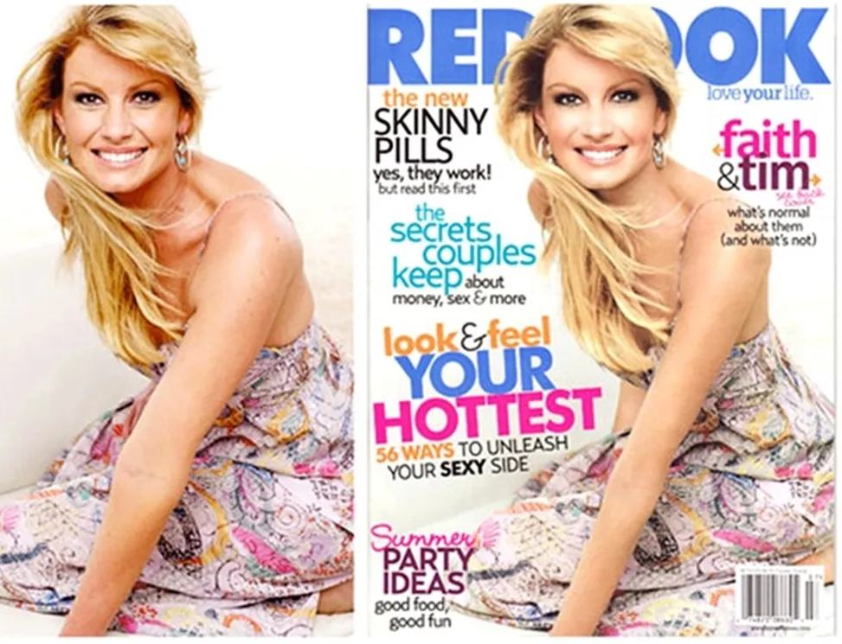
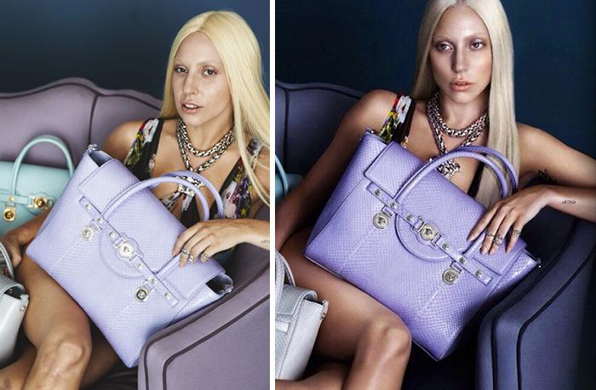
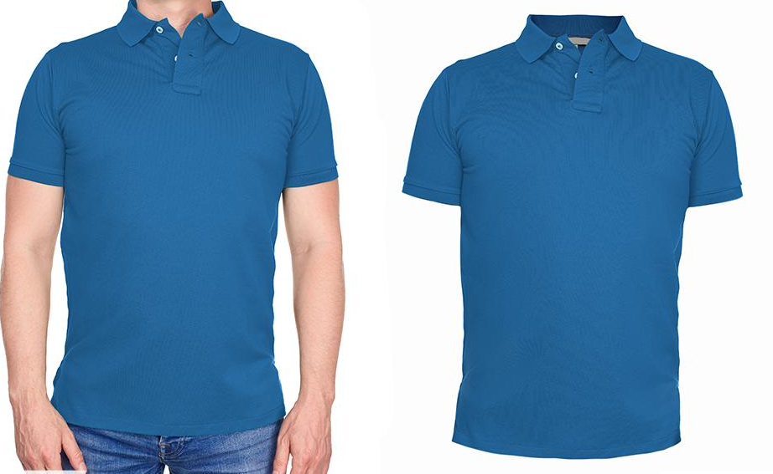
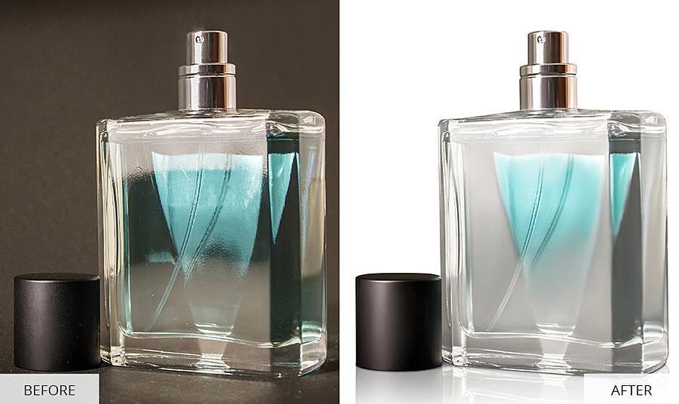
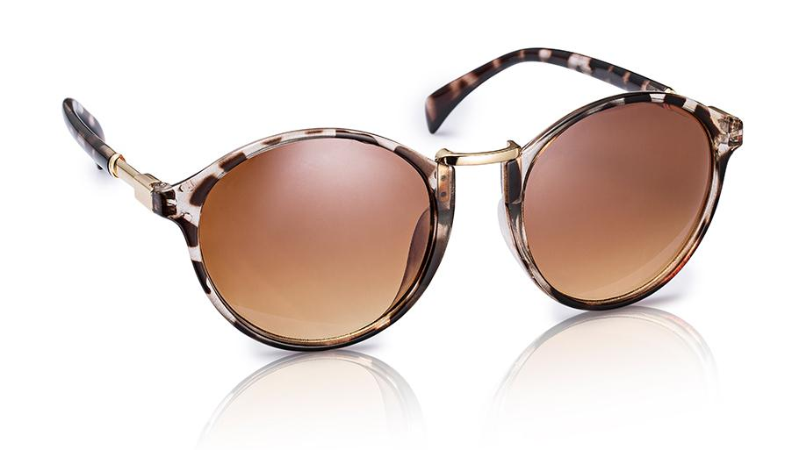
Notes:
What do you notice? What do you wonder?
Wrinkles removed, colors enhanced, more vibrant, skin tones evened out.
Mood created by deepening contrast and color vibrancy on Lady Gaga’s image.
Products are touched up.
Reflection added on glasses
Person removed from the shirt
Background removed from the cologne
Same techniques are used professionally to make celebrities look awesome in the media.
Sources:
Gabulaitė, V. (2016, September 7). 57 Celebrities Before And After Photoshop Who Set Unrealistic Beauty Standards. Bored Panda. https://www.boredpanda.com/before-after-photoshop-celebrities/
Rossi, T. (n.d.). How to Edit Product Photos in Photoshop. Shift4Shop. https://blog.shift4shop.com/edit-product-photos-photoshop

Slide 3
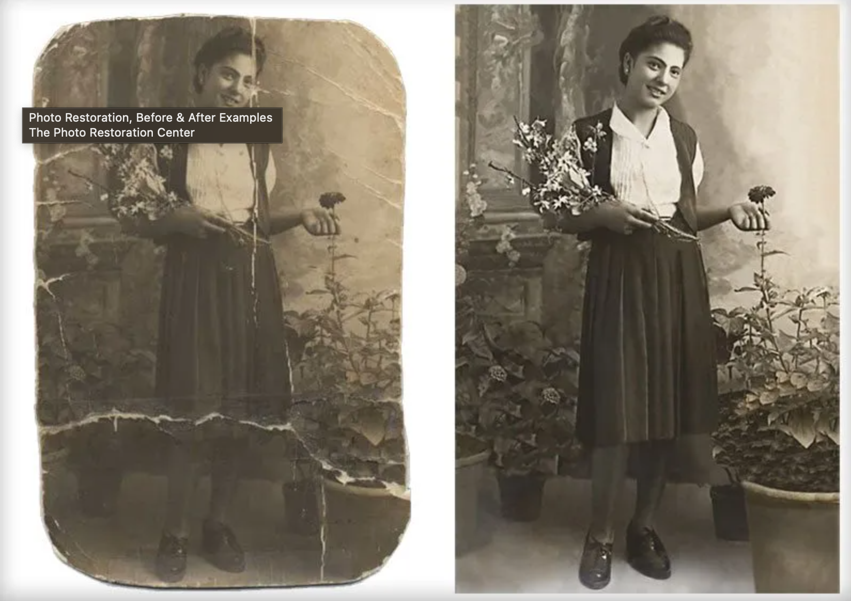
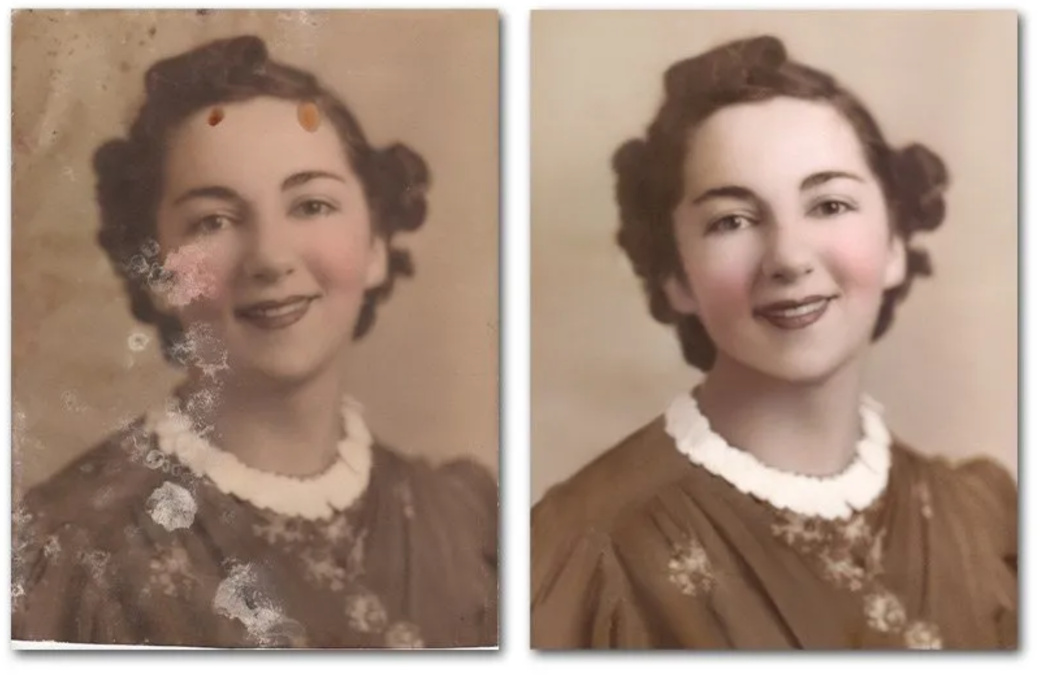
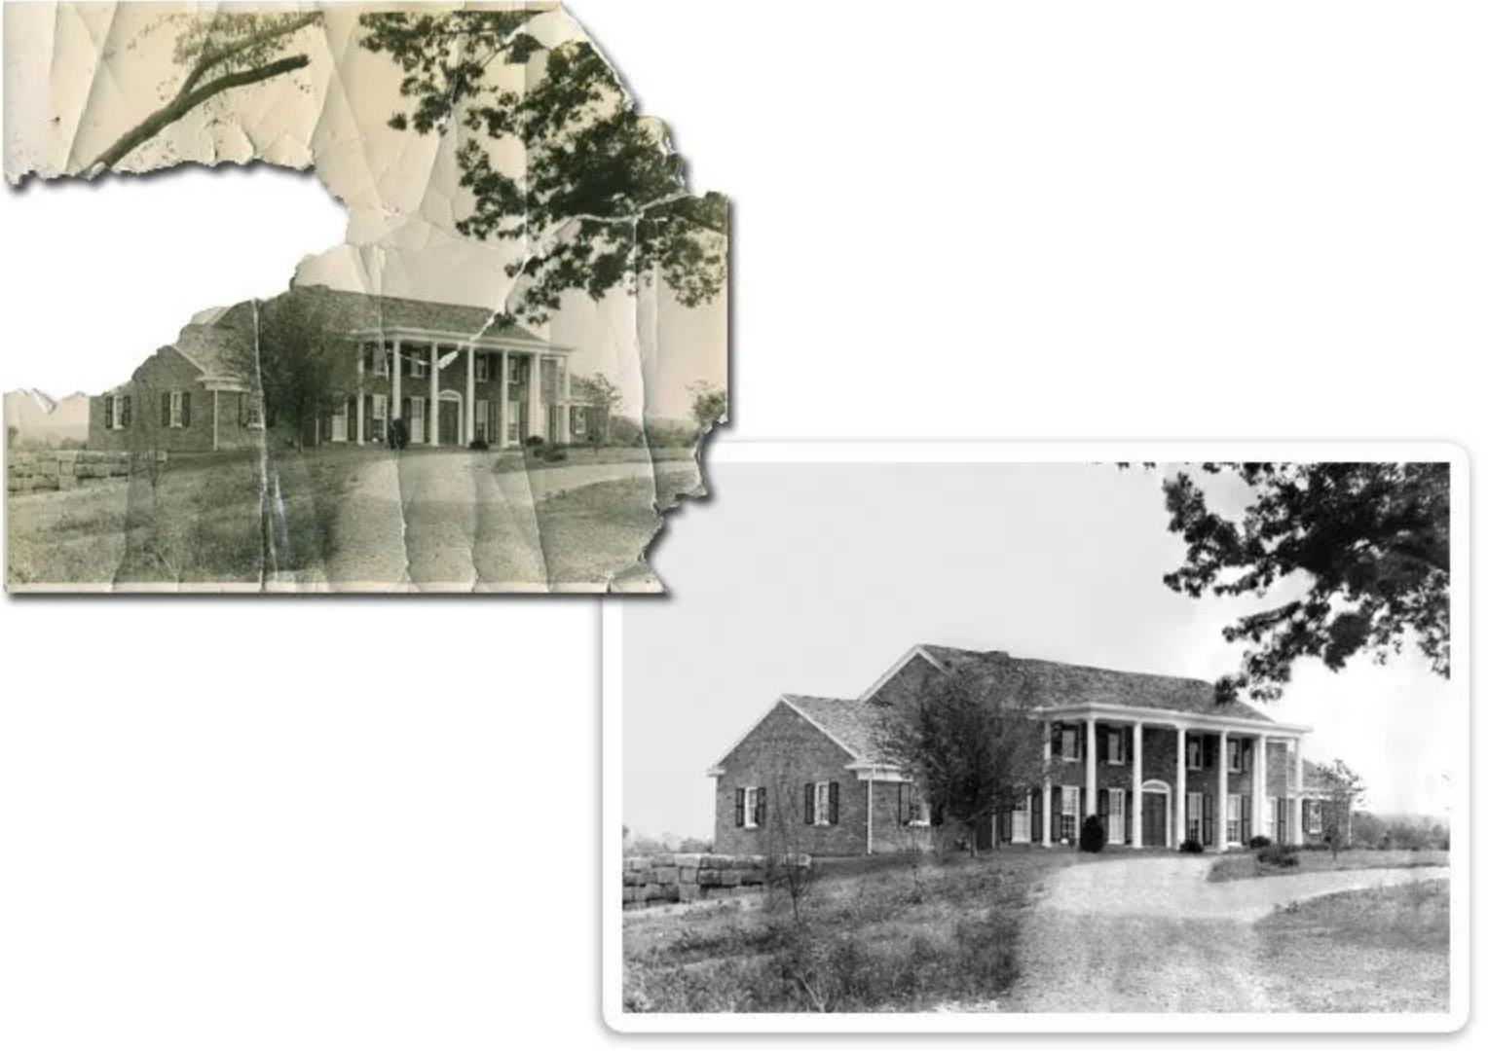
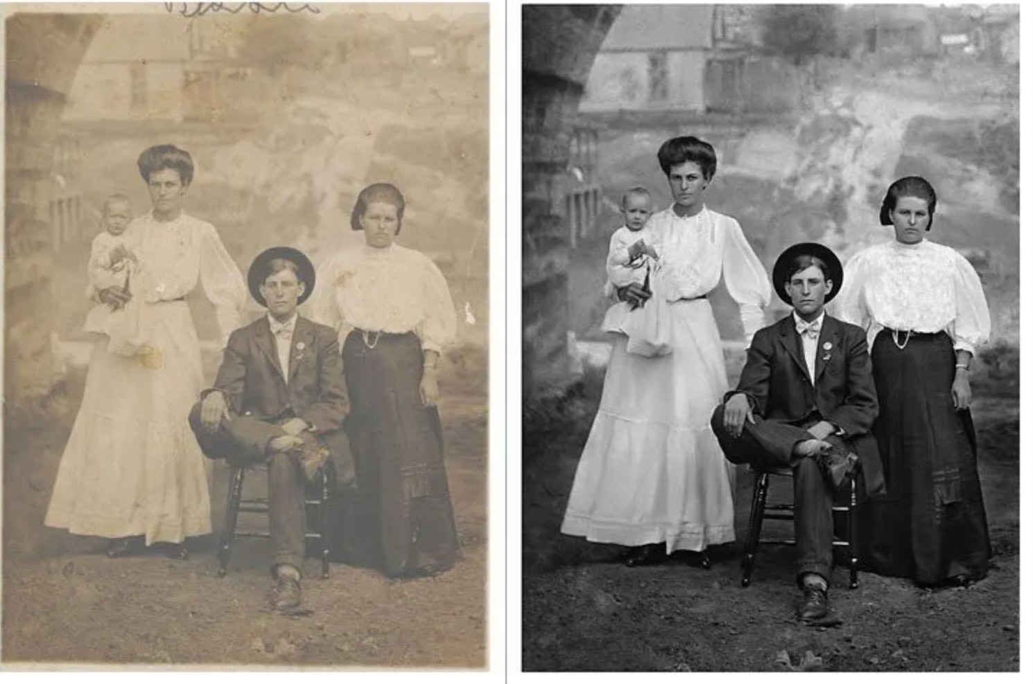
Notes:
Note what kind of work needed to be done to each photo to make it look new again.
Fading, restored detail and contrast.
Blemishes have been erased.
Missing pieces were cropped out and sometimes reconstructed.
Recoloring.
Examples of photo editing software used professionally to restore historically photographs
Source: Christie, S. (2012, April 17). Before and after examples. The Photo Restoration Center. https://thephotorestorationcenter.com/samples/

Slide 4
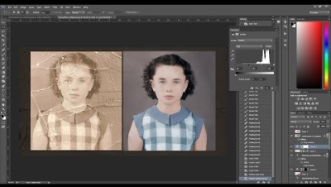
Notes:
Timelapse video of some of the techniques. Play at 2x speed if you need to cut some time.
You can find hundreds of youtube videos that explain other approaches and tricks to restore photos.These could be handy for kids to explore as they are trying to create their own art later in the lesson.
Source: Joaquin Villaverde Photography [@JoaquinVillaverdePH]. (2015, June 28). Old damaged photo RESTORATION & COLORIZATION - [TIMELAPSE]. YouTube. https://youtu.be/vcriltNQMfI

Slide 5
Objective
Use professional photo editing techniques to create a work of art.
Combine existing images correctly following fair use guidelines.

Slide 6
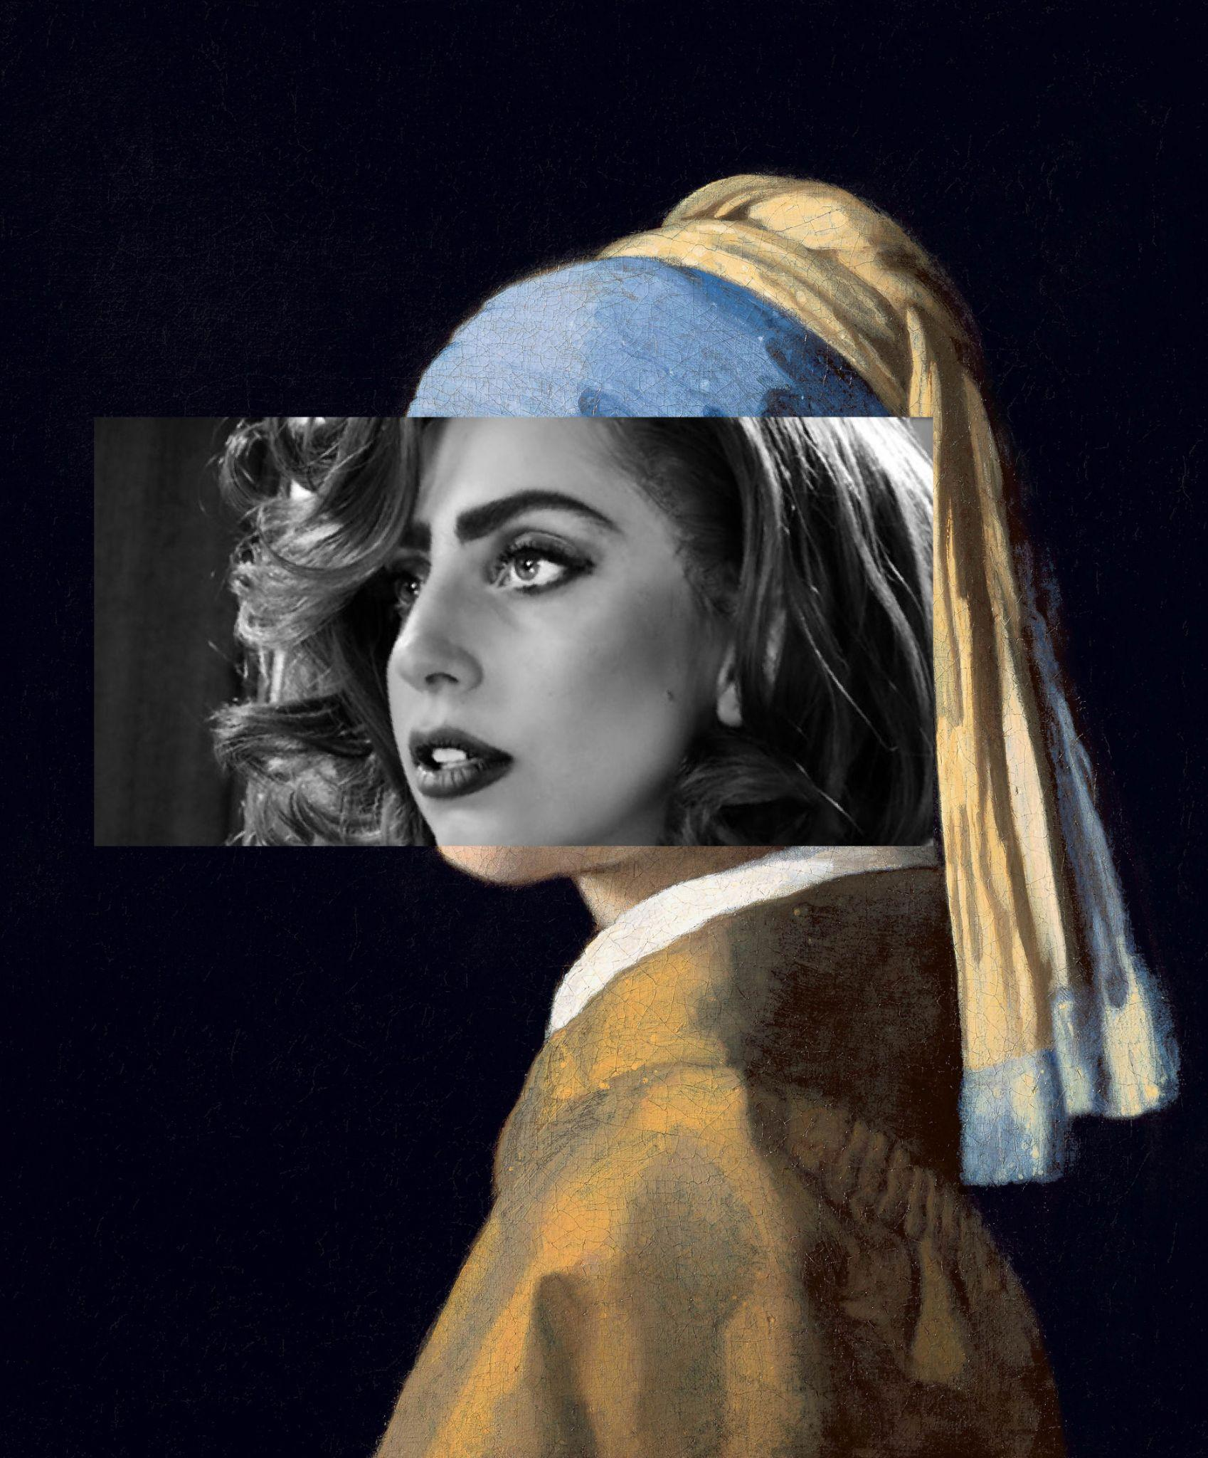
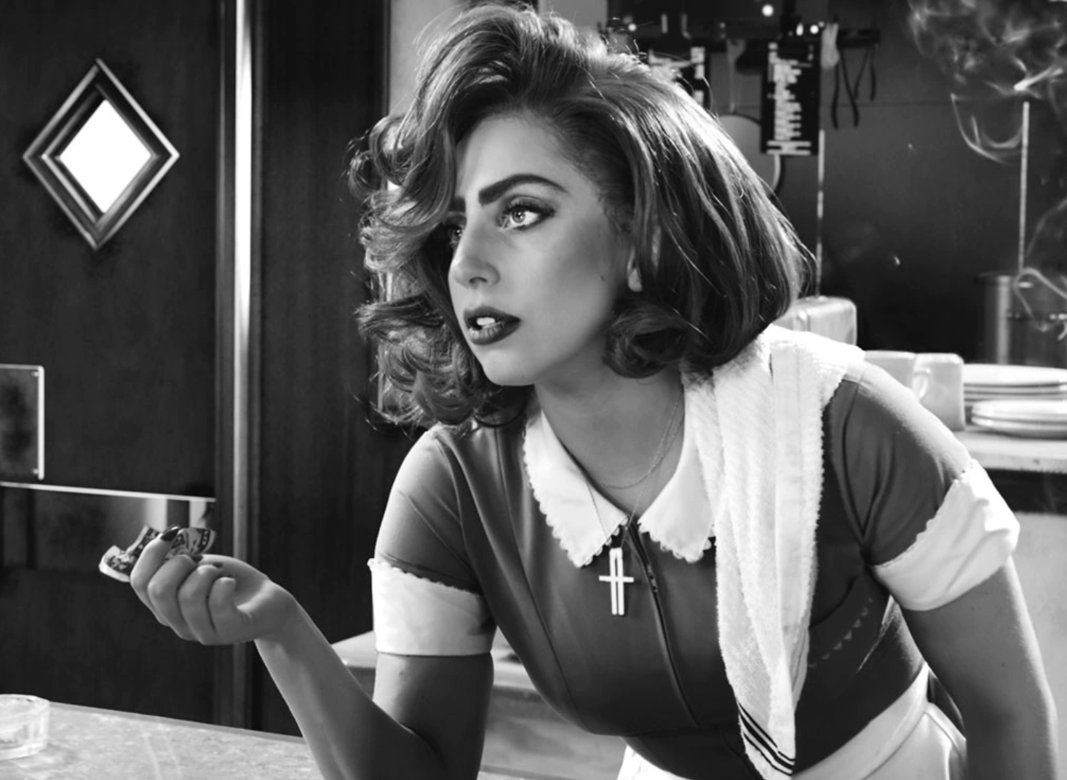
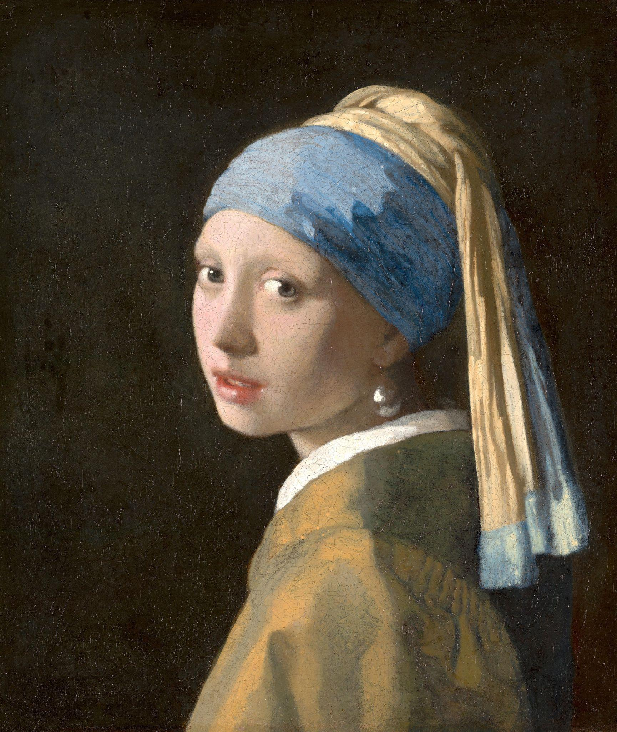
Notes:
Can be used to make art.
Notice how in the left image the lines of Lady Gaga’s face in the photo line up with the chin and forehead of the woman in the painting.
Collage source:
Hosseini, K. (2019, March 25). Digital Collage. Behance. https://www.behance.net/gallery/78005253/Digital-Collage
Reference sources:
Malkin, M. (2014, August 21). Lady Gaga Wigged Out While Making the Sin City Sequel. E! News. https://www.eonline.com/ca/news/571400/lady-gaga-wigged-out-while-making-the-sin-city-sequel
Vermeer, J. (1665). Girl With a Pearl Earring. Wikimedia Commons. https://commons.wikimedia.org/wiki/File:1665_Girl_with_a_Pearl_Earring.jpg

Slide 7
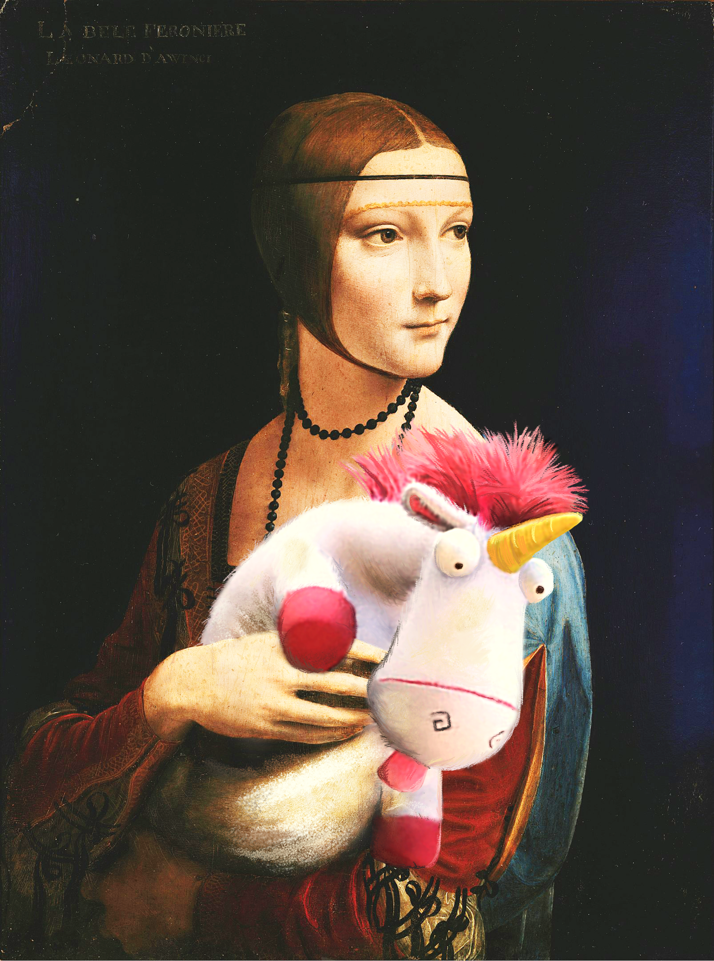
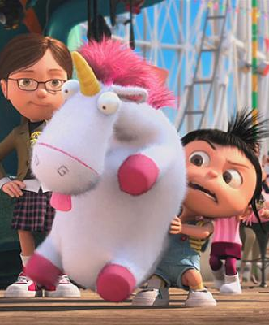
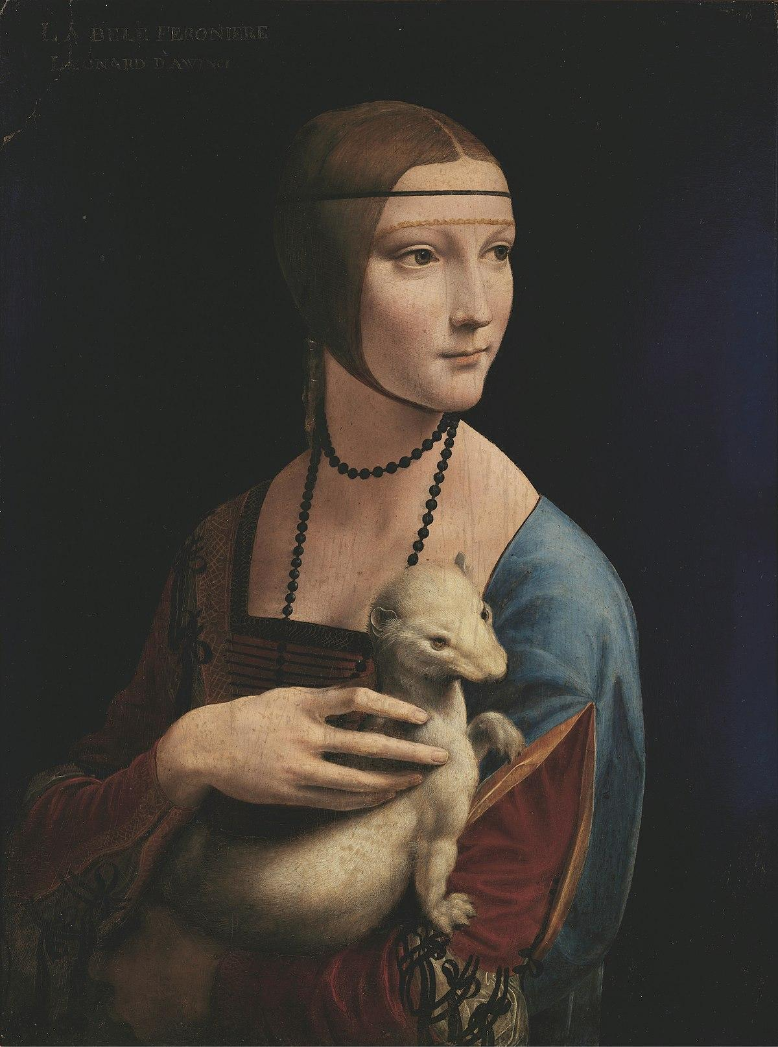
Notes:
Can be used to make art.
Notice how in the right image, there are color adjustments made to make it so the unicorn from Despicable me so it looks like he belongs in the painting.
Notice how there is a shadow under her hand in the original is used so that the mashup would be more believable. The legs of the unicorn have been moved strategically to cover the ermine foot from the original.
The mashup artist has used a digital paintbrush to touch up the edges and add colors from the painting into the unicorn to better blend the art styles together.
Reference sources:
Leonardo da Vinci. (1490). Lady With an Ermine. Wikimedia Commons. https://en.wikipedia.org/wiki/File:Lady_with_an_Ermine_-_Leonardo_da_Vinci_-_Google_Art_Project.jpg
Coffin, Pierre and Chris Renaud, directors. Despicable Me. Universal Pictures, 2010.

Slide 8
Essential Question
Is using someone else’s art to make your own considered stealing?

Slide 9
Notes:
Discuss. Is this stealing? Why or Why not? Make a criteria list.
Image on left:
Hosseini, K. (2019, March 25). Digital Collage. Behance. https://www.behance.net/gallery/78005253/Digital-Collage
Image on right:
K20 Center. (2023, Jan 6). LEARN.k20center.ou.edu

Slide 10
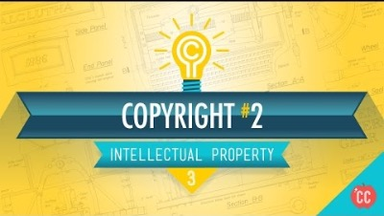
Notes:
The more true the better, but not all have to be true to justify the use.
Source:
[CrashCourse]. (2015, May 7). Copyright, Exceptions, and Fair Use: Crash Course Intellectual Property #3. YouTube. https://youtu.be/Q_9O8J9skL0

Slide 11

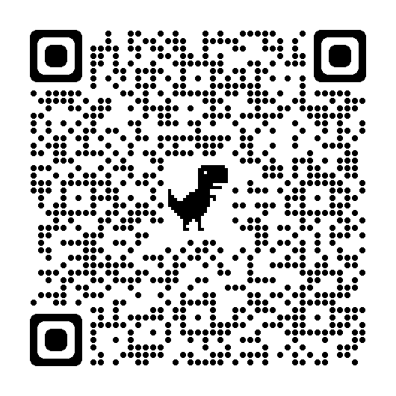
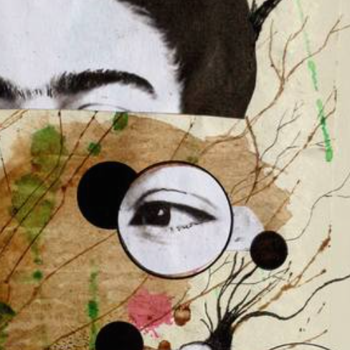
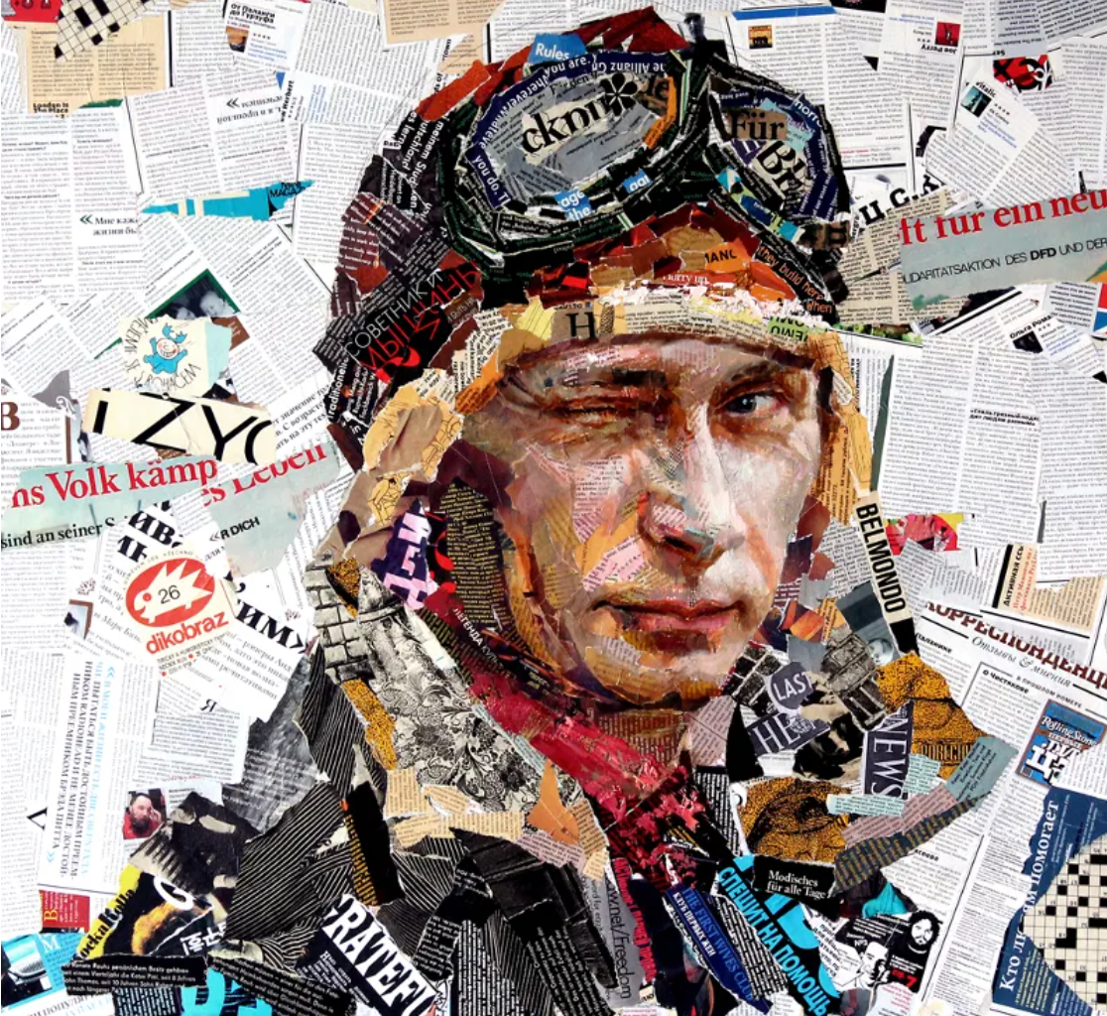
Group Analysis
Group 1
Group 2

Slide 12
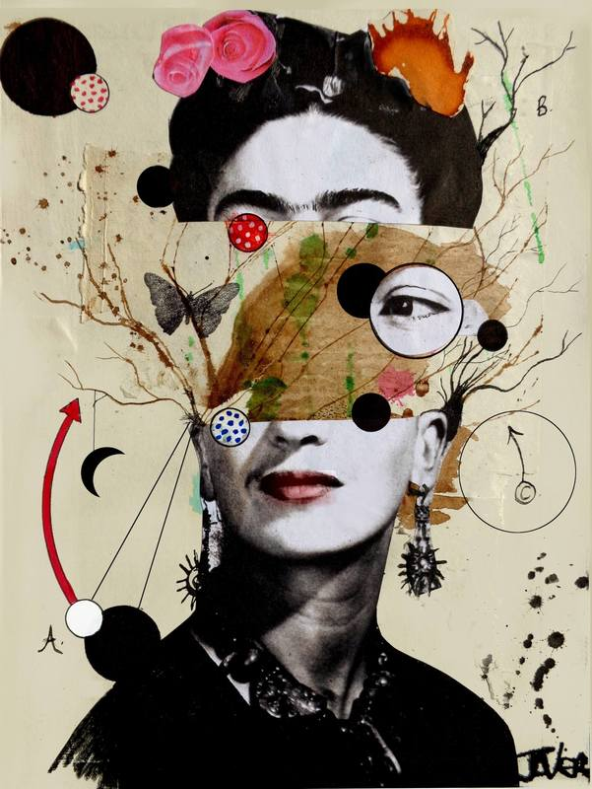
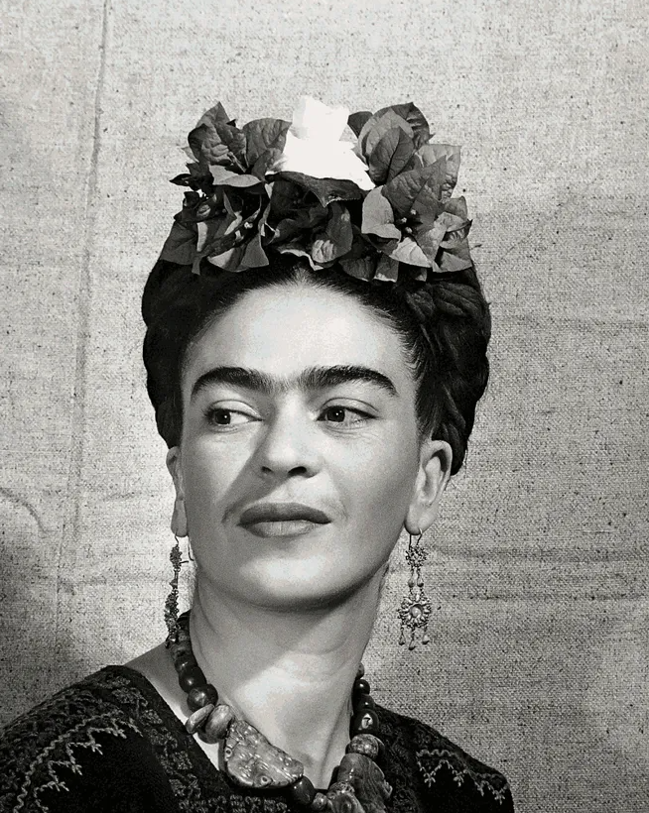
Notes:
This artwork is on an art teacher’s portfolio website.
Is this one fair use?
In favor, the photo of Frida may be considered historical
Not in favor, the photo is held in collection by Cincinnati Art Museum
In favor, the artist’s use of the work is highly transformative and creative
In favor, the works is not being sold or reproduced as far as we can tell
Not in favor, the artist uses a significant amount of a photo of Frida Kahlo and this could be considered the “heart” of the original photo
What about the other elements of art included? Can we safely assume these are all original creation of the collage artist?
Collage art source: https://jfarson.weebly.com/collage-examples.html
Frida Kahlo Photo reference: https://artsandculture.google.com/story/fQVReywc0iFIIw

Slide 13
[PASTE SOURCE
IMAGE HERE]
Notes:
Is this one fair use?
This artwork on the left is for sale as prints from the artist’s merchant page. The artist has used a photo of Putin as reference that is available for purchase by gettyimages.
Is this a fair use of the image?
In favor, they have highly transformed the photo with their art design
In favor, They’ve added their own design elements such as the hat
In favor, The photo is a news photo, not highly creative
Not in favor, it might be argued that the “heart” of the original photo is also the “heart” of this artist’s use.
Would the artist need to purchase this photo to have fair use? Why or why not?
They should purchase it because they are selling many copies of their artwork
Putin Collage art: https://www.template.net/design-templates/art/examples-of-collage-artwork/
Original photo reference:https://www.gettyimages.com/detail/news-photo/russian-president-vladimir-putin-looks-on-prior-to-a-news-photo/74438762?adppopup=true
The original photo cannot be legally hosted by our site, however, teachers can show the source by bringing up the getty site in class or they may place the image on this slide themselves.
Gallerix. (2018). Andrey Shatilov. Familiar faces. Gallerix. https://gallerix.org/pr/andrey-shatilov/

Slide 14
Copyright
A law that protects intellectual property, giving the creator/owner of a created work the right to determine how their work is used, copied, and distributed, as well as the authority to license others to do so.
Notes:
Note: these examples weigh very strongly in favor of fair use however both walk along a lot of the same territory as the Shepard Fairey case which did not produce a clear ruling in favor of fair use. It’s important to note that cases that have very similar factors in favor of fair use can swing wildly in different directions depending on the amount of money/profit and/or influence that is at stake with use of the art.
Even with a license purchase, a use can gain enough profit and influence that the source material artist will sue for more profit margin: Warhol vs Goldsmith

Slide 15
Public Domain
Belonging /available to the public, not subject to copyright. Fair Use guidelines are not needed if an image is in the public domain.
Notes:
Neither of the source photos in these examples fall into public domain, however the examples we looked at earlier in this lesson used historical paintings over 100 years old which do fall into public domain and combined the paintings with popular culture / copyright images

Slide 16
Notes:
Are these two fair uses?
They both could be considered parodies of famous paintings, so that favors fair use
It’s not really using the “heart” of the painting on the left, but maybe it’s not a fair use of Lady Gaga’s photo, it’s almost her whole face. I wonder if they got permission to use the photo?
Using the unicorn from Despicable Me is using a highly creative and copyrighted artistic character. I doubt that’s considered a fair use. It might depend on how it’s being distributed. If it’s just for fun and not for sale, that’s probably okay.
Image on left:
Hosseini, K. (2019, March 25). Digital Collage. Behance. https://www.behance.net/gallery/78005253/Digital-Collage
Right image created by K20 as an example for this lesson

Slide 17
Create your own collage artwork
Explore the photo editing software and play with tools available
Use at least two of the images provided in the folder or as many as you want!
Place your art file into the shared folder when you are ready for feedback, it’s okay if it’s not perfect or finished yet.

Slide 18
Gallery Walk
Display your work
Tell us what you were trying to do
What did you figure out
What challenges did you encounter?
It’s okay if it’s not what you want it to be at this point.
Notes:
As the students present there should be a good amount of shared learning about how students accomplished similar tasks in different ways as well as a variety of different tasks.
Prompt students to explain how they found the tools they needed to accomplish something and to help one another find these tools later as they continue to work on these projects.
Following this sharing time, discuss and provide insights on techniques that can make their works even more successful. Some techniques to cover are: Color matching images, cutting out backgrounds, identifying light sources, making shadows, blending edges, etc..You can demonstrate these with your own copy of the practice files and/or encourage students to find youtube videos that show techniques. There is demo video provided with this lesson for how to do some of the basics in Krita on slide 17.

Slide 19
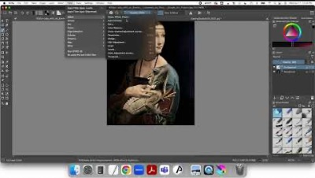

Slide 20
Professional Guidelines on Collage and Fair Use
Read the Q&A from the Graphic Artists Guild
Use the Fair Use checklist to evaluate if your collage art is fair use or not
Notes:
Have students read the last question from this Q&A published by the Graphic Artist’s Guide:
https://graphicartistsguild.org/fair-use-or-infringement/
Then have them use fair use checklist to evaluate if the way they used their images qualifies as a fair use.

Slide 21
Erase/Rewind?
Would you like to continue working on or make changes to your collage?
Would you like to start over with your own photos or found images?
Notes:
Students can choose to continue working on their practice image to improve it and better apply fair use guidelines OR make a new collage artwork with their own photographs and/or found images striving to meet fair use guidelines.

Slide 22

Is using someone else’s art to make your own considered stealing?
What did you used think the answer to this question was before this lesson?
What do you know now?
Notes:
Have students do a short reflective writing using the strategy, I used to think… But now I know…. Revisit the essential question, “Is using someone else’s art to make your own considered stealing?”
Ask students to write down what they believed about using other’s artwork to make your own before this lesson and what they think about it now.

